Slide 1
CTC/MTC 101
Academic Requirements

Slide 2
Review
Continue to develop excel skills
Job Opportunities
experience
software

Slide 3
Objectives
An ability to:
Understand the academic requirements you need to obtain your degree
Calculate your GPA using quality points
To know when you will graduate and know which courses you need to graduate

Slide 4
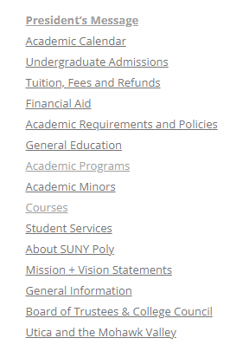
Academic Requirements
Follow rules using the Undergraduate Catalog at the time of matriculation.
For you as a new freshman starting in fall of 2025 you will look here: https://webapp.sunypoly.edu/undergrad-catalog-2025-2026/
Academic programs show program
specific requirements.

Slide 5
Degree Works
Used for determining whether you have met all requirements
If you find an error ask your advisor
Work towards greens (completed) and blues (in progress). Get rid of reds (requirement not met)
Check detailed notes

Slide 6
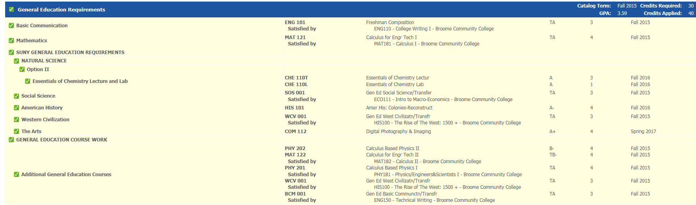
Degree Works
(credits, overall/gened, liberal arts, major)

Slide 7
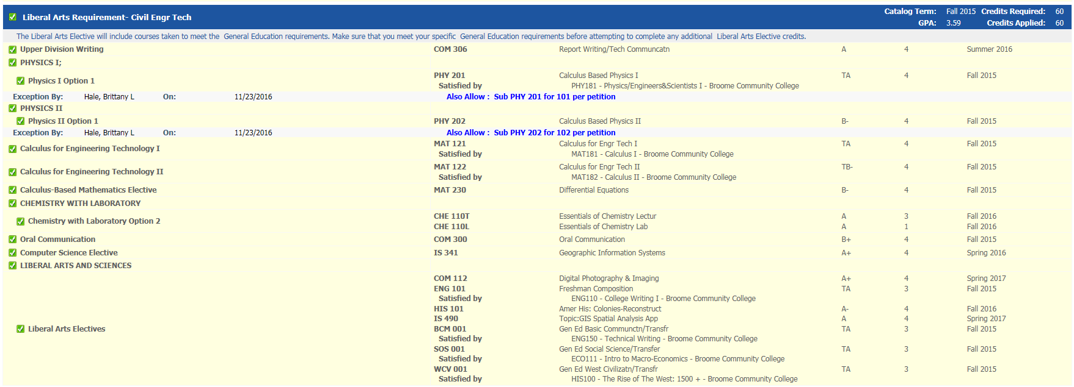
Degree Works
(credits, GPA/gened, liberal arts, major)

Slide 8
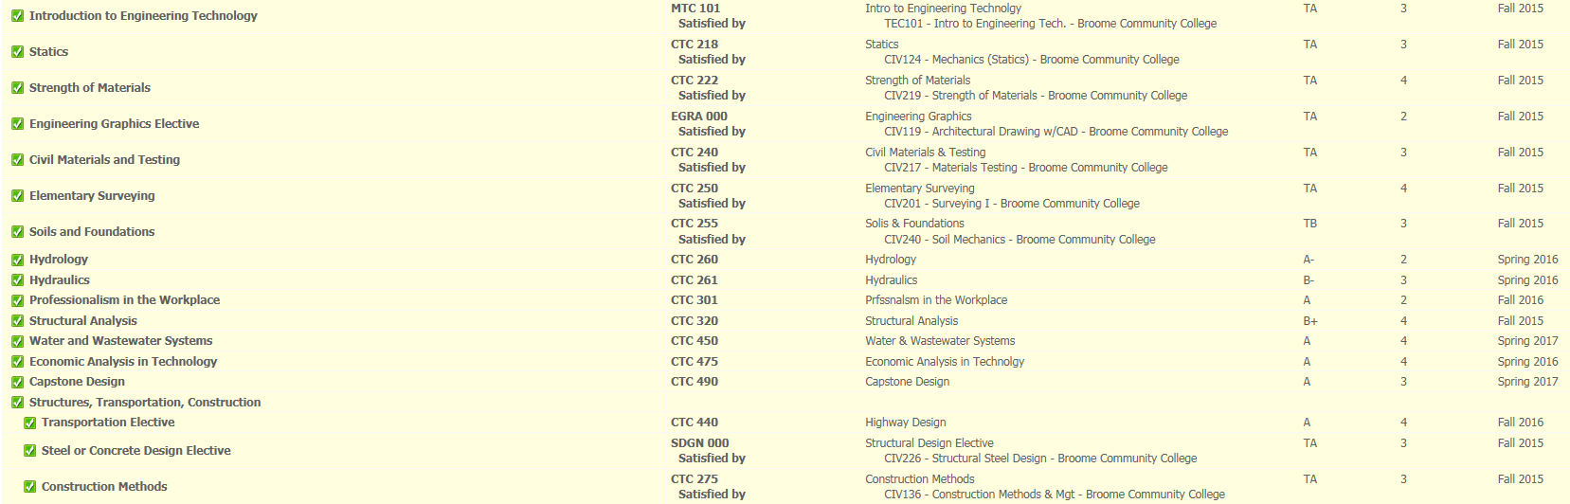
Degree Works
(credits, GPA/gened, liberal arts, major)

Slide 9
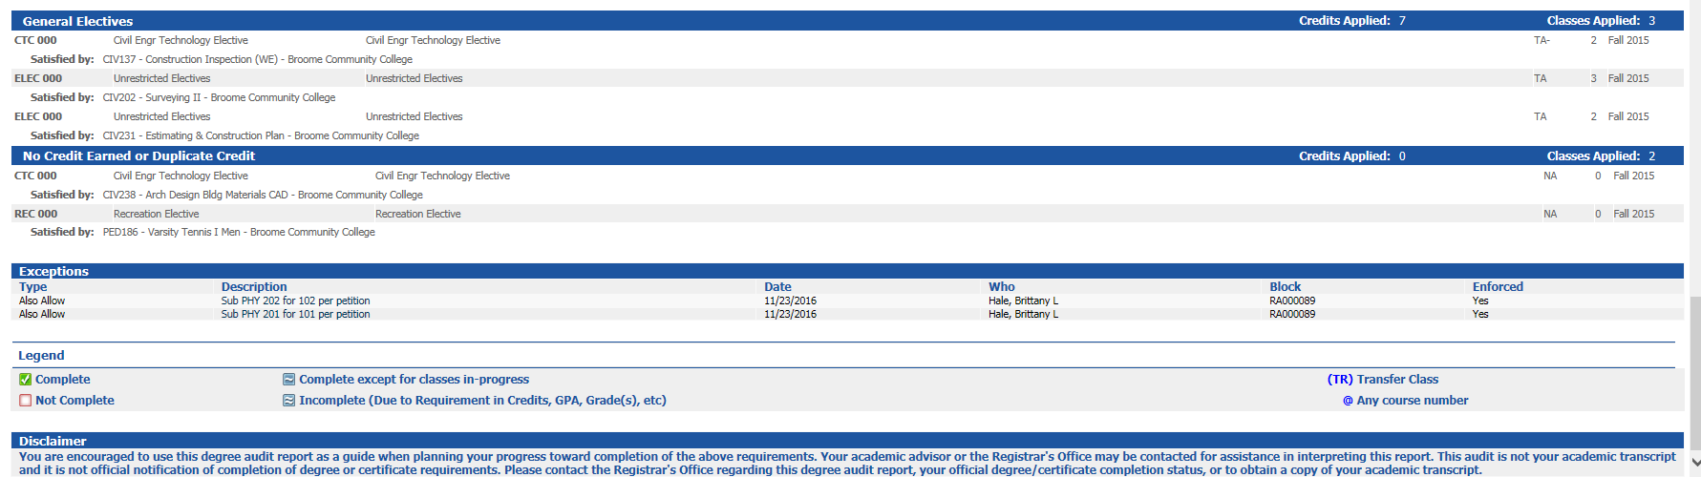
Degree Works
(miscellaneous---note disclaimer)

Slide 10
Transfer Credit
Degreeworks shows transfer credit and remaining requirements
Transfer Credit
  Another school(s)
  AP credit
  CLEP
  Others (see catalog)
Transfer varies by program
  Grade
  Maximum transfer
  Equivalency

Slide 11
Transfer
Maximum of 64 lower level credits prior to matriculation
Additional 12 may be taken via petition
  Schedule
  Graduation
Maximum of 90 credits (upper/lower) can be transferred
C or better (in civil) to transfer courses

Slide 12
Academic Forms-discuss
https://sunypoly.edu/student-life/student-resources/registrar/forms.html

Slide 13
Planning your Schedule
Degreeworks
See SUNY Poly programs:
Suggested schedule for Civil Engineering Technology
Suggested schedule for Mechanical Engineering Technology

Slide 14
Graduation Requirement Details
General education
  https://sunypoly.edu/student-life/student-resources/registrar/general-education.html
Courses with labs (see catalog descriptions)
Course pre- and co- requisites (see catalog descriptions)
Course availability (check past schedules)
  Courses taken at another college
  https://sunypoly.edu/sites/default/files/registrar/Petition-to-take-courses.pdf
  SUNY Learning Network
Graduate Application (semester before you graduate) https://sunypoly.edu/sites/default/files/registrar/Graduation-Application.pdf

Slide 15
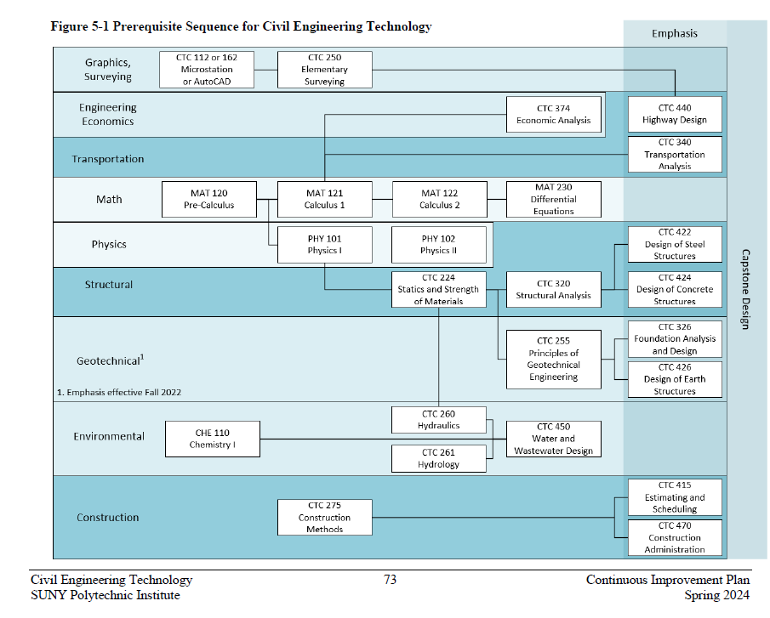

Slide 16
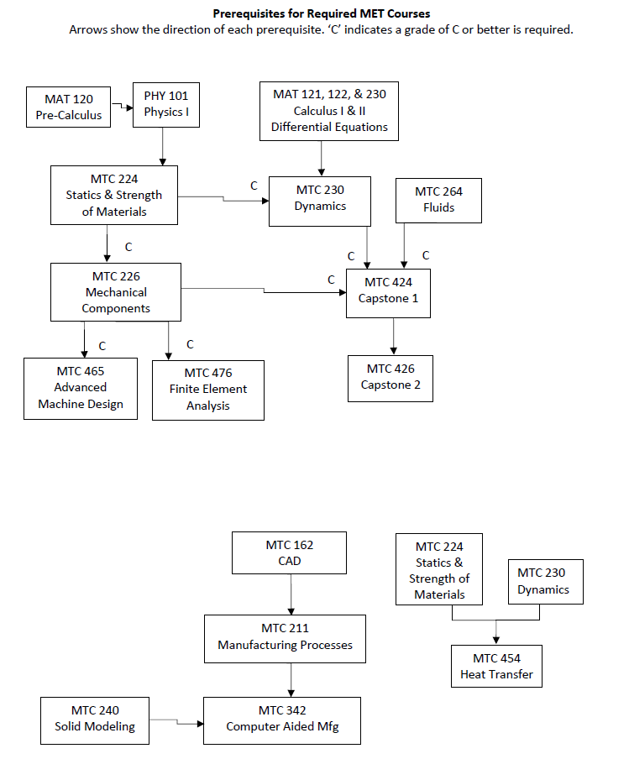

Slide 17
Academic Requirements Part 2
ACCREDITATION

Slide 18
Accreditation
The civil and mechanical engineering technology programs are accredited by ETAC-ABET (Engineering Technology Accreditation Commission-Accreditation Board for Engineering and Technology)
History of ABET and relevant documents can be found at http://www.abet.org/

Slide 19
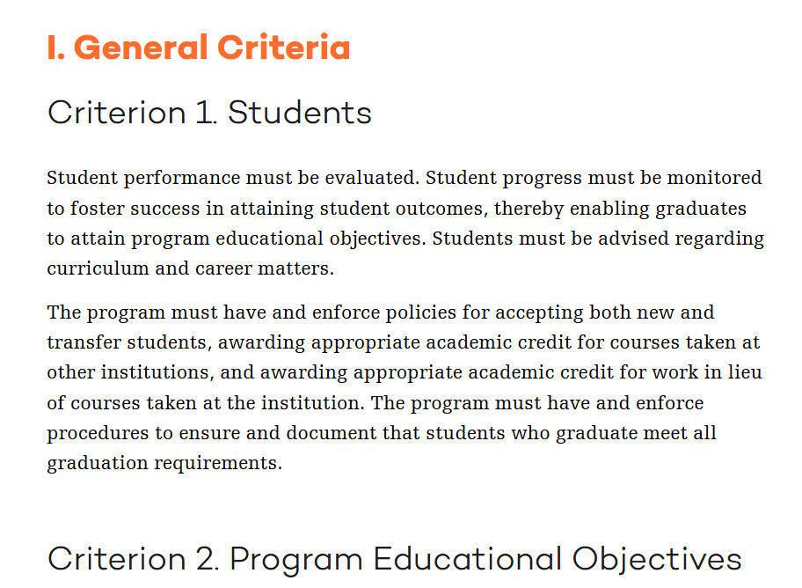
Engineering Technology Program Criteria
https://www.abet.org/accreditation/accreditation-criteria/criteria-for-accrediting-engineering-technology-programs-2025-2026/

Slide 20
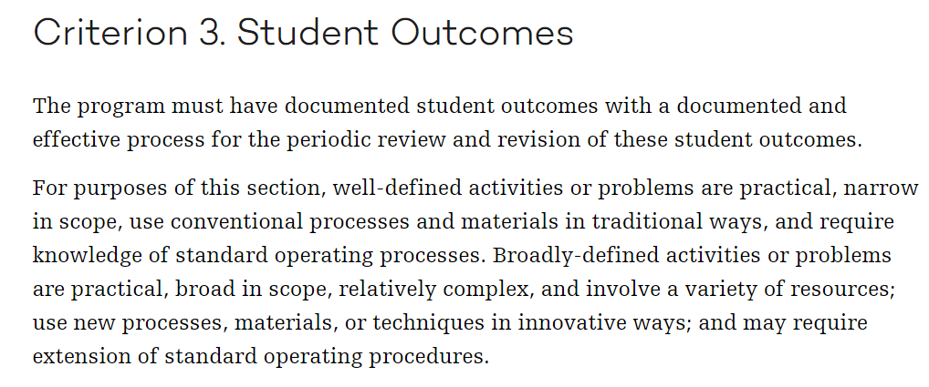
Student Outcomes (Description)
Source: https://www.abet.org/accreditation/accreditation-criteria/criteria-for-accrediting-engineering-technology-programs-2025-2026/

Slide 21
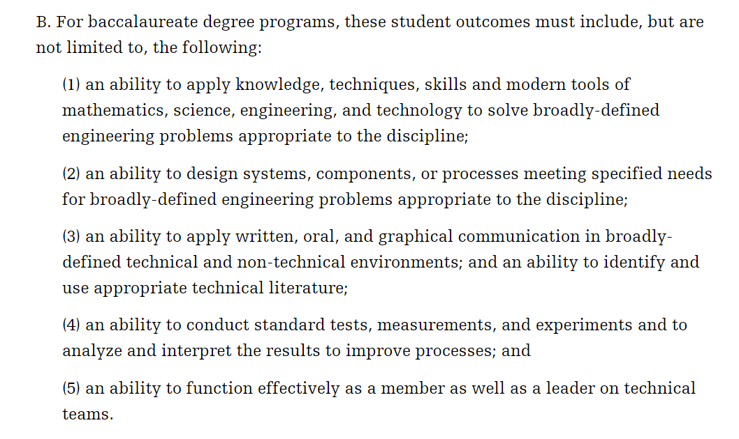
Student Outcomes (1-5)
Source: https://www.abet.org/accreditation/accreditation-criteria/criteria-for-accrediting-engineering-technology-programs-2019-2020/

Slide 22
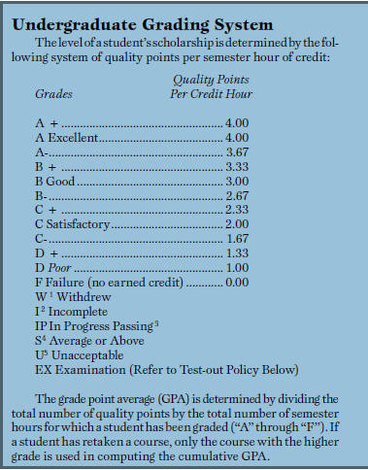
Calculating GPA
Weighted
Quality Points per Credit Hour

Slide 23
GPA Example
CTC 101; 2 cr; A
MTC 218; 2 cr; B
MTC 162; 4 cr; A-
MAT 121; 4 cr; C
PHY 101; 4 cr; B-
GPA=(2*4)+(2*3)+(4*3.67)+4*(2.0)+(4*2.67)=
8+6+14.68+8+10.68=
47.36 (total quality points)
47.36/16=2.96

Slide 24
HW Assignment (individual-drop off in Brightspace by Monday 9/15/2025)
Look up the specific program criteria in your program (civil, or mechanical engineering technology) in the undergraduate catalog. Develop a draft schedule showing the classes you plan to take each semester. Check:
    Prerequisites
    Course availability (only offered in the spring or fall?)
    Course load
    General education requirements
Using the SUNY Poly undergraduate catalog answer the following questions:
    What is the test-out policy used for?
    What is Advanced Placement credit?
    What is the difference between a dual baccalaureate degree and a second major?
    What is the “writing requirement” and which courses fulfill the requirement?
    What is the minimum upper division credit requirement?
    What is an academic petition?

