Slide 1


CTC/MTC 101 Introduction to Engineering Technology

Slide 2
Objectives
Understand the class requirements
Understand the difference between engineering and engineering technology programs
Understand the different engineering technologies on the SUNY Poly campus

Slide 3
Why an “Intro” Course?
Discuss requirements of the programs
Explore your interests
Learn tools to help you succeed in your classes
Discuss the soft skills critical to professionalism
Prepare a resume
Learn Excel
Rule of thumb expectation: “3-4 hours of outside work for every credit hour” –treat your education like a full-time job

Slide 4
Round Robin Introductions

Slide 5
Class Requirements
My website: https://people.sunypoly.edu/~barans/
  Syllabus
  Schedule
  Lectures/Assignments
  Grades
  Drop off assignments in Brightspace

Slide 6


Choosing Engineering Technology as a Career
Technology has vastly improved our lives:
  Safety (front wheel drive, air bags, antilock brakes)
  Work (safer, less labor intensive)
  Homes (dishwashers, washing machines, dryers)
  Communications (cell phones, internet)
Many types of jobs are needed in technology

Slide 7
History of Technology
Stone Age (Skara Brae)
Copper/Bronze
Iron
Industrial Revolution
Petrochemical
Electrical
Nanotechnology

Slide 8
Historical Branches of Engineering
Civil
Mechanical
Mining and Metallurgical
Chemical
Electrical
Newer: Aerospace, Computer, Environmental, Nuclear, Systems, etc.

Slide 9
Roles of Technologists
Communicate between management (or engineers) and skilled employees
Implement and interpret the ideas of management
Calibrate, test, inspect

Slide 10
Important Qualities
Enjoy:
Working with computers, equipment, machinery
Working with data
Math and science
Problem solving
Working with teams to achieve a common goal
Communicating with others

Slide 11
Differences between Engineering and Engineering Technology
Engineering Technology | Engineering
Practical | Theoretical
Hands-on | Analytical
Application of Current Technology | Development of New Technology
Faculty with Industrial Experience | Faculty with an Academic Background
Math (3 courses) | Math (5 or more courses)

Slide 12
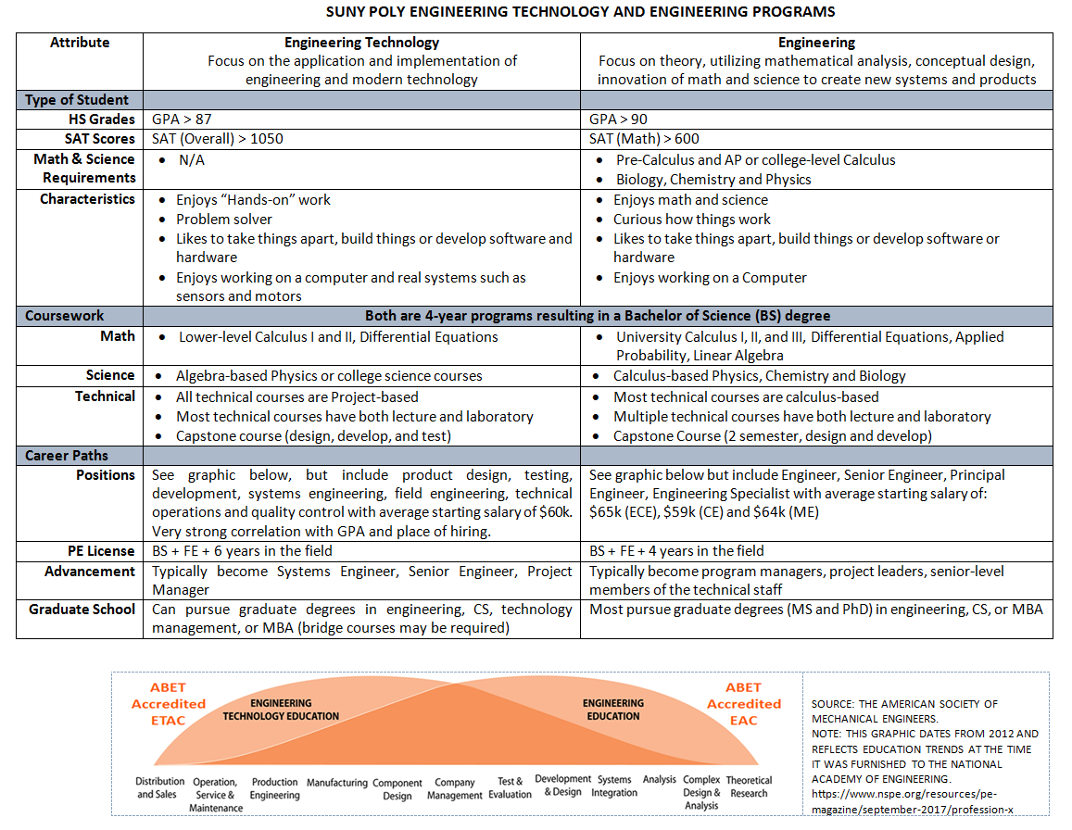
SUNY Poly has Engineering & Engr.Technology

Slide 13





Engineering Technologies

Slide 14
Software Skills
Microsoft Word
MS PowerPoint
MS Excel
PDF
Brightspace (D2L)
DegreeWorks
CAD (Autocad/Microstation/Solidworks)

Slide 15
HW Assignment (individual)
In Microsoft Word answer the following questions and submit the document (as a PDF) in the Brightspace subfolder by September 2nd (this is a holiday but assignment is still due)
How did you decide you were interested in engineering technology?
Research and describe one specific occupation in either civil or mechanical that is of interest to you.
Research five different job opportunities available for engineering technology graduates (choose either civil or mechanical). List the job title, physical location, job responsibilities and job requirements (years of experience, skills, education).
List 3 subjects you would like to cover in this course.

Slide 16
On Wednesday
Intro to Excel
No class next Monday (September 1)

Slide 17
CGAM
https://sunypoly.edu/academics/cgam.html
Mechanical
MTC 211 and 342 (also Capstone projects)
Civil
3d printing/Baja Buggy

