Slide 1
Professionalism

Slide 2
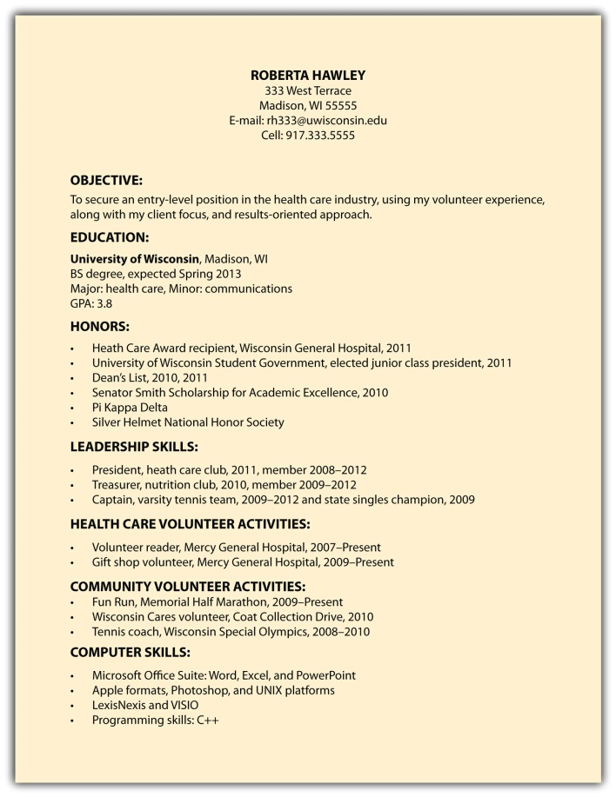


Objectives

Slide 3
Why Internships?
Experience
Learn about yourself
Learn about your field
Evaluate yourself as an employee
Future job search
Money

Slide 4
Career Planning
What are your assets and traits?
Where do you want to start?
What are your short-term goals?
What are your long-term goals?
(Career—not personal goals)

Slide 5
Round Robin
How did you find your first job!

Slide 6
Looking for Jobs
Career Services
Internet
Professional Organizations
Newspapers
Magazines
Friends and Family

Slide 7
Resume
References:
What Were They Thinking
Resumes: The Basics
Reverse chronological order (most important first)
Limit to one-page
No misrepresentations (ET, not ENGR)
Visually pleasing

Slide 8
Resumes
Handouts and Exercise

Slide 9
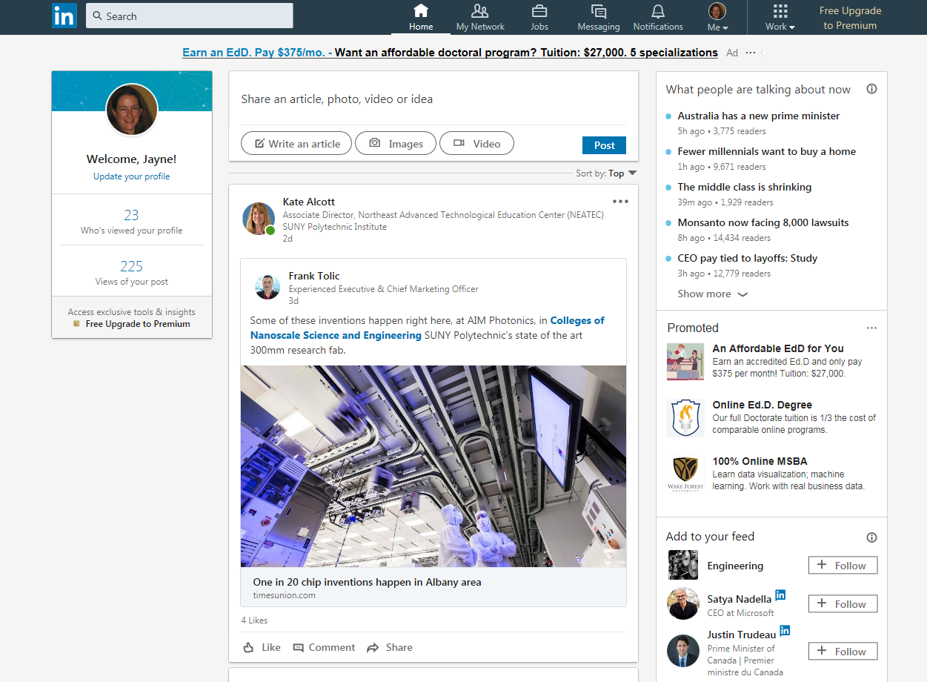
LinkedIn

Slide 10
Homework Assignments-Individual
Prepare a professional resume (pdf format). Drop off a copy in Brightspace (2 points) and bring a paper copy to class next Monday (Sept 29) (3 points). On Monday you will switch with another student to review your draft. Drop off draft and final October 1 (3-pts draft and 2-pts final)
Provide answers to 5 interview questions and drop off in blackboard October 1 (5 points)

Slide 11
Break

Slide 12
Interviewing
Be prepared
Arrive early
Dress appropriately
Get names of those you interview with (ask for cards)
Ask open-ended questions
Follow-up

Slide 13
Interview Questions
Typical Interview Questions

Slide 14
References
Better to ask before the job hunt
Provide detailed info to the person who is giving you a reference:
When is due date?
Provide additional information about yourself
Provide a self-addressed envelope (if mailed)

Slide 15
Landing the Job – Next steps
How to act professionally in the workplace!!!

Slide 16
Professionalism
Managing your time
Communicating
Teamwork
Treating others with respect
High ethical standards
Positive attitude
Reliable
Leadership

Slide 17
Traits for Success in the Workplace
Competence
Pursuit of Excellence
Personal Integrity
Likeability
Positive Attitude
Effective Communication

Slide 18
Professional Licensing-Why
Professionalism
Pride
Job requirement
Enhances Resume

Slide 19
Professional Licensing
FE (Fundamentals Exam)
PE (Professional Exam)
Administered by State
FE reciprocal but details controlled by state
PE state specific

Slide 20
New York State
New York State Education Dept
Licensed Professionals
http://www.nysed.gov/

Slide 21
Differences between ET and Engr
 | Engineering Technology | Engineering
Eligibility for FE exam | After graduation | Before graduation
Experience before PE | 6 years | 4 years
Test is now online----Can take FE in Vermont (and PA?) before graduation

