Slide 1






















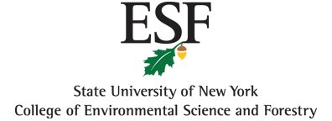




Slide 2

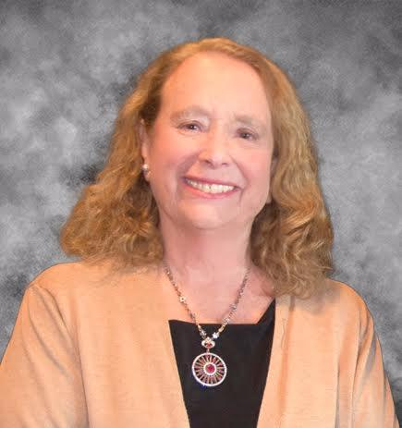
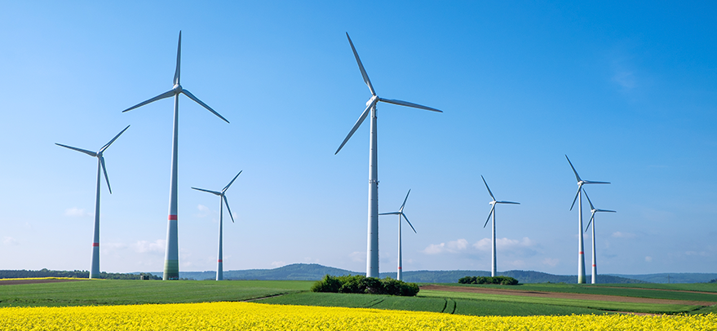
Rhea Jezer, Ph.D
President
President, Energy 21

Slide 3







Twenty First Annual
Symposium on Energy in the 21st Century
April 4, 2025
Schedule
Watch the slides until we start at 8am and again, during lunch.
8am-10:15 Speakers Presentations
Break: Be back promptly at 10:30
10:30am-12:00pm
Panel Discussion
YOUR questions will be discussed
Click Q&A to write your question
12:pm Lunch
12:45 - 2:30 Keynote & Panel Discussion

Slide 4
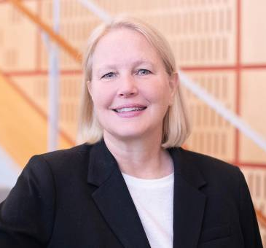


JOANIE MAHONEY
PRESIDENT
SUNY ESF

Slide 5


DONOVAN GORDON
Director Community Thermal Networks
NYSERDA

Slide 6
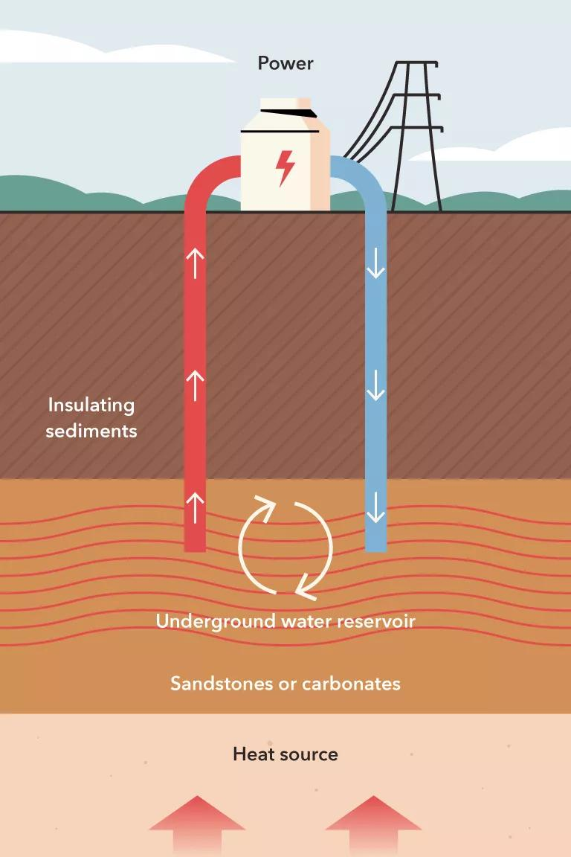


Donovan Gordon
Director, Community Thermal Networks
April 4, 2025
Geothermal Energy​
"From the Ground Up"​

Slide 7
Agenda
    What is Geothermal Energy
      Power Generation
      Heating & Cooling
      Case Studies
      NYSERDA and Utility Activities to Advance Geothermal

Slide 8
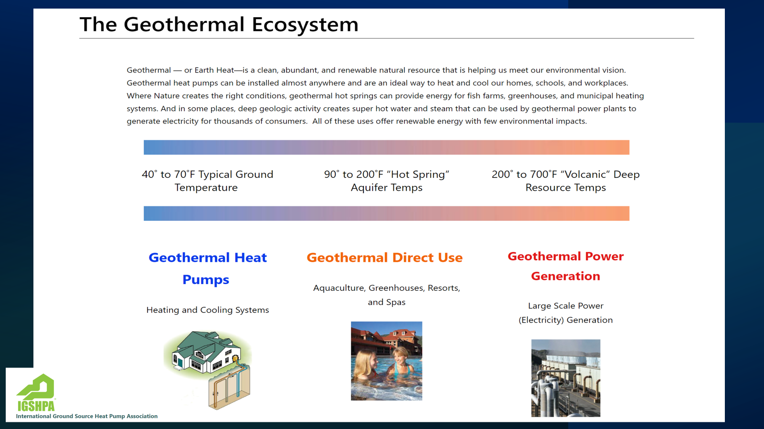
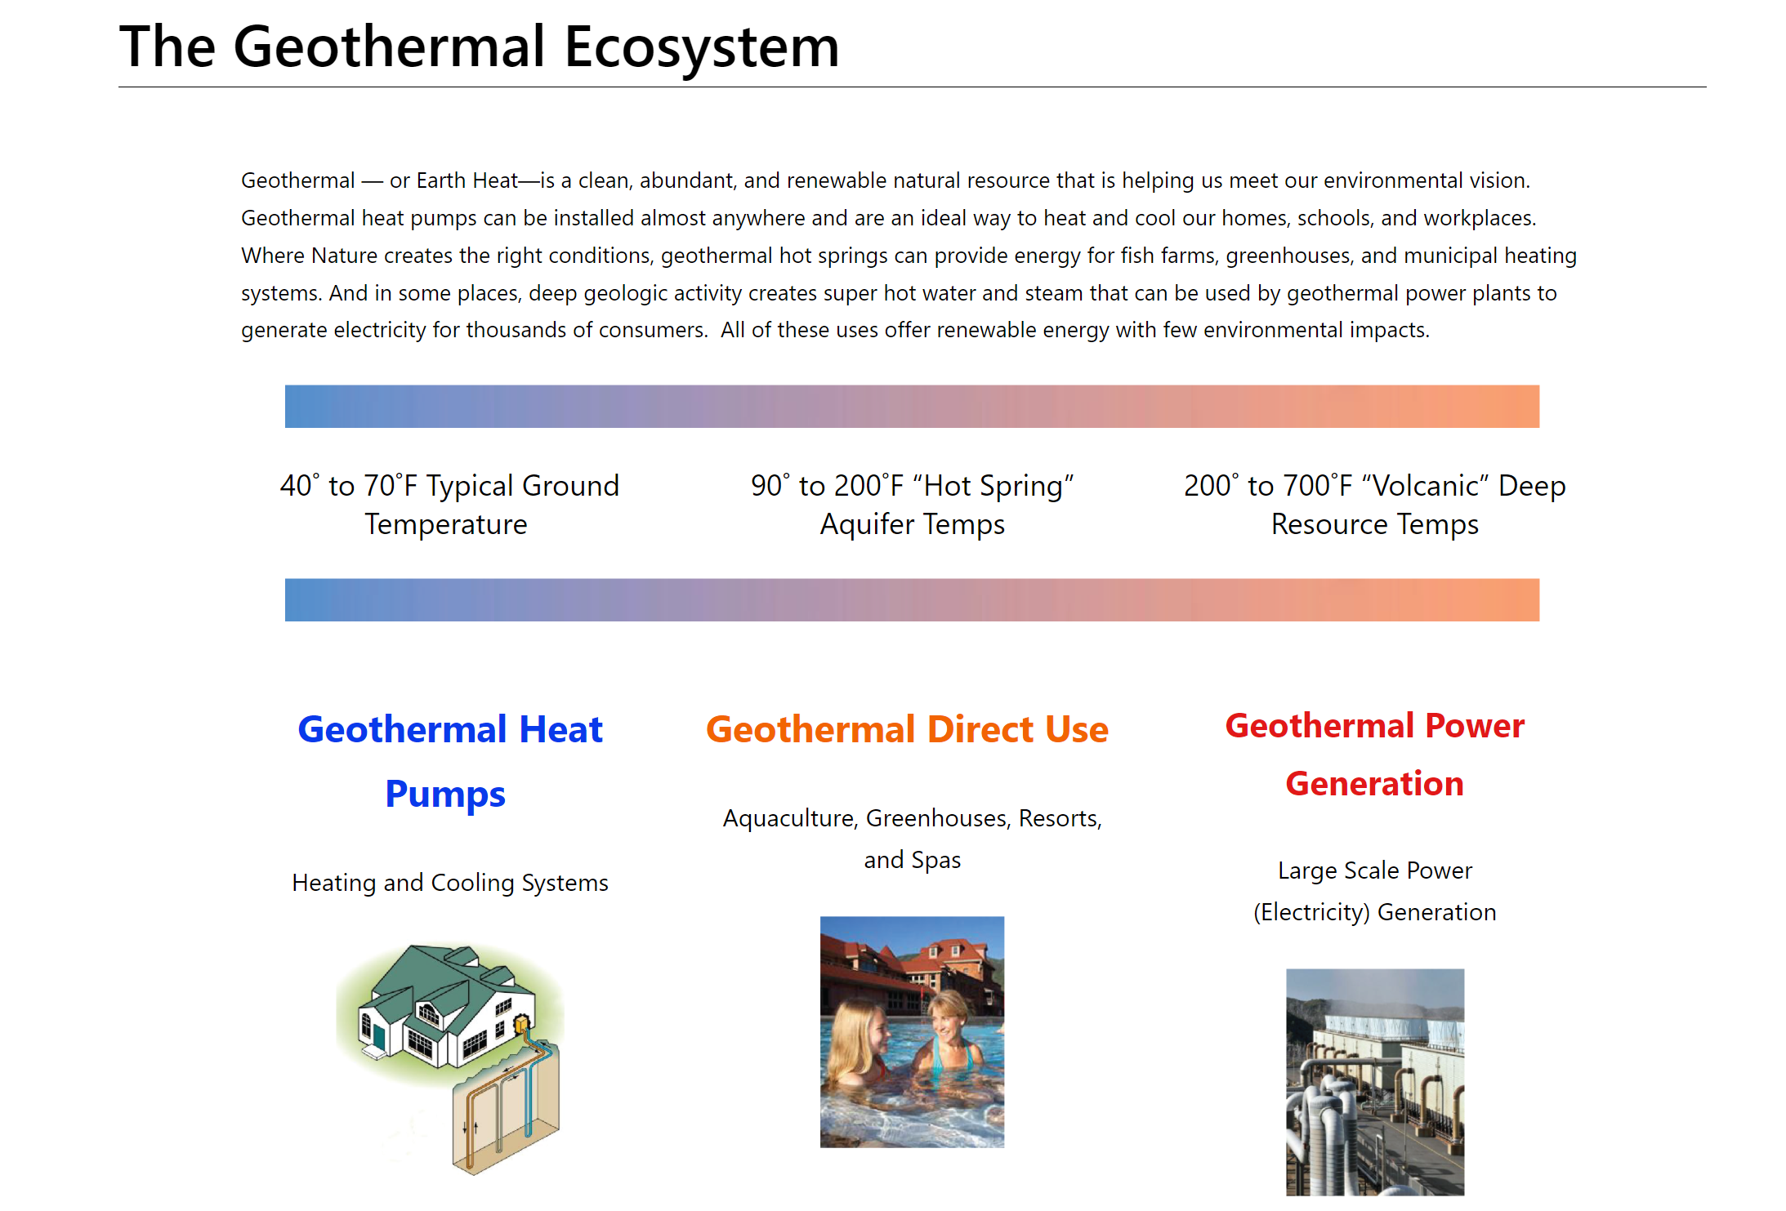


Slide 9
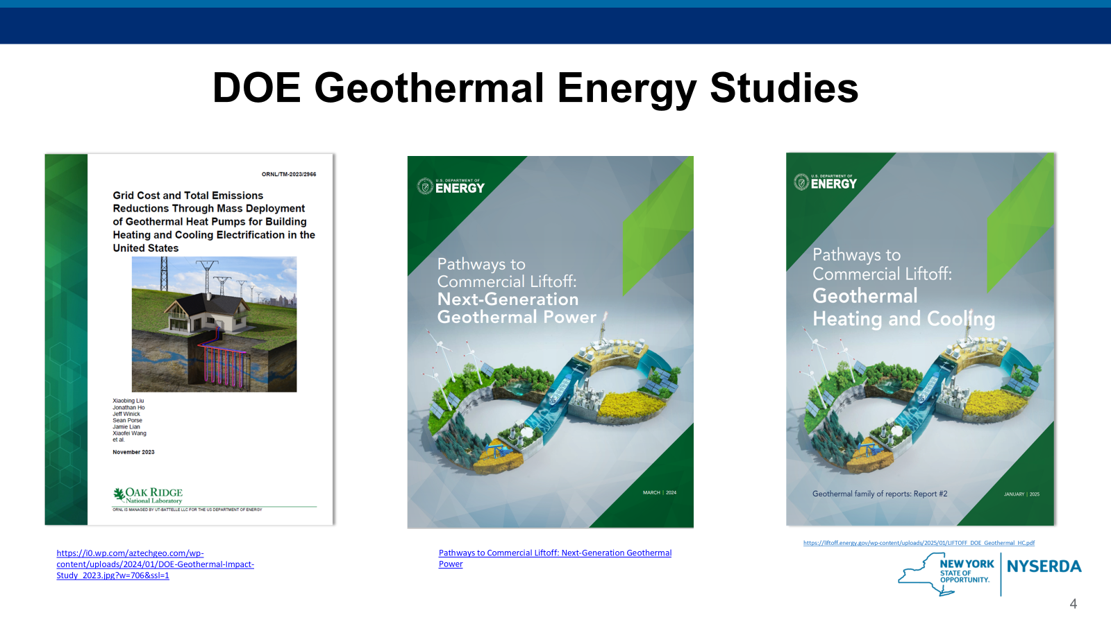
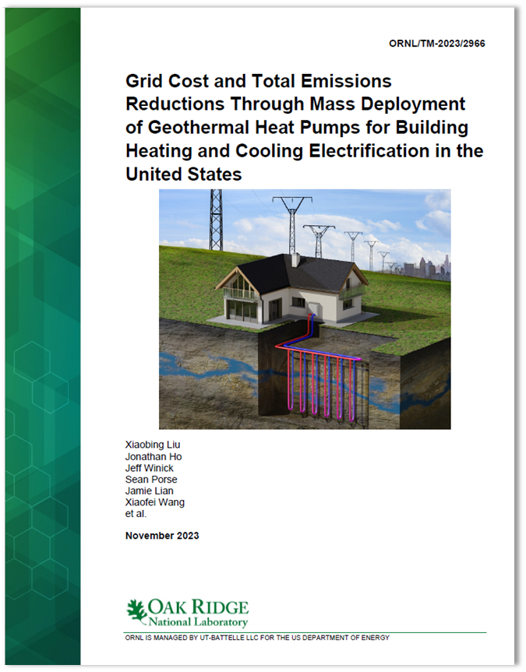


DOE Geothermal Energy Studies
“…the mass deployment of GHPs can electrify the building sector
without overburdening the US electric power system.” – US DOE
“…the mass deployment of GHPs can electrify the building sector
without overburdening the US electric power system.” – US DOE
https://i0.wp.com/aztechgeo.com/wp-content/uploads/2024/01/DOE-Geothermal-Impact-Study_2023.jpg?w=706&ssl=1
Pathways to Commercial Liftoff: Next-Generation Geothermal Power

Slide 10
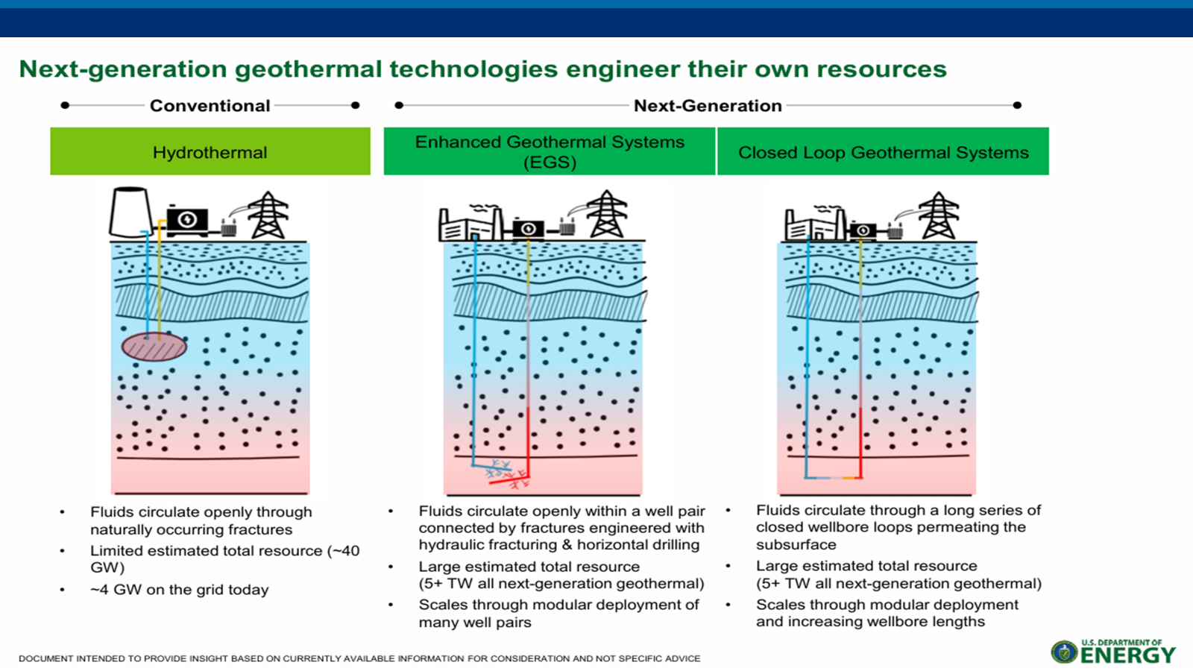
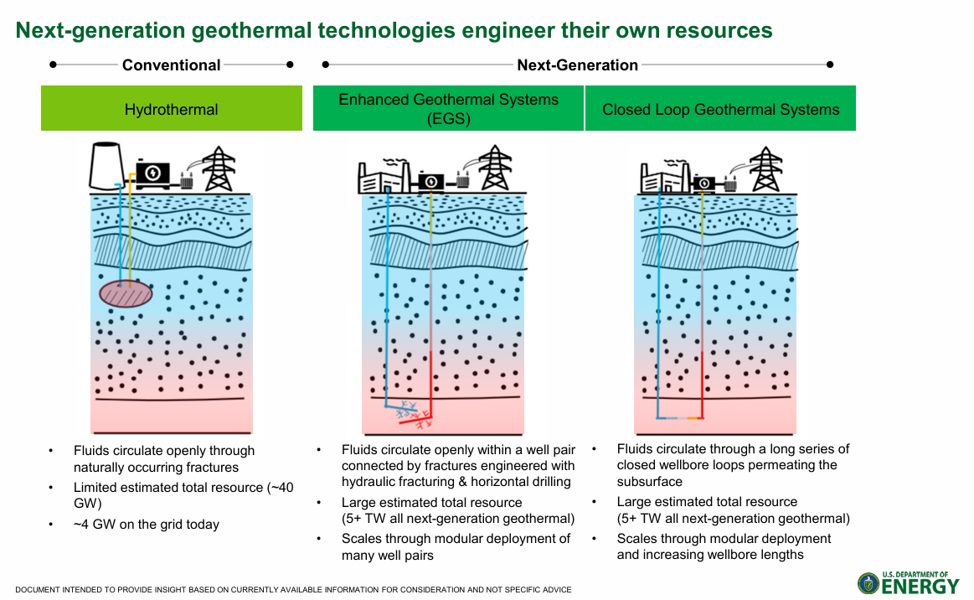

Slide 11
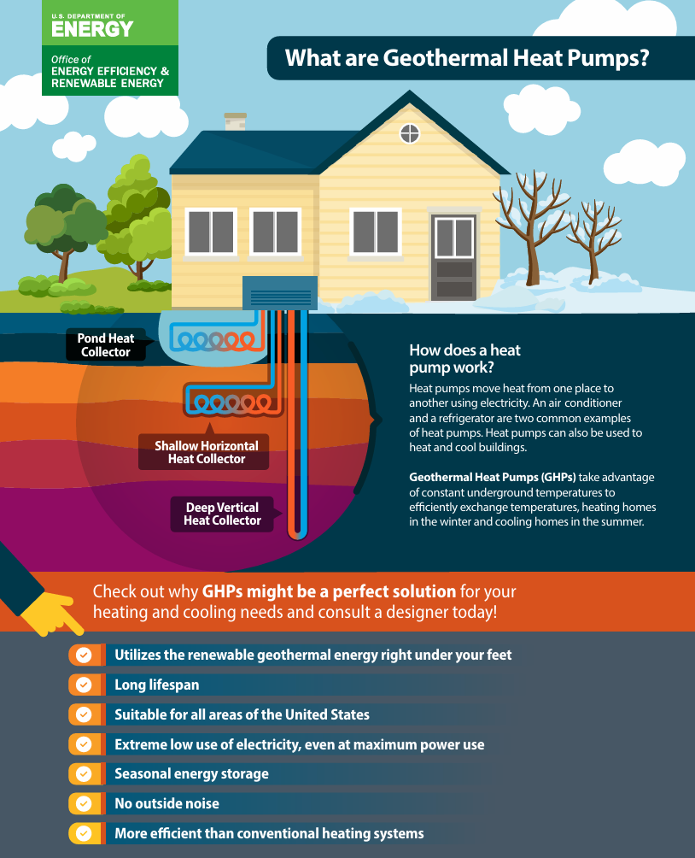
Geothermal
Heating & Cooling
(Ground Source Heat Pumps)

Slide 12
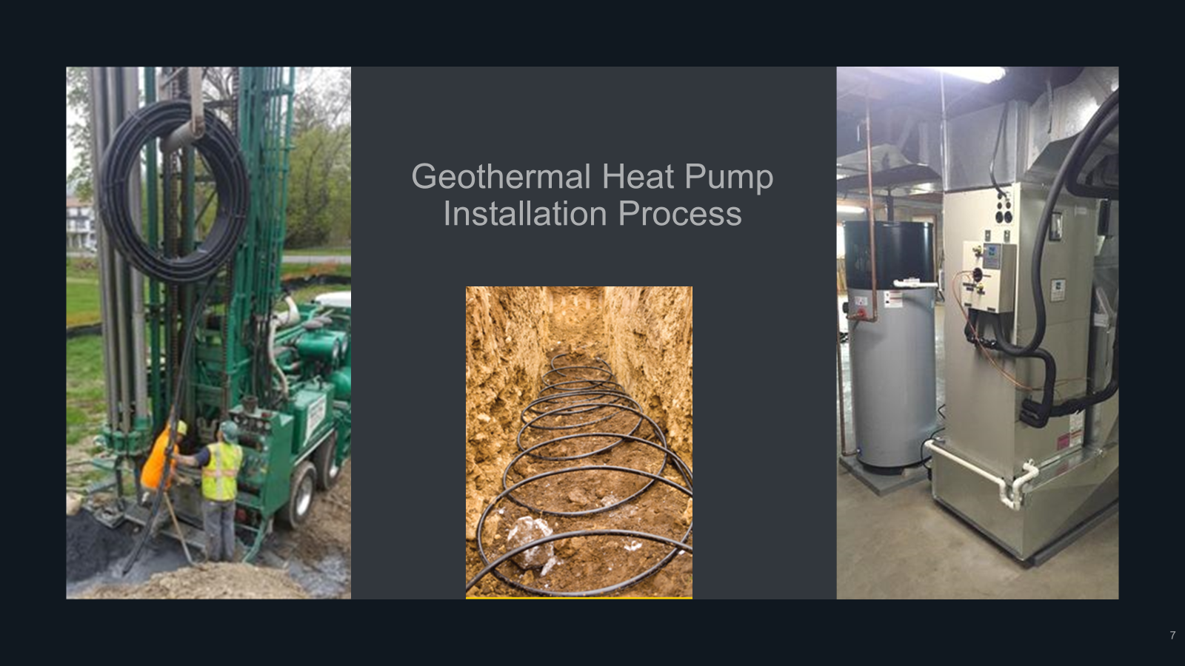
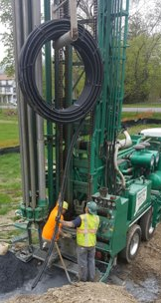
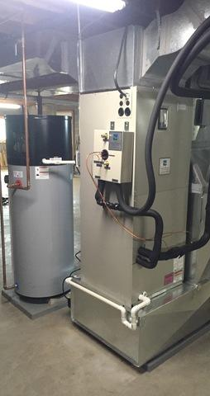
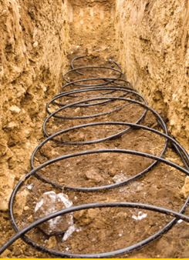
Geothermal Heat Pump Installation Process

Slide 13
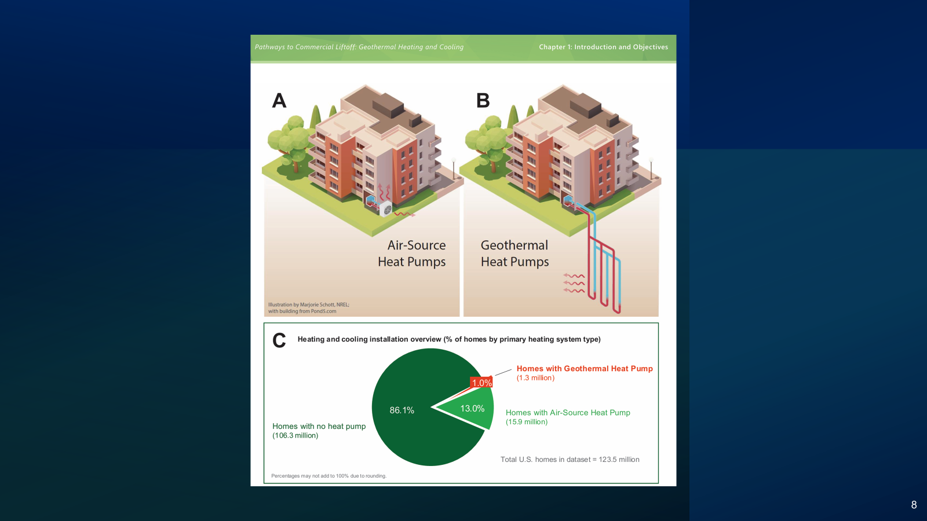
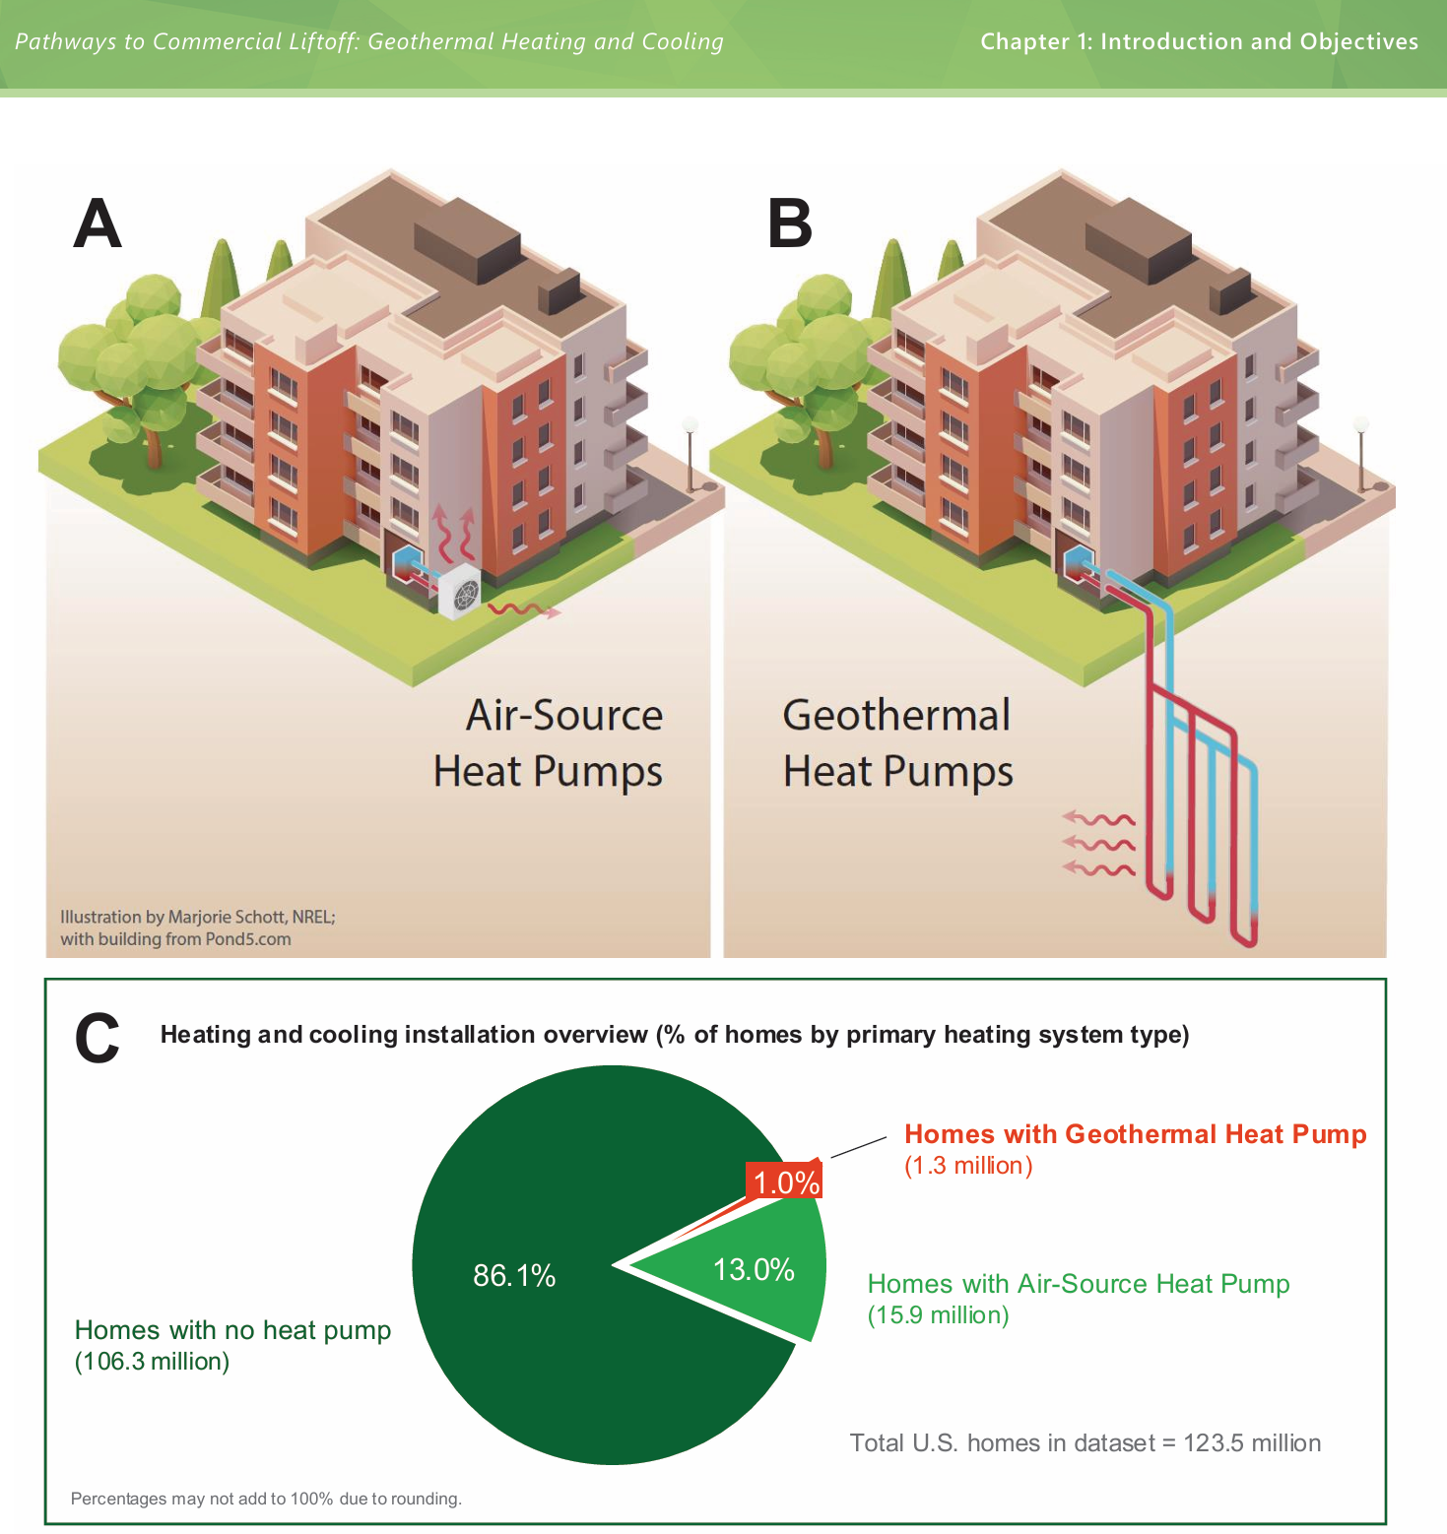

Slide 14
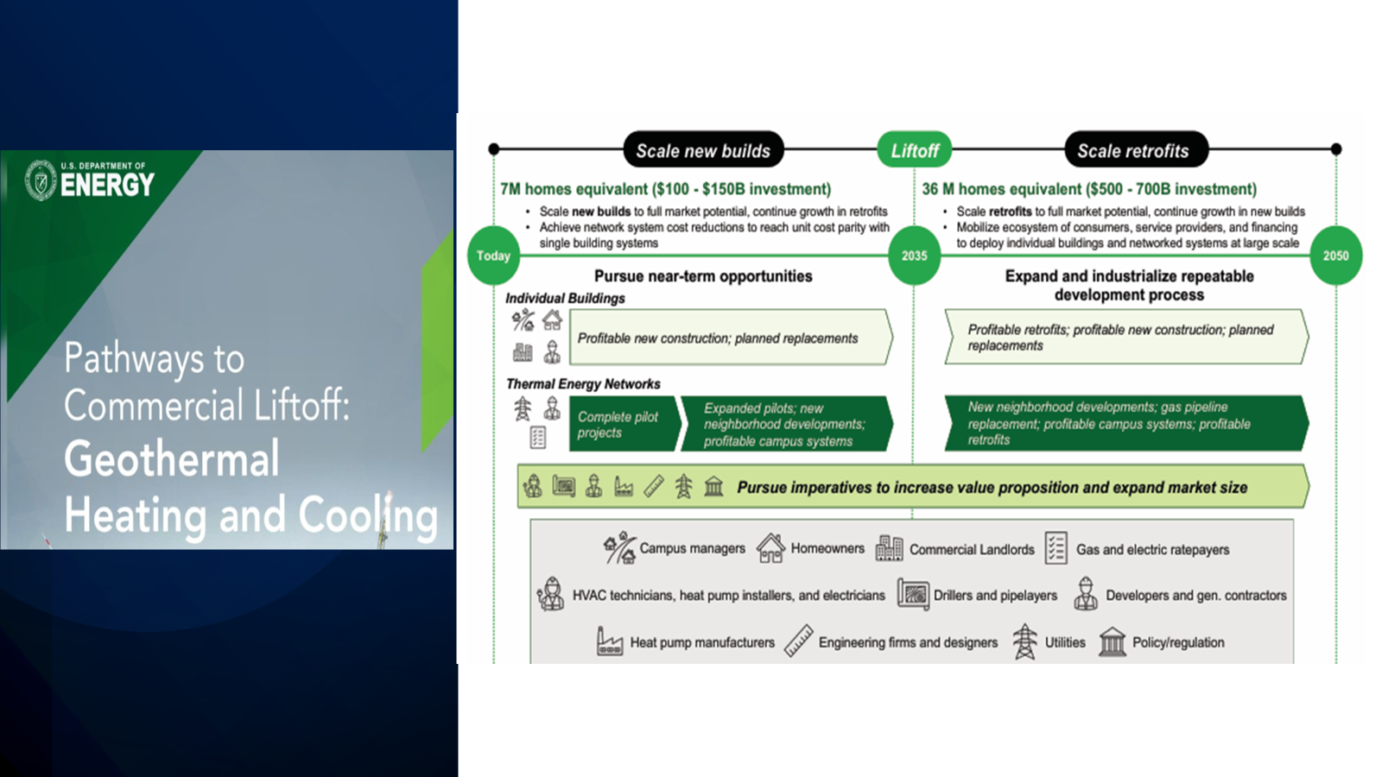
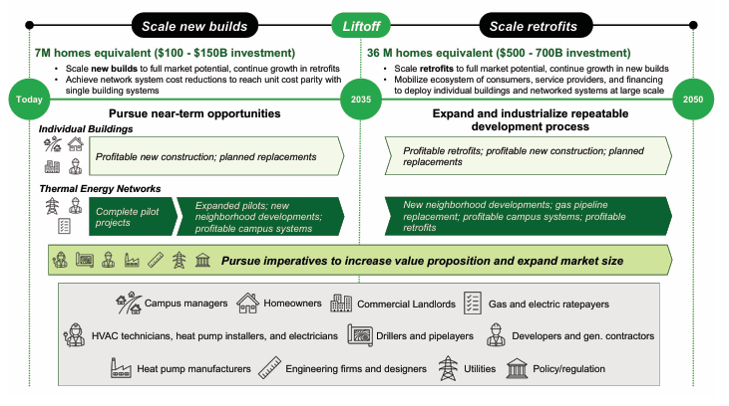


Slide 15
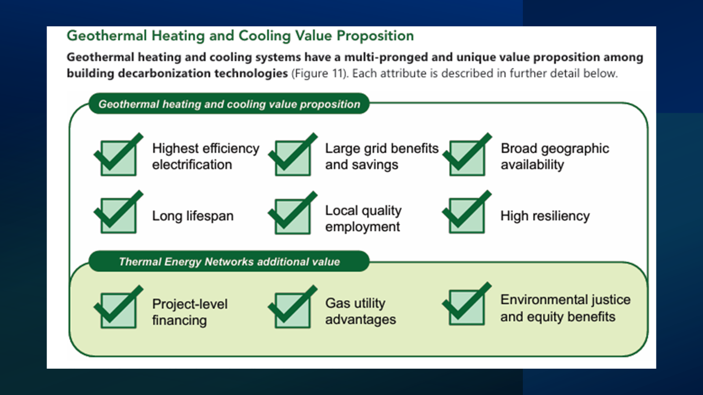
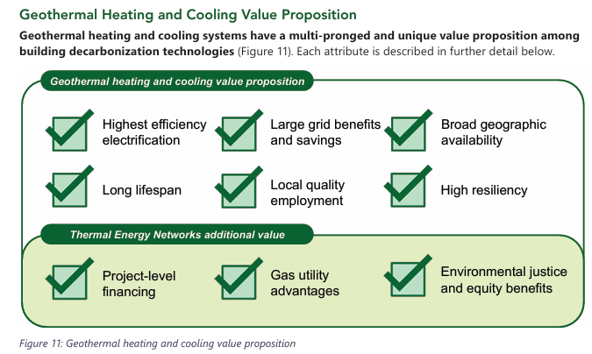

Slide 16
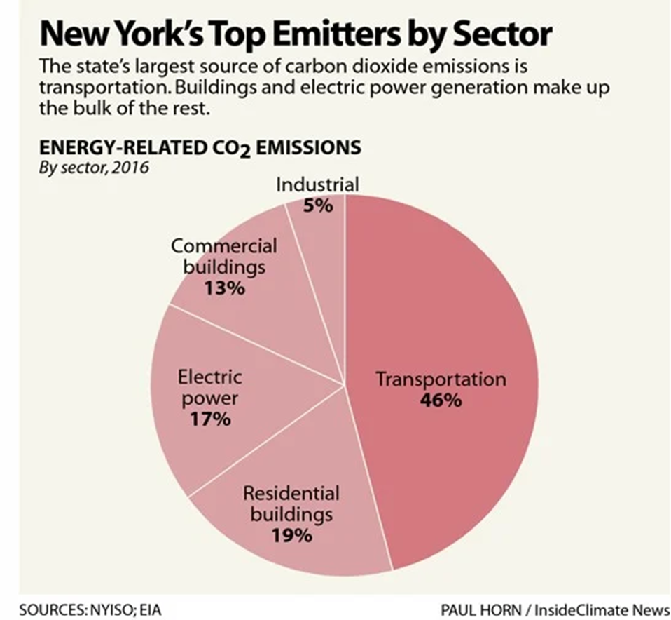
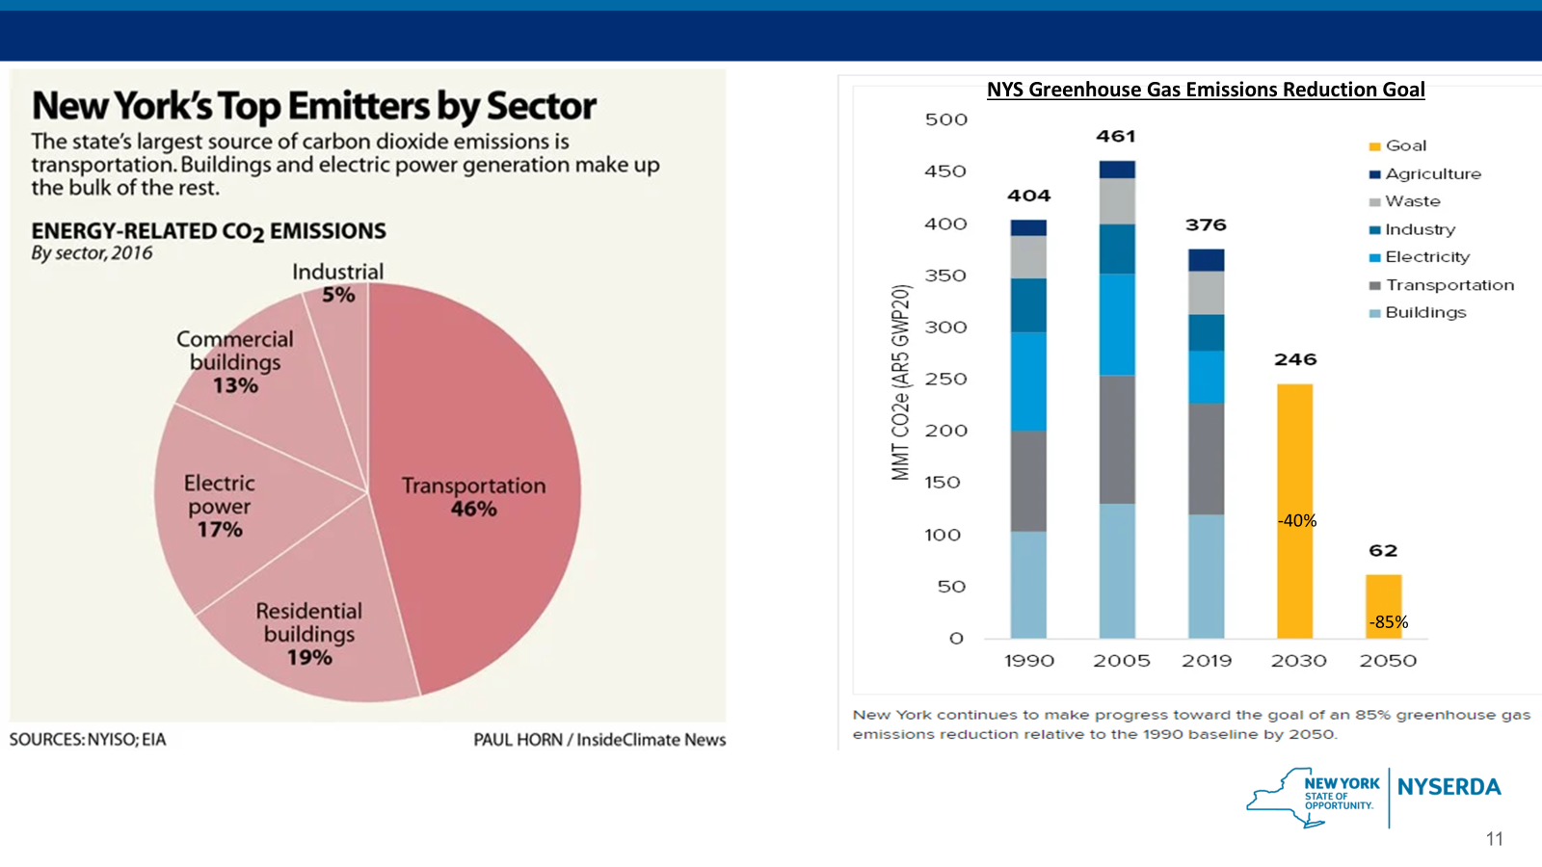
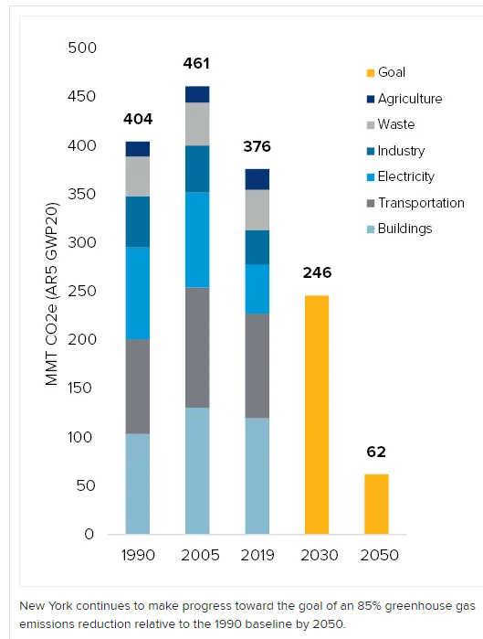
NYS Greenhouse Gas Emissions Reduction Goal
-40%
-85%

Slide 17
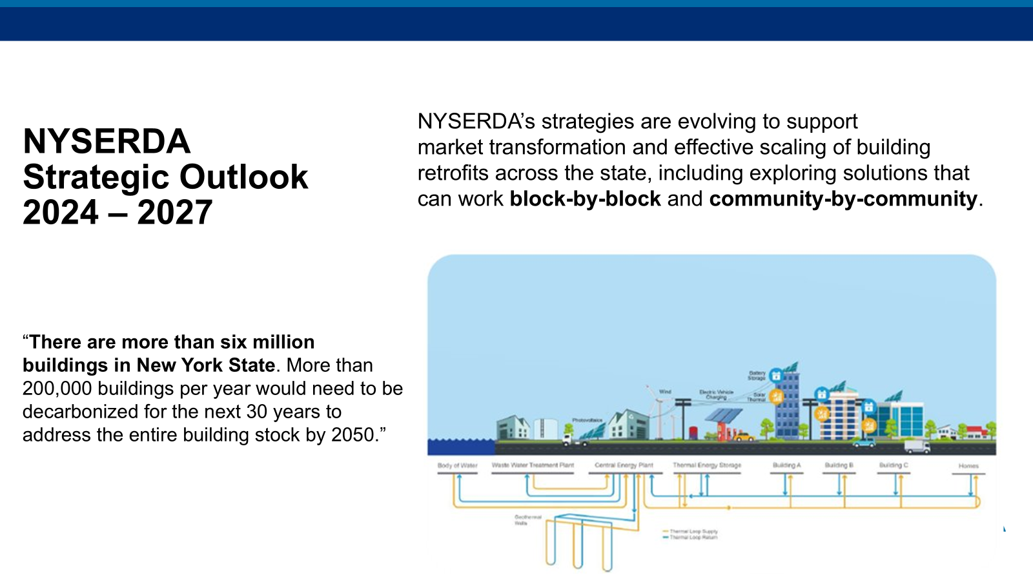
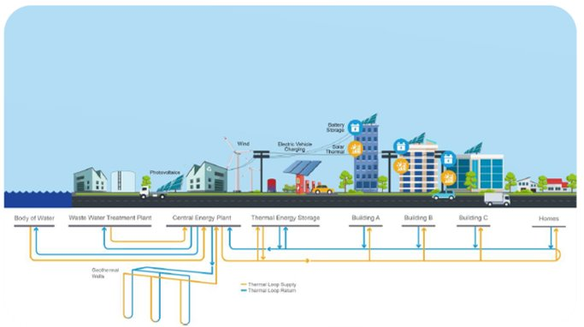
NYSERDA’s strategies are evolving to support market transformation and effective scaling of building retrofits across the state, including exploring solutions that can work block-by-block and community-by-community.​
NYSERDA​
Strategic Outlook​
2024 – 2027​
“There are more than six million
buildings in New York State. More than 200,000 buildings per year would need to be decarbonized for the next 30 years to address the entire building stock by 2050.”​

Slide 18
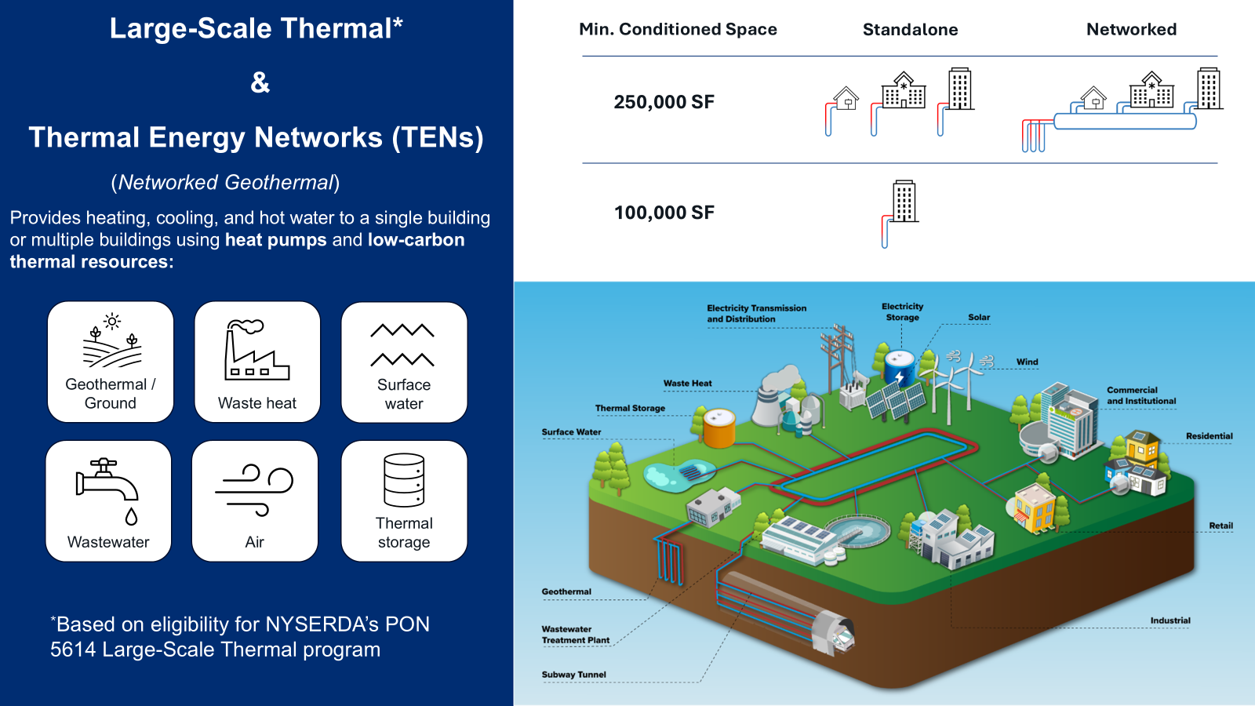
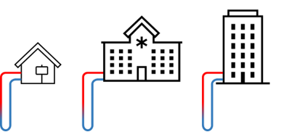
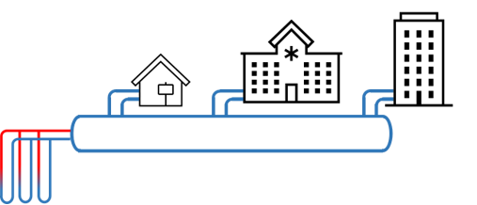
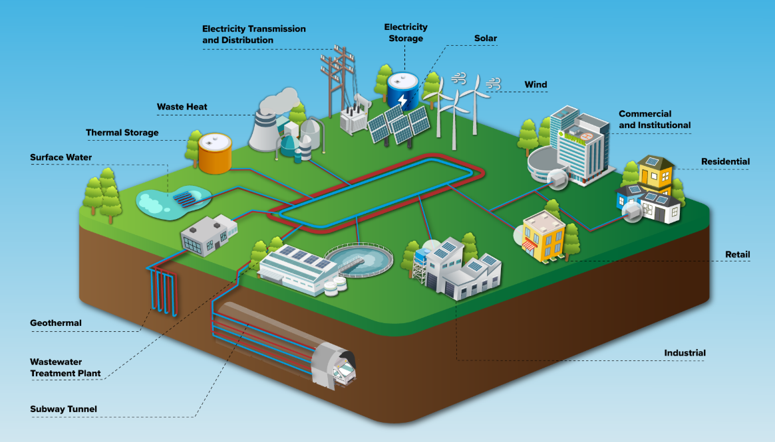






Large-Scale Thermal*
&
Thermal Energy Networks (TENs)
    (Networked Geothermal)
    Provides heating, cooling, and hot water to a single building or multiple buildings using heat pumps and low-carbon thermal resources:
    Min. Conditioned Space
    Standalone
    Networked
    250,000 SF
    100,000 SF
Geothermal / Ground
Waste heat
Surface water
Wastewater
Air
Thermal storage
*Based on eligibility for NYSERDA’s PON 5614 Large-Scale Thermal program

Slide 19
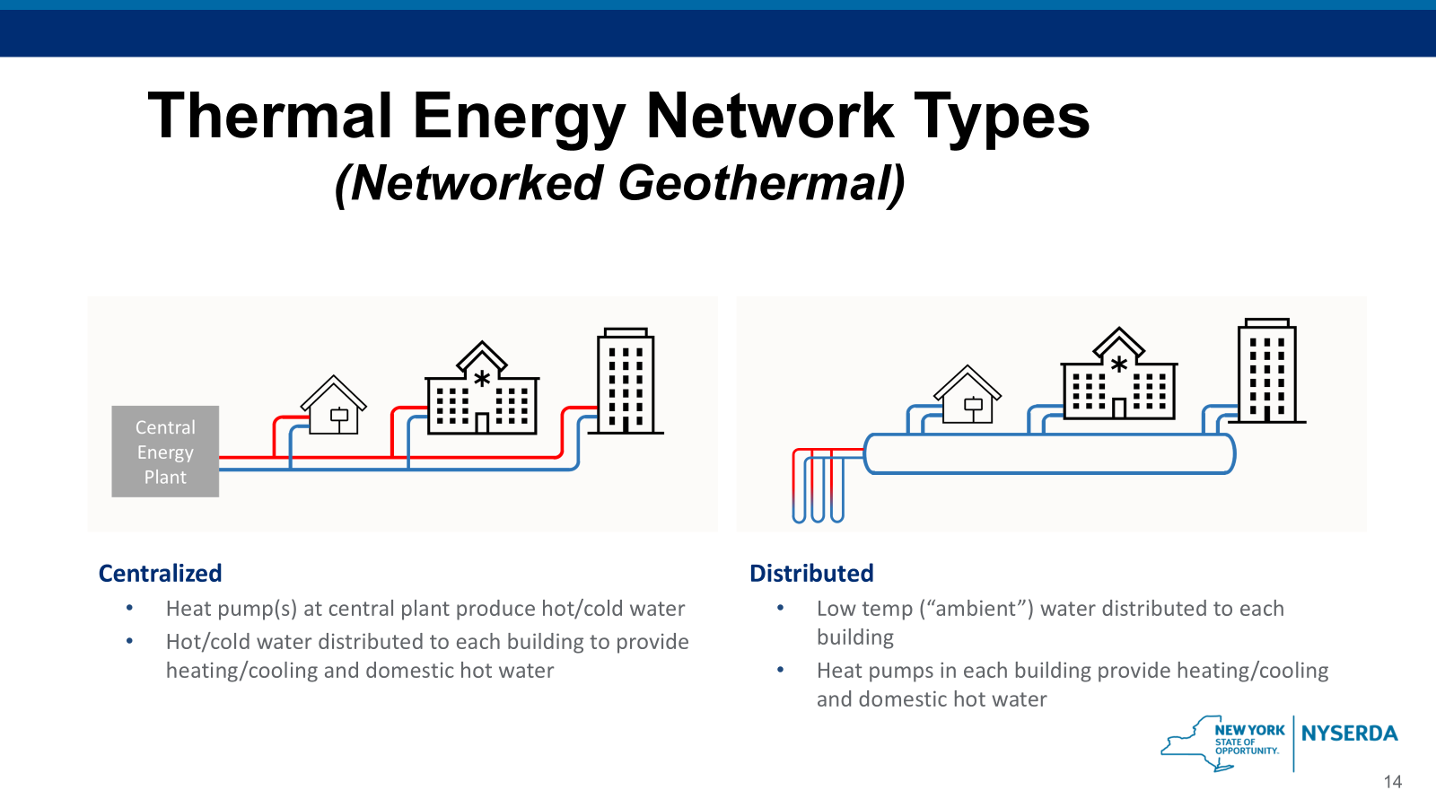
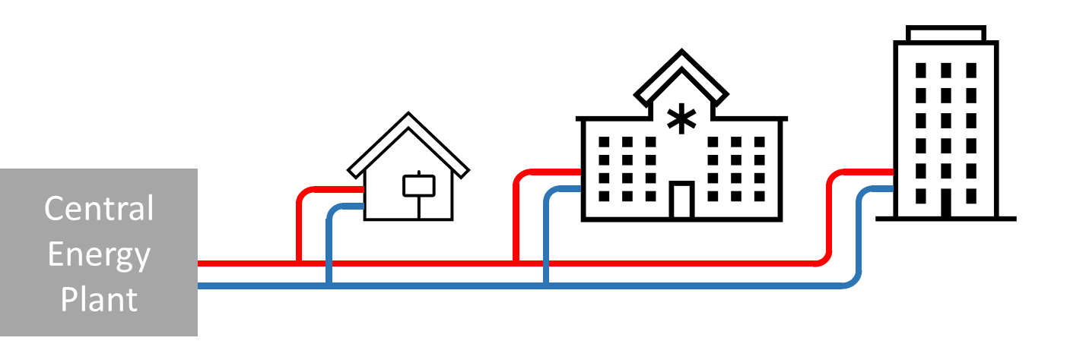
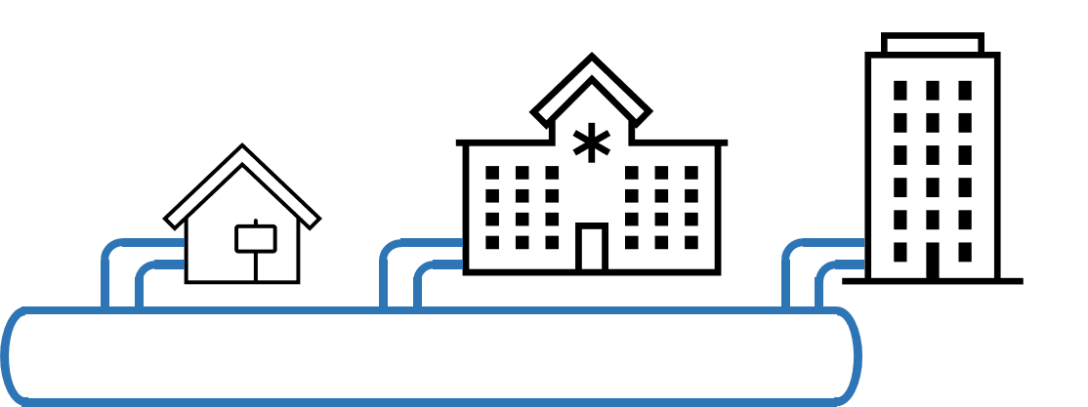

Thermal Energy Network Types
(Networked Geothermal)
Centralized
    Heat pump(s) at central plant produce hot/cold water
    Hot/cold water distributed to each building to provide heating/cooling and domestic hot water
Distributed
    Low temp (“ambient”) water distributed to each building
    Heat pumps in each building provide heating/cooling and domestic hot water

Slide 20
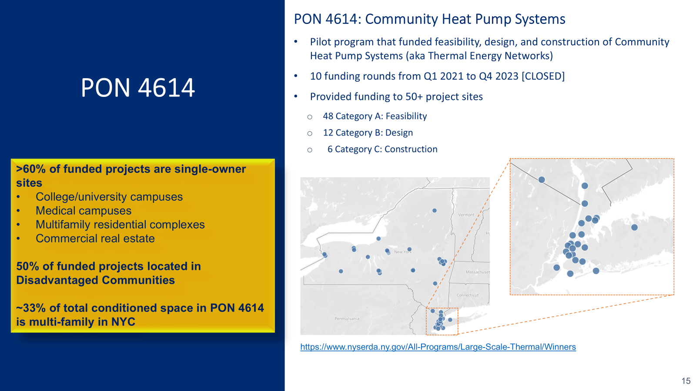
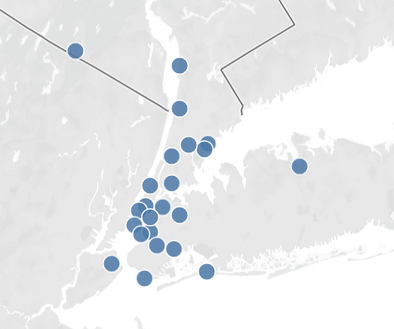
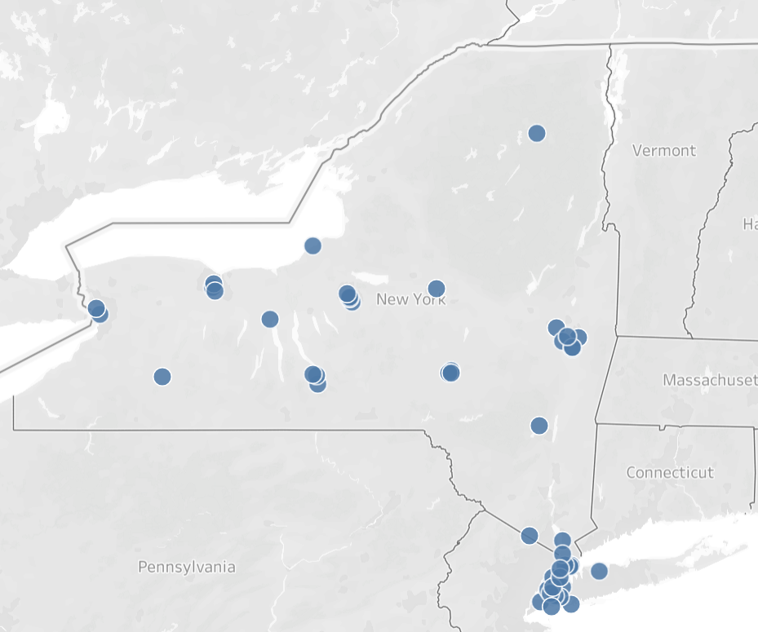
PON 4614: Community Heat Pump Systems
Pilot program that funded feasibility, design, and construction of Community Heat Pump Systems (aka Thermal Energy Networks)
10 funding rounds from Q1 2021 to Q4 2023 [CLOSED]
Provided funding to 50+ project sites
    48 Category A: Feasibility
    12 Category B: Design
    6 Category C: Construction
PON 4614
>60% of funded projects are single-owner sites
College/university campuses
Medical campuses
Multifamily residential complexes
Commercial real estate
50% of funded projects located in Disadvantaged Communities
~33% of total conditioned space in PON 4614 is multi-family in NYC
    https://www.nyserda.ny.gov/All-Programs/Large-Scale-Thermal/Winners

Slide 21
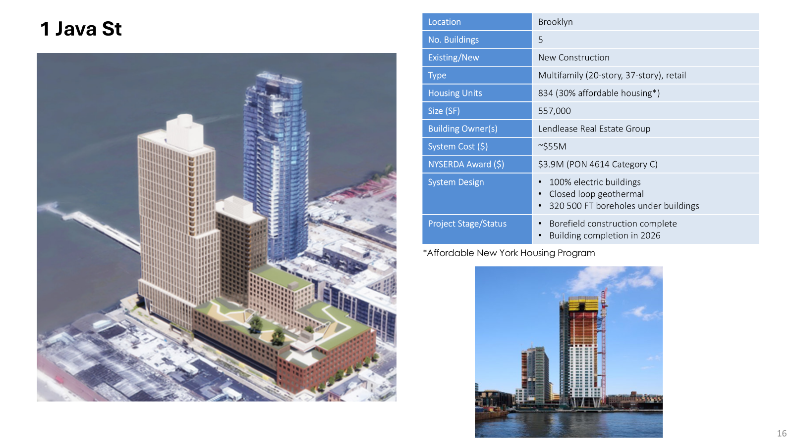
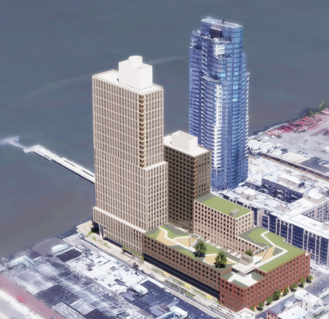
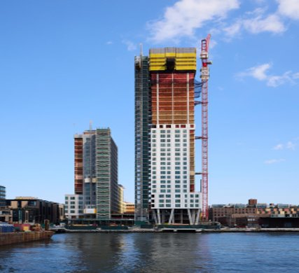
1 Java St
Location | Brooklyn
No. Buildings | 5
Existing/New | New Construction
Type | Multifamily (20-story, 37-story), retail
Housing Units | 834 (30% affordable housing*)
Size (SF) | 557,000
Building Owner(s) | Lendlease Real Estate Group
System Cost ($) | ~$55M
NYSERDA Award ($) | $3.9M (PON 4614 Category C)
System Design | 100% electric buildings Closed loop geothermal 320 500 FT boreholes under buildings
Project Stage/Status | Borefield construction complete Building completion in 2026
*Affordable New York Housing Program

Slide 22
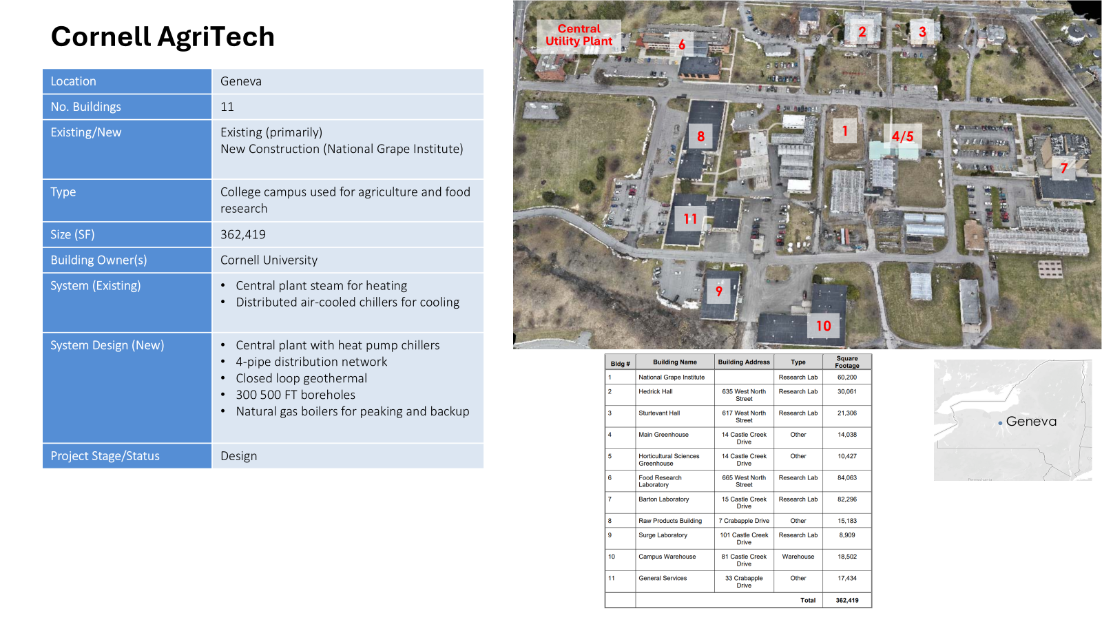
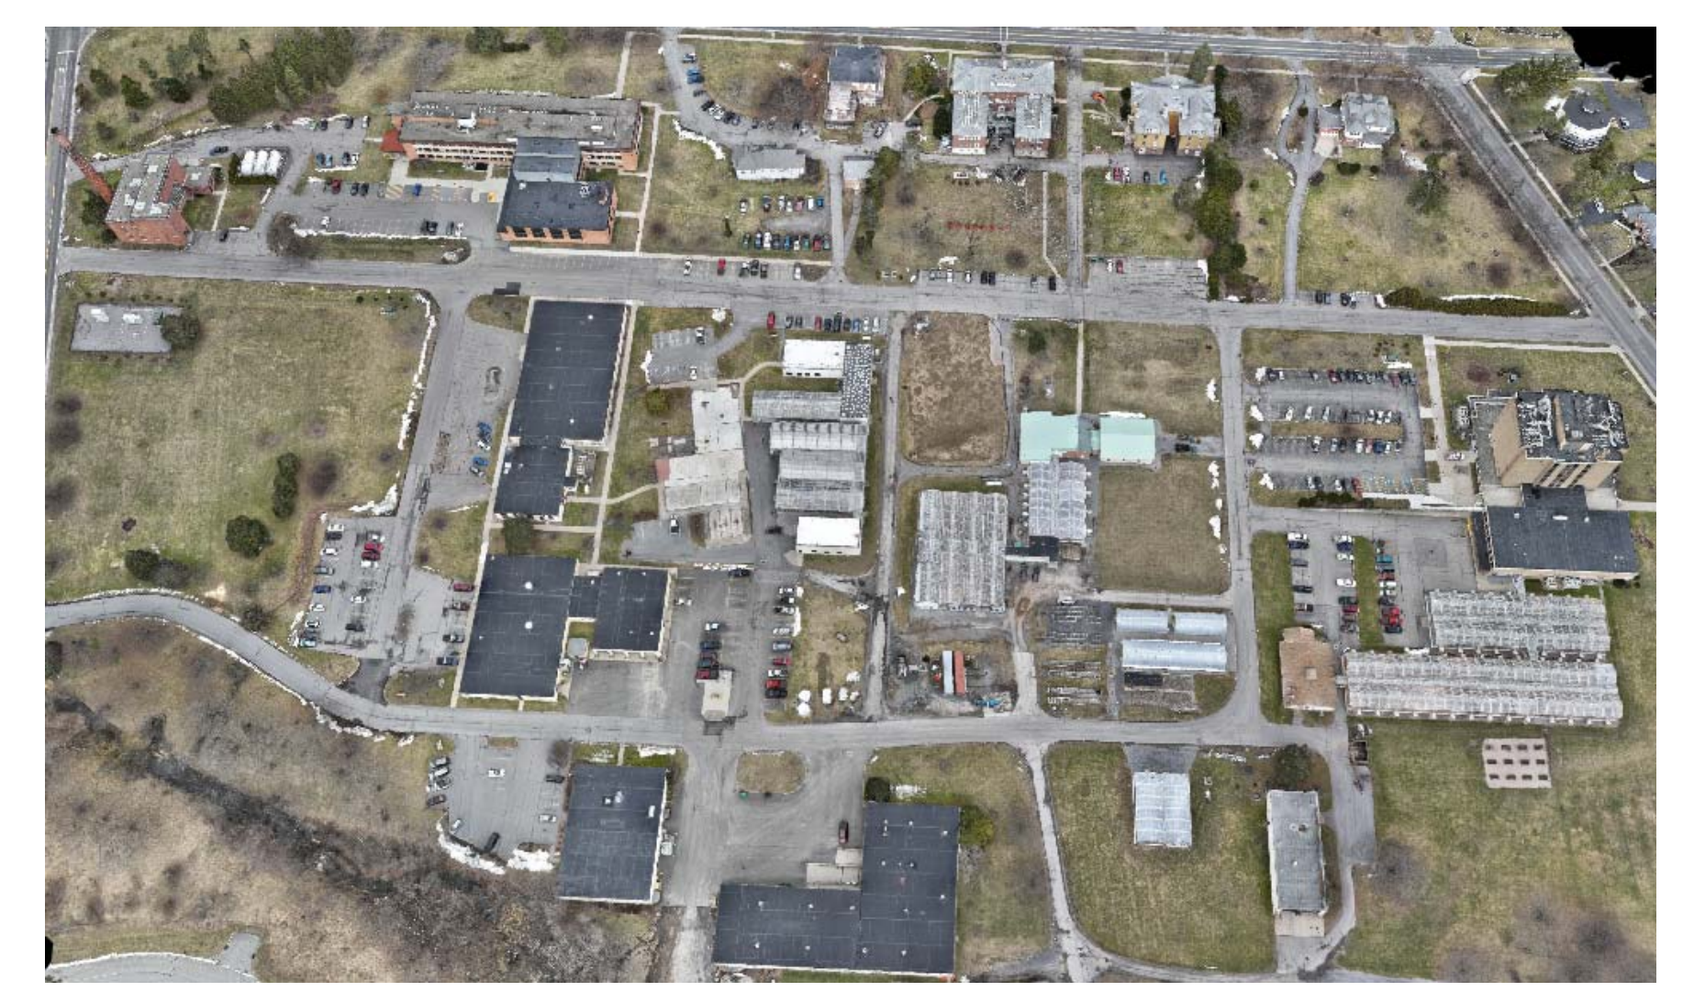
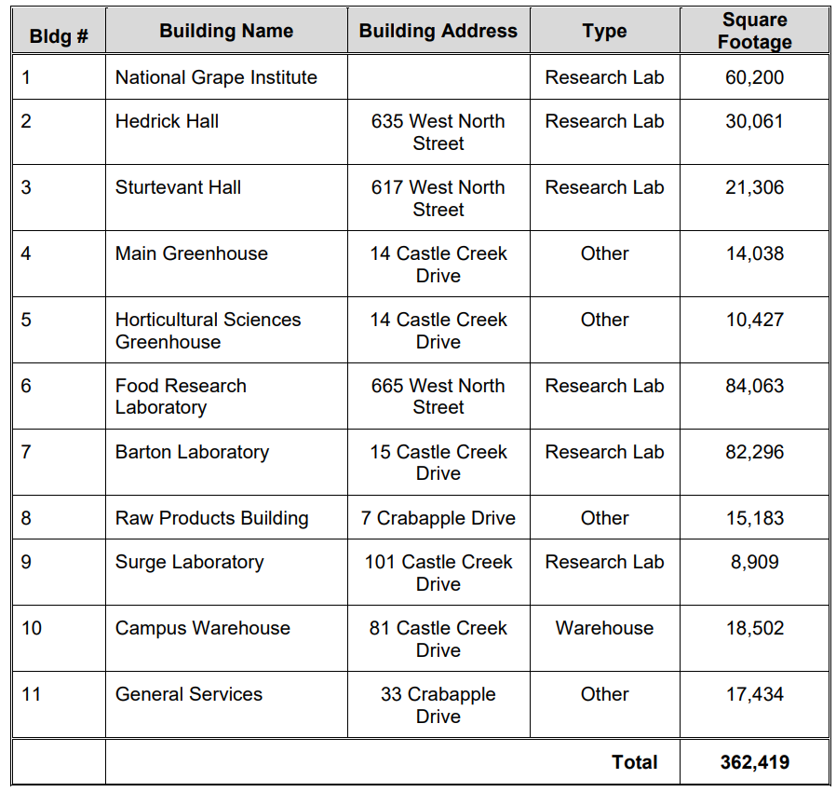
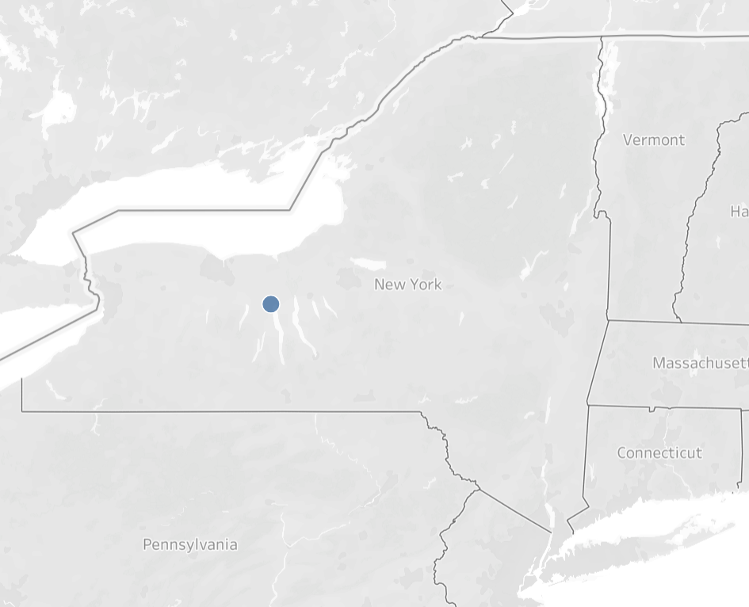
Cornell AgriTech
Central Utility Plant
2
3
6
Location | Geneva
No. Buildings | 11
Existing/New | Existing (primarily) New Construction (National Grape Institute)
Type | College campus used for agriculture and food research
Size (SF) | 362,419
Building Owner(s) | Cornell University
System (Existing) | Central plant steam for heating Distributed air-cooled chillers for cooling
System Design (New) | Central plant with heat pump chillers 4-pipe distribution network Closed loop geothermal 300 500 FT boreholes Natural gas boilers for peaking and backup
Project Stage/Status | Design
8
1
4/5
7
11
9
10
Geneva

Slide 23
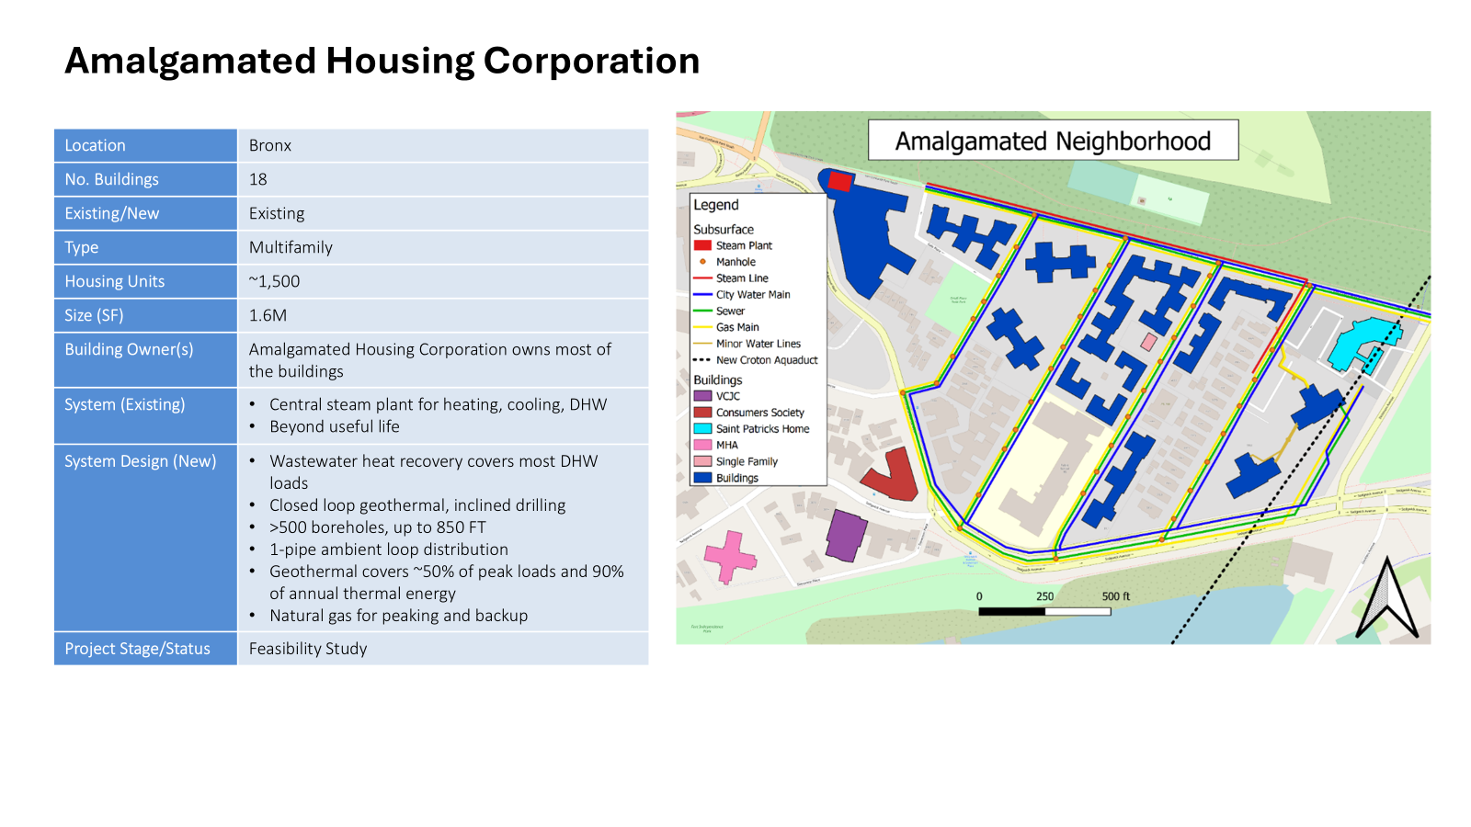
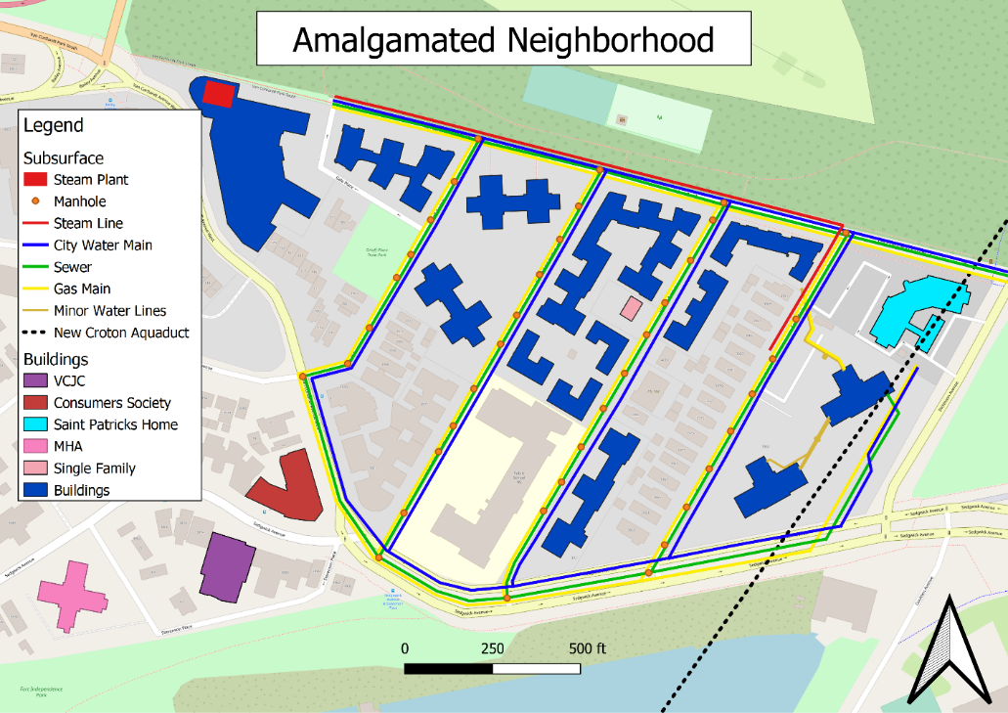
Amalgamated Housing Corporation
Location | Bronx
No. Buildings | 18
Existing/New | Existing
Type | Multifamily
Housing Units | ~1,500
Size (SF) | 1.6M
Building Owner(s) | Amalgamated Housing Corporation owns most of the buildings
System (Existing) | Central steam plant for heating, cooling, DHW Beyond useful life
System Design (New) | Wastewater heat recovery covers most DHW loads Closed loop geothermal, inclined drilling >500 boreholes, up to 850 FT 1-pipe ambient loop distribution Geothermal covers ~50% of peak loads and 90% of annual thermal energy Natural gas for peaking and backup
Project Stage/Status | Feasibility Study

Slide 24
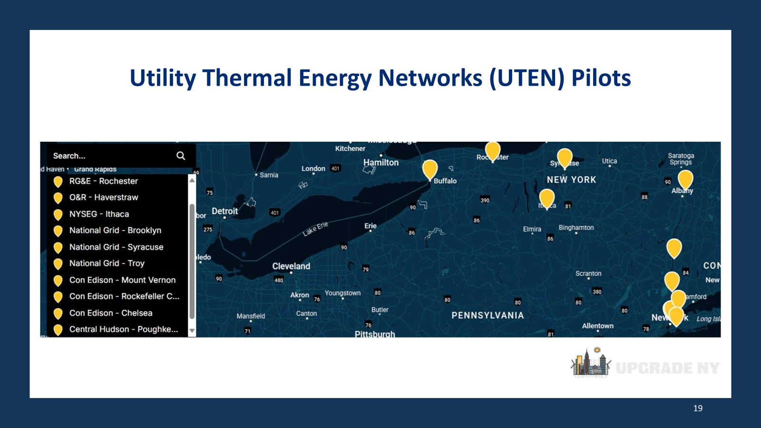
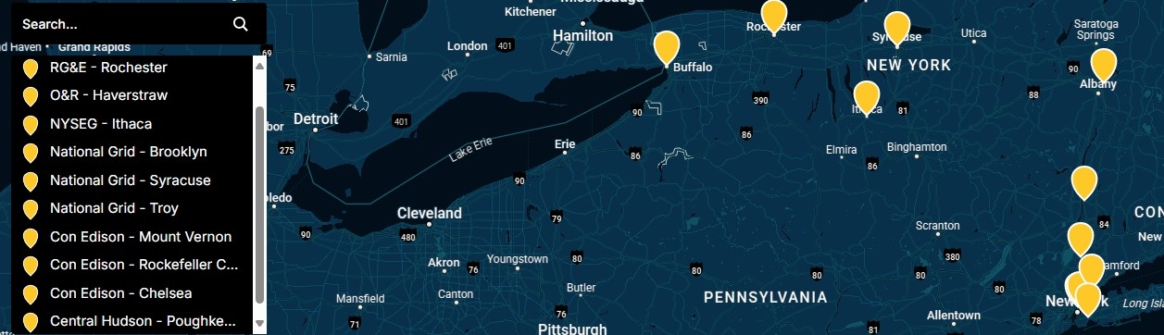

Utility Thermal Energy Networks (UTEN) Pilots

Slide 25
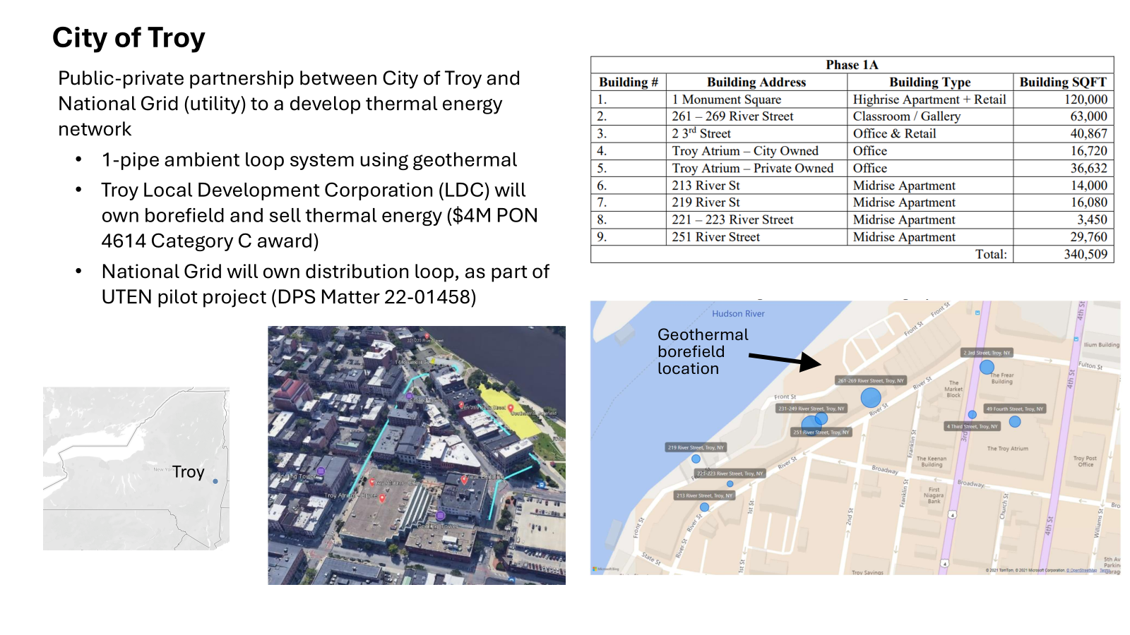
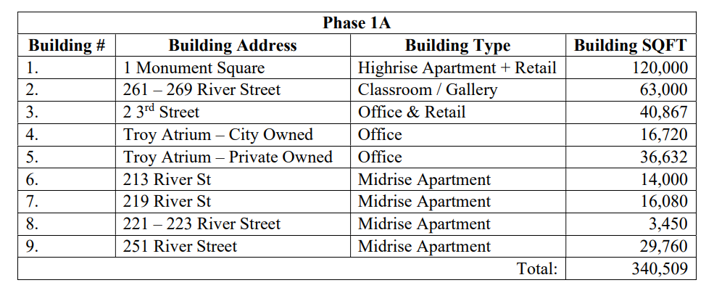



City of Troy
Public-private partnership between City of Troy and National Grid (utility) to a develop thermal energy network
  1-pipe ambient loop system using geothermal
  Troy Local Development Corporation (LDC) will own borefield and sell thermal energy ($4M PON 4614 Category C award)
  National Grid will own distribution loop, as part of UTEN pilot project (DPS Matter 22-01458)
  Geothermal borefield location
Troy

Slide 26

NY Laws Benefiting the Geothermal Industry
Climate Leadership and Community Protection Act (Climate Act) December 2019
  Established GHG reduction goals (40/30 & 85/50)
  35-40% of benefits from clean energy investments must go to disadvantaged communities
    1/3 of GHG in NY comes from building heating & colling systems
    Need to decarbonize building HVAC systems
NYS Geothermal Tax Credit
  25% State Tax Credit Capped at $5,000
Utility Thermal Energy Networks and Jobs Act (UTENJA) July 2022
  Allowing utilities to build, own, and operate Thermal Energy Networks
  The 7 investor-owned utilities have submitted 11 pilot project proposals for DPS approval
  Promotes development of TENs and provide jobs to transitioning gas utility workers
Advance Building Codes, Appliance and Equipment Efficiency Standards Act of 2022
  Establishes appliance and equipment efficiency standards for products that are sold, rented, leased, and installed in NY
2023 New York State Budget Bill
  NYPA conduct TENs feasibility studies for15 of the highest GHG emitting State facilities
Geothermal Borehole Bill
  Exempts certain geothermal borehole depths beyond 500 FT from certain requirements
Local Law 97
  Establishes carbon emission limits for NYC’s building over 25k square feet

Slide 27


Geothermal Heating & Cooling Scalability

Slide 28
Thank You

Slide 29

Visit to South Fork Offshore Wind Farm

Slide 30


LYNDIE HICE-DUNTON, Ph.D Executive Director
National Offshore Wind Research & Development Consortium

Slide 31


US Offshore Wind
Symposium on Energy in the 21st Century
Lyndie Hice-Dunton, PhD
Executive Director, NOWRDC
April 4, 2024

Slide 32

US Offshore Wind
Recent period of rapid expansion of offshore wind in the US
Driven by state and federal renewable energy goals
  Previous federal targets
    30 GW by 2030
    15 GW floating OSW by 2035
Locations of U.S. offshore wind energy pipeline activity and Call Areas as of May 31,2024.
NREL Offshore Wind Market Report: 2024 Edition Executive Summary

Slide 33

US Offshore Wind
Numerous offshore wind farms are in various stages of the BOEM permitting process
The U.S. offshore wind energy development pipeline encompasses a potential generating capacity of approximately 80.5 GW, reflecting significant growth and interest in this renewable energy sector.
Significant investments in US supply chain and workforce to meet growing demand.

Slide 34

NREL Offshore Wind Market Report: 2024
Edition Executive Summary

Slide 35
US Offshore Wind
As of February 2025, the US has 3 operational wind farms collectively contributing 174 MW of offshore wind energy capacity to the U.S. grid:
Block Island (RI)- 30 MW
Coastal Virginia Offshore Wind Pilot (VA)- 12 MW
South Fork (RI/MA)- 132 MW
Several offshore wind projects have received final permits from BOEM and are in various stages of development:
Vineyard Wind 1 (MA)- 806 MW; started delivering power in January 2024, faced setbacks due to a turbine blade incident in 2024 but is progressing towards completion.
Revolution Wind (RI/MA)- 704 MW- began construction in 2023
Coastal Virginia Offshore Wind (VA)- 2,597 MW- began construction in 2023
Empire Wind 1 (NY)- 810 MW- began construction in 2024; offshore construction expected in 2025
Sunrise Wind (RI/MA)- 924 MW- began construction in 2024
New England Wind 1 (MA)- 791 MW- scheduled to begin construction in 2025

Slide 36

US Offshore Wind
However, recent political developments have introduced uncertainties into the future of offshore wind energy in the US. In January 2025, President Trump issued an EO halting federal permits and leases for wind projects on both land and sea.
These policy shifts may impact the progression of offshore wind projects currently in the permitting stages, potentially affecting the timeline and development of the US OSW industry.
Already seeing impacts on US projects including developers announcing project delays, permit remands, and reduction in US staff.
Executive Order on Offshore Wind

Slide 37

US Offshore Wind
  Despite recent policy shifts, US OSW is essential to meet increased energy demands
  OSW should continue to be considered as part of the “all of the above” energy approach
  Significant investments have been made in US supply chain and workforce that are critical to support both the US and global OSW pipeline
  Continued need to support research and technology innovation to reduce costs and increase economic and social benefits.

Slide 38


NOWRDC’s Formation
The National Offshore Wind Research and Development Consortium (NOWRDC) was created in 2018 when the U.S. Department of Energy selected the New York State Energy Research and Development Authority (NYSERDA), to create a new 501(c)(3) non-profit organization to advance offshore wind technology R&D through competitive grants.
DOE provided initial funding of $20.5 million, which NYSERDA matched to form formed a funding pool of $41 million.
Since NOWRDC’s formation, 7 states, 10 developers, and 10 other public and independent members have joined the Consortium.

Slide 39





NOWRDC Funding and Competitive Solicitations
Goals of the funding:
Accelerate the deployment of offshore wind energy in the U.S.
Address challenges and obstacles facing the offshore wind industry and maximize economic and social benefits.
Reduce the levelized cost of energy (LCOE) of offshore wind in the U.S.
Notes:
**NOT YET UPDATED FOR SOLICITATION 4.0

Slide 40

R&D Projects Funded to Date
Notes:
**NOT YET UPDATED FOR SOLICITATION 4.0

Slide 41

Impacts of R&D support
To date, NOWRDC has funded 55 research projects, with 39 now completed. Upon project completion, we collect both quantitative reports and testimonial feedback.
NOWRDC recently assessed impacts of our projects, presented in three key areas:
High-Level Summary Statistics: Overview of portfolio distribution, TRL & CRL advancements, matched funding, and more.
LCOE Impact: A detailed analysis of LCOE impacts, with a link to the full report available in our resources tab.
Project PI Testimonials: Insights from project leaders on how NOWRDC funding has supported their work and contributed to project success.
Notes:
**NOT YET UPDATED FOR SOLICITATION 4.0

Slide 42



High Level Impacts of R&D
NOWRDC-funded projects have,
on average, advanced by:
3 levels on the Technology Readiness Level (TRL) scale
1.5 levels on the Commercial Readiness Level (CRL) scale

Slide 43





LCOE Impact
NOWRDC has assessed the impact its closed out project awards have had on the levelized cost of energy (LCOE) and annual energy production (AEP) metrics of offshore wind in the US.
NOWRDC modeled innovation deployment across three hypothetical baseline wind farms:
Nearshore fixed bottom
Farshore fixed bottom
West Coast floating site
Across each case, deploying NOWRDC-funded innovations led to:
Significant LCOE reductions ranging from 3-9.5%,
and increases in AEP ranging from 1.5-3.5%.

Slide 44

Goals of Offshore Wind Innovation
Lower cost - reduce capex and/or opex
Reduce risk, and associated risk premiums with project finance and insurance entities
Improve performance - AEP - annual energy production
Reduce environmental impacts and streamline permitting
Accelerate the development of floating offshore wind technology that will be needed for projects slated for 2030s - focus on driving commercialization and scalability
Continued investment in US workforce and supply chain
NOWRDC’s project with Crowley, "Technical Validation of Existing U.S. Flagged Barges as a 'Feeder' Solution for the U.S. Offshore Wind Industry,"

Slide 45
US Offshore Wind
  Despite recent policy shifts, US OSW is essential to meet increased energy demands
  OSW should continue to be considered as part of the “all of the above” energy approach
  Significant investments have been made in US supply chain and workforce that are critical to support both the US and global OSW pipeline
  Continued need to support research and technology innovation to reduce costs and increase economic and social benefits.

Slide 46


Thank you!
Lyndie.Hice-Dunton@nationaloffshorewind.org
Visit our website
  Project database
  R&D Roadmap 4.0
  Impact Metrics
Stay informed
  Sign up for our mailing list
  Follow us on LinkedIn
Increase U.S. content and job opportunities

Slide 47


MARGUERITE WELLS
Executive Director, ACE NY

Slide 48
Wind Development in NY:
Status and Challenges
April 4, 2025
Marguerite Wells

Slide 49
Outline of Topics
Introduction
Status of Wind Projects in NY
Stages of Development
Challenges
Questions?

Slide 50

Introduction
I am the Executive Director of Alliance for Clean Energy New York,
Advocating for all clean energy technologies: onshore and offshore wind, distributed and utility-scale solar, energy storage, transmission, EVs and charging, and energy efficiency. Board members are half environmental NGOs, half industry.
8 Years as developer at Invenergy in NY, led development from beginning to end on:
~1000MW of wind, ~1000 MW of solar
Have worked through Article 10, Article 7, SEQRA, and 94-C
9 years in community wind with Black Oak Wind Farm
And also a farmer…
Hay, livestock and solar grazing business currently
Host 2.3 MW of community solar on our farm
Farm Bureau Member- Northeast Farm Dog of the Year!

Slide 51

Operating Onshore Wind Portfolio in NYS
33 Operating projects
representing 2,944 MW
5 main areas- Wyoming, Steuben,
Madison, Lewis, and Clinton Counties

Slide 52

Generation Profiles of Wind and Solar
Or, why we
need wind AND
solar…
and storage

Slide 53

Wind Map of NYS @50m above surface:

Slide 54
Basic Utility-scale Wind Site Selection Criteria:
Commercially viable amount of wind on less than 5% of the state
Within ~15 miles of transmission line, hopefully one with capacity available/reasonable upgrade costs
Willing landowner(s)- no eminent domain

Slide 55
Pipeline of Projects
The NYISO Transitional Cluster Queue: Represents the near-term pipeline of projects
300 projects:
  19 wind projects representing 2,519 MW of wind
  61 solar projects representing 6,980 MW
  183 storage projects representing 29,956 MW

Slide 56
Recent Major Process Improvements
The new NYISO Interconnection Process:
ORES replaced Article 10 and scaled up operations
NYSERDA procurement improvements through CES review??
    Note: a canceled NYSERDA contract is NOT a terminated project

Slide 57

In a best-case scenario: 5-7 years to operations

Slide 58
Federal Headwinds
Executive Order as of January 25, barring federal leasing of offshore areas for wind
Bars federal agencies from permitting ANY wind including onshore wind on private land
Army Corps of Engineers permits required on virtually every project east of the Mississippi
Tariffs impact all equipment, even that manufactured in the US of imported materials

Slide 59
Major Obstacles to NY Renewable Development
Opposition is highly organized, both sides of political spectrum
Second homeowners and retirees vs long-time locals
Cost of electric bills blamed on renewables, actually just needed grid investments
Limited viable land base compared to energy demand of the state overall

Slide 60

E
ED NEDEAU
Business Manager Steamfitters Local 7

Slide 61


Slide 62


Slide 63


Slide 64


Slide 65


Slide 66


Slide 67


Slide 68


Slide 69


ZERYAI HAGOS
Director, New York State
OFFICE OF RENEWABLE SITING

Slide 70
RAPID Act Proposed Regulations: Streamlining the Siting of Major Renewable Generation and Electric Transmission Projects
Zeryai Hagos, Executive Director
Office of Renewable Energy Siting & Electric Transmission
April 4, 2025

Slide 71


Climate Leadership & Community Protection Act
70% renewable energy by 2030 and zero emissions electricity grid by 2040
Develop: Solar, Onshore & Offshore Wind, Storage
Maintain: Nuclear and Hydroelectric
Transition: Gas & Oil to Zero Emission Resources

Slide 72




Office of Renewable Energy Siting & Electric Transmission Basics
Originally established within Department of State pursuant to the Accelerated Renewable Energy Growth & Community Benefit Act¹
Replaced the Board on Electric Generation Siting & the Environment for the siting of renewable energy facilities with a capacity of 25 MW or greater
ORES issues a single permit for the construction of large-scale renewable energy facilities
Streamlines the environmental review and siting of large-scale renewables through the application of uniform standards & conditions (“USCs”) to timely achieve the Climate Act goals
1 - L. 2020, Ch. 58, Part JJJ, § 4

Slide 73


Primary Objectives of the RAPID Act
Transfer the Office of Renewable Energy Siting (ORES) and its existing authority to permit major renewable energy facilities to the Dept. of Public Service (DPS)
Provides ORES “with additional responsibilities for the review and permitting of major electric transmission facilities” pursuant to new Public Service Law (PSL) Article VIII
Ensures that significant upgrades in the bulk and local transmission system necessary to achieve the CLCPA targets and replace aging infrastructure can be permitted in an “expedited timeframe” consistent with ORES’s existing streamlined process for generation.

Slide 74
Noteworthy Requirements of the RAPID Act
Generation -- PSL § 138(1)(a), (3): The statute authorizes ORES, in consultation with DPS, and subject to the approval of the PSC, to promulgate rules and regulations with respect to all necessary requirements to implement the siting permit program established in Article VIII and promulgate modifications to such rules and regulations as it deems necessary.
  Impacts to lands used in agricultural production: The RAPID Act expressly directs ORES to develop uniform standards and conditions designed to avoid, minimize, or mitigate to the maximum extent practicable, potential significant adverse impacts to land used in agricultural production, with additional consideration for land within an agricultural district or land that contains mineral soil groups 1-4.
Electric Transmission -- PSL § 139(1)(a), (4): The statute requires ORES to within 1 year of the effect date of the RAPID Act (or by April 20, 2025) to promulgate regulations (1) establishing “a set of uniform standards and conditions for the siting, design, construction, and operation of major electric transmission facilities”; and (2) any other related requirements.

Slide 75
PSL Article VIII Rulemaking Timeline
Notice of Proposed Rulemaking, Acceptance of Draft Generic Environmental Impact Statement, Public Comment Period, and Public Comment Hearing:
  Issued Dec. 18, 2024; notice of additional hearings issued Jan. 14, 2025.
  Proposes to repeal the current 16 NYCRR Part 1100 (Office of Renewable Energy Siting and Electric Transmission) (former 19 NYCRR Part 900) and replaces it with a new Part 1100 (General Procedures), Part 1101 (Major Renewable Energy Facility Siting), and Part 1102 (Major Electric Transmission Facility Siting).
  DPS, by and through ORES, as lead agency, completed and accepted a draft generic environmental impact statement (DGEIS) in connection with the proposed rulemaking.
  120-day public comment period through April 18, 2025
  Scheduled 22 public comment hearings: 20 in-person at 11 locations around the State, and 2 virtual public comment hearings.

Slide 76
Analogous Provisions to Articles VII & 10 Incorporated into the Proposed Regs
  Applicability: “Major renewable energy facility” (MRE) is defined similar to Article 10 - any renewable energy system, as such term is defined in PSL § 66-p¹, with nameplate capacity >= 25 MWs; “Major electric transmission facility” (MET) is defined the same as Article VII².
  Intervenor Funding: Like Article VII and 10, the applicant must deposit same fees as required under Article VII (dependent on kV and distance) or Article 10 ($1,000 per $1,000 kW of capacity), although made subject to inflation.
  Application of Local & Other State Law: One-stop permitting law. All State and local substantive laws must be applied; exception: substantive local law requirements are subject to waiver if deemed “unreasonably burdensome in view of the CLCPA targets and environmental benefits” of the facility and, in the case of electric transmission, the public need for the facility.
  Deadline for permitting decision – one year from completeness determination: similar to Article 10.
1 – Systems that generate electricity or thermal energy through use of the following technologies: solar thermal, photovoltaics, on land and offshore wind, hydroelectric, geothermal electric, geothermal ground source heat, tidal energy, wave energy, ocean thermal, and fuel cells which do not utilize a fossil fuel resource in the process of generating electricity
2 – An electric transmission line of a design capacity of: (i) 150 kV or more extending a distance of one mile or more, or 100 kV or more, including associated equipment; and (ii) less than 125 kV, extending a distance of ten miles or more, including associated equipment. Do not include any such transmission line located wholly underground in NYC.

Slide 77
Application of Uniform Standards & Conditions
To streamline the process, each application would be subject to uniform standards and conditions – analogous to ORES’s existing authority.
  All permits would include uniform standards and conditions to address those environmental impacts common to each type of MRE facility, or to MET projects.
  USCs “shall be designed to avoid or minimize, to the maximum extent practicable, any potential significant adverse environmental impacts . . .”
  ORES shall identify site-specific adverse environmental impacts that “are unable to be addressed by the uniform standards and conditions” and develop site-specific conditions to avoid or mitigate those impacts “taking into account the CLCPA targets and the environmental benefits” of the facility and, in the case of transmission, the public need for the facility.

Slide 78
Municipal and Community Involvement
Pre-application consultation
Municipal statement of local law compliance
Landowner statement challenging need (transmission): ORES must provide any landowner “for which the applicant lacks a right-of-way agreement . . . with an opportunity to challenge the explanation for the public need given in” the application.
Host community benefit (generation):
  Final permit to require permittee to provide a host community benefit, as determined pursuant a program established by the PSC pursuant to the Accelerated Renewable Energy Act, or as determined by ORES, or as subsequently agreed to between applicant and the host community.

Slide 79
Thank you

Slide 80


Special Guest Speaker
SARAH KURTZ Ph.D
Distinguished Professor
University of California, Merced

Slide 81


Slide 82


Slide 83


Slide 84


Slide 85


Slide 86


Slide 87


Slide 88


Slide 89


Slide 90


Slide 91


Slide 92


Slide 93


Slide 94


Slide 95


Slide 96


Slide 97


Slide 98


Slide 99


Slide 101


Slide 102


JOHN MANNION
Congressional Representative
22nd District

Slide 103
The Twenty First Symposium on Energy in the 21st Century
High School Student Awards
For Best Renewable Energy Project in Their District
For The Science Fair

Slide 104


Slide 105


Slide 106


The Twenty First Symposium on Energy in the 21st Century
Proudly Awards
BARRY CARR
The Symposium on Energy 2025 Environmental Award
With our deep appreciation for your many years of dedication advancing the use of clean transportation to mitigate the risks of climate change by your promotion and leadership in alternative fuel cars, buses and trucks.
Your passionate commitment particularly promoting clean school buses for the health of our children and the planet is exemplary and a model for our country.
We further thank you for your twenty-one-year commitment to helping the success of our Symposium.
Rhea Jezer, Ph.D
President, Energy 21
April 4, 2025

Slide 107


KEYNOTE
CARL POPE
Senior Environmental Analyst
Michael Bloomberg
THE FUTURE OF THE ENVIRONMENTAL MOVEMENT

Slide 108


ROGER DOWNS
Conservation Director
Atlantic Chapter, Sierra Club

Slide 109


JULIE TIGHE
President/CEO
New York League of Conservation Voters

Slide 110


ERIC WALKER
Energy Justice Senior Policy Manager,
WE ACT for Environmental Justice

Slide 111
MARGUERITE WELLS
Executive Director, ACE NY

Slide 112


KIT KENNEDY
Senior Director
Climate & Clean Energy Program

Slide 114
Thank you! 🙏
To our speakers who came long distances to be with us to share such vital information
To Tom Amidon & crew, and Danny Jezer for his incredible support
To Christopher Baycura, & crew, and Ora Jezer, our production staff
To our interns Alyssa Jacoby, Joshua Chung & Dawson Schultz and the ESF Sustainable Energy Club
To SUNY ESF for welcoming us to this beautiful facility,
To our friends at NREL for helping shape the program
To our many valued sponsors, without whom we cannot have a Symposium, particularly our co-sponsor:
RAV Properties, Robert Lieberman and NYBusSales for providing our electric buses.
To all of you for taking the time to learn how to make our world safer and more environmentally sound.

Slide 115

Follow the Energy21 newsletter every other month for the most cutting edge information on renewable energy, and join our informationals.
If you do not want to receive the newsletter, don’t unsubscribe (because I will lose the ability to ever contact you – but just jot me a note)
Please remember to be kind to this world - it is the only one we have.
Celebrate earth day, April 22

