Slide 1
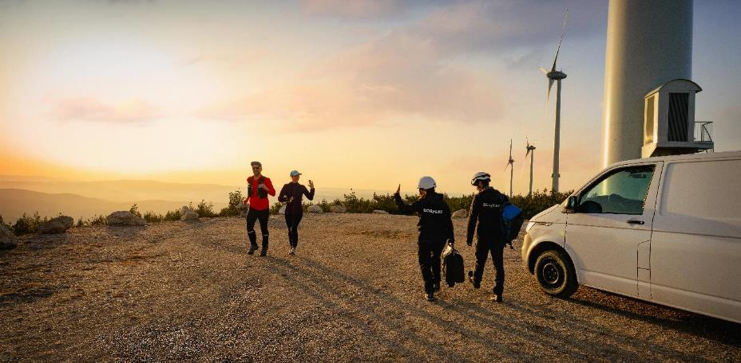
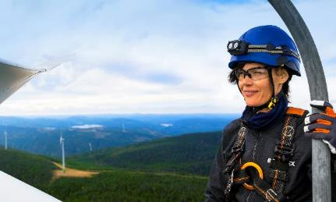



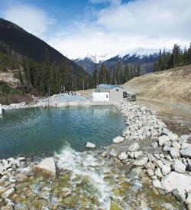

At a glance
Uptaded June 15th, 2022
February 2023

Slide 2

A Leader
Major player in renewable energy, at the cutting edge of a rapidly changing sector

Slide 3
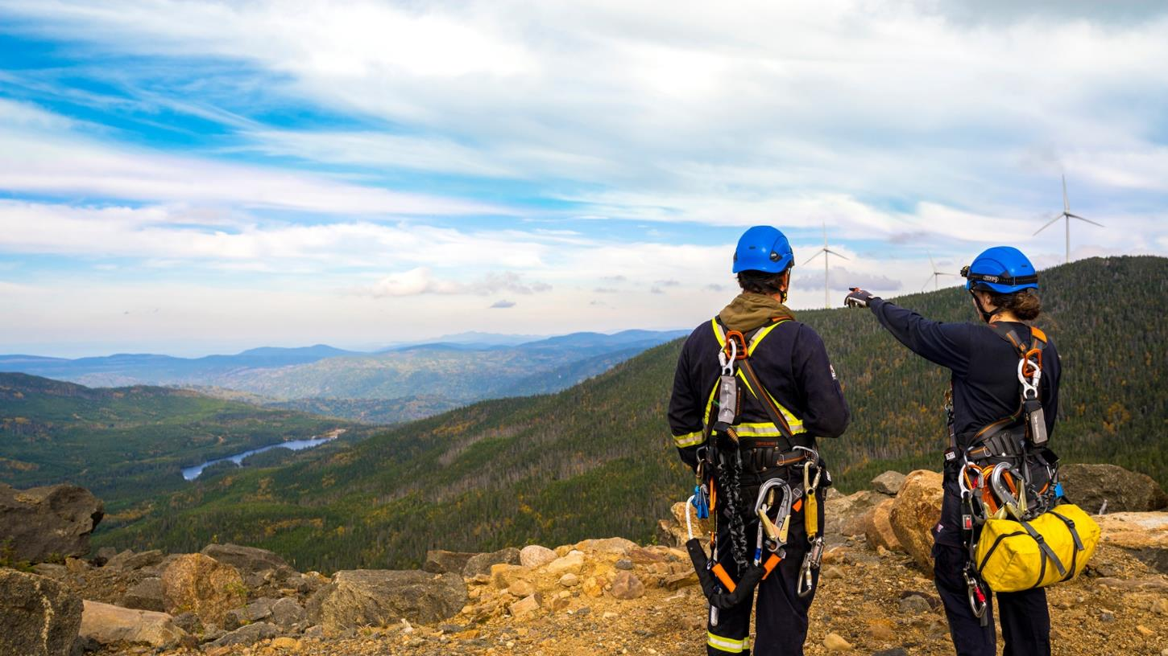




OUR EMPLOYEES
322
251
43
10
626

Slide 4








Boralex around the World
Total installed capacity
3,020 MW
As of December 31, 2022
2,584 MW
255 MW
181 MW
2 MW
An international presence with strong growth potential
Projects in development and construction
Storage
4.7 GW
800 MW
Guided by social and environmental values, Boralex provides its customers with clean energy in the most competitive way possible. The Corporation generates profitable and sustainable growth, thereby creating and sharing value while respecting its stakeholders.
Segment breakdown
Geographic breakdown
3,020 MW
3,020 MW
To learn more about our sites and projects
https://www.boralex.com/our-projects-and-sites/
WIND
SOLAR
HYDRO
CANADA
FRANCE
UNITED STATES

Slide 5









Boralex in the United States
2
4
4
5
Present in the United States for 20 years
3
Operates sites in 6 States, including in the ERCOT and SPP markets
2
2
Represents 25% of Boralex's operating assets
121 MW
5 SITES IN OPERATION
150 MW
2 SITES IN OPERATION
9 MW
1 SITE IN OPERATION
81 MW
7 SITES IN OPERATION
79 MW
1 SITE IN OPERATION
297 MW
3 SITES IN OPERATION
CALIFORNIA
WIND
SOLAR
Storage
NEW MEXICO
INDIANA
1,000 MW
12 PROJECTS IN DEVELOPMENT
447 MW
209 MW
81 MW
ALABAMA
TEXAS
NEW YORK

Slide 6
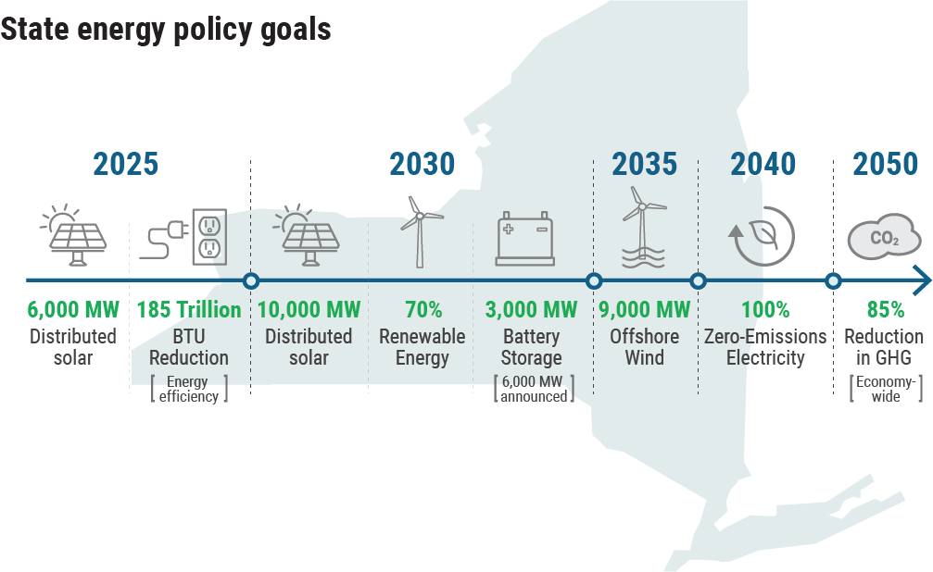
New York State Climate Goals
I
New York State Passed the Climate leadership and Community protection Act (CLCPA) in 2019

Slide 7


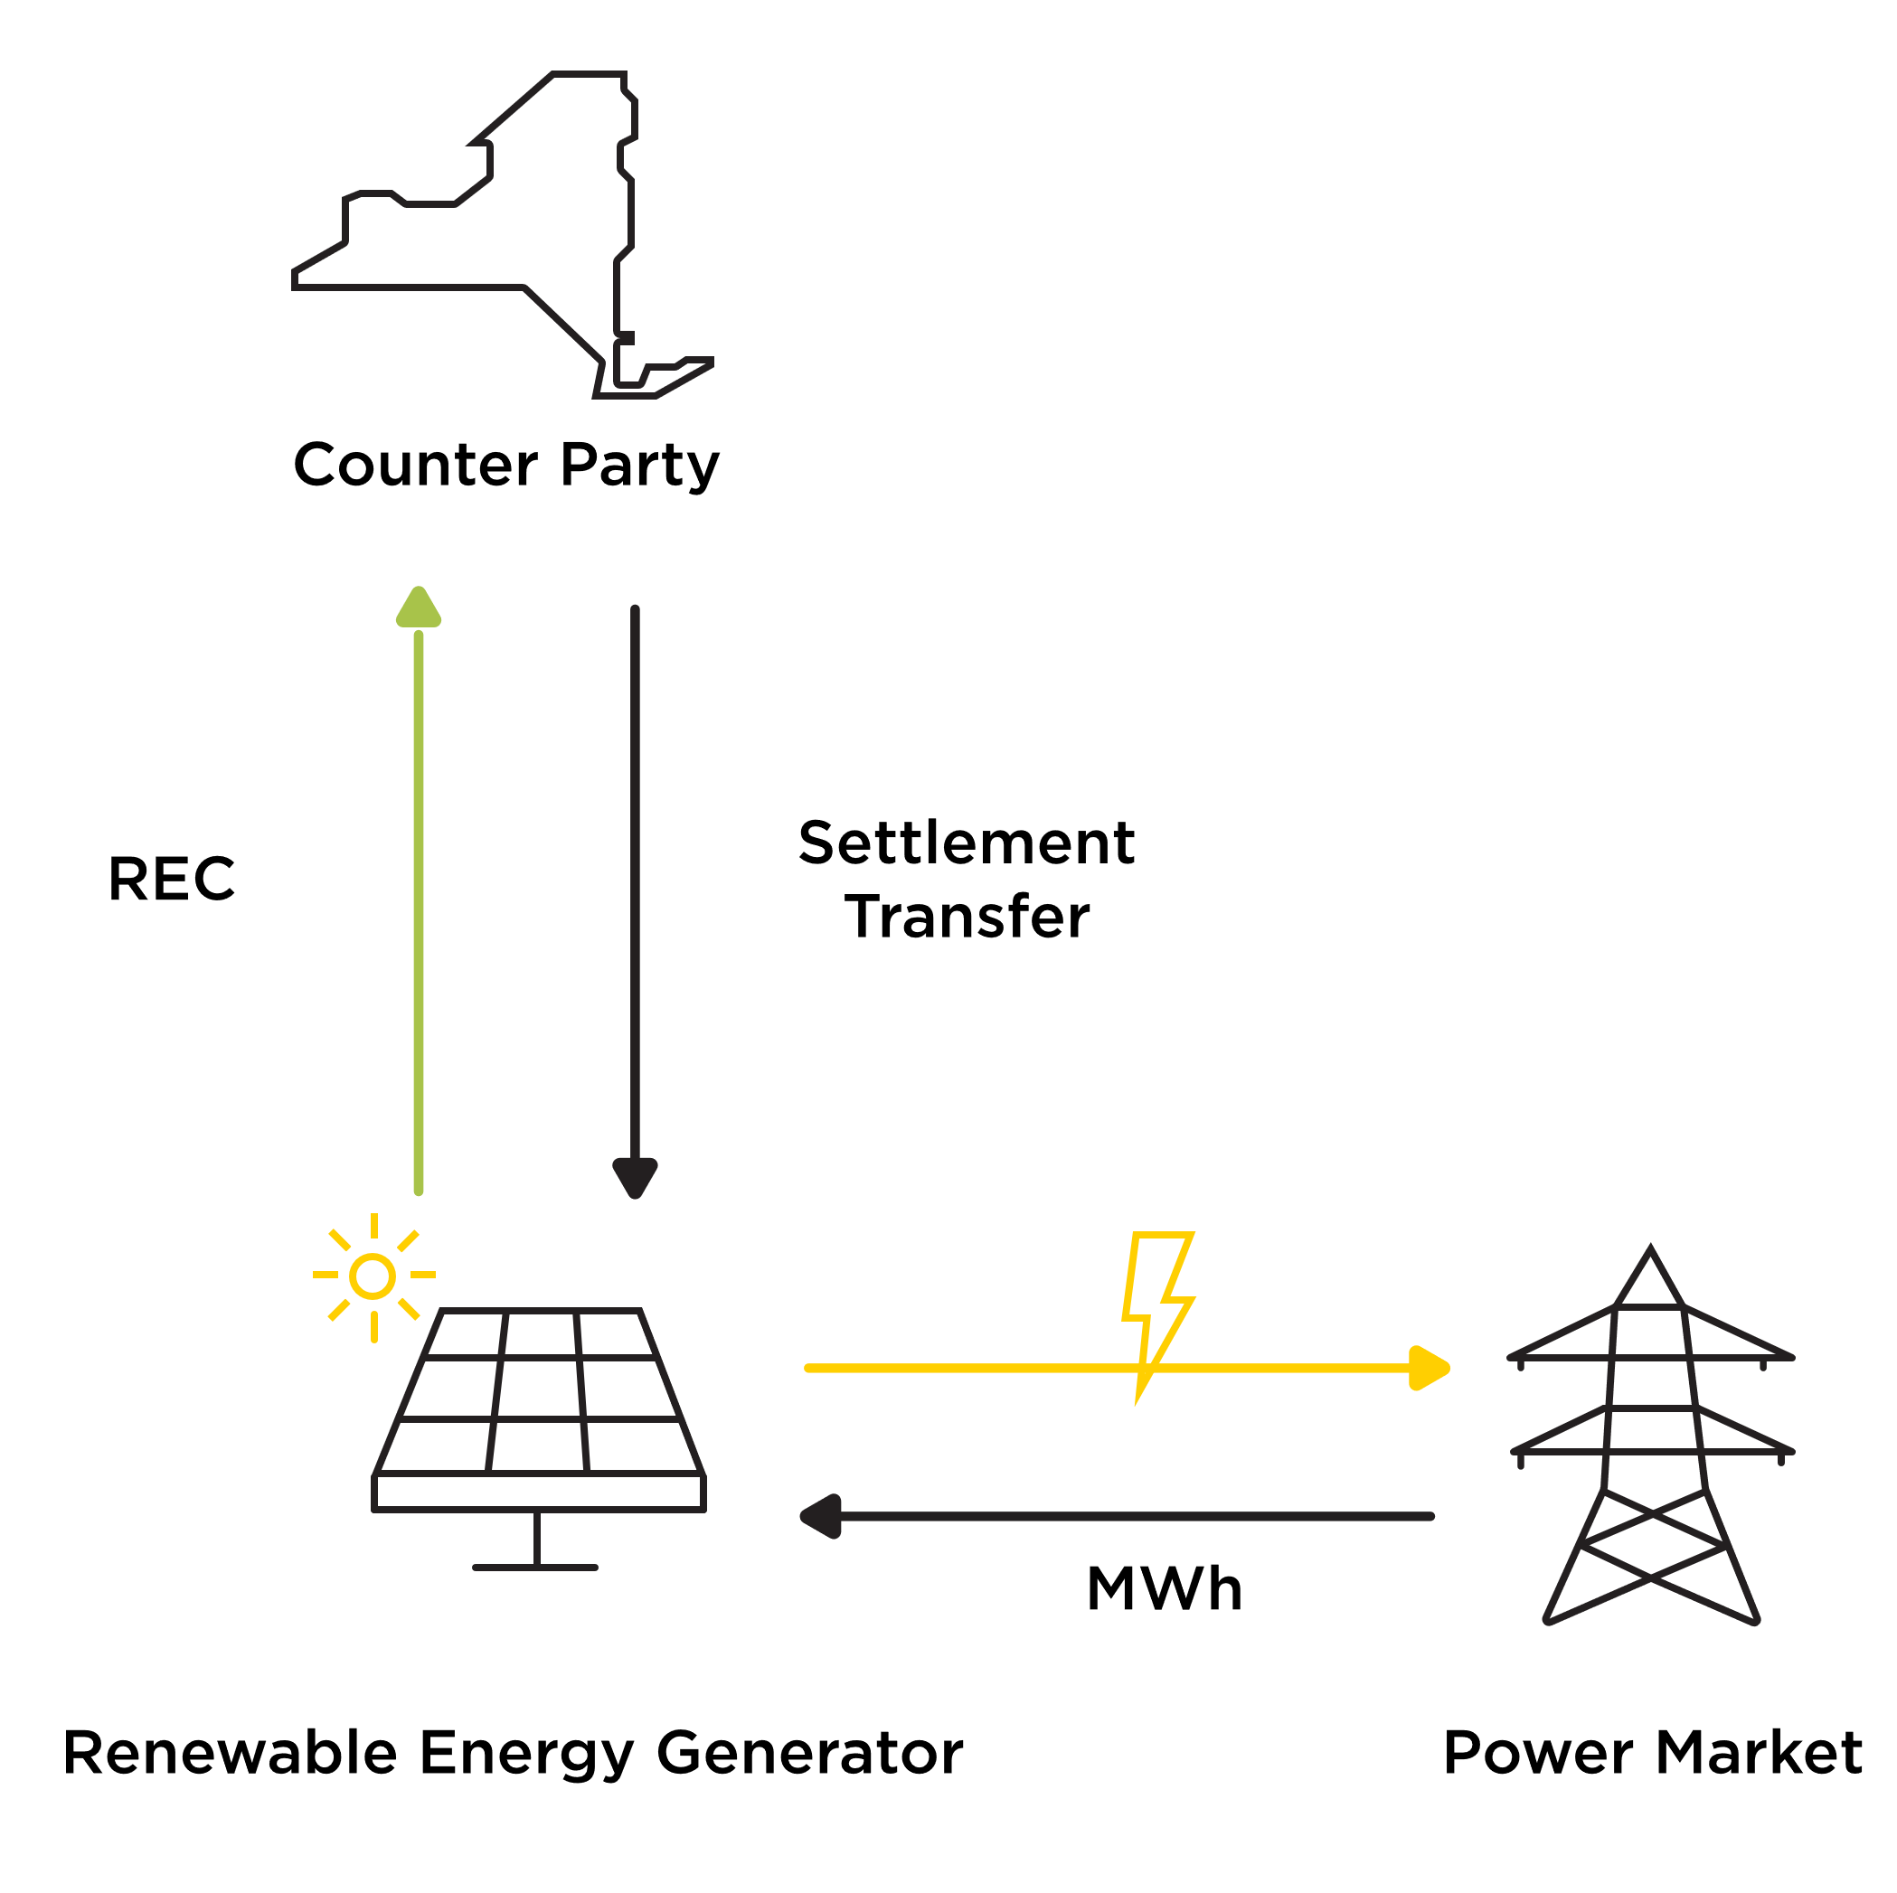

Renewable Energy Certificates (RECs)
What are Indexed RECs?
An Indexed REC price is based on a difference between the market price and an agreed “strike price”. If the “strike price” is higher than the market price, the Counterparty (NYSERDA) pays the renewable generator the difference between the “strike price” and the market price.
If the market price is higher than the agreed to “strike price”, the Counterparty does NOT pay anything.
The state has said indexed RECs: “reduce the risk premiums that developers account for in their bids to accommodate for uncertainty in power market revenues, thereby lowering ratepayer costs.”
What is a REC?
To support renewable development, NYSERDA enters into an agreement to compensate renewable energy owners for a REC. A Tier 1 REC represents the ENERGY PRODUCTION of one megawatt-hour of generated electricity. Each REC is proof that energy has been produced from eligible renewable sources.
When do projects receive state funding?
NYSERDA will purchase RECs from the contracted projects AFTER they have become operational and begin to deliver power. Depending on the type of project, these REC contracts can last up to 20 years. RECs ARE NOT upfront payments. Developers bare ALL THE COSTS of project development.
Why is this needed?
The development and construction of renewable energy projects involves significant capital investment, necessitating LONG-TERM CONTRACTS, in order to finance and construct the projects. A REC contract allows project developers to fund project development and construction costs then recoup their investment over the life of the project.
Notes:
No changes - can reuse from previous set

Slide 8
ORES 94-c Application Process
Once Completeness Determination is received ORES must issue Final Permit decision within One Year
Notice of Intent to File Application
Application Filed
ORES Completeness Determination
Draft Permit Issued
Public Comment Period
Adjudicatory Process
(if necessary)
Final Permit Decision Issued
≥ 60 days
≤ 60 days
≤ 60 days
≥ 60 days
Approx. 130 days
If no substantive or significant issues raised ≥ 60 days
Public Meeting required at least 60 days prior to Application being filed*
If application requires additional information ORES will issue a Notice of Incomplete Application and developer will need to resubmit
This process requires that we engage with local municipalities throughout the development of the project. Significant funding will be made available in the Local Agency Account to assist municipalities and other potential intervenor groups with review of the 94-c application.
Public Comment Period
Public Comment Hearing
Public Comments Due to ORES
Municipal Statement of Compliance Due
* Today’s meeting is voluntary and in advance of the 94-c application process. There will be another meeting held at least 60 days prior to application submission.
Notes:
No changes - Can be reused from earlier set

Slide 9
94-c Application
Extensive desktop assessments and on-site environmental assessments to support the 94-c application are currently underway and will include information for the following required Exhibits:
General Overview, Public Involvement, and Energy Planning Objectives
Facility Location and Local Laws/Ordinances
Geology, Ecology, Water, and Agricultural Resources
Noise, Vibration, and Public Health and Safety
Visual, Cultural, and Socioeconomic Effects
Design, Transportation, Communication, and Electric Systems
Decommissioning and Restoration
Other Permits and Approvals
Exhibit 1 General Overview
Exhibit 3 Location of Facilities
Exhibit 10 Geology, Seismology, and Soils
Exhibit 6 Public Health and Safety
Exhibit 8 Visual Impacts
Exhibit 5 Design Drawings
Exhibit 23 Decommissioning and Restoration
Exhibit 25 Other Permits and Approvals
Exhibit 2 Public Involvement
Exhibit 4 Real Property
Exhibit 11 Terrestrial Ecology
Exhibit 7 Noise and Vibration
Exhibit 9 Cultural Resources
Exhibit 16 Effect on Transportation
Exhibit 17 Consistency with Energy Planning Objectives
Exhibit 24 Local Laws and Ordinances
Exhibit 12 Threatened and Endangered Species
Exhibit 18 Socioeconomic Effects
Exhibit 20 Effect on Communications
Exhibit 13 Water Resources and Aquatic Ecology
Exhibit 19 Environmental Justice
Exhibit 21 Electric System Effects
Exhibit 14 Wetlands
Exhibit 22 Electric Magnetic Fields
Exhibit 15 Agricultural Resources
Once available, all application information can be found on our website: https://www.boralex.com/projects/newport-solar
Notes:
No changes - Can be reused from earlier set

Slide 10
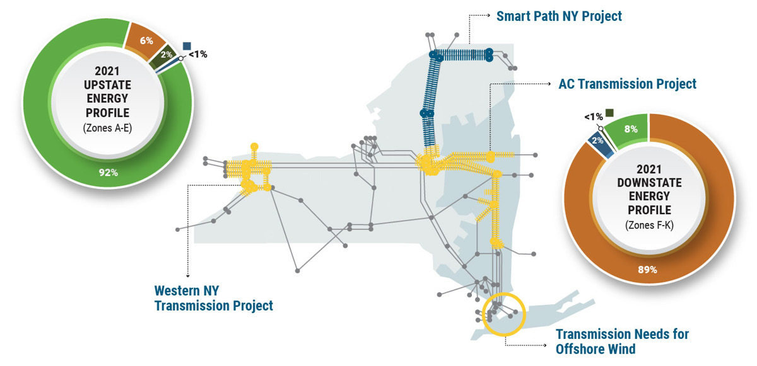
Energy Mix in New York State (as of 2021)

Slide 11
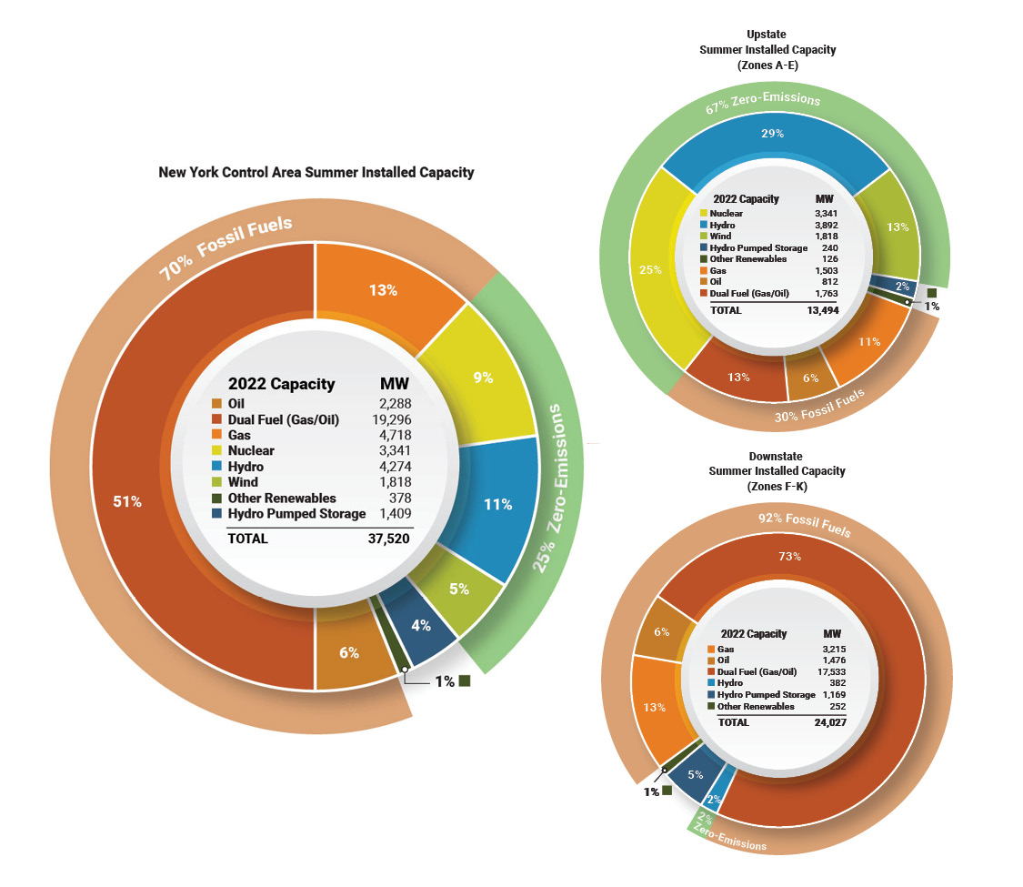
Energy Mix in New York State (as of 2021)

Slide 12
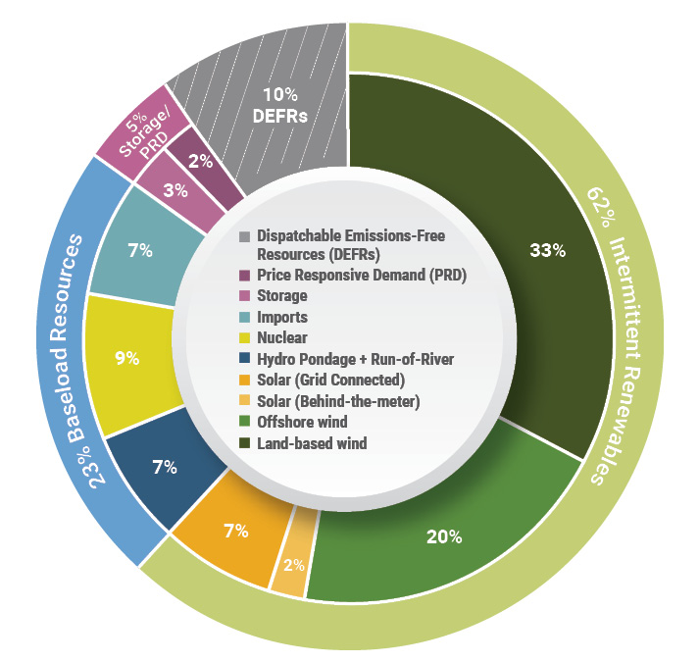
Where we need to go

Slide 13
Newport Solar Anticipated Project Schedule
Q4 2021
Q3 2023
Q1 2025
Environmental Field Studies Commenced
Pre-submission Open House
ORES 94-c Siting Decision
Q3 2020
Project Origination
Q4 2021 – Q3 2023
FIELD STUDIES
Q1 2024 – Q2 2025
ORES PERMITTING REVIEW
Q3 2025 – Q4 2026
CONSTRUCTION/ COMMISSIONING
2021
2022
2023
2024
2025
2026
ONGOING CONSULTATION PROCESS
Q2 May 2021
Q2 June 2022
Q4 2023
Q3 2025
Q4 2026
NYSIO Interconnection Application
NYSERDA Contract Awarded
ORES 94-c Application Submission
Estimated construction start
Commercial Operation Begins
Throughout the development process there will be multiple opportunities to provide your input and feedback on the project. Boralex will hold additional open houses and throughout the process be available for individual meetings or by email and phone. We will continue to seek input from stakeholders to design a project in line with the community's priorities.

Slide 14

