Slide 1
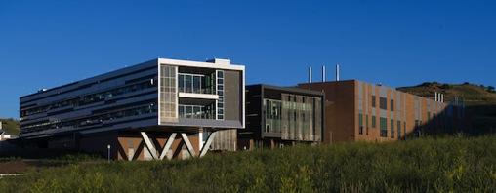
A Layered Solution to Cybersecurity
Dr. Erfan Ibrahim
Cyber-Physical Systems Security & Resilience Center
National Renewable Energy Laboratory
Notes:
Slide deck by Erfan…

Slide 2
Abstract
The Smart Grid is an instance of IoT
“Trust and Security” vital to securing our infrastructure
NREL has demonstrated end-to-end security using off-the-shelf technology
The key: Choosing technology to cover 9 system layers
7 logical layers in the OSI Basic Reference Model
1 semantic layer
1 business layer
Tested on NREL’s Distribution Grid Management testbed
Results: Highly secure, resistant to penetration testing

Slide 3
What technical approach did we take?
Built a testbed in NREL ESIF Smart Power Lab with a routed network emulating a typical utility enterprise site, the ISP, 2 substations and field network
Integrated the DC Systems RT-SCADA, MatLab Grid Simulator and Field Equipment on the routed network using “power hardware in a loop” architecture
Secured access to the enterprise and 2 substation access with firewalls
Segmented the network in each site to separate IT, OT and Management functions with firewall policies and restrictive access control lists on the routers
Provided network, email and file protection against malware proliferation from the Internet or insider threat with in-line blocking appliances for all three targets in the enterprise

Slide 4
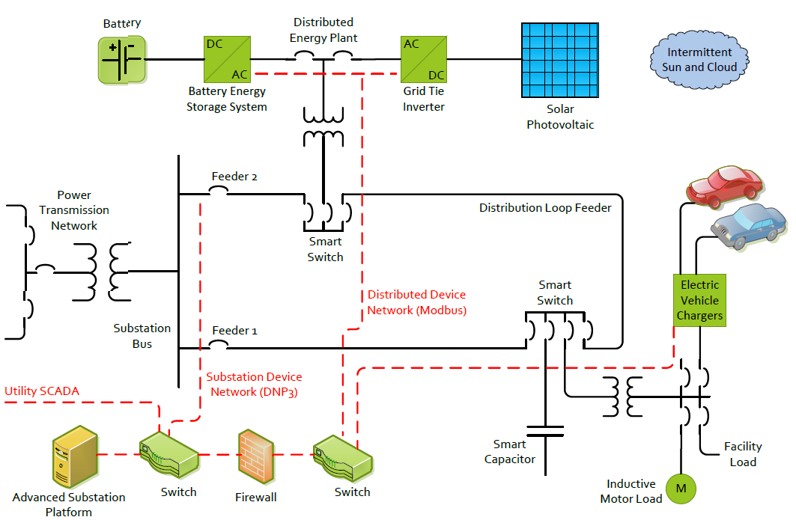
CPSS&R’s DGM Testbed
Internet of Things

Slide 5
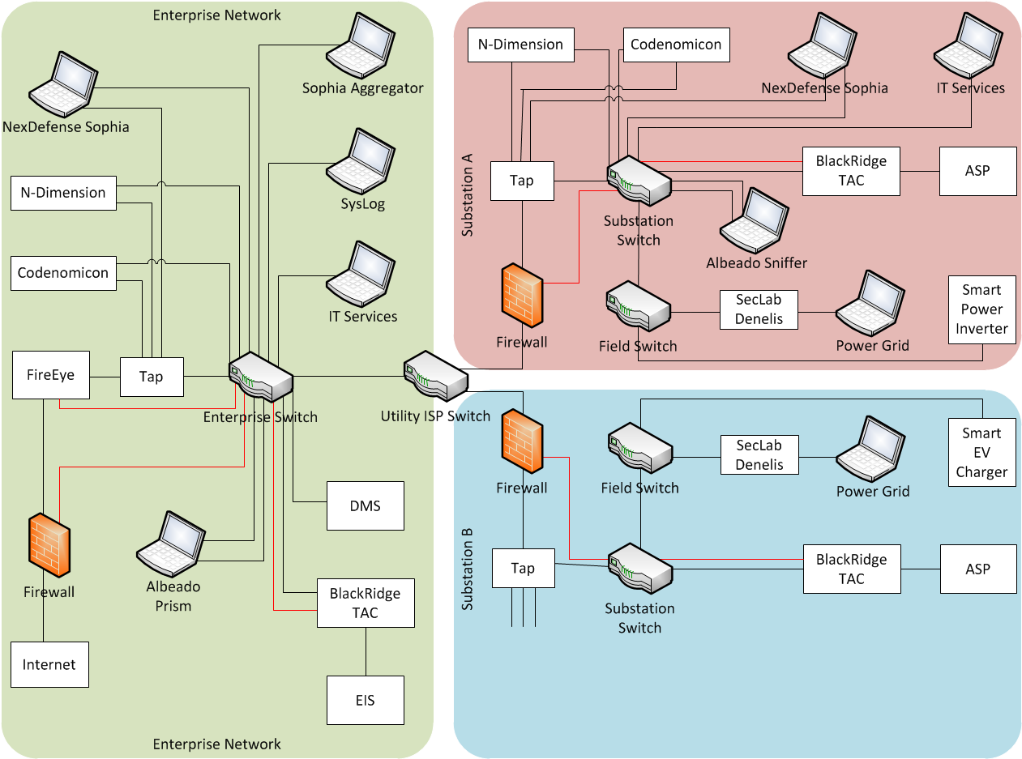
Testbed Security

Slide 6
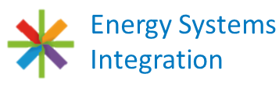
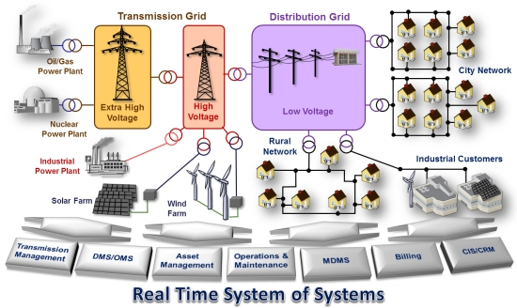
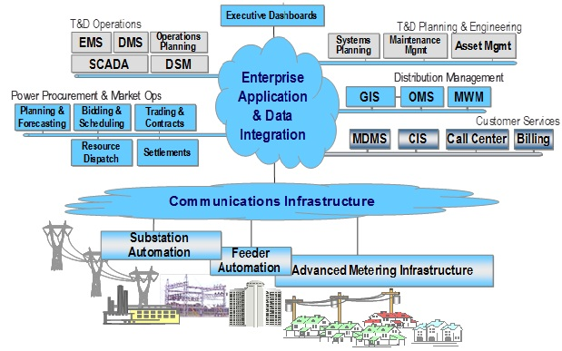
Use Cases
Develop 5 use cases utilizing Distribution Grid Management application:
Auto sectionalizing and Restoration (ASR)
Volt-Var Optimization (VVAR)
Demand Response with EV Charging (DR)
PV Smoothing with Storage
Frequency Regulation with Storage
Build the distribution system test bed with a DMS, enterprise SCADA, substation automation platform, intelligent electronic devices (RTUs, PLCs, and field sensors), electric storage, electric vehicles and simulated grid with capacitor banks and smart switches

Slide 7
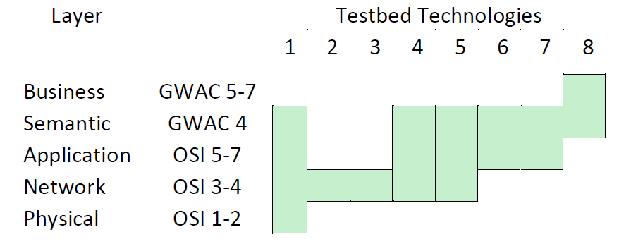
Solution: 9-Layer Security
The secure DGM LDRD provides security at all 9 logical layers of a typical information system (7-layer OSI model + 2 upper layers of Gridwise Architecture Council Stack).
Coverage of the 8 vendor products against the 9 layers is shown schematically below.
Notes:
Today’s modern mission critical business applications are highly networked and vulnerable to threats from multiple sources at various logical layers.

Slide 8
Cyber-Physical Systems Security & Resilience Center Key R&D Thrust
Problem Definition
Multiple cybersecurity technologies protecting energy systems today
No standard alarming capability (vendor specific alarms)
Poor situational awareness in the event of a coordinated cyber-attack (siloed data with no correlation capability)
CPSS&R R&D Thrust
Develop cybersecurity alarm and performance data integration from multiple vendor technologies
Link integrated alarm data with system configuration data
Perform root cause analysis and develop mitigations for risks in real time
Implement risk mitigations for enhanced security and resilience

Slide 9
Project Conclusions
Security of power systems is a layered problem with each layer requiring protection (entire GWAC Stack)
The technology challenge of securing DGM has been largely solved with off the shelf products today (research is needed in developing integration best practices rather than building new cybersecurity technologies from basic research)
The more important matter is sound network design, proper technology integration, strict security policies on routers and firewalls, well defined security patch management processes in the organization and regular employee training on security awareness and defeating social engineering schemes for data exfiltration and insider threat

Slide 10
Project Conclusions (Contd.)
There is no need to force power systems protocol standards to have all the security controls to protect DGM – systemic level security with third party technologies does a better job of protecting critical infrastructure assets than protocol standards security controls
Situational awareness is more robust with multiple viewing perspectives (minimize false positives from monitoring by a single technology)
Situational awareness requires security monitoring by third party technologies (not effective within a standard protocol standard security specification)

Slide 11
Recommendations
Apply project results to secure NREL Energy Systems Integration Facility research data assets, corporate network infrastructure and power systems SCADA
Work with DoE, DoD, NIST, etc. to expand the adoption of “lessons learned” from project to develop new “best practices” to secure data assets, corporate network infrastructure and power systems SCADA across US Federal Government facilities
Work with utilities, independent power producers, national labs, academia, state and federal agencies, vendors and integrators to establish a new set of empirically based R&D projects (along the lines of this project) to secure critical infrastructure in electric, water, waste water and oil & gas sectors with a combination of public and private sector funding at the national level

