Slide 1
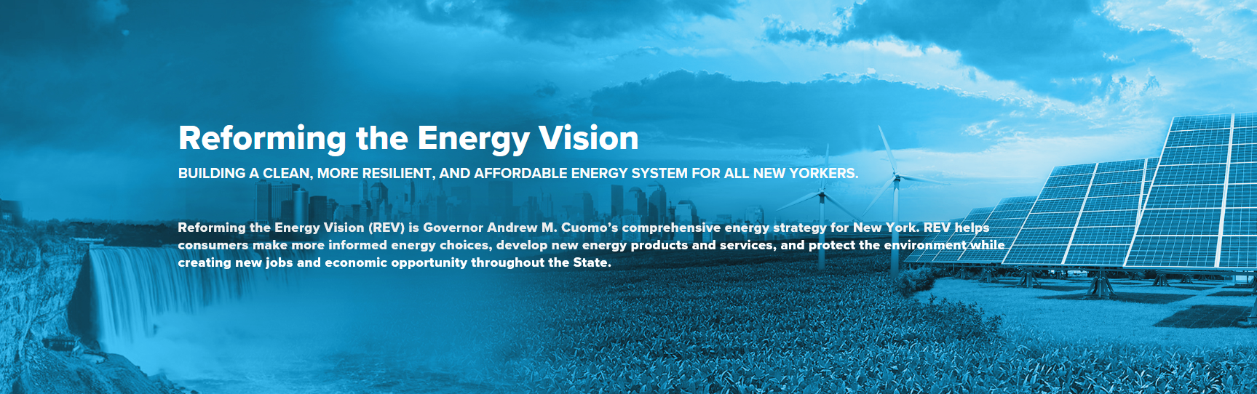
Sustainability/Energy/Global Warming
https://rev.ny.gov/

Slide 2
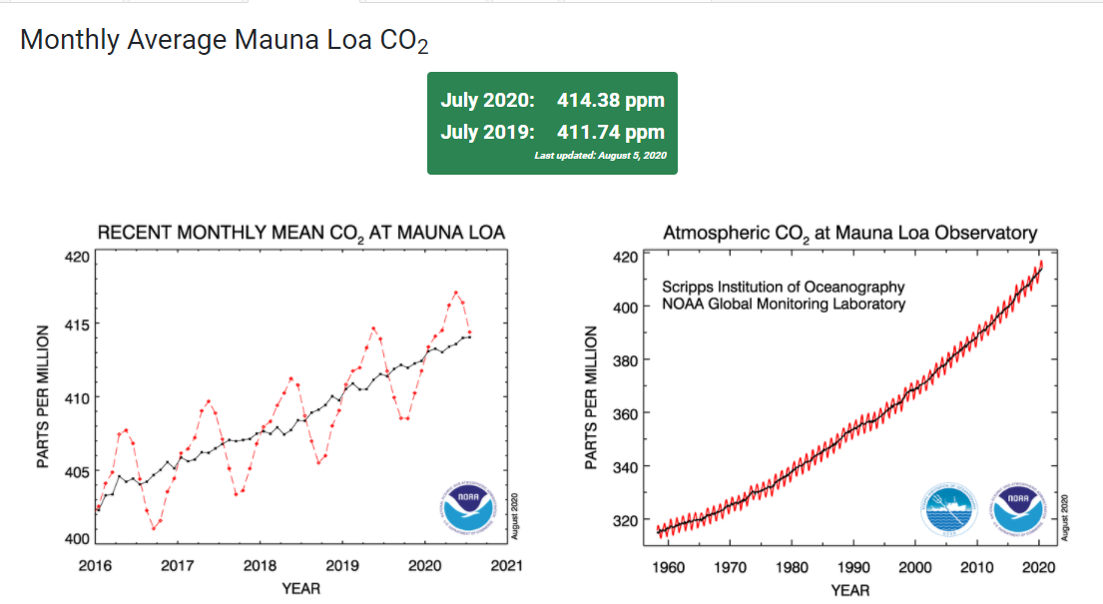

Slide 3
Global Warming-CO2 History
https://www.esrl.noaa.gov/gmd/ccgg/trends/history.html

