Slide 1
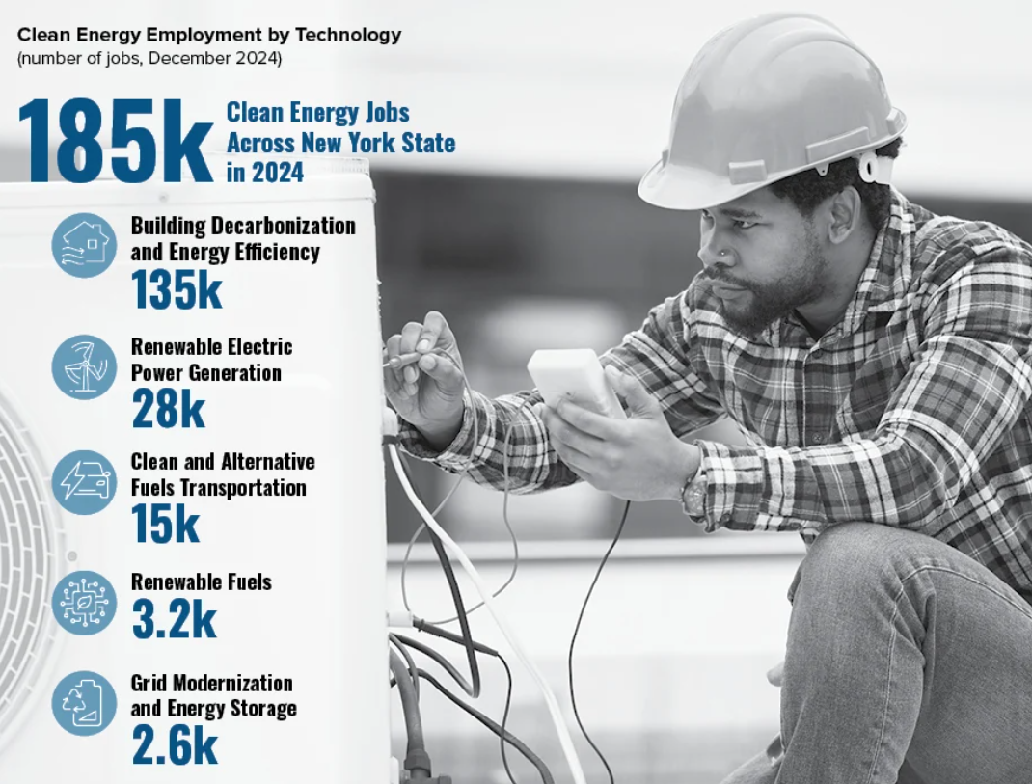
CTC/ETC/MTC 215 Sustainable Energy Systems
https://www.nyserda.ny.gov/About/Publications/New-York-Clean-Energy-Industry-Report

Slide 2
Objectives
Class Requirements
Energy Overview (US/NY)

Slide 3
Class Requirements
On-Web: http://people.sunypoly.edu/~barans/
Schedule
Lectures/Assignments
Grades
Brightspace:
Syllabus
Many powerpoints (from book author)
Electronic dropoff
Multiple Choice Quizzes

Slide 4
United States Energy Use

Slide 5
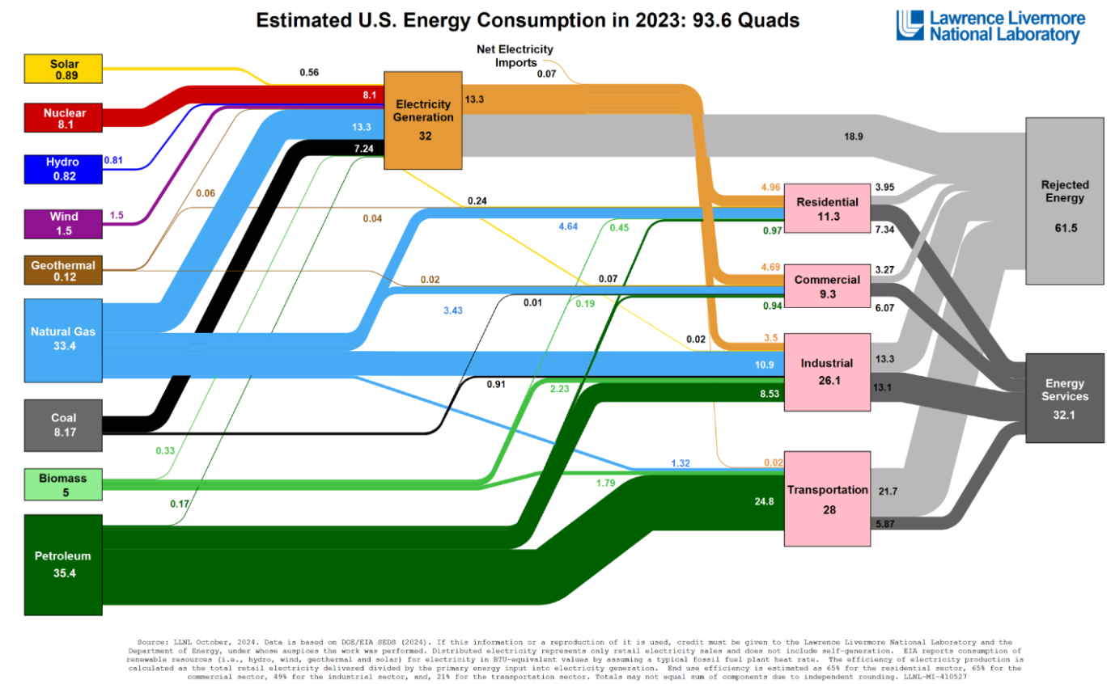

Slide 6
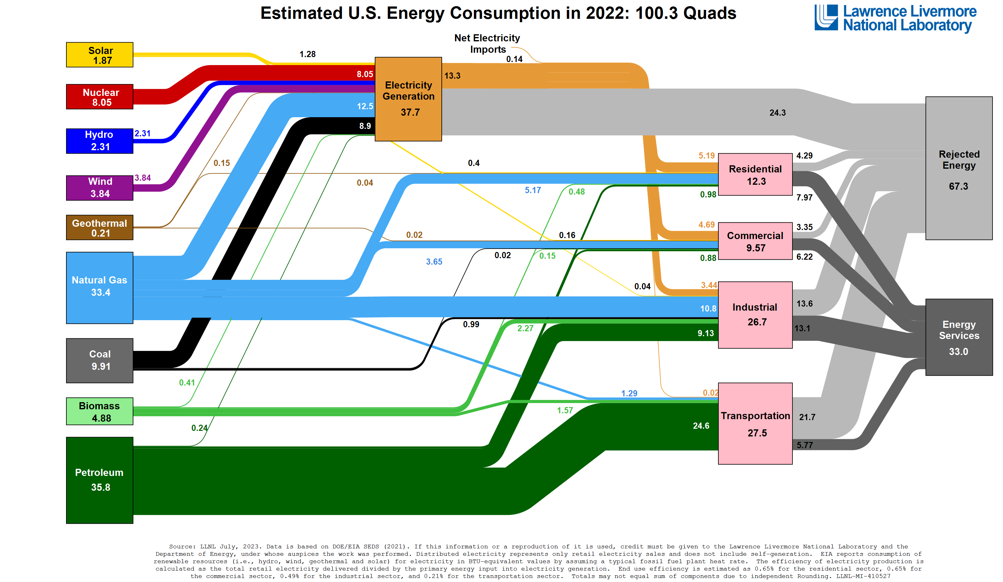

Slide 7
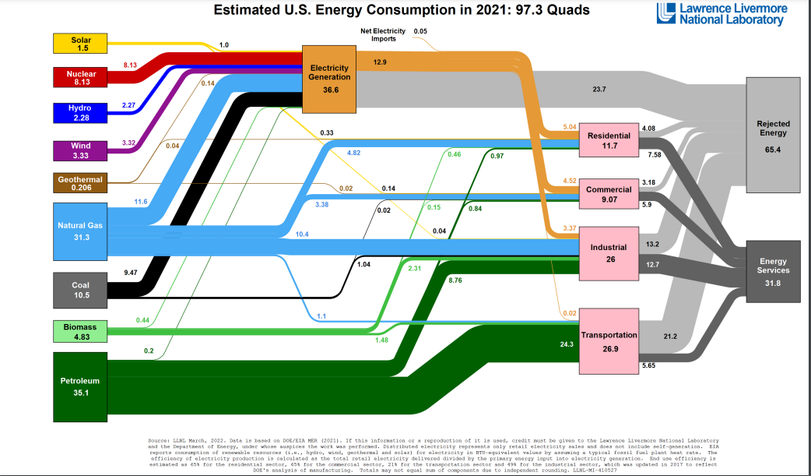

Slide 8
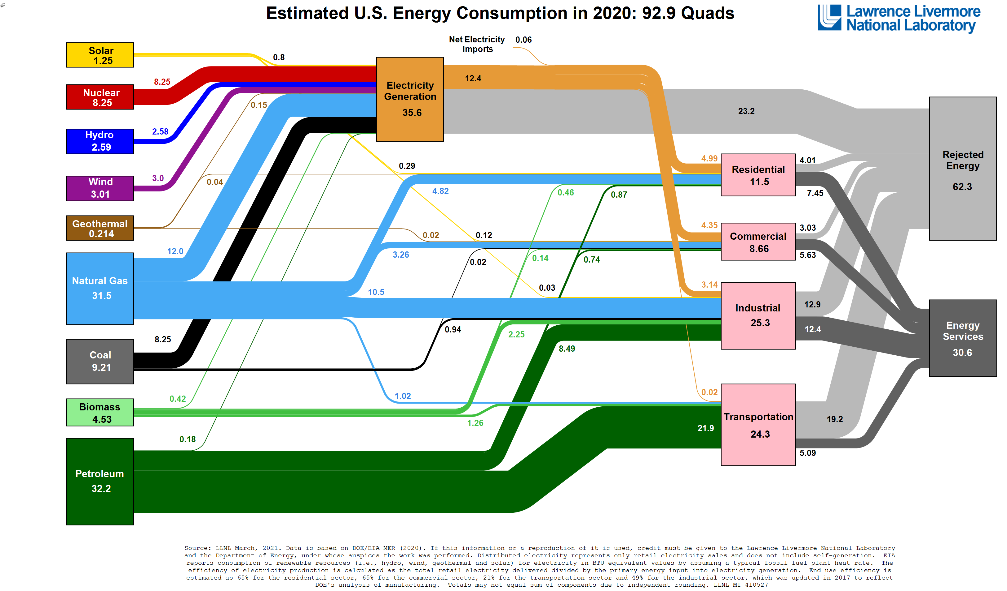

Slide 9
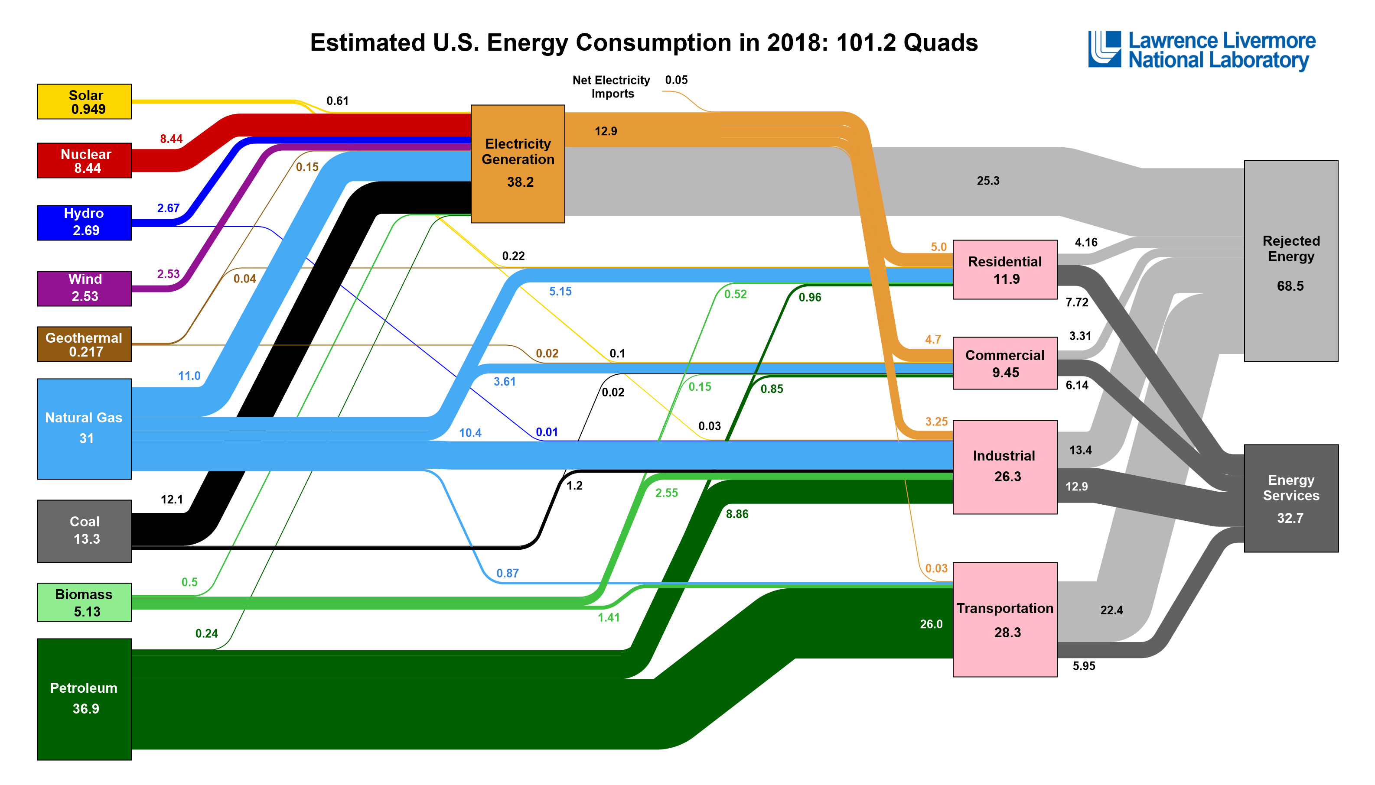

Slide 10
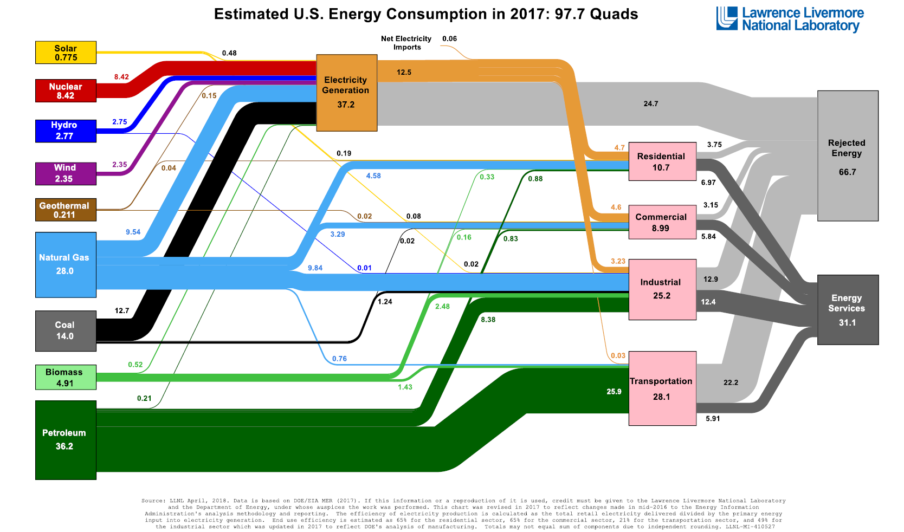

Slide 11
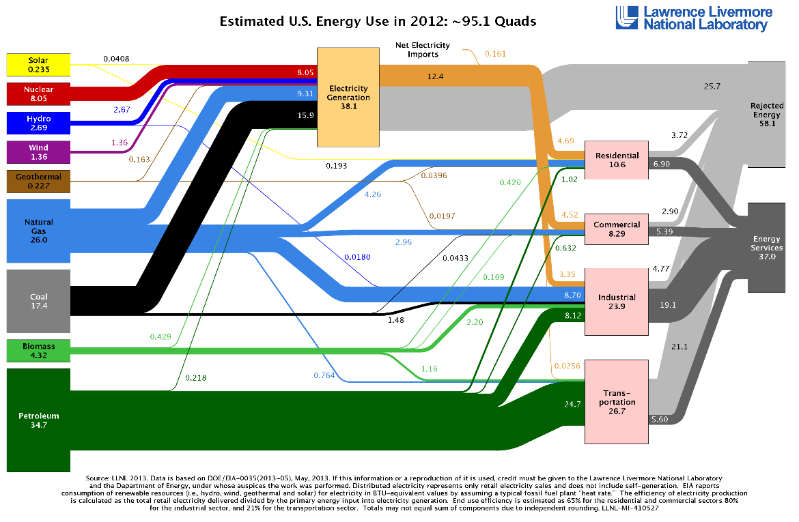

Slide 12
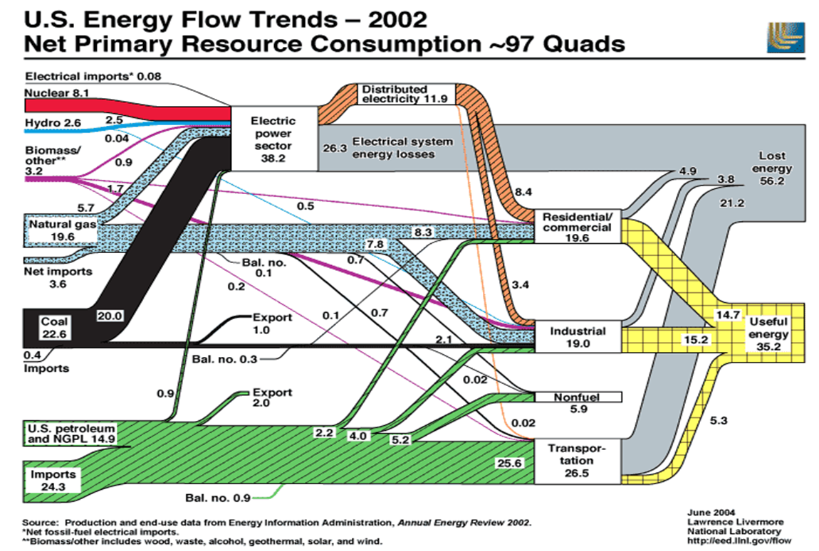

Slide 13




Slide 14
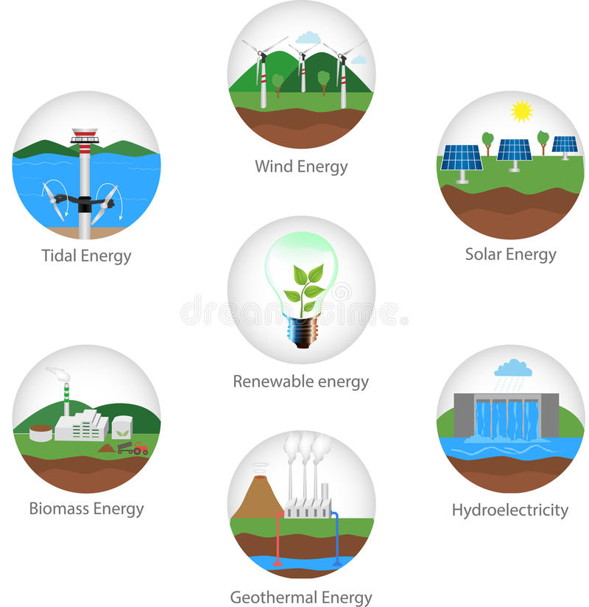
The Big Picture (US/NY)

Slide 15
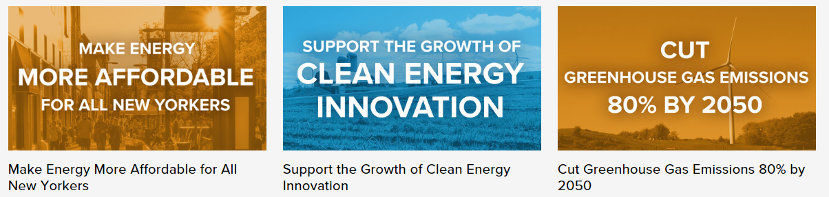

Reforming the Energy Vision (NYREV)-Goals

Slide 16
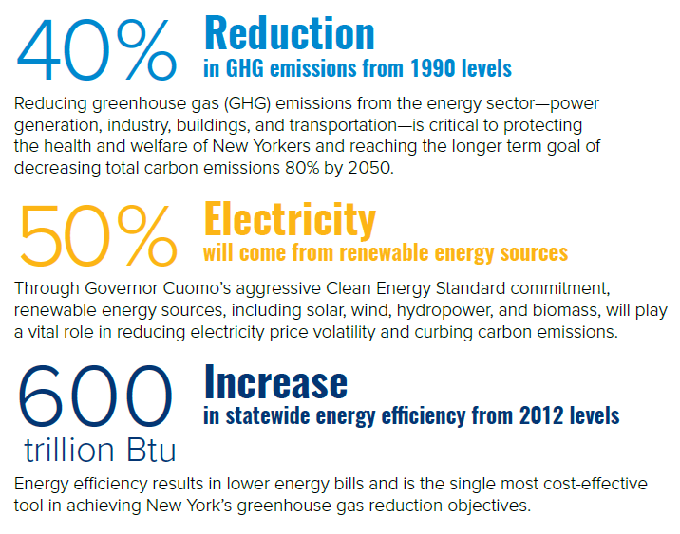

Slide 17
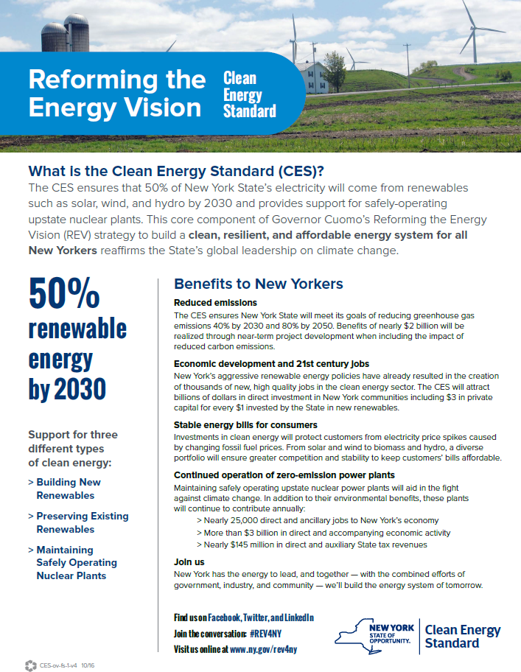

Slide 18
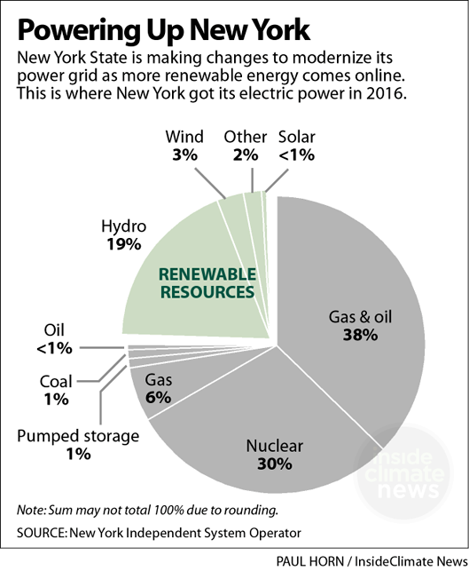

Slide 19
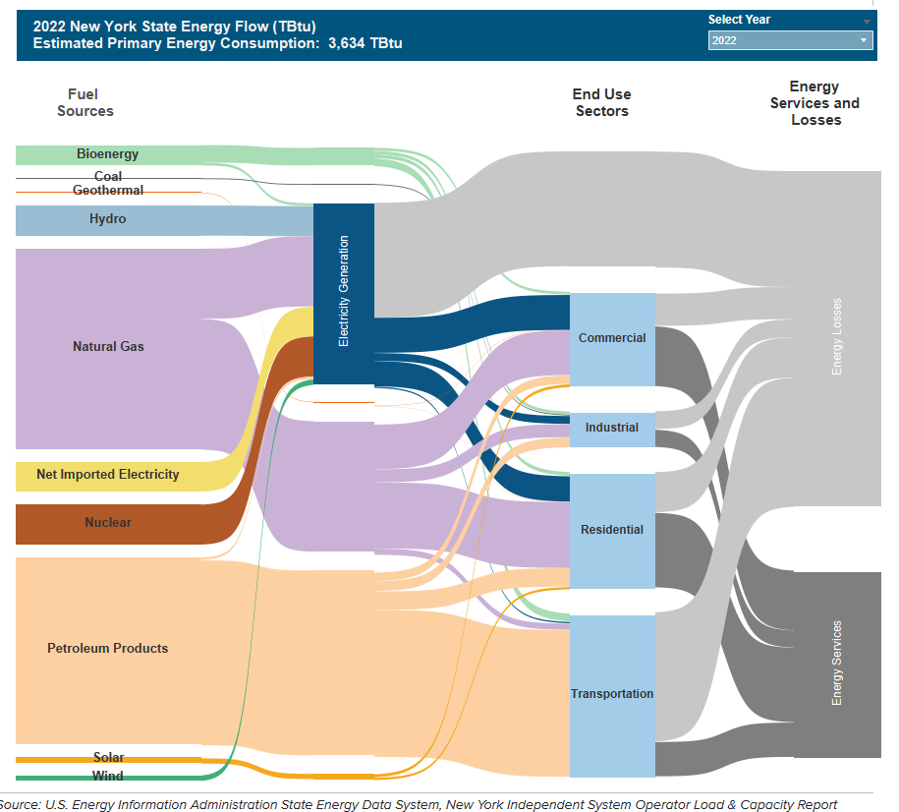
NY Energy – Patterns and Trends NYSERDAhttps://www.nyserda.ny.gov/About/Publications/Energy-Analysis-Reports-and-Studies/Patterns-and-Trends

Slide 20

Energy (same units as work)
https://en.wikipedia.org/wiki/Power_(physics)#Units
Joule (N-m) (Remember F=ma)
BTU (1055 J)
Gasoline gallon (120 million J)
KWh (3.6 million J)
Therms (105,500 Joules)

Slide 21
Power (energy/time)
https://en.wikipedia.org/wiki/Power_(physics)#Units
Watt (joule/sec)
Horsepower (746 Watts)

Slide 22
Nameplate capacity-intended full-load sustained output of a facility such as a power plant, wind turbine or solar array
Capacity factor-unitless ratio of an actual electrical energy output over a given period of time to the maximum possible electrical energy output over that period
Nuclear plant (0.9)
Wind (0.3)
Hydro (0.25-.45)
Solar (0.1-.25)
See https://en.wikipedia.org/wiki/Capacity_factor

Slide 23
Symposium on Energy in the 21st Century
https://energy21symposium.org/
April 17, 2026
Boralex Presentation

