Slide 1
Community-Scale Clean Efficient Energy Systems
By
Dr. Sy Oliker, P.E.
Principal
Joseph Technology Corporation

Slide 2
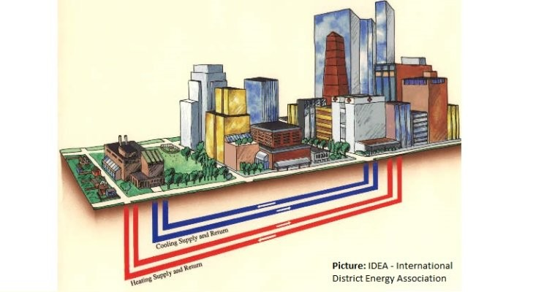
Diagram of Community-Scale Energy System

Slide 3
Why Community Energy System?
Community growing economic, social, and environmental challenges
Growing threat of climate change is focusing attention onto local energy opportunities.
Energy can be a significant driver for:
economic sustainability for communities
growth and development of business
health and welfare of residents

Slide 4
Why Community Energy System?
Available energy incentives and environmental policies(PSC’s January 16,2020 for heat pumps and energy efficiency) have opened up opportunities for:
reducing energy cost
contributing a part of local energy revenues into municipal budget
economic development and job creation
Municipalities and businesses are actively considering becoming energy producers
Cities and communities that take steps to improve their energy security and resilience are more attractive to businesses

Slide 5
Why Community Energy System?
CES’s is the:
most efficient means to combine various energy generating technologies with maximum energy utilization.
proven means of meeting energy demand for various customers
well established in a number of U.S. cities and is widespread across Europe and Asia.

Slide 6
CES’s provide reliable, efficient, affordable, and clean energy from highly efficient local generating plants
CES’s have the flexibility to utilize and integrate multiple fuel sources and to harness waste heat from commercial and industrial facilities as well as local renewable resources such as geothermal, solar, wind and biomass
Many above technologies cannot be used for individual buildings.

Slide 7
The key tool to addressing the above listed concerns is the Community Energy System (CES)
CES’s, sometimes called microgrids or district energy systems provide a wide range of benefits for communities. The CES’s offer: reduction of cost of energy; more efficient use of resources; community-based economic engine; safe, secure, and reliable energy; affordable, high-quality energy services; attractive local environments; livable city.

Slide 8
CES LOOP
CES Loop combines energy demands of many buildings to achieve the economies of scale that are necessary to make these technologies practicable

Slide 9
MULTIPLIER EFFECT
Cash that would otherwise leave the area to pay for outside energy supplies is kept within the local economy to be spent on local goods and services. This strengthens the local tax base, enabling the municipality to provide high-quality services to residents and businesses.

Slide 10
Are the CES’s Used in the US Today?
Some of the CES’s are located in:
Jamestown,NY
Buffalo,NY
Schenectady,NY
St.Paul,MN
Trenton,NJ
Harvard,CT
Indianapolis,IN

Slide 11
The major priorities during the CES planning and development are:
Provide affordable energy cost to community, create clean energy jobs, urban renewal and sustainable development;
Address the negative environmental impacts that energy sources have on downtown community.
Integrate existing support programs and services
Engage resources in order to expand employment of distributed energy resources(DER) to multifamily affordable housing projects
Provide continued support for energy efficiency services through the Clean Energy Fund, and Promote building energy efficiency

Slide 12
Community Engagement Assess the Community Energy Resources Provide estimates of potential energy savings to residents and environmental benefits The messengers include the City Mayor, Economic Development Agencies, Environmental Organizations and Experienced Consulting Engineer Resources. The City of Utica is already involved in the NYSERDA Clean Heating and Cooling Community Project

Slide 14
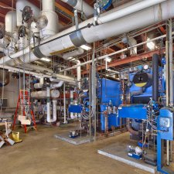
Proctor CES at Schenectady

Slide 15
District Heating Piping Installation at JFK Airport

Slide 16
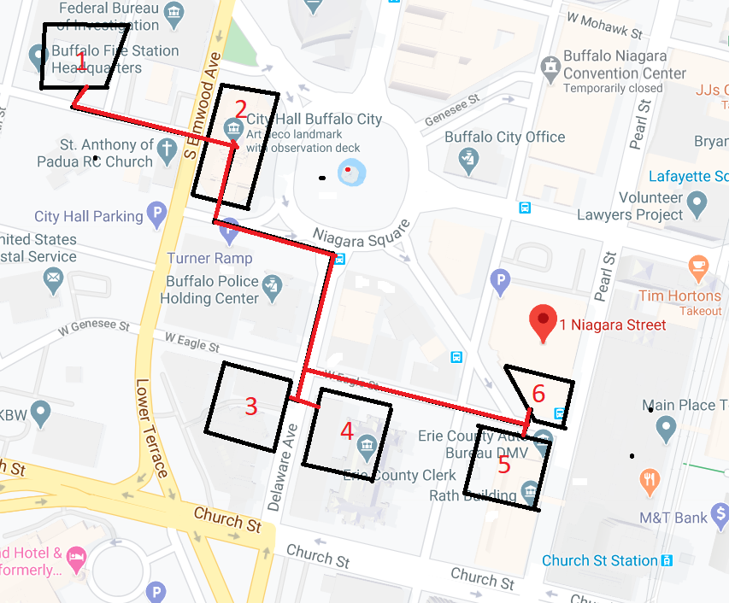
Buffalo District Heating System

Slide 17
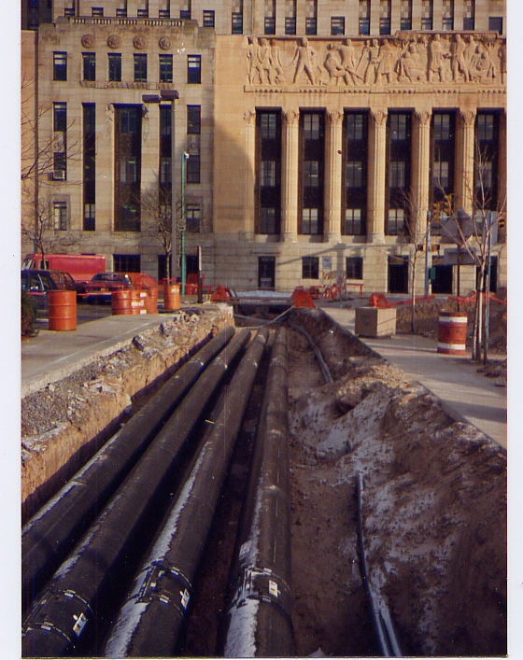
City of Buffalo District Heating Piping

Slide 18
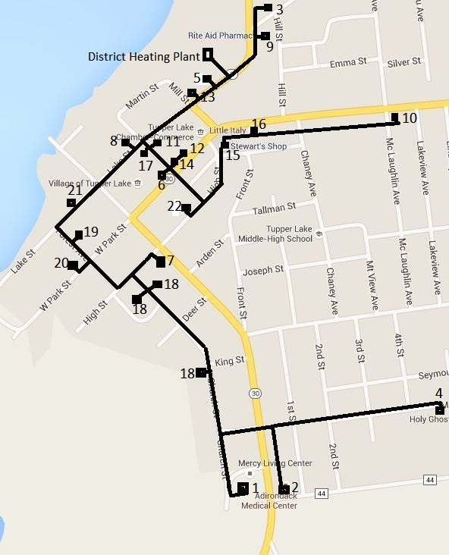
Tupper Lake Biomass Pellet District Heating System

Slide 19
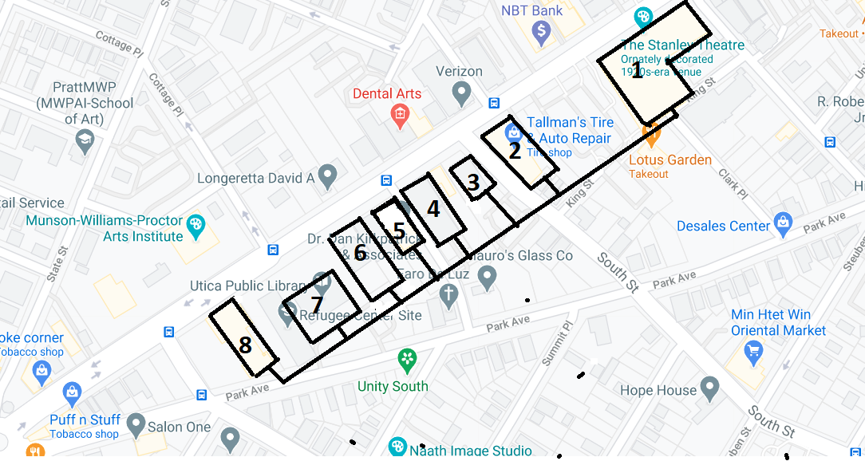
Beginning of Utica Geothermal District Energy System
1-Stanley Theatre; 2-Tallman Building; 3-Hage Building; 4-Teachers Ass.; 5-Dakin Building; 6-M. Fitzgerald Building; 7-Utica Public Library; 8-St.Francis De Sales School

Slide 20
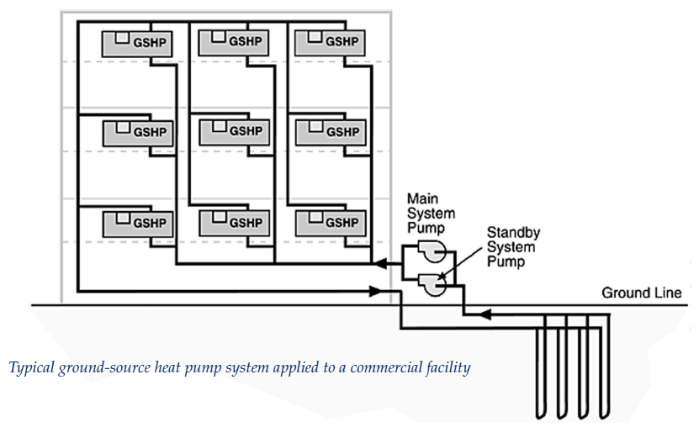
Ground Source Heat Pump System

Slide 21
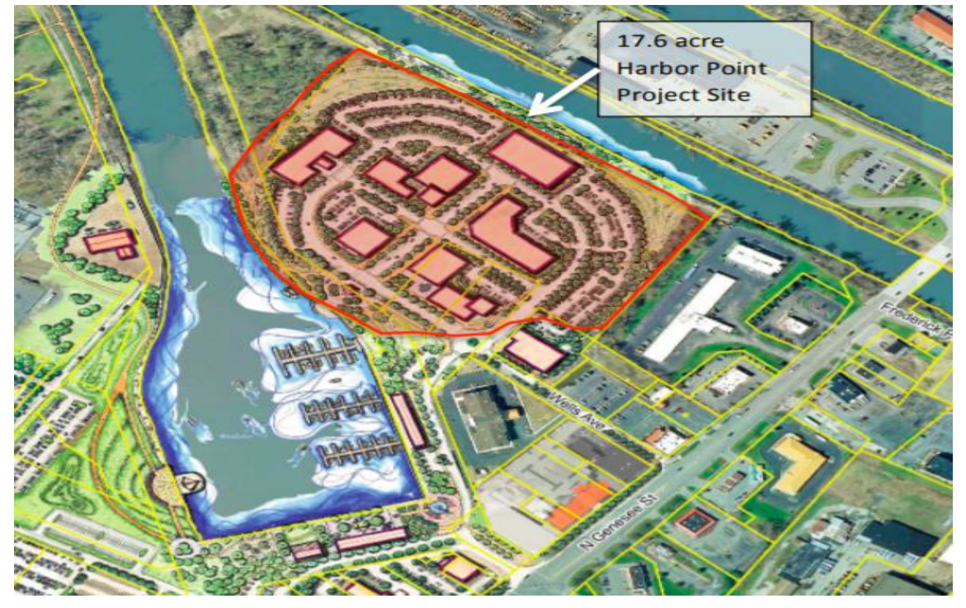
Utica Harbor Point Development Project

Slide 22
Associated Publications:
Oliker, I. How Modern Hot Water Systems Can Lower Campus Energy Use, HPAC Engineering, August 2019.
Oliker, I. Green District Energy Systems with Large Heat Pumps, ENINEERING SYSTEM MAGAZINE, August 2020.
Oliker, I., Morris, P., Tortorici, R., and Jerabek, E. Development and Operation of a District Energy System in Schenectady, NY, ENGINEERING SYSTEM MAGAZINE, February 2021.
Oliker, I and Spaeth, J. City of Utica Community Microgrid System, DISTRIBUTED ENERGY MAGAZINE, January 17, 2019.
Oliker, I. Case Study: District Heating Supply from a Combined Heat and Power Plant. CONSULTING/SPECIFYING MAGAZINE, February 2021.

Slide 23
Prepared by:
Dr. Ishai Oliker, P.E. - Principal of Joseph Technology Corporation, Directs development of community renewable energy systems. jtcincorp@optonline.net; Web: Oliker.net Phone: 201-573-0529
In Cooperation with S. Jayne Baran, P.E. Associate Professor, Chair, Department of Engineering Technology, College of Engineering, State University of New York Polytechnic Institute at Utica, NY Jayne.Baran@sunyit.edu Phone: 315-792-7542
In Cooperation with Jack Spaeth, Executive Director of Economic and Industrial Development of City of Utica, NY jspaeth@cityofutica.com
Phone: 315-534-4997

