Slide 1
Solar Farm 2.7 MW DC
Baldwinsville

Slide 2
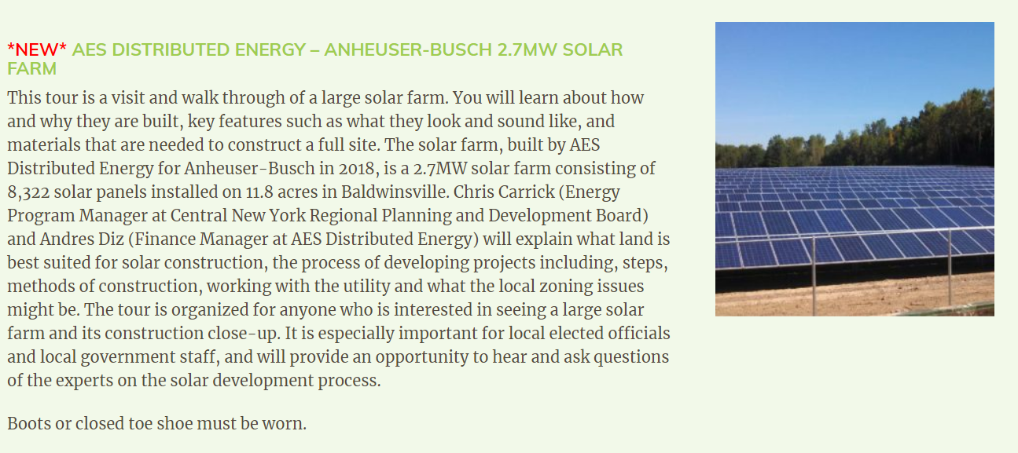
Visit April 12, 2019

Slide 3
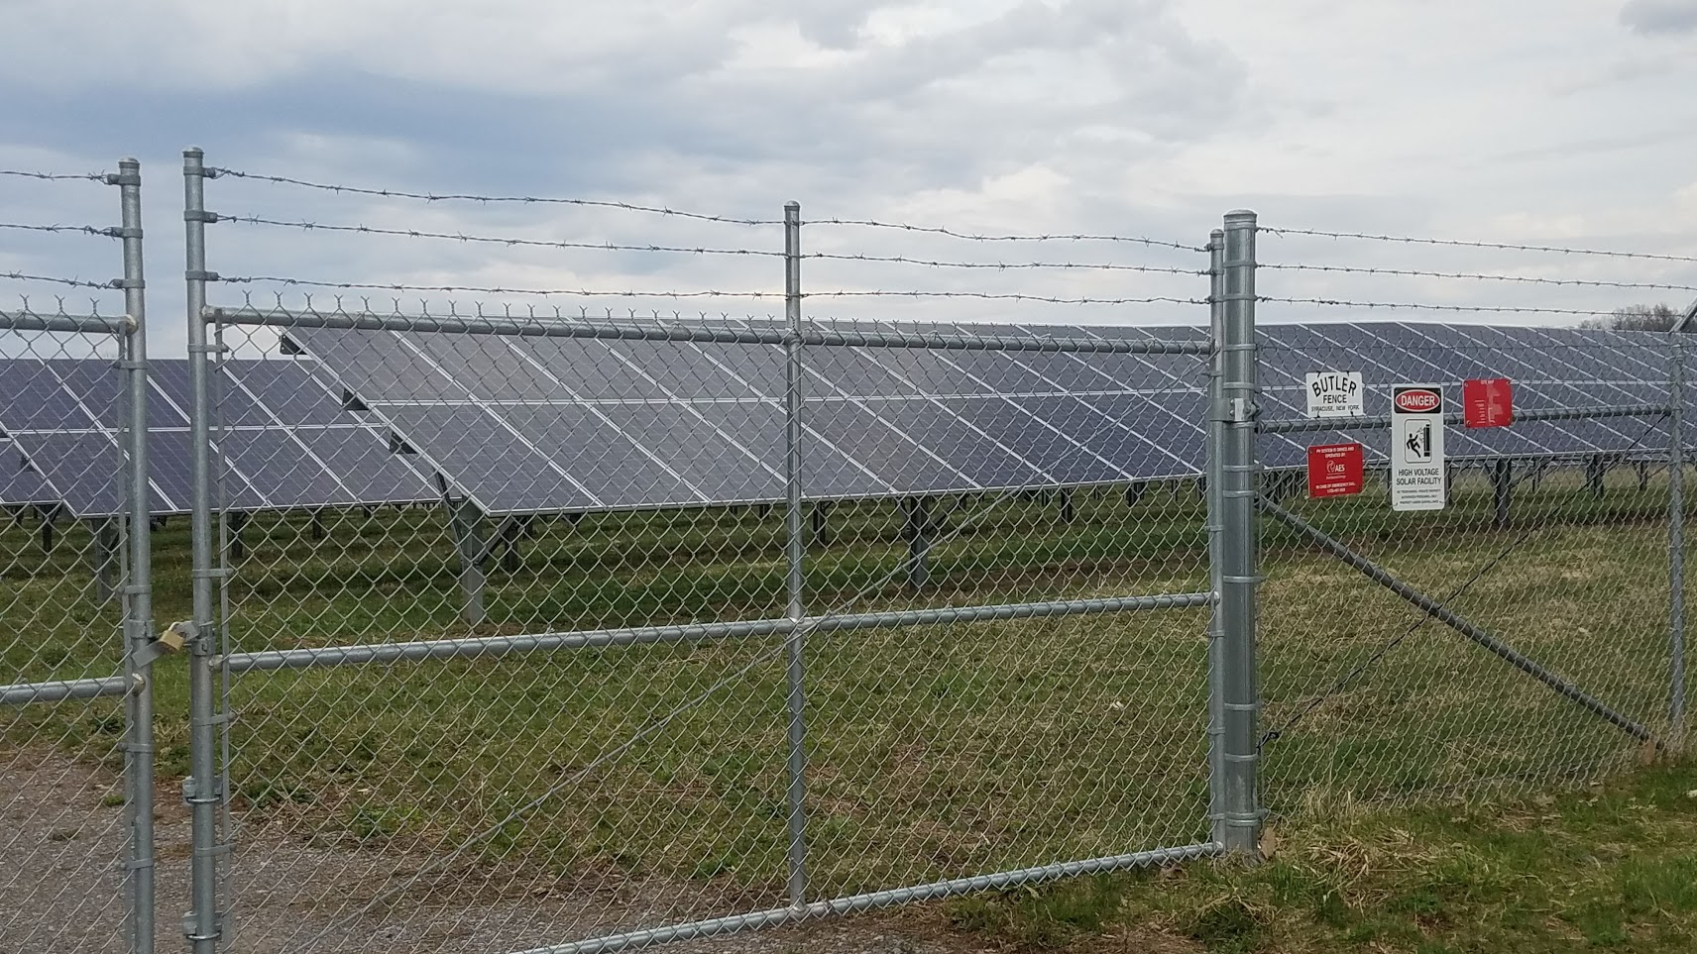
Site

Slide 4
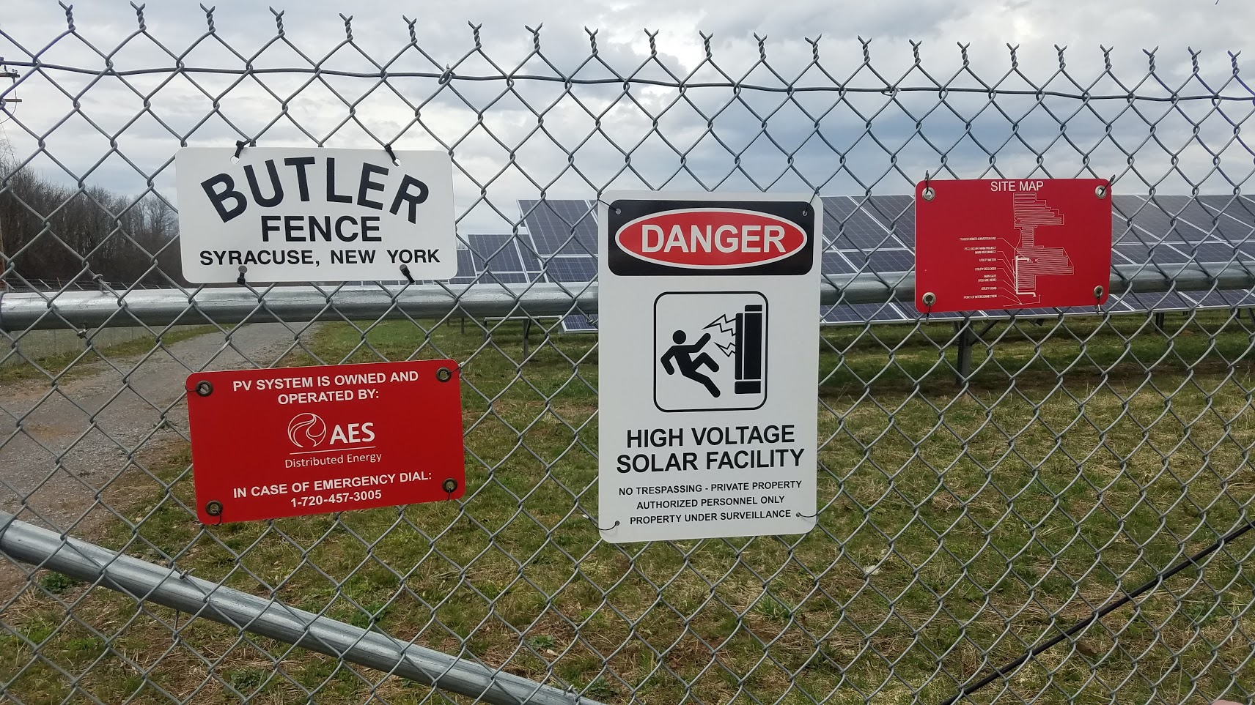
Notification

Slide 5
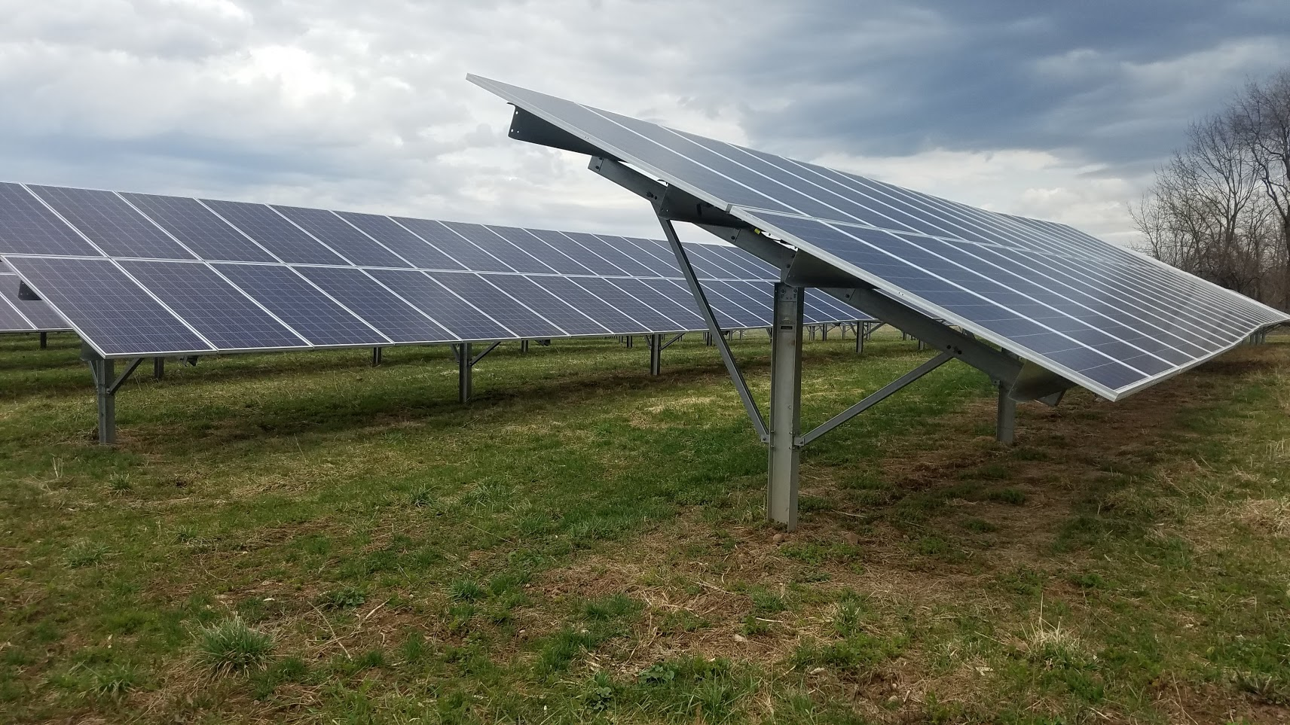
Tilt angle?

Slide 6
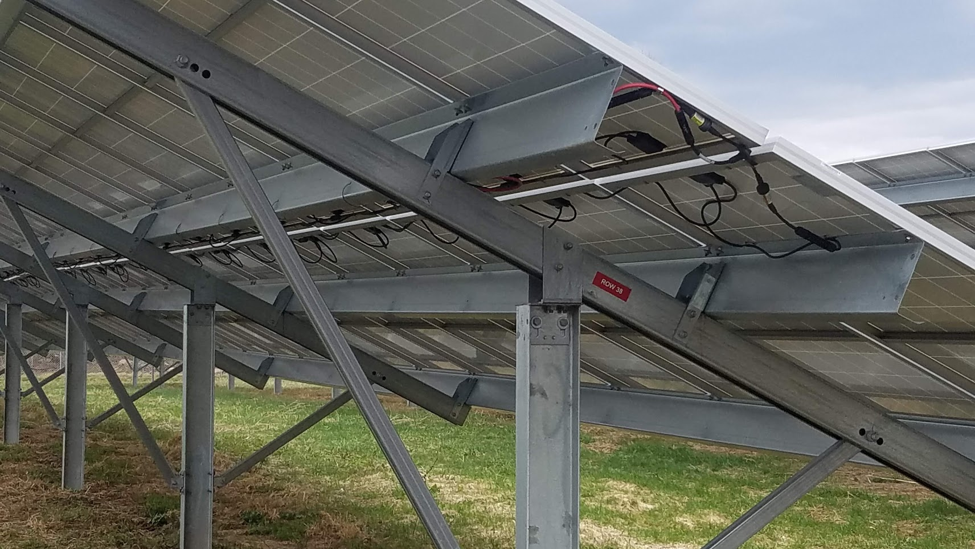
Numbered Rows

Slide 7
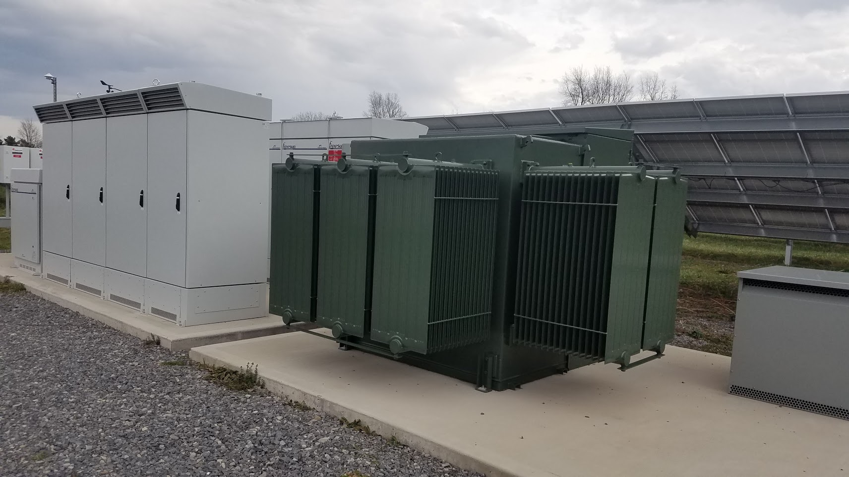
Transformer

Slide 8
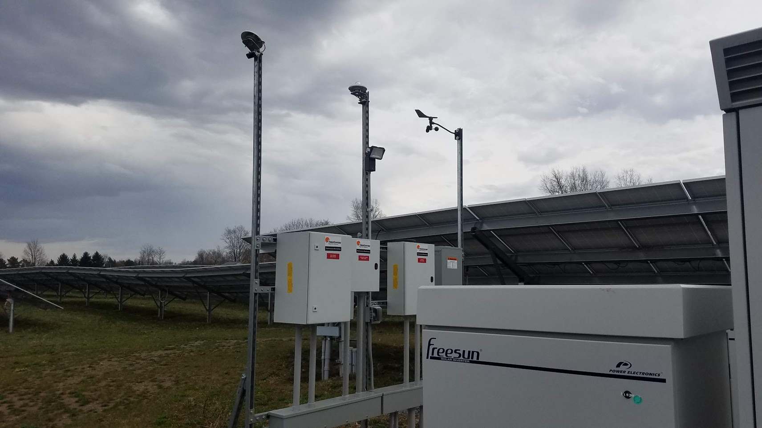
Sensors (Insolation-2/Wind Direction/Speed)

Slide 9
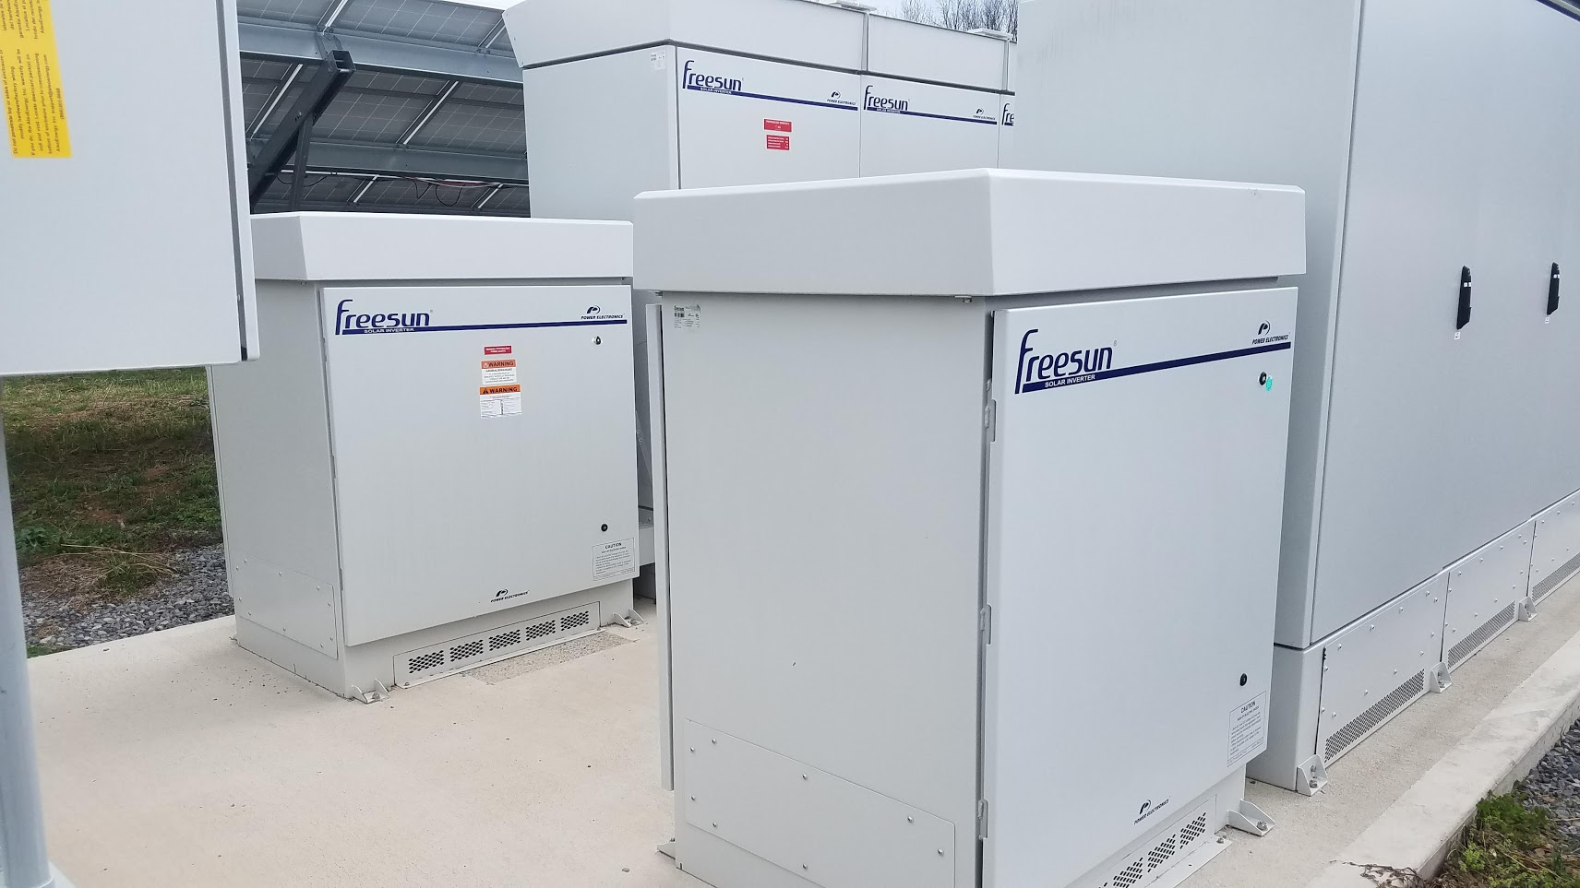
Inverters

Slide 10
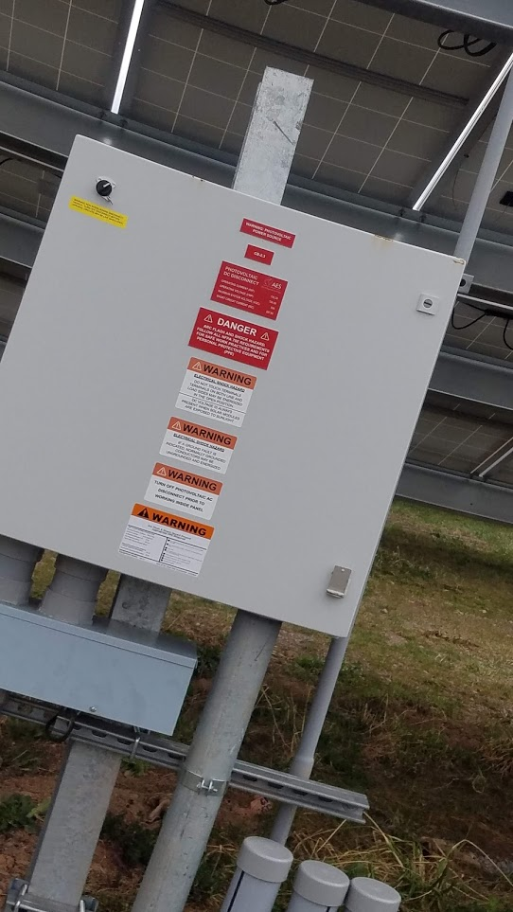
Pic Tilted

Slide 11
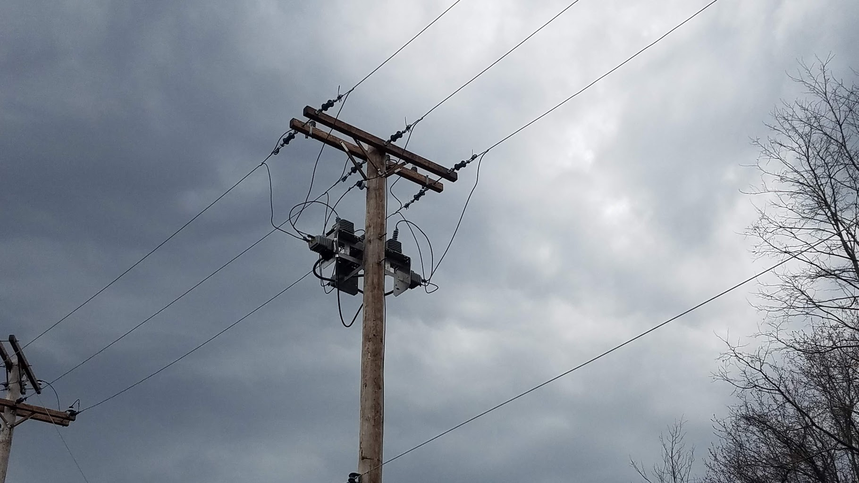
3-Phase

Slide 12
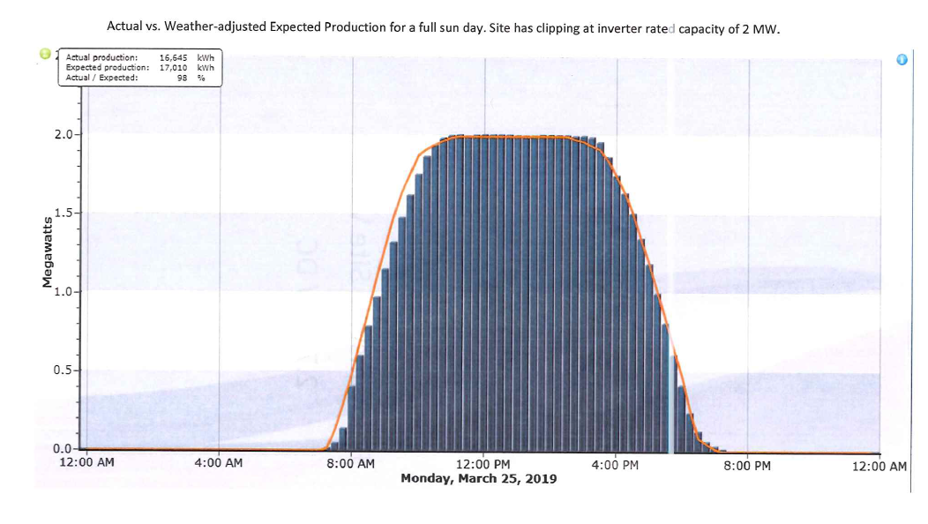
Full Sun Day (16,645 kWh)

Slide 13
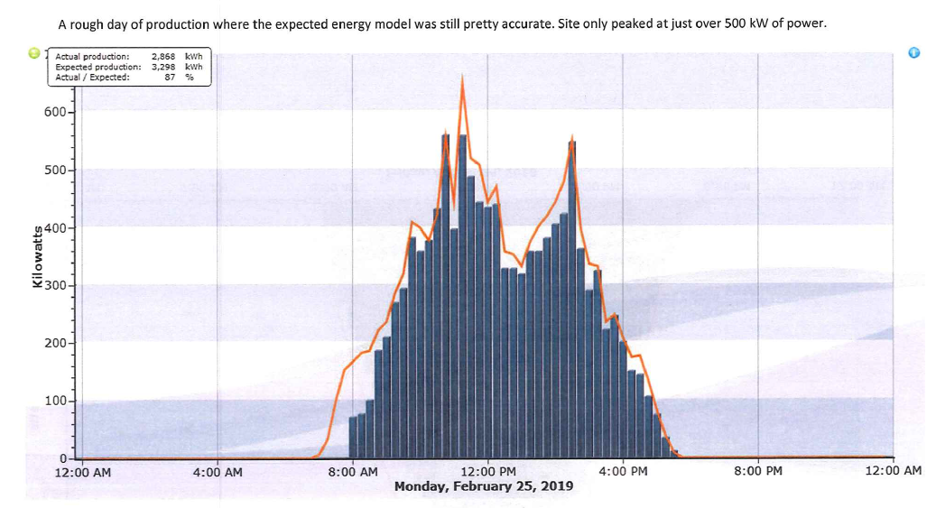
Poor Sun Day (2,868 kWh)

Slide 14
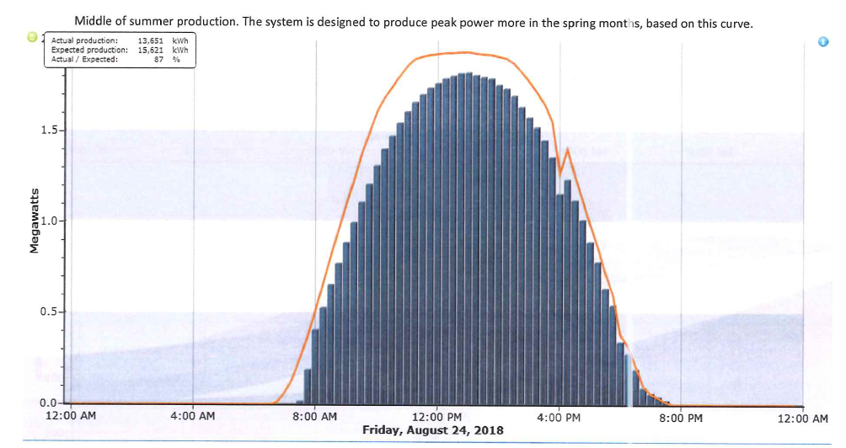
Summer Day (13,651 kWh)

Slide 15
Sunny Winter Day (7,889 kWh)

Slide 16
Anheuser-Busch, Inc.

