Slide 1

Notes:
Thank you for coming today! These events (which we call SolarParties) are simply how we share the “New Way” that solar power has become available to almost everybody! We believe that GREAT THINGS are shared by “Word of Mouth”; like a great book or movie or restaurant, when people discover something amazing they want to tell their friends, family, neighbors and cohorts. This is how SolarCity Spreads the Word; and why Going Solar is Going Viral across the country!
I am going to spend about 15 minutes and run through this slide show which provides a great overview of who we are, what we do and how it works. Then I’ll spend another few minutes answering your questions.
Please allow me to set the stage with 3 important points before we get started:
First of all, this is NOT a Sales Presentation today, but rather just information sharing. After seeing this presentation, if any of you decide that you would like to schedule a 1:1 Consultation at your home, I’d love to do an analysis with you to see if Going Solar is a fit.
Number two, I am not going to go into any questions/discussions today which are individual or personal to your home or situation (that’s what we will do at your Consultation). Each home and situation is different depending on your electricity usage, roof pitch and azimuth, tree shade, utility rate plan, etc. And no other company has the tools, technology and experience to do an analysis like SolarCity. We are simply on the “cutting edge”! So I really hope that many of you DO choose to set up a time to discuss this with me one-on-one.
And finally, I find that occasionally SolarParty attendees want to debate or challenge me on topics in this presentation or related to Going Solar. If that the case with any of you, I am glad to have those discussions, but in fairness to all, I ask that we do so after the presentation and not in this group setting.
Does that all sound fair? Great, then let’s get going…

Slide 2

Notes:
In July 2006, our Founders, brothers Pete and Lyndon Rive, set out to create a NEW way, a BETTER way, for something we all do every month ANYWAY…Pay our electricity bills!
Their vision was to offer every homeowner a CHOICE for cheaper, cleaner electricity; a simple idea but an enormous undertaking which no company had yet to figure out!

Slide 3


Notes:
Although the SolarCity’s name is gaining recognition, we find that most people really don’t know much about us, or the Value Propositions we provide. This 2-½ minute video featuring our founders Pete & Lyndon Rive and Chairman Elon Musk, really paints the picture of who we are and our Mission… Let’s take a look! [Play the Video]
Wow, pretty cool, huh? I never get tired of watching that video!

Slide 4
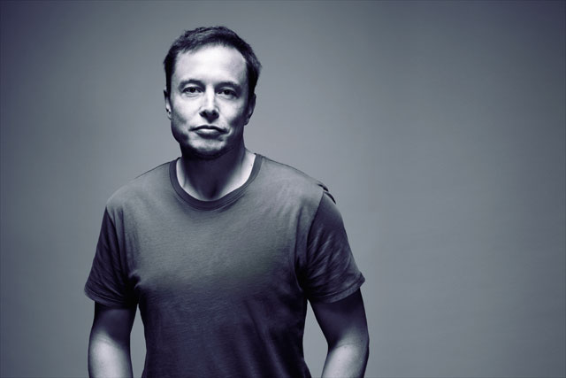

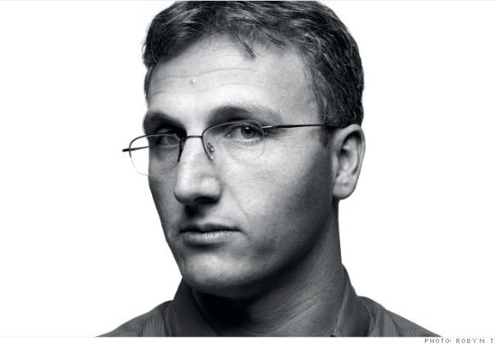

Slide 5
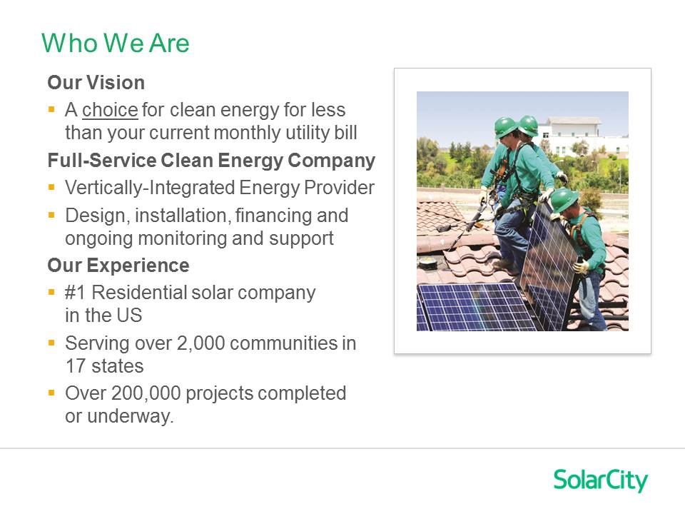
Notes:
As you can see, we are passionate about our mission: to offer every homeowner the CHOICE for cleaner, less expensive electricity!
When I started with the Company this slide said, “Over 10,000 projects completed or underway!” Now, just 4 short years later, we have over 200,000 Customers! And experts agree that we will blow past our goal of reaching 1 million Customers by July 2018 as we are now doubling every year!
If there are savings and a sunny roof we plan to be there. there are no generating plants or power lines inhibiting our growth!

Slide 6
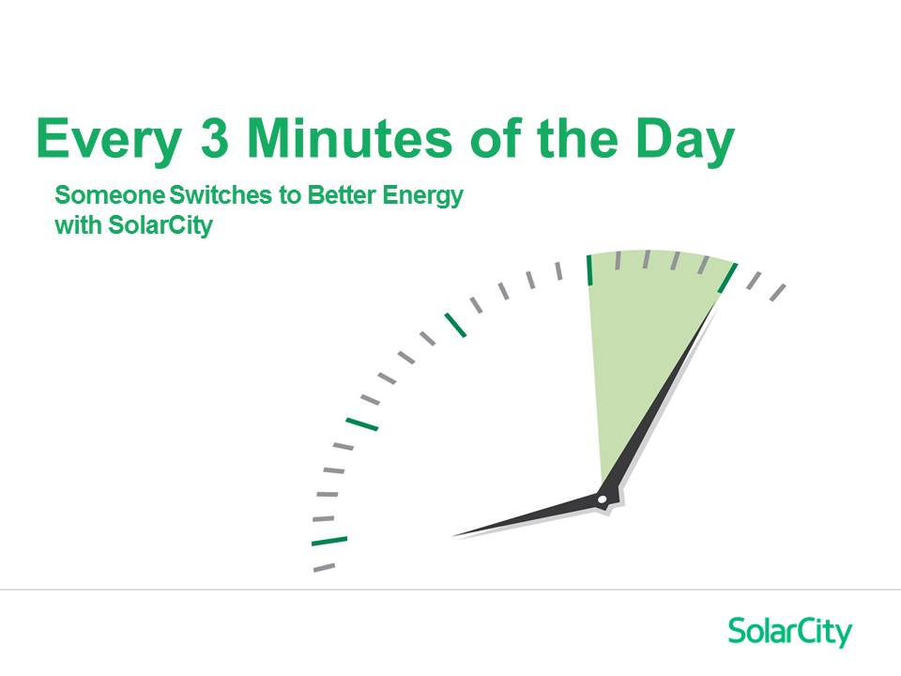
Notes:
In fact, every 3 minutes of every workday, a new Customer switches to SolarCity for cleaner, cheaper electricity!

Slide 7
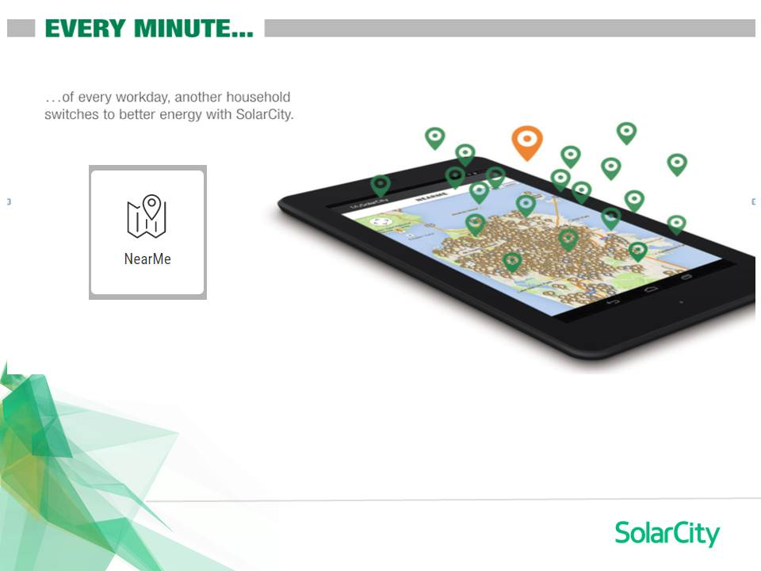
Notes:
Just take a look at the number of homeowners who have made SolarCity their choice for electricity!
[Have NearMe already up and running and do a quick live demonstration]

Slide 8
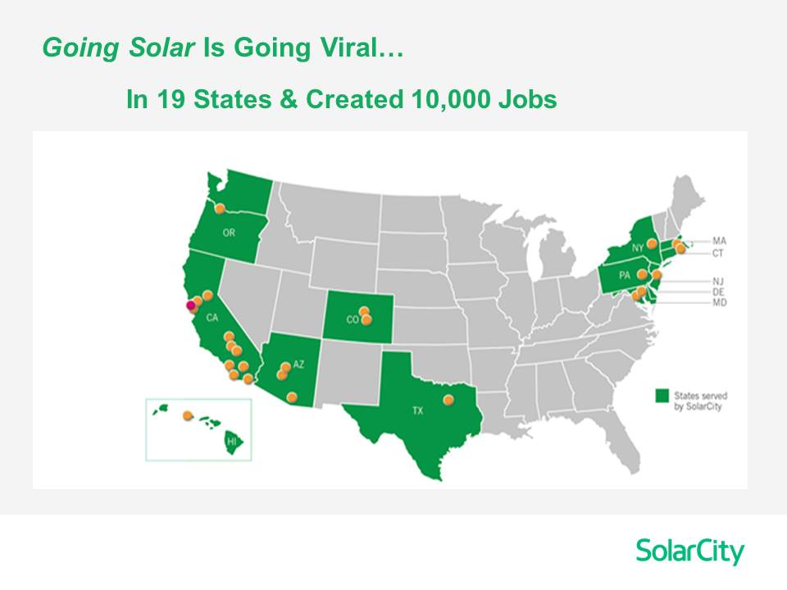
Notes:
When we started in 2006, we were the lone red dot on the map in Foster City California. But as our concepts caught fire, we grew throughout the west. In 2011, we expanded to East Coast where electricity costs are particularly high! Recently we added New Mexico and Rhode Island and are in 18 states stretching from coast-to-coast.
We’ve already created over 10,000 jobs in over 2,000 communities and our mission has barely begun!
Participation Question: Which of the orange dots on the map do you think has the most expensive electricity? [Answer: Hawaii. Explain that it’s because they have to “ship in” most of their electricity – in oil tankers]

Slide 9
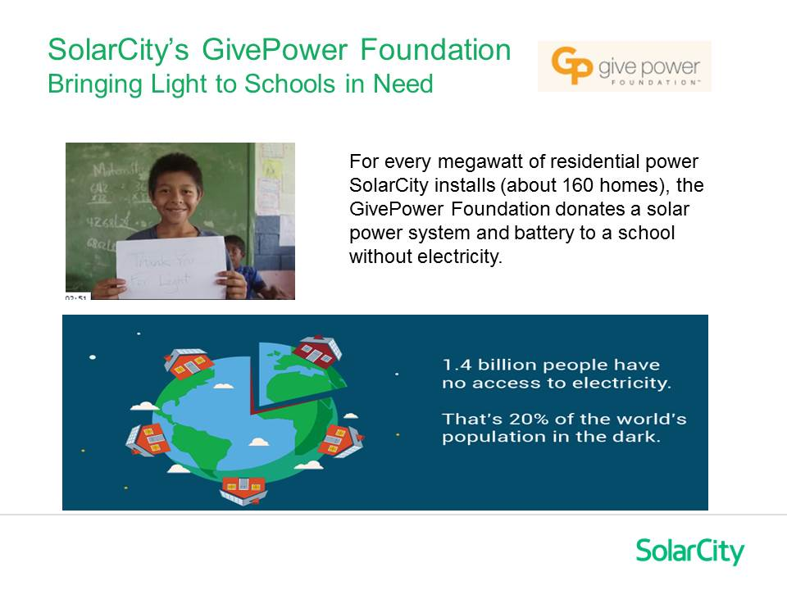
Notes:
As we have spread the word across America, a new Mission has evolved:
SolarCity believes that Going Forward means Giving Back!
SolarCity has joined other like-minded organizations to “Give Power” to underdeveloped communities throughout the world. For every MegaWatt of SolarCity installations (about 160 homes), the GivePower Foundation donates a Solar Panel System and Battery to a school without electricity!
In 2014, we installed over 500 systems in Africa and South America. And in 2015, we are on pace to install over 1,000 more!
Our Vision is to literally change the world, one rooftop at a time, and we invite you to get on board our movement!!!

Slide 10


Slide 11
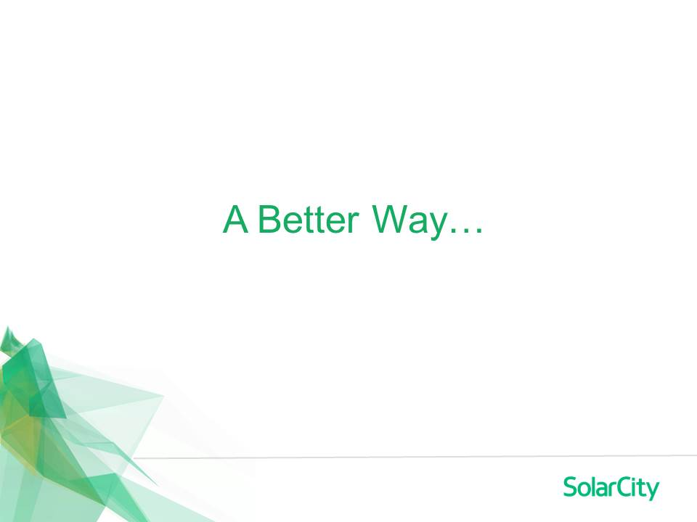
Notes:
The way that most Americans still get their electricity is a system that’s over 100 years old (going back to the origins of Thomas Edison)…
They make the electricity in a central location with pollution-producing resources
Inefficiently transport it for hundreds of miles through wires on unsightly towers
Then distribute it to the end-Customer through a massive network of expensive infrastructure
SolarCity has developed a New Way, A Better Way…

Slide 12
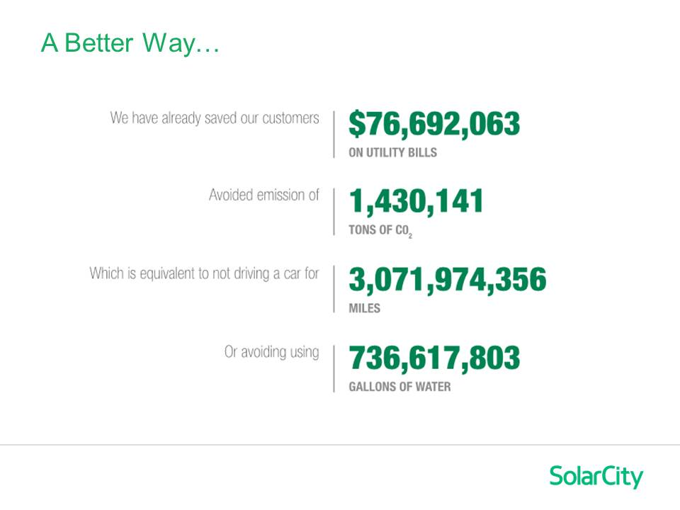
Notes:
Not only does Going Solar save millions on utility bills, but it also has an incredible impact on air pollution and water conservation. Add to that the potential impacts of “Driving on Sunshine” through the relationship of our “sister company”, Tesla Motors, and the impact potential to our communities and our nation is INCREDIBLE!!!
Check this out…[Discuss the numbers]
Seeing numbers like this is STAGGERING, right??
So you ask yourself, then why hasn’t almost everyone gone solar?
I wondered that too…

Slide 13
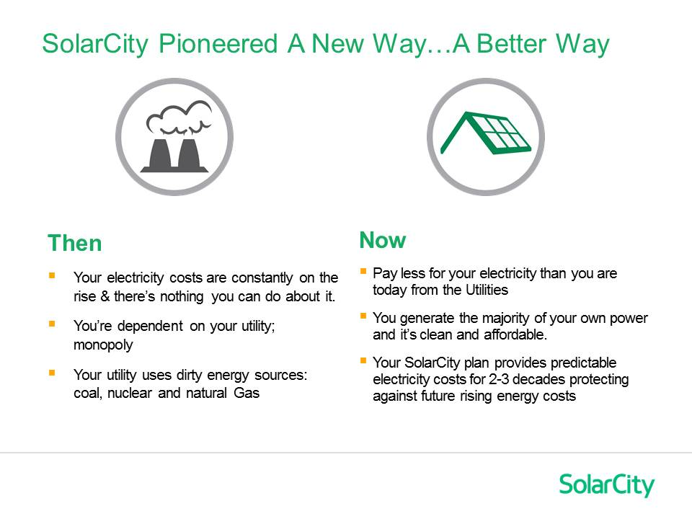
Notes:
[Share your Personal Story Here…]
After being a Science Teacher for 6 years, I moved to Phoenix in 1989. I thought virtually every house would have solar panels on it! I mean seriously, where does solar make more sense than right here, the Valley of the Sun?! But back then practically no one had solar! Here’s Why…
[Tell “Then & Now”]
[THEN]: It used to be that the only way to ‘Go Solar’ was to purchase a system; it was very expensive with a long payback period, usually 10-15 years (“big outlay, slow repay”).
In 2008, SolarCity pioneered a new way. Now, all it takes to Go Solar is a qualified roof and approved credit!
[NOW]: As a result, Going Solar is going viral across the America!
And Here’s How We Do It…
We offer a lower price for solar electricity than you’re paying today from the Utility. (Lower your arm)
You control your electricity costs with a predictable plan for 2-3 decades (Point your arm),
Protecting you from the ever-rising cost of electricity from the Utility company. (Tilt your arm upward)
And you can put no money down or as much as you want; we’ll customize the plan and find the ‘best fit’ for you.

Slide 14

Notes:
And We Make It SO Easy…
From Design to Permits, Installation to Operation, Monitoring, Warranty & Repairs…We Do It All!
We own proprietary technology, equipment and installation systems that are unmatched in the industry.
It’s just a better way to do what you do every month ANYWAY…pay your electric bill!

Slide 15
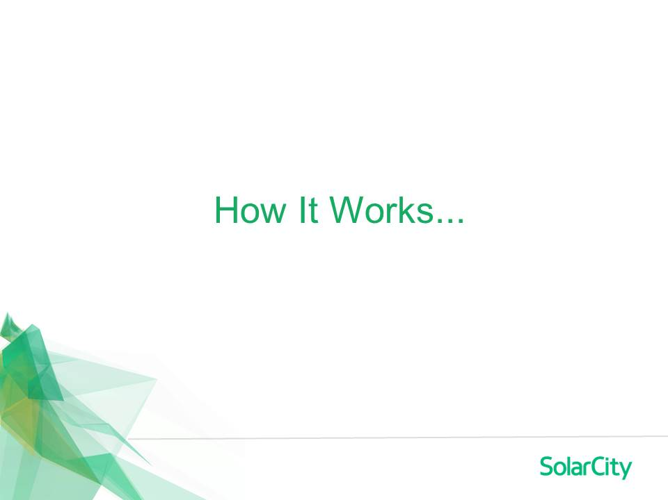
Notes:
Here’s How It Works…

Slide 16
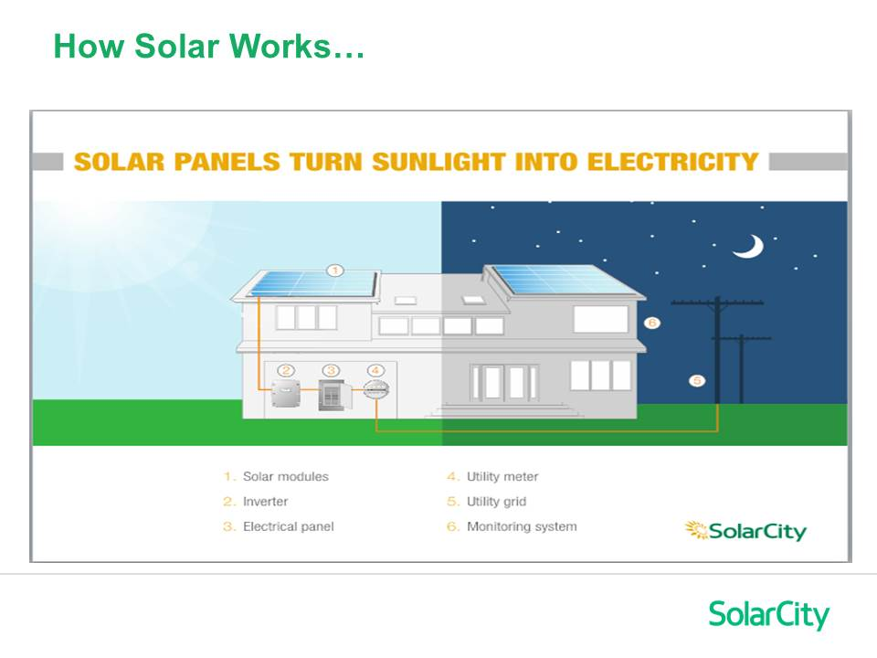
Notes:
“It’s light, not heat that generates electricity in the panels. The solar panels produce Direct Current (DC electricity).
It then runs through a device called an “Inverter” which converts it to Alternating Current (AC electricity).
At that point the solar electricity is exactly the same as what you get from the Utility company.
Then the electricity goes directly into your Electric Panel. If you are using electricity, it goes straight into your home.
If you are not at home, or if you are producing more solar electricity than you are using, the excess goes off to the Grid.”
Finally, the amount of kWh that you give to the Grid is tracked by the Utility company, and at later times when you need it (like hot months in the summer) you are given credit on your bill for the amount that you put onto the Grid (it’s called Net Metering).”

Slide 17
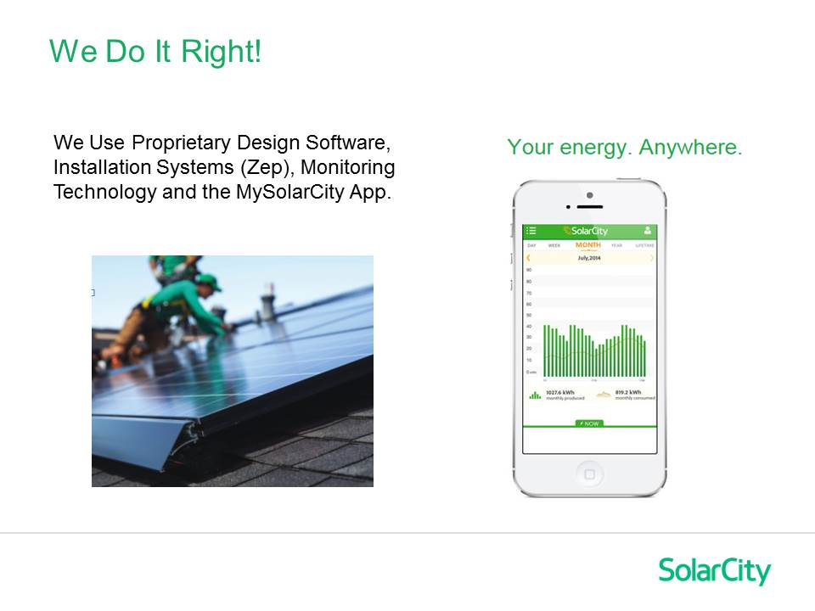
Notes:
And We Do It Right…
We are in it with you for the long run and do it right from the get-go!
We want to make sure the system is the absolute best possible fit for you – right size, location and design to maximize performance and benefits.
Our proprietary software and analysis tools enable us to determine the right system (size, panel placement, etc.).
We own Zep Solar installation Systems, the most innovations installation system in the world!
And our PowerGuide monitoring system and MySolarCity App provide unparalleled reliability, information and communication.

Slide 18
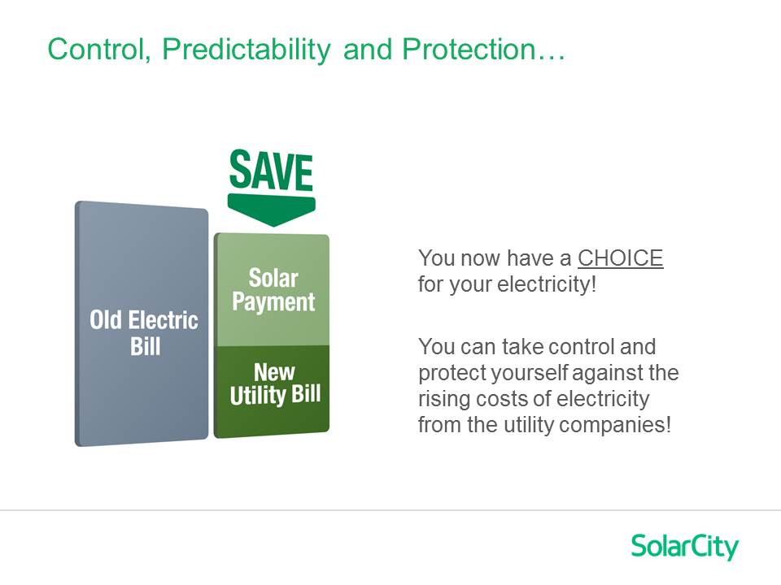
Notes:
So for the first time YOU are able to Control the cost of your electricity with a long-term predictable plan.
Instead of having your single bill to the Utility Company (in which they tell you what you will pay), you will now have two payments each month: one to SolarCity (usually for the majority of your electricity) and a small payment to the Utility (you’re still on the grid).
But now, the majority of your electricity is protected against the ever-rising costs from the Utility Company.
Discuss “The Hedge”. [Southwest Airlines jet fuel futures; Forever Stamps; What if you could have locked in the cost of a gallon of gas 20 years ago?!!]

Slide 19


We Believe Utility Costs Are Rising!!!
Utility companies’ aging infrastructure costs billions $$$ to repair or replace!
EPA regulations for “clean coal” power plants costs millions $$$ !
Costs must be passed on to the Customer !
Notes:
These are actual headlines from newspapers in 2014!!!
Go back look at what you paid for electricity 20 years ago!
Where do you think those costs will go in the future?
[Explain WHY we believe the cost of electricity will “necessarily” rise!]
Again, bring up the power of “The Hedge”.

Slide 20
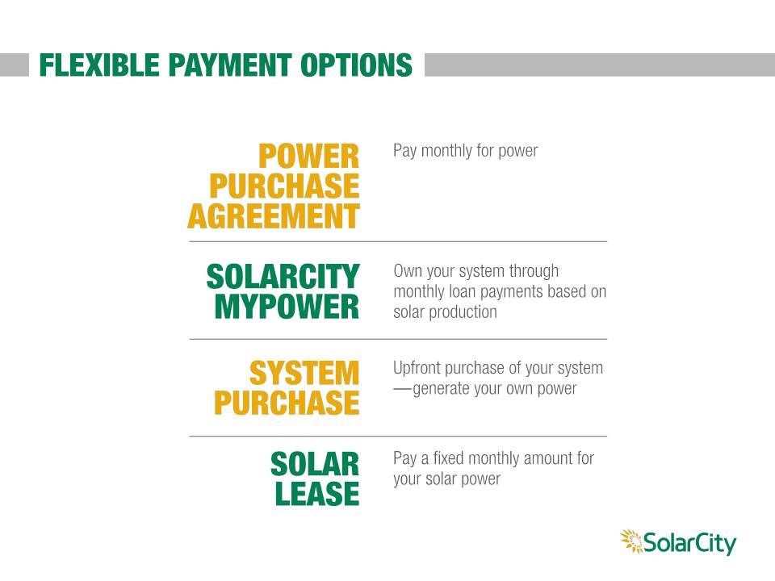
Notes:
SolarCity offers different products to fit the different needs of our Customers.
Which plans are available depends upon your state and your specific utility.

Slide 21

Notes:
Briefly explain that we offer different products in different states & utility regions and for different Customer Preferences…
[Only stop on the slides for the products offered in your regions.] [Just barely touch on this and go over it quickly.]
[Explain that you will discuss these options in detail at their Consultation and determine which is the “best fit” for them!]

Slide 22

Notes:
Briefly explain that we offer different products in different states & utility regions and for different Customer Preferences…
[Only stop on the slides for the products offered in your regions.] [Just barely touch on this and go over it quickly.]
[Explain that you will discuss these options in detail at their Consultation and determine which is the “best fit” for them!]

Slide 23

Notes:
Briefly explain that we offer different products in different states & utility regions and for different Customer Preferences…
[Only stop on the slides for the products offered in your regions.] [Just barely touch on this and go over it quickly.]
[Explain that you will discuss these options in detail at their Consultation and determine which is the “best fit” for them!]

Slide 24
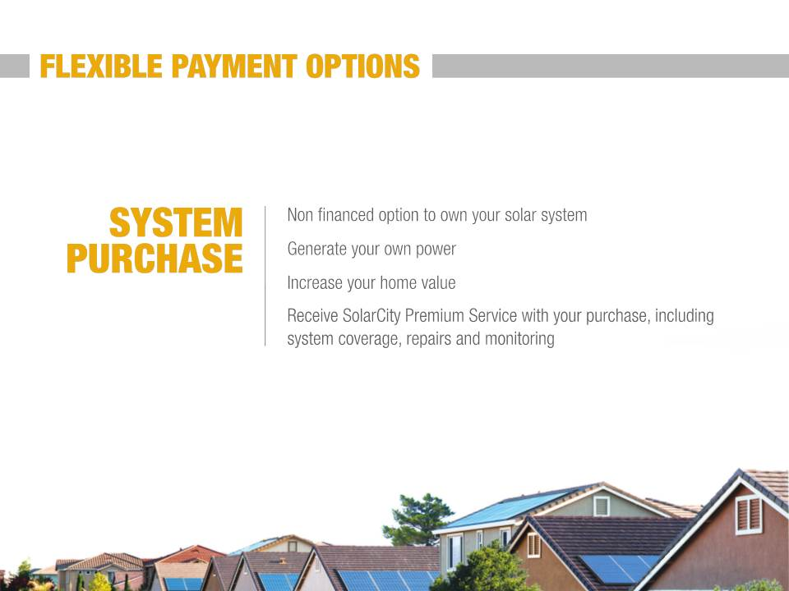

Slide 25
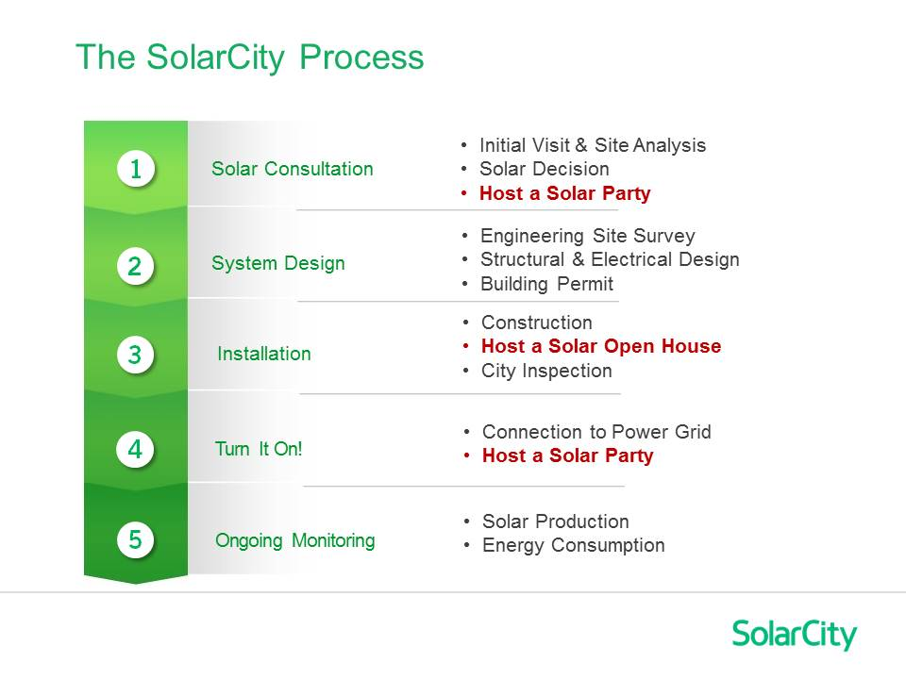
Notes:
Briefly describe the SolarCity process from Signing-to-Install-to-PTO. [Again, emphasize the fact that we are “Vertically Integrated”]
Give an estimated time line range for Install & PTO in your area. Limit this overview to about 1 minute in length.
Intentionally skip over the 3 “Red Bullets” (Host a SolarParty or Solar Open House) and invariably attendees in the audience will raise their hands and ask you about them!

Slide 26
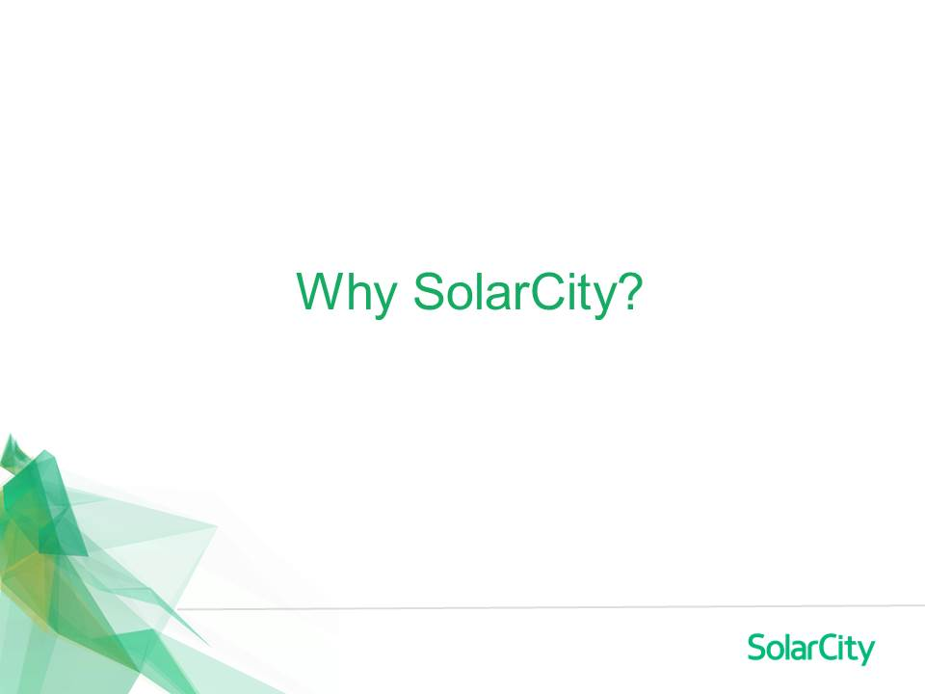
Notes:
[Deliver the following Credibility Wall Slides…this is SO powerful and important]
So if you are considering Going Solar…Why SolarCity?
Why? Because NO other solar company even comes close…

Slide 27
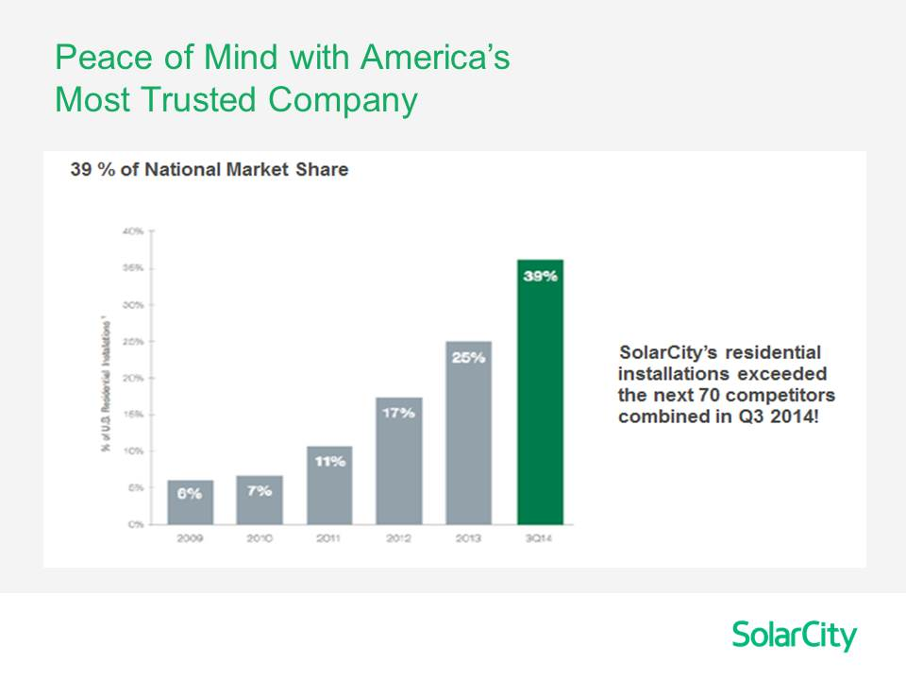
Notes:
We are by far, the leader in the U.S. Solar industry!
By the end of 2014, SolarCity was installing more residential solar than the next 70 competitors combined!

Slide 28
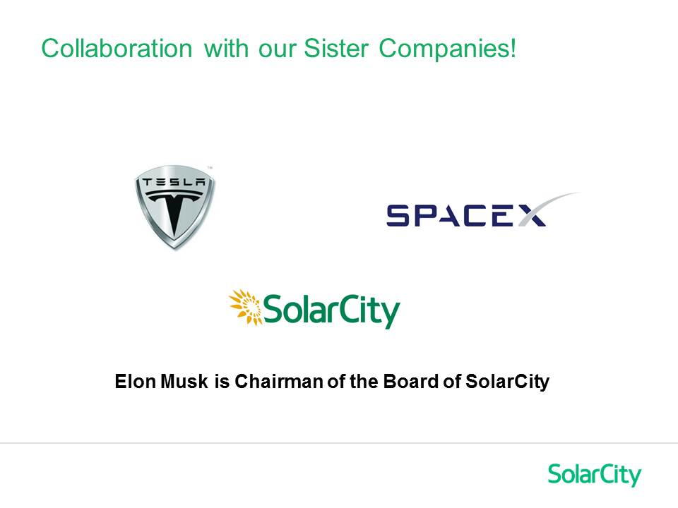
Notes:
WE are on the CUTTING EDGE of energy technology!
Elon Musk is the Chairman of our Company, and with our “Sister Companies”, Tesla Motors and SpaceX, SolarCity benefits from unparalleled R & D [Research & Development] in energy technology! From Solar panels to battery development, energy monitoring to mini-grids, no other company has the resources and commitment of SolarCity!

Slide 29
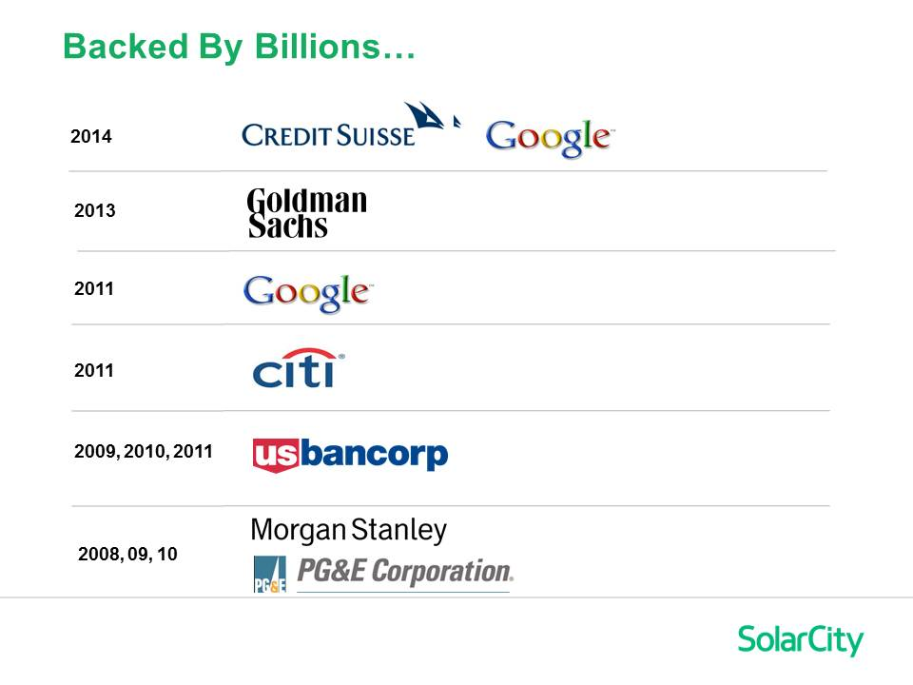
Notes:
And we are BACKED BY BILLIONS!!!
We are in it for the long run! [not to just put panels on a rooftop and run on to the next one] I am often asked how I can guarantee that we will be in business 20 years from now? The answer is, I can’t…no company can guarantee that!
But what I can assure you is that these financial giants did their homework!! And year-after-year they continue to demonstrate that they believe SolarCity is the energy company of the future!
In 2011, Google invested $280 Million igniting our coast-to-coast expansion.
In 2013, Goldman Sachs stepped up with $500 Million.
And already in 2015 we have received over $1 Billion in investment capital from Google, Credit Suisse and Morgan Stanley!!

Slide 30
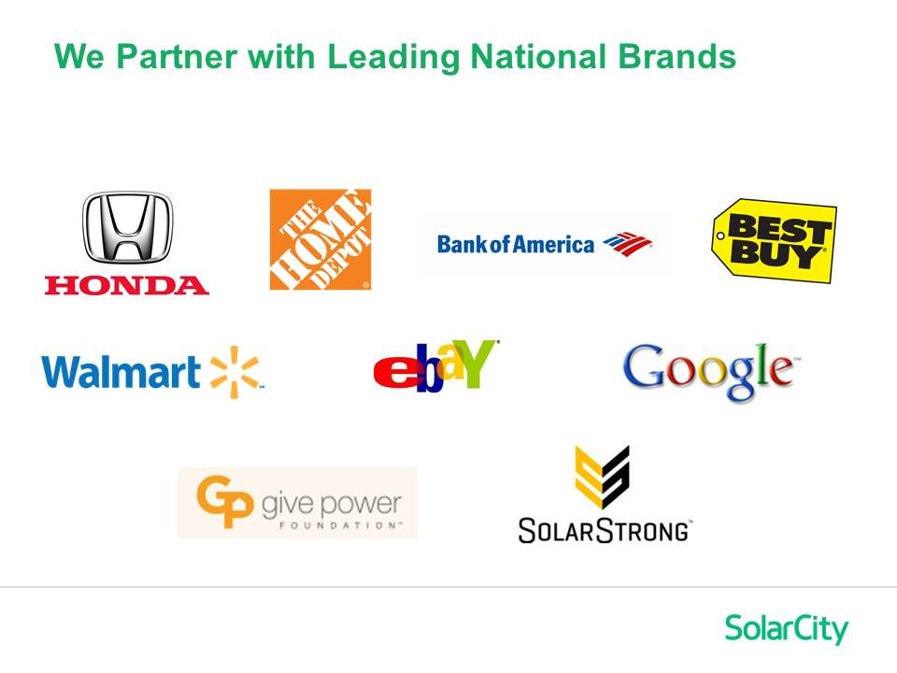
Notes:
Our Marketing Partners are household names!
We are in over 600 Home Depot stores
We have a national contract with Best Buy
We’ve launched successful “cross marketing campaigns” with Honda, Bank of America, BMW and others! In 2012, Honda invested $65 Million so their own car customers could receive a discount for Going Solar with SolarCity! [the first time that Honda had ever marketed with another U.S. company!]
The middle row here shows some of our Large Commercial customers. And, we are now launching a new $1 Billion Small-Mid Commercial division bringing solar to the business masses!
And finally, for SolarCity “giving back” is our way of moving forward! GivePower and SolarStrong are incredible, heart-warming programs! SolarStrong will be the largest residential photovoltaic project in American history converting over 120,000 military homes to solar. Plus, the initiative seeks to fill many of the needed jobs with Veterans!
I “pinch myself” everyday that I work for this TRULY amazing company! I am SO excited to be a part of it!

Slide 31
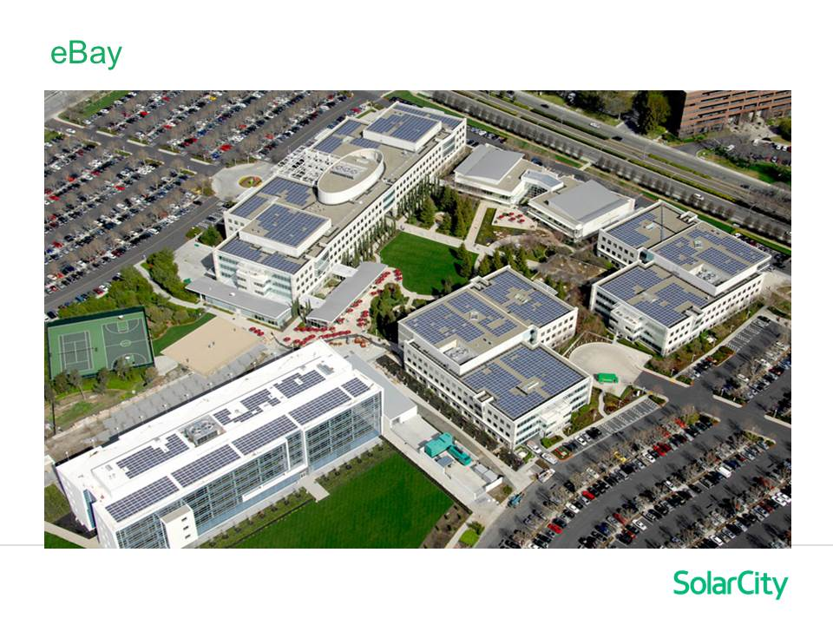
Notes:
Here’s one of our “little” commercial installations (ha, ha, ha!)
This is the eBay national headquarters [San Jose, CA]. Pretty impressive, huh? Did you notice the SolarCity truck out front! [point it out]
I am pretty sure that if we can tackle this project, we can handle your home!

Slide 32
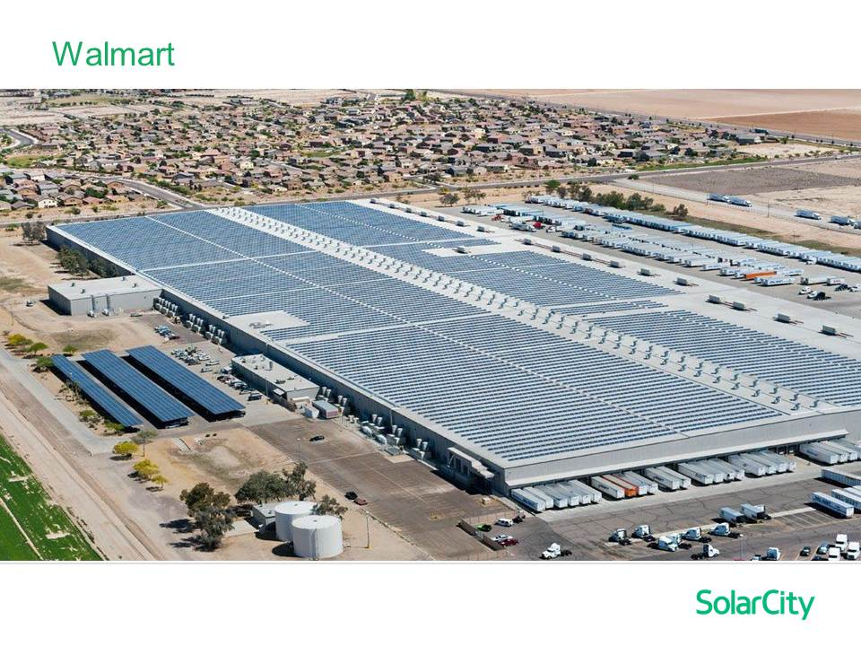
Notes:
And take a look at this one! Wow is right!!!
This is the Walmart distribution center in Buckeye, Arizona!
This SolarCity job is the largest commercial installation in America. Just for scale, those are semi-trucks in the lower right corner!

Slide 33
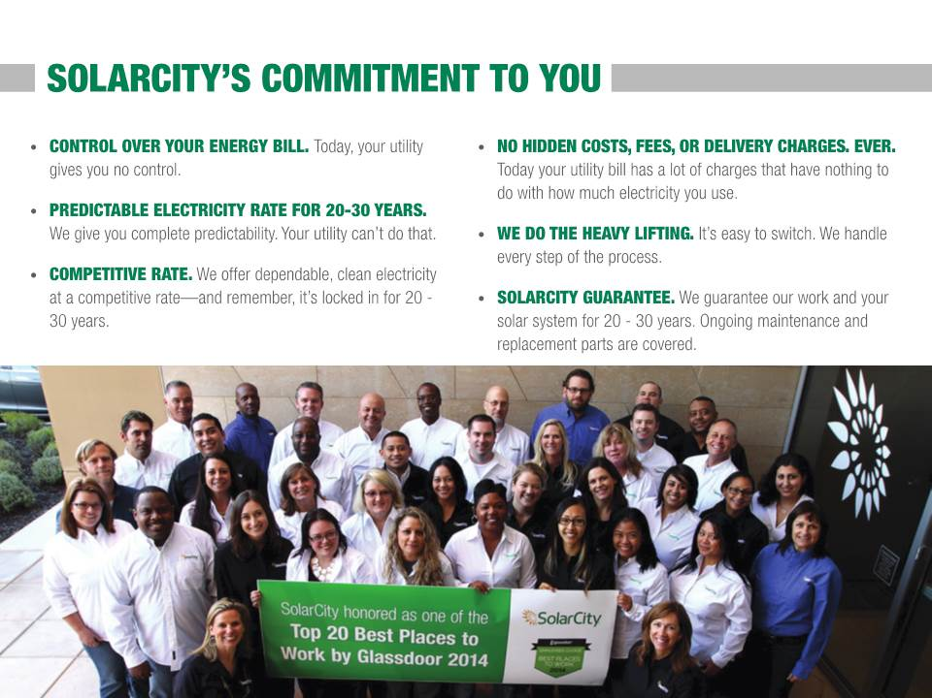

Slide 34

Notes:
So if you decide that you would like to have me come over to your home for a SolarCity Consultation, it would be my pleasure!
I will analyze all aspects of your situation – your home, utility plan, usage, tree shade, etc., to see if Going Solar with SolarCity is a fit for you.
And if it’s not, I will simply extend my hand and thank you for taking a look!

Slide 35
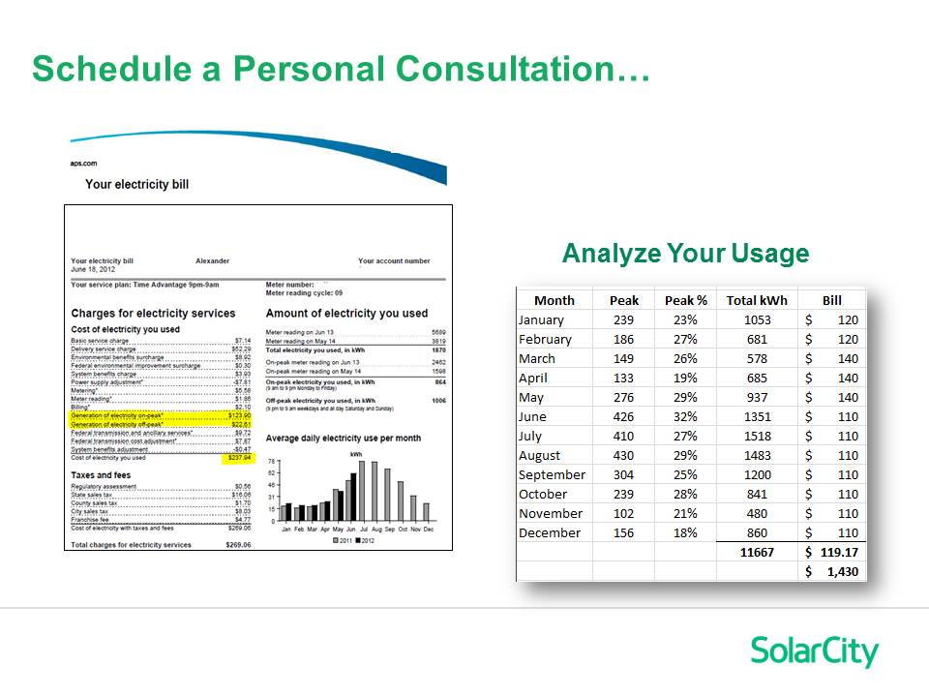
Notes:
All I will need for your Consultation is a copy of your Utility Bill and the last 12 months of your electricity usage. I will take that information, prepare a preliminary design and then come over to your home to discuss options, answer your questions and hopefully welcome you to the SolarCity family!
Thanks again for your time and now I will spend a few minutes for a brief Q & A session…

Slide 36
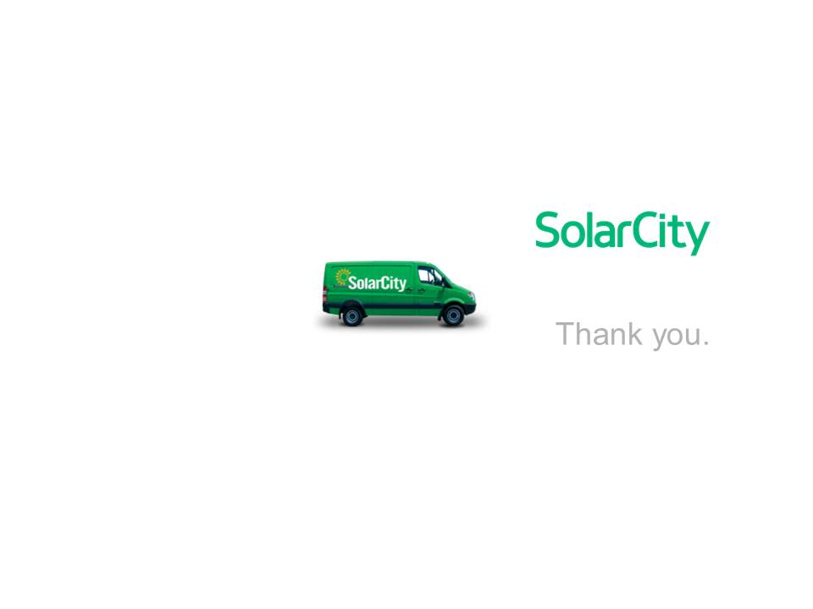

Slide 37
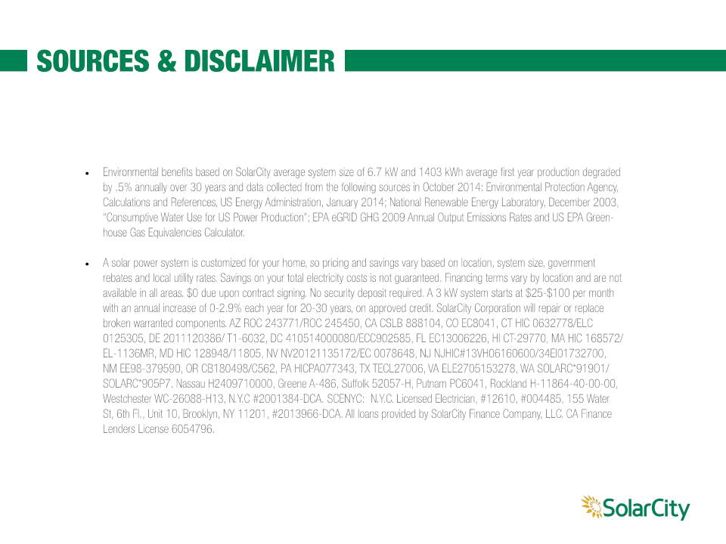

Slide 38


