Slide 1
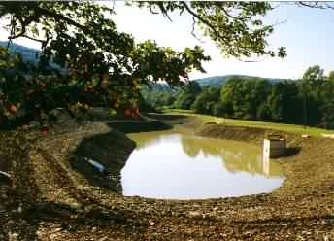
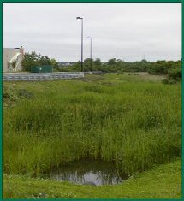
Detention Basics

Slide 2
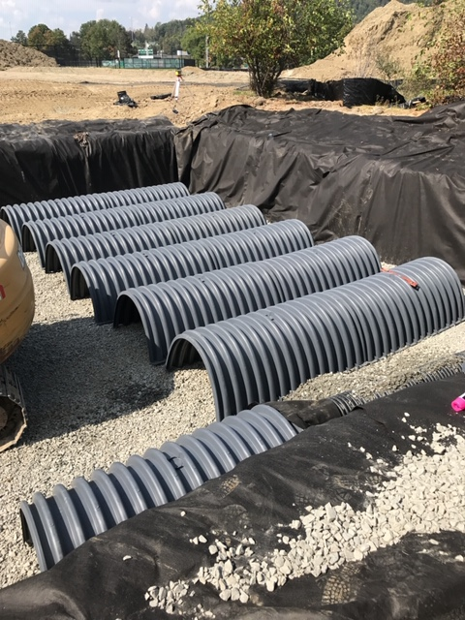
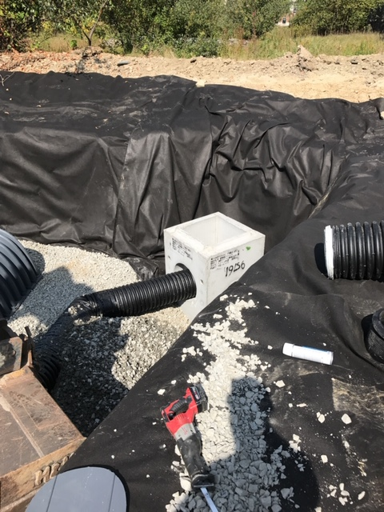
Detention Basics-UG

Slide 3
Objectives
Students should have the ability to:
Name the advantages of a detention basin
Develop an inflow hydrograph
Develop a stage-storage curve
Develop an outflow curve for single or multi-staged outlets

Slide 4
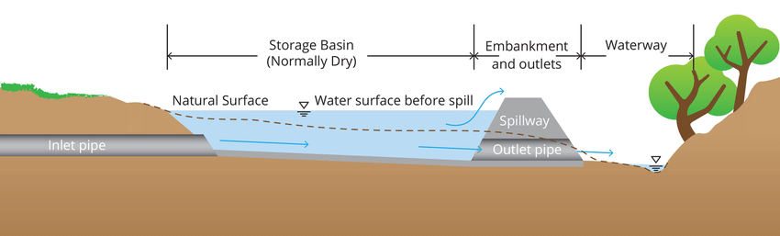
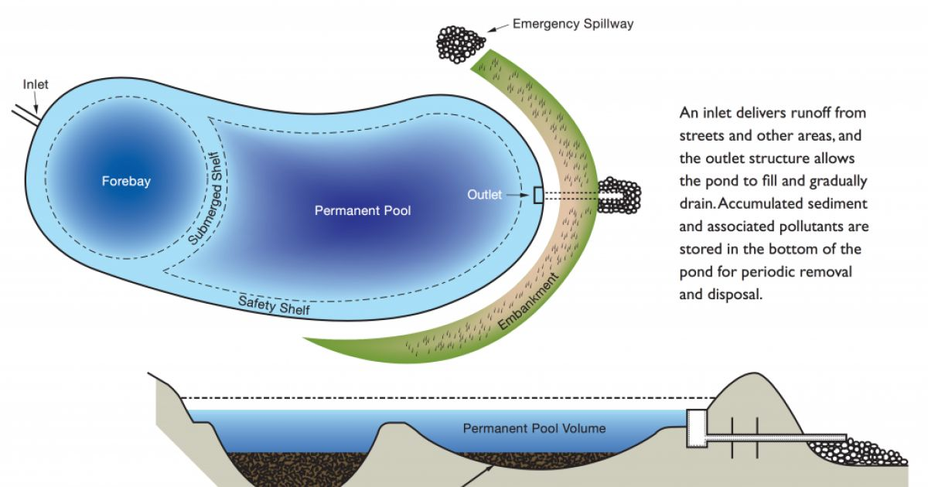
Detention Basin Elements

Slide 5
Detention Basin-Purposes
Store water temporarily during a storm and release the stored water slowly (attenuate the flow)
Store first-flush
Allow and/or Design for infiltration
  If all water is infiltrated then (retention basin)

Slide 6
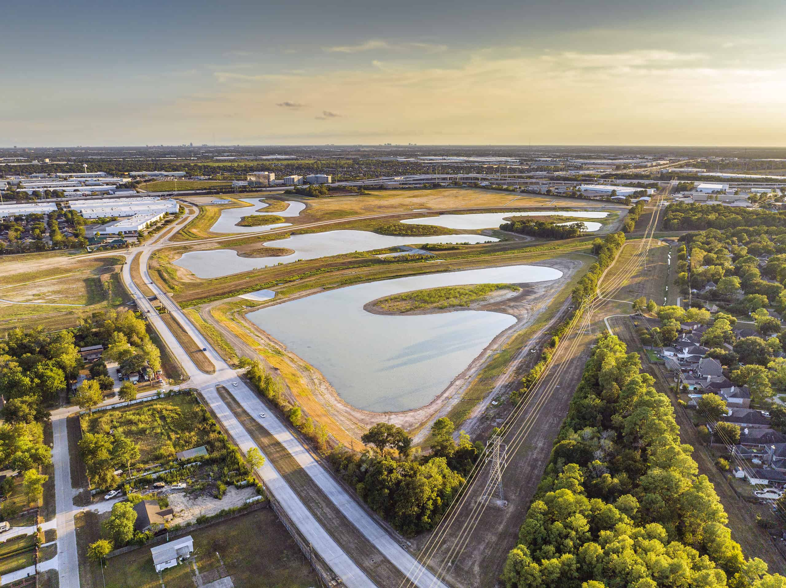
Detention Basins (location)
On-Site?
Or
Regional?
Discussion

Slide 7
Detention Basin Components
Inflow (ditch or pipe)
Storage
Outflow (single/multiple stage)
  Orifice
  Weir
Emergency spillway

Slide 8
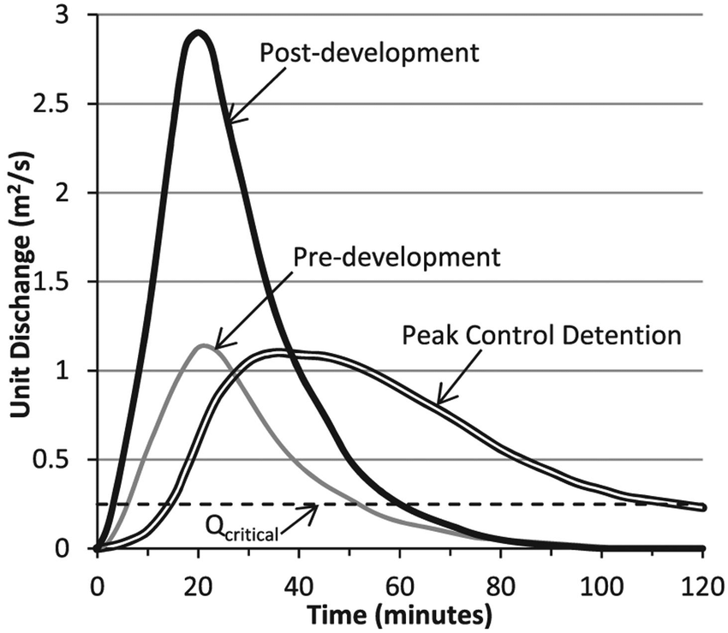
Routing
Method used to model the outflow hydrograph
Based on continuity equation
  Water in varies
  Water out varies
  Storage

Slide 9
Information Needed to Route
Inflow hydrograph
Table or graph of storage volume to water elevation in the proposed detention basin
Table or graph of outflow to water elevation (discharge rating)

Slide 10
Inflow hydrograph (3 methods)
1. Ch 5 of TR-55 (NRCS method)
Rational method:
2. Simple symmetrical triangle
(base = 2*tc and peak occurs at tc)
3. Asymmetrical triangle
(total base = 2.67 tc and peak occurs at tc)

Slide 11
TR-55 Hydrograph
(NRCS Method)
Peak flow is higher after development
Peak flow occurs earlier after development

Slide 12
Rational Method:
Simple Symmetrical Triangle

Slide 13
Rational Method:
Time base of 2.67 tc
Area under hydrograph?

Slide 14
Computing Storage Volumes
Two Methods:
  Elevation-Area (detention basins)
  Average End-Area (pipes)

Slide 15
Elevation-Area
15
Elevation-Area (detention basins)
  Contour lines are determined around basin
  Determine area of each contour
  Volume between 2 contours = average area*depth between the contours
  Prepare a table showing elevation, area, incremental volume and cumulative volume

Slide 16
Plan and Profile-Detention Basin

Slide 17
Elevation-Area Method
Elev (ft) | Area (ft²) | Incr. Vol (ft³) | Cum. Vol (ft³)
230 | 0 | 0 | 0
231 | 250 | (250/2*1)=125 | 125
232 | 840 | ((250+840)/2*1)= 545 | 670
233 | 1350 | 1095 | 1765
234 | 2280 | 1815 | 3580
235 | 3680 | 2980 | 6560
236 | 5040 | 4360 | 10,920

Slide 18
Water Volume versus Elevation

Slide 19
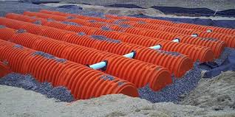
Computing Storage Volumes when Underground Pipes are Used
Average end-area (pipes)
  Find u/s area at elevation increments
  Find d/s area at elevation increments
  Average the areas & multiply by length
  This gives you total volumes (not incremental volumes)

Slide 20
Sloped Pipe Water Volumes at Various Elevations

Slide 21
End Area Method

Slide 22
Pipe used as Detention Basin

Slide 23
Break

Slide 24
Discharge Rating
Calculate outflows based on water elevation in the detention pond
Orifice and weir equations are used
  Single stage
  Multi stage
If more than one stage, calculate each outlet separately and add to get stage-discharge curves

Slide 25
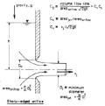

Orifices
Hole in a wall through which water flows
  Square edge
  Beveled edge
25

Slide 26
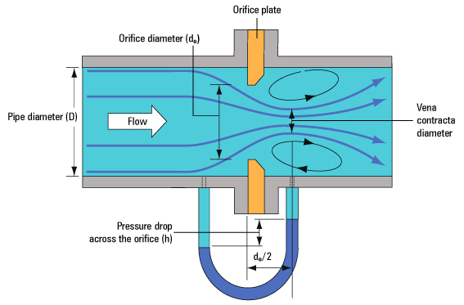
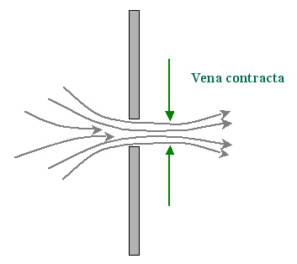
Orifice
When water flows through an orifice the water contracts with a smaller area than the original orifice opening (vena contracta)
www.spiraxsarco.com
www.diracdelta.co.uk
26

Slide 27
General Orifice Equation
27
Q=ca(2gh)^{.5}
Where:
  Q=discharge (cfs or cms)
  c=discharge coefficient (0.62 often used)
  a=cross-sectional orifice area (sq ft or sq meters)
  h=total head (ft or m)
  g=gravitational constant (32.2 or 9.81)

Slide 28
Orifice Discharge
28
Free Discharge
Submerged Discharge
Equation is the same. Head for the submerged discharge is the difference between upper and lower water surfaces

Slide 29
Orifice-Free Discharge
29
Given: Dia=6”, WSE=220.0 ft;
Elev of orifice centerline=200.0 ft
Q=ca(2gh)^{.5}
Q=0.62*0.196*(2*32.2*20)^{.5}
Q=4.4 cfs

Slide 30
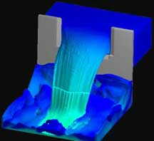
Weir
Horizontal surface over which water is allowed to flow
Used to regulate and measure flows
http://www.flow3d.com/appl/weir.htm
30

Slide 31
Rectangular, Sharp-Crested Weir
31
Q=cLH^{3/2}
  Q-flow (cfs)
  c-adjusted discharge coefficient (careful)
    c=3.27+0.4(H/P) where P is ht of weir above channel bottom
  L-effective crest length, ft
    L=L’-0.1nH
      L’=actual measured crest length and n=# of contractions
  H-head above crest, ft

Slide 32
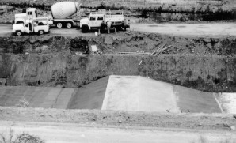
Rectangular, Broad-Crested Weir
32
Q=cLH^{3/2}
  Q-flow (cfs)
  c-discharge coefficient
  L-crest length, ft
  H-head above crest, ft

Slide 33
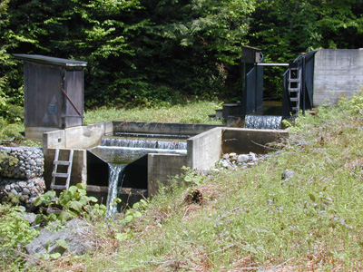
V-Notch or Triangular Weir
33
Q=c*tan(angle/2)*H^{5/2}
  c = 2.5 (but should calibrate)

Slide 34
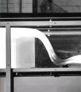
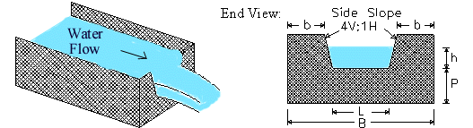
Other Weir Types
Cipoletti (trapezoidal)
Ogee (dam spillway)
youngiil.co.kr
www.lmnoeng.com
34

Slide 35
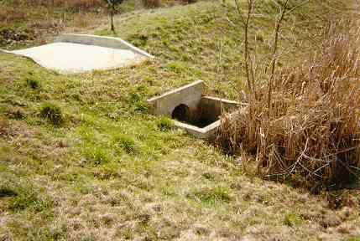
Detention Outlet Structures
Single Stage (culvert or orifice)
Multi-Staged to handle different flows
Combination of orifices &/or weirs
35

Slide 36
Single Stage Outlet Example
36
An outlet consisting of a 12” pipe is proposed for a detention basin. The invert of the pipe is 320.0 feet and the top of berm is 325.0 ft. Compute the discharge rating for the outlet.
Area=0.785 sq ft
Assume c=0.62
Use orifice equation: Q=ca(2gh)^{.5}

Slide 37
Single Stage Outlet Example
WSE (ft) | h (to c/l of pipe) | Q out (cfs)
320 | 0 | 0
321 | 0.5 | 2.8
322 | 1.5 | 4.8
323 | 2.5 | 6.2
324 | 3.5 | 7.3
325 | 4.5 | 8.3
37

Slide 38
Single State Outlet
38

Slide 39
Multi-Stage (Three-Stage Outlet)
39
4” Orifice and 2 weirs L=1.5’ and L=12.5’

Slide 40
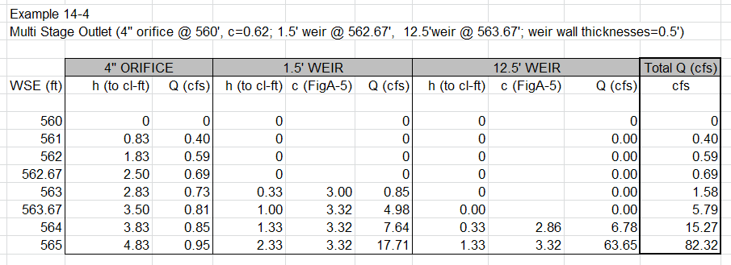
Multistage Outlet

Slide 41
Multi-Stage Outlet
41

Slide 42
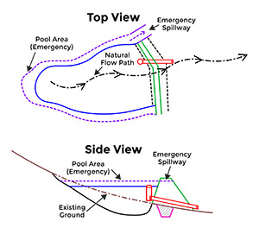
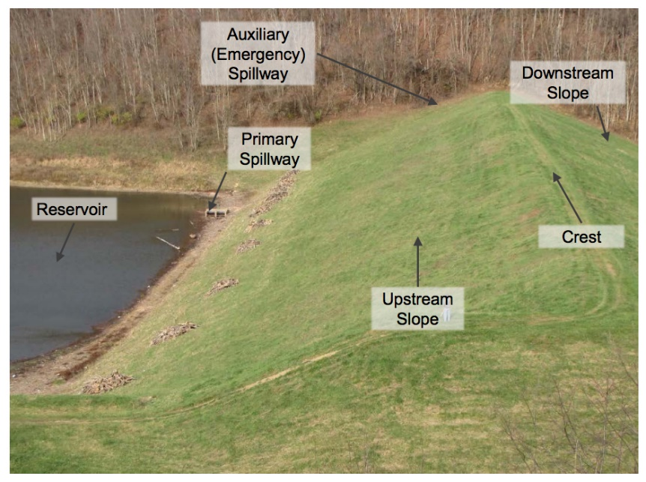
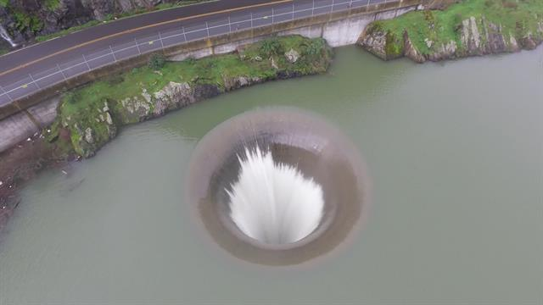
Emergency Spillway
Emergency Outlet
  Rainfall exceeds design storm
  or outlet becomes blocked
Purpose
  Prevent overtopping of berm
  Control direction of overflow

Slide 43
Emergency Spillway
Typical Design Criteria
Spillway crest set at or above the maximum impoundment elev
Designed for emergency spillway design storm (minus what can be handled by outflow structure) or designed to convey peak discharge of design storm (assuming outflow structure plugged)
Top of berm = WSE through the spillway + freeboard (1-2’ typical)

