Slide 1
Detention Routing

Slide 2
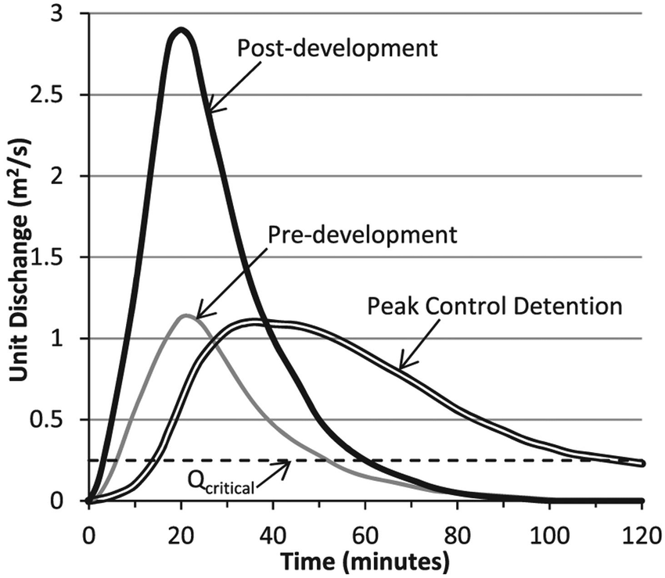
Objectives
Determine an outflow hydrograph (peak control detention-see map on right) given:
Inflow Hydrograph (post development)
Storage and Outflow versus WSE (based on detention basin design)
Note: Peak control detention must be equal to or less than the pre-development peak

Slide 3
Detention Basin Components
Inflow (ditch or pipe)
Storage
Outflow (orifice or weir or combination)
Berm
Emergency spillway

Slide 4
Routing
Method used to model the outflow hydrograph
Is based on the continuity equation (hydraulics)
Water in varies
Water out varies
Storage versus elevation varies

Slide 5
Information Needed to Route
Inflow hydrograph
Relation of storage volume to water level elevation in the proposed detention basin
Relation of outflow to water level elevation (discharge rating)

Slide 6
Set up table with small time steps
Water in – Water Out = Difference in Storage
(water in is changing w/ time)
(water out is a function of basin WSE)
(basin WSE is a function of basin geometry)
WSE-water surface elevation

Slide 7
Reservoir Routing
Over that time step:
Avg Inflow (I) – Avg Outflow (O) = Change in storage per some increment of time
If I=O there is no change in water elevation
If I>O then water surface rises
If I<O then water surface decreases

Slide 8
Reservoir Routing Over some time increment (1 to 2)
I₁ and I₂ are inflows at beginning (1) and end (2) of time increment (the entire inflow hydrograph is known)
O₁ and O₂ are outflows
S₁ and S₂ are actual storage volumes
Delta t is the time from 1 to 2
Note-variables in red are initially known
We need to solve for O2 and S2

Slide 9
Equation (1/2)
(I₁+I₂)/2 – (O₁+O₂)/2 = (S₂-S₁)/t
Rearrange to:
(I₁+I₂) + [(2*S₁/t)-O₁]=2*S₂/t + O₂
Left hand side – knowns
Right-hand side - unknowns

Slide 10
Equation (2/2)
O₂ and S₂ ; both are unknown; need 2 equations (but we have only one)
However:
We do have a relationship between outflow and storage volume since we determined outflow versus water elevation and the storage elevation versus the water elevation.

Slide 11
Example Inflow Hydrograph

Slide 12
Example Storage Vol & Discharge vs WSE
(I₁+I₂) + [(2*S₁/t)-O₁]=2*S₂/t + O₂
Cell G9=(2*7500/1440)-2.5=7.9 cfs
Cell H9=(2*7500/1440)+2.5=12.9 cfs
Note: 1440 is delta t from previous slide; 0.4 hours =1440 seconds

Slide 13
Volume vs Water Surface Elev.

Slide 14
Outlet Discharge vs Elevation

Slide 15
Determining Outflow

Slide 16
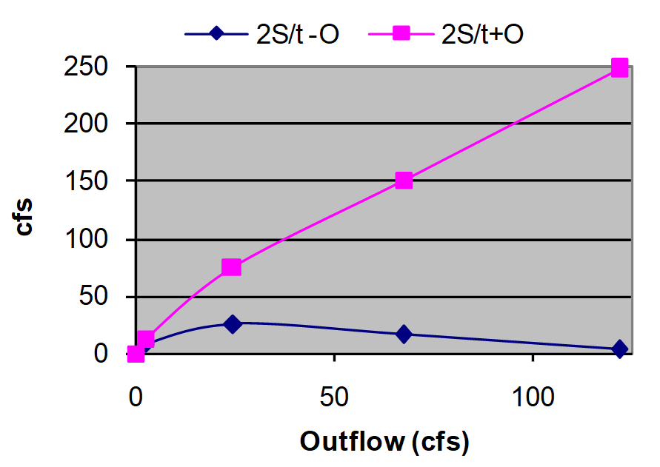
Routing Table
(I₁+I₂) + [(2*S₁/t)-O₁]=2*S₂/t + O₂

Slide 17
Inflow and Outflow Hydrograph

