Slide 1
Hyetographs & Hydrographs

Slide 2
Objectives
Understand what a hyetograph represents
Understand what a hydrograph represents
Understand what a unit hydrograph represents
Know how unit hydrographs can be used to develop various hydrographs

Slide 3
Hyetograph
Graphical representation of time (usually hrs) vs rainfall (“) or intensity (“/hr)

Slide 4
Rainfall
Abstraction--------rainfall lost
evaporation
infiltration
depression storage
Excess------rainfall which runs off

Slide 5
Rainfall Depth versus Time

Slide 6
Rainfall Intensity versus Time

Slide 7
Rainfall Intensity
Usually varies over storm duration

Slide 8
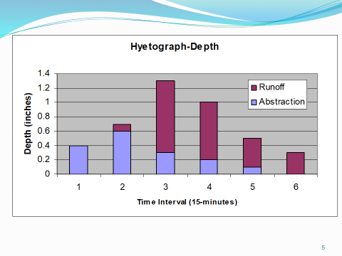
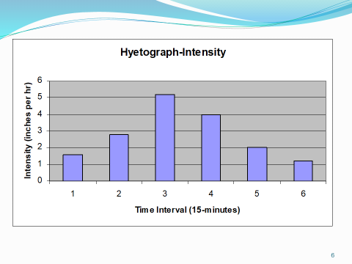
Area under the hyetograph
Represents total amount of precipitation dropped by the storm over its duration
Sum total inches
.4+.7+1.3+1+.5+.3=4.2” or
Sum (intensity*time intervals)
1.6”/hr*.25hr=.4” (and so on)

Slide 9
To Calculate Runoff Volume
Total runoff * Drainage Area
1” of excess rain over 1 acre represents a runoff volume of 3,630 cubic feet = 27,154 gallons

Slide 10
Mass Hyetograph
Another way to represent a hyetograph is a mass curve (accumulated time versus accumulated rainfall)
Rainfall ratio (inches/total inches)
Time ratio (time/total time)

Slide 11
Mass Hyetograph Graph

Slide 12
Deriving the Mass Hyetograph

Slide 13
Question
What does the instantaneous slope of a mass hyetograph represent?

Slide 14
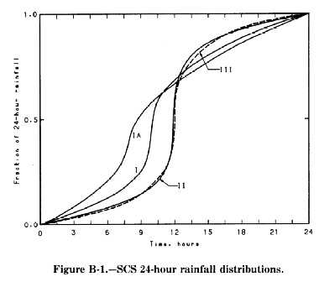
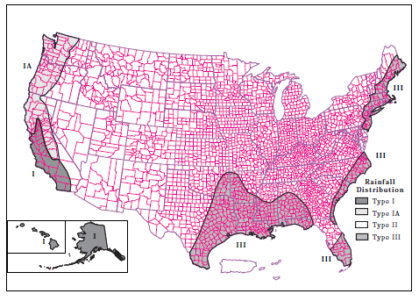
Rainfall Data for 4 Different US locations
Area I-Alaska, Hawaii, Southern CA
Area IA-Pacific Northwest
Area II-Most of the US
Area III-Gulf & Eastern Coast

Slide 15
Class Exercise (Handout)
Unit Mass Hyetograph

Slide 16
Break

Slide 17
Hydrograph
Graphical representation of time (hours) versus discharge (cfs or cms) at a particular point on a stream or channel which drains the watershed area

Slide 18
Hydrograph Shape
Shape represents basin characteristics
Size of Basin (Area)
Shape of Basin
Stream pattern within basin
Land/channel properties/slopes
Infiltration capacity

Slide 19
What is a Hydrograph?
Represents rainfall that runs off into the stream (rainfall-excess or direct runoff)
Base flow (from groundwater) is not part of the hydrograph

Slide 20
Hydrograph Segments
Rising Limb
Crest Segment
Falling Limb (Recession Curve)

Slide 21
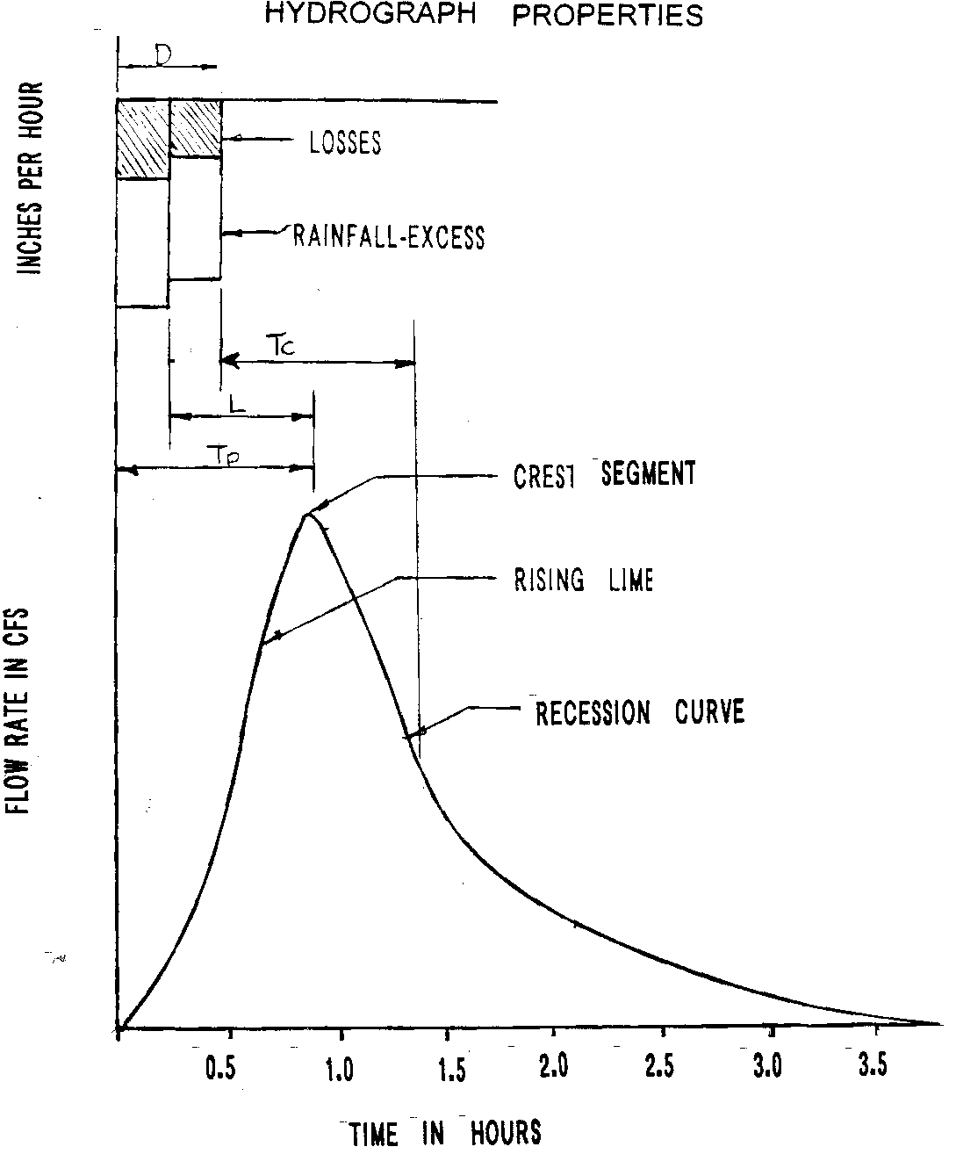
Hydrograph Properties

Slide 22
Hydrograph-Definitions
Lag Time
Time interval from the center of mass of the rainfall-excess to the peak of the resultant hydrograph
Time to Peak
Time interval from the start of the rainfall-excess to the peak of the resultant hydrograph
Rainfall Duration
Time interval from the start to the end of rainfall-excess
Time of Concentration
Time interval from the end of the rainfall-excess to the point of inflection on the hydrograph recession curve or
Time required for runoff to travel from the hydraulically most distant point on the watershed to the point of interest

Slide 23
Hydrograph-Duration/Frequency
Associated with the time duration and frequency of the rainfall-excess producing it
If the duration D of the rainfall-excess is 30 minutes and the frequency is 2 years, the hydrograph is referred to as a 30-minute, 2-year frequency hydrograph

Slide 24
Area under Hydrograph
Area under the hydrograph represents a volume of water (total volume of rainfall that fell on the basin and appeared as runoff)
If the area under the hydrograph represents 1 inch (or 1 cm) of rainfall-excess over the entire drainage basin then the hydrograph is called a Unit hydrograph

Slide 25
Unit Hydrograph
Area under a unit hydrograph graph=
1” of excess rainfall * Drainage Area
Area under the unit hydrograph=Volume of Runoff
(units are usually cfs*hr; can be converted to cubic ft)
1” of excess rainfall*Drainage Area=Volume of Runoff
(units are usually acre-in; can be converted to cubic ft)

Slide 26
Unit Hydrograph-Assumptions
Identical rainfalls with the same antecedent conditions produce identical hydrographs
The time bases of all hydrograph from rainfalls of the same duration with the same antecedent conditions are equal
Superposition: If the storm duration is the same, the hydrograph of a 2” storm is twice the amount of a 1” storm.

Slide 27
Hydrographs-Example of Superposition

Slide 28
Example
After a 2-hour storm, a station downstream from a 45 square mile drainage basin measures 9400 cfs as a peak discharge and 3300 acre-feet as total runoff.
a) Find the 2-hour unit hydrograph peak discharge.
b) What would be the peak runoff and design flood volume if a 2-hour storm dropped 2.5 inches of net precipitation?

Slide 29
a) Find Unit Hydrograph Peak Flow
Find volume of runoff which represents 1” of excess runoff over the 45 square mile drainage area
45 square miles * 1” = 2400 acre-ft
Since the actual measured 3,300 acre-ft is greater than the 2400 acre-ft for 1” of runoff, the storm had more than 1” of excess runoff

Slide 30
a) Find Unit Hydrograph Peak Flow Continued
The ratio of 3300/2400=1.375; therefore the storm had 1.375” of excess runoff
If the peak discharge is 9400 cfs for a runoff of 1.375” then the ratio of the peak discharge of the unit hydrograph must be:
2400/3300 (or 1/1.375) = 0.727
Peak discharge=0.727*9400 = 6,800 cfs

Slide 31
b) Find Q_{peak} & R_{off} of 2.5” storm
Once you know the peak flow and runoff volume that represents 1” of excess rainfall, then you just use ratios:
2.5*6,800 cfs= 17,000 cfs
2.5*2400 acre-ft = 6,000 acre-ft

Slide 32
Use of Hydrographs
Development can cause less infiltration and more runoff. In addition, runoff velocities increase because of smoother surfaces.
The net effect is that development can increase peak flow, resulting in inadequately sized drainage structures
Most stormwater management regulations require that post-development peak runoff rates be equal to or less than the predevelopment peak runoff rates
This can be done by constructing detention basins which temporarily store the water
Hydrographs are used to design detention basins (time is an issue)
Sometimes, only the peak runoff flow is needed.

Slide 33
Hydrographs
From rainfall data (not typical)
Synthetic
TR-55
Snyder
Simple Triangular
Modified Rational Method

Slide 34
Higher Level Content Not covered in this class
Deriving hydrographs for other storm durations
Subtract groundwater
Synthesize unit hydrographs for different storm durations using the:
Lagging storm method
S-Curve method

Slide 35
Next Lecture
Time of Concentration
Manning’s Equation (open channel flow equation)

