Slide 1
Hydrographs-Cont.

Slide 2
Objectives
Ability to subtract groundwater (base flow)
Ability to synthesize unit hydrographs for different storm durations using the:
  Lagging storm method
  S-Curve method

Slide 3
Separating Base Flow (Groundwater) from Overland Flow
Straight Line
Fixed Base
Variable Slope

Slide 4
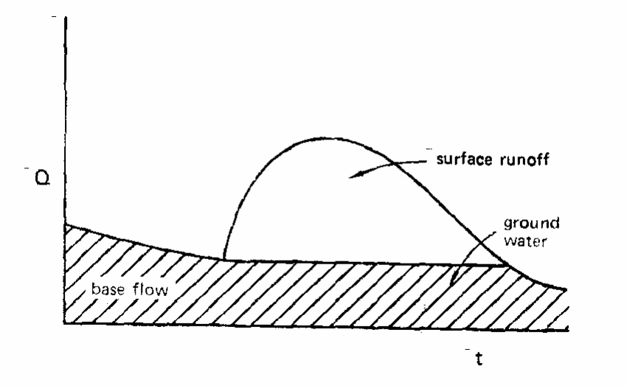
Straight Line
A horizontal line is drawn from the start of the rising limb to the falling limb. All of the flow under the horizontal line is considered base flow.

Slide 5
Fixed Base
The base flow existing before the storm is projected down to a point directly under the hydrograph crest. Then a straight line is used to connect the projection to the fall limb N days later. N is determined by inspection or by rule of thumb equations:
N=A^{0.2} (N-days and Area-square miles)
N=6.59A^{0.2} (N-hours and Area-acres)

Slide 6
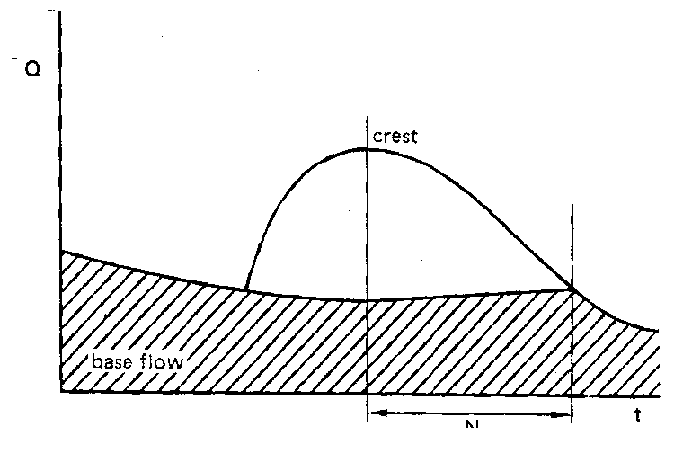

Slide 7
Variable Slope
Based on the assumption that the shape of the base flow curve before the storm will match the shape of the base flow curve after the storm. Base flow curve after the storm is projected back under the hydrograph to a point under the inflection point of the falling limb. The separation line under the rising limb is drawn arbitrarily
Pt of inflection-assumed to mark the time at which the surface inflow to the channel system ceases. After the point of inflection, the recession curve represents withdrawal of water from the basin

Slide 8
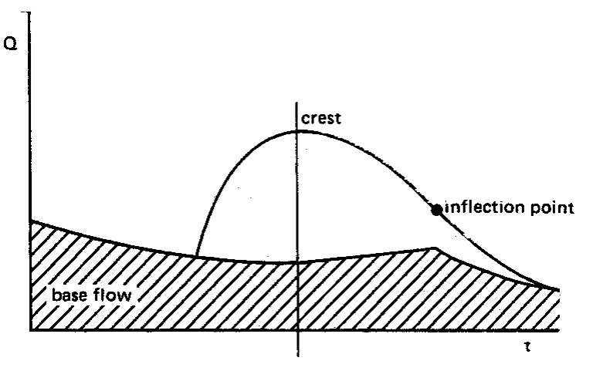

Slide 9
Hydrographs-Assumptions
The ordinates of all hydrographs from identical rainfalls of the same duration and the same antecedent conditions are proportional to the volume of rainfall-excess. That is, if unit hydrographs were obtained from a 2” and 3” rainfall excess by dividing ordinates of each hydrographs by 2 and 3, respectively, the unit hydrographs would be identical in shape.
The ordinates of several partial hydrographs obtained by multiplying the unit hydrograph ordinates by successive rainfall-excess amounts may be added to obtain a total storm runoff hydrograph.
Not all of these assumptions are always true. Unit hydrographs from large flows would be different than that of small flows due to variable channel storage. However, drainage design using the concept of the unit hydrograph has been found to be reasonably accurate.

Slide 10
Runoff from a 6-hour storm cannot be directly predicted from a 2-hr unit hydrograph by multiplying ordinates w/ ratios
However, hydrographs for other storm durations can be derived (or synthesized)

Slide 11
Synthesizing Unit Hydrograph for Different Storm Durations
Lagging Storm Method
  Construction hydrograph of a longer storm from the unit hydrograph of a shorter storm. Can only be used if the longer storm duration is a whole multiple of the shorter duration
  S-Curve Method
  Can be used to construct hydrographs from unit hydrographs with longer or shorter durations

Slide 12
Lagging Storm
(synthesize a 12-hr unit hydrograph from a 6-hr unit hydrograph)
Lag storm by short duration (6hr) until desired duration is obtained (total of 12/6=2 times)
Add shorter duration lagged storms to get a 12-hr hydrograph
Divide by the multiple (12/6=2) to get a unit hydrograph

Slide 15
S-Curve Method
(synthesize a 2-hr unit hydrograph (tr’) from a 6-hr unit hydrograph (tr)
Add ordinates of many hydrographs lagged by tr (eventually the curve levels off and remains constant—S-Curve)
Lag the S-curve by the proposed duration (tr’)
Difference between S-curves is the hydrograph for storm duration tr’
Convert to unit hydrograph by multiplying ordinates by tr/tr’ (6/2=3)
Smooth the data

Slide 22
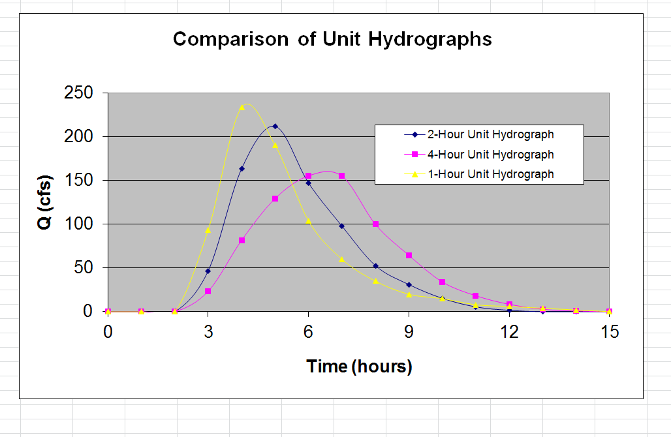
Lecture 5 homework: Extra Credit
Drop off Excel: Email Attachment

Slide 23
Next class
Determining the time of concentration
  Sheet flow
  Shallow concentrated flow
  Channel flow
    Manning’s equation

