Slide 1
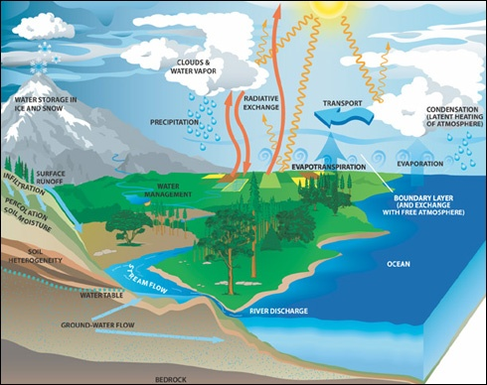
CTC 260 Hydrology
Introduction

Slide 2
Objectives
Class Requirements
Drainage Design Overview
Review of Significant Figures
Review of Accuracy and Precision

Slide 3

Class Requirements
On-Web: http://people.sunypoly.edu/~barans/
Schedule
Lectures
Grades
Brightspace:
Syllabus
Assignments/Dropoffs

Slide 4
Handouts-Also Online
Hydro-35
TR-55

Slide 5
Two Parts to Drainage Design
Hydrology – Determine water quantity
Hydraulics – Size structure to handle water

Slide 6
Drainage Design Steps
Delineate Watershed
Collect Watershed Data
Determine Design Storm
Determine Excess Precipitation (runoff)
Determine Peak Flow
Size Structure

Slide 7
End of Intro

Slide 8
Review-Drainage Design Steps
Delineate Watershed
Collect Watershed Data
Determine Design Storm
Determine Excess Precipitation (runoff)
Determine Peak Flow
Size Structure

Slide 9
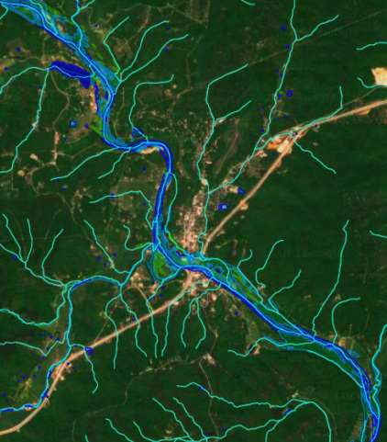

Slide 10
Watershed Data
Land Use
Soil Types
Overland flow Length
Length of Channel
Slope
Vegetative Cover
Roughness Coefficient
Existing Storage
Channel Shape
Existing Drainage Structures

Slide 11
Delineate Watershed
Identify points of interest
  Existing/Proposed Culvert Locations
  Changes in Land Use
  Major Stream Branching
Define Watershed Boundary
Delineate Subcatchment Areas
Determine Drainage Areas

Slide 12
What is a Watershed
https://www.youtube.com/watch?v=uaZPO7dgEnk

Slide 13
Design Storm
Return period (frequency)
Precipitation data (quantity/time)
IDF
  Rainfall Intensity
  Storm Duration
  Storm Frequency

Slide 14
Runoff
Part of design storm will become runoff and part will be retained by watershed (abstraction)
Dependent on:
  Soil type
  Cover type/land Treatment
  Land Use
  Antecedent runoff condition
  Impervious/pervious relationship

Slide 15
Hydrograph
Graph of time vs direct runoff at one particular location (point of interest)
  Rising limb
  Crest
  Falling (Recessional) Limb

Slide 16
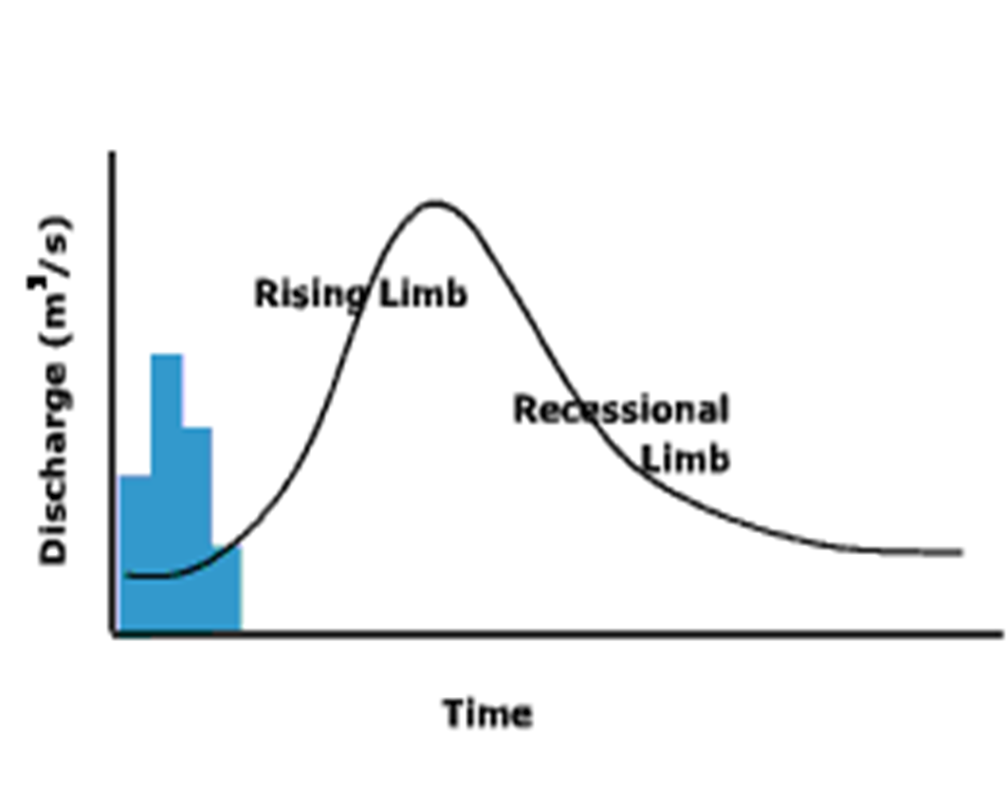
Hyetograph; Resulting Hydrograph

Slide 17
Unit Hydrograph
Hydrograph representing 1” of excess precipitation occurring uniformly over the watershed for a specified storm duration

Slide 18
Ungaged Watershed
If watershed is ungaged, then a synthetic unit hydrograph is developed from empirical equations
Rational Method
TR-55
others

Slide 19
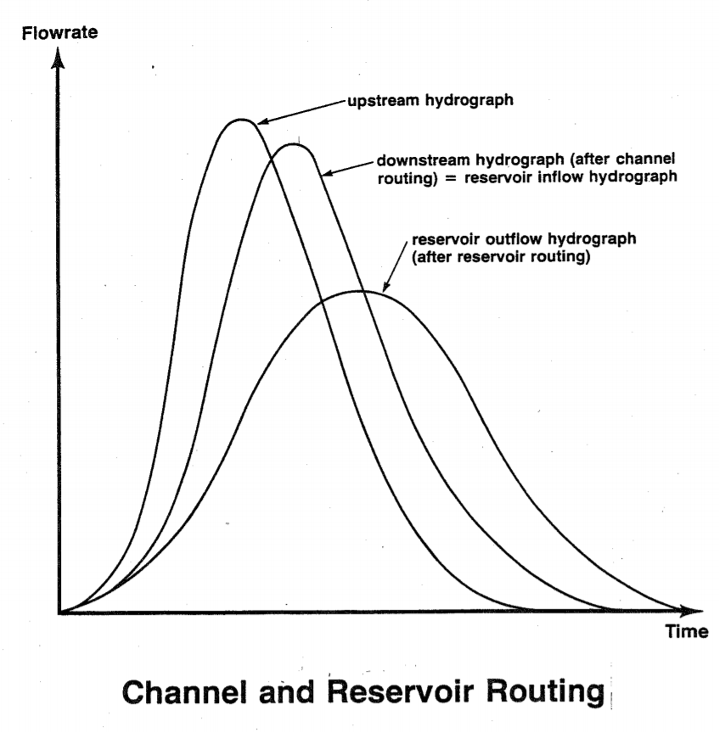
Peak flow or Hydrograph
Peak flow
Entire hydrograph

Slide 20
Sizing Drainage Structures
Inlets
Ditches
Culverts
Storm drainage system
Outflow structures
Detention Basin
Open channel flow
Energy/Hydraulic Grade Lines
Friction
Pressure
Head Loss

Slide 21
Documenting Work
Narrative on what was done and why
Map of watershed delineations
Tables summarizing info
Nomographs/equations used
References

Slide 22
Significant Figures
Number of digits used to form a quantity
132, 4.01, and 0.00425 all have 3 significant figures
350, 2500, 92,000 all have 2 significant figures
350., 2500., 92,000. have 3, 4, and 5 significant figures, respectively

Slide 23
Numbers not subject to significant digits
pi
Formulas (2*pi*r)---2 is exact

Slide 24
Measured numbers-significant digits
229 feet – assumed measured to the nearest foot (could be 228.5 to 229.4); has 3 significant figures
229.5 feet – assumed to be measured to the nearest 0.1 foot (could be 229.45 to 229.54); has 4 significant figures
230 feet
  (2 significant figures; measured to nearest 10 feet)
230. feet
  (3 significant figures; measured to nearest 1 foot)

Slide 25
Significant Digits-Computation Rules
Multiplication and Division
  Answer should have no more significant figures than the least number of significant figures in any quantity in the computation
Example:
  230.0 x 20. = 460 (2 significant figures; not 460. which would imply 3 significant figures)

Slide 26
Significant Digits-Computation Rules2
Addition and Subtraction
  Answer should have no more digits to the right of the decimal point than the least number of digits to the right of the decimal point in any quantity in the
Example:
  230.1 + 20. = 250.
  (3 significant figures; not 2; not 4)

Slide 27
Significant Digits – Computation in Series
Series
  If the answer to one computation is used in another computation, then the final answer is rounded to the quantity with the lowest number of significant digits

Slide 28
Accuracy and Precision
Accuracy-how close a value is to the actual value
Precision-how many significant digits are displayed
  Avoid displaying lots of numbers because your calculator displays lots of numbers (answer looks precise but is not necessarily accurate)

Slide 29
Next Lecture
Watersheds
  What are they?
  Why are they important?
  How do you delineate them?
  How do you measure their areas?

