Slide 1
Precipitation and IDF Curves

Slide 2
Objectives
Students will have the ability to:
Explain the definition of return frequency
Create an IDF curve from precipitation data

Slide 3
Precipitation
Any type of falling moisture
Formed when moisture-laden air is cooled so that water condenses
Nuclei are usually needed for water droplets to form
Sources:
90% evaporation from ocean
10% evaporation from continents

Slide 4

Rain
Liquid Water Drops

Slide 5
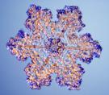


Snow
Ice crystals

Slide 6

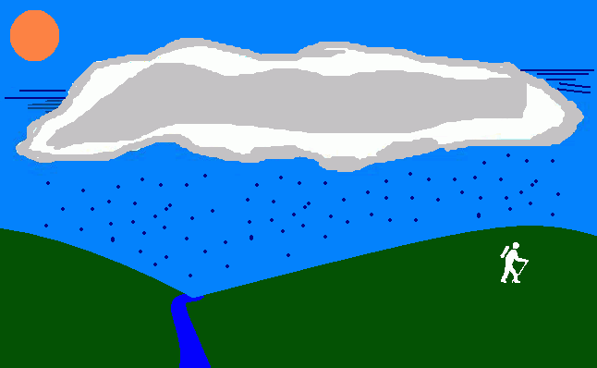
Drizzle
Mist; slow settling rates (.04 in/hr)

Slide 7

Rime
White, opaque deposits of ice granules which are separated by trapped air. Formed by rapid freezing of supercooled water drops impinging on exposed objects.

Slide 8
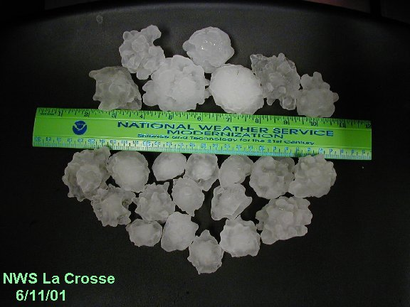
Hail
Balls of ice (alternating layers of glaze and rime)

Slide 9
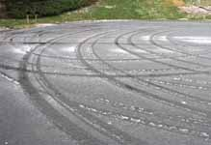
Sleet
Transparent, globular, solid grains of ice formed by freezing of rain drops falling through a layer of subfreezing air near the earth’s surface

Slide 10
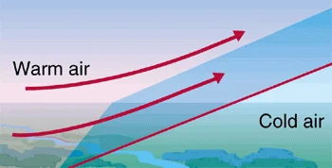
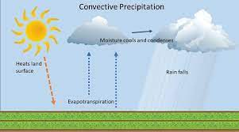
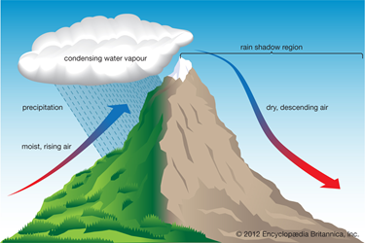
Factors Responsible
Cyclonic-Lifting of air converging into a low-pressure area
Convective-rise of warm, lighter air in colder denser surrounding
Orographic-lifting over mountains

Slide 11
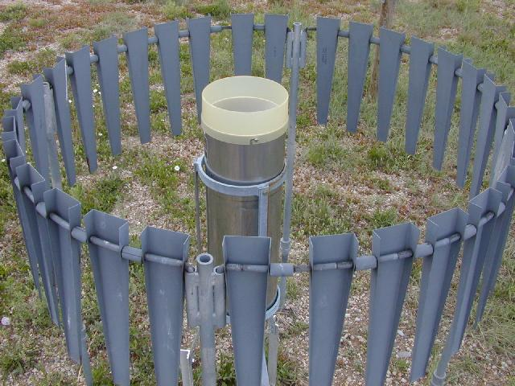
Precip Data
National Weather Service (NWS) collects and publishes data
Point rainfall collected in vertical cylindrical rain gauges (dia. = 8”)

Slide 12
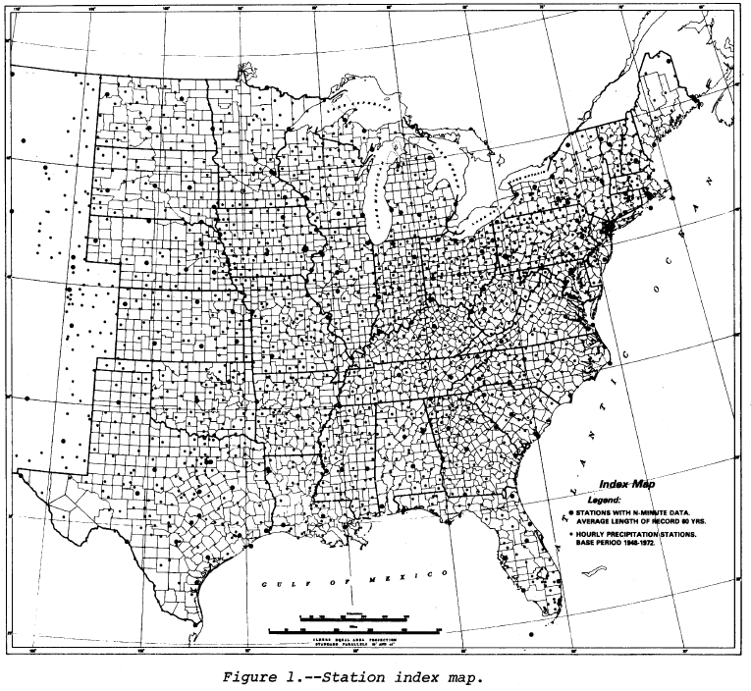
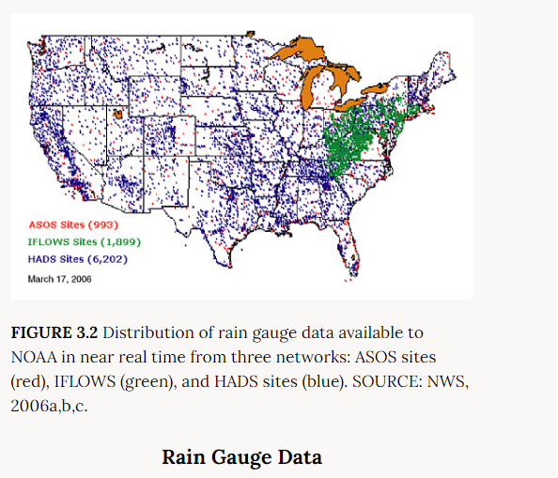
Rain Gage Data Locations

Slide 13
First Order Station
Continuous records of precipitation, temperature, humidity, wind direction, wind velocity, and other
NOAA Northeast Regional Climate Center in Ithaca, NY
http://www.nrcc.cornell.edu/

Slide 14
Precipitation-Varies by Region See next slide
Eastern third of country-reasonable uniform rainfall throughout the year
Central plains-Wet summer as compared to winter months
Mountainous areas-Light rainfall; not much rainfall in the summer
West Coast-Most of the rainfall in the winter months

Slide 15
US Seasonal Precipitation

Slide 16
Effect of Mountains See next slide
Discontinuities in the precipitation maps caused by the Rocky Mountains, the Cascades, and to a lesser extent, the Appalachian Mountains

Slide 17
Annual Rainfall in US

Slide 18
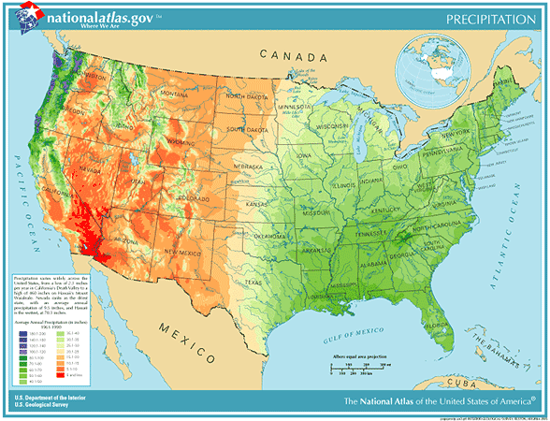
Precipitation in US (Colorized)

Slide 19
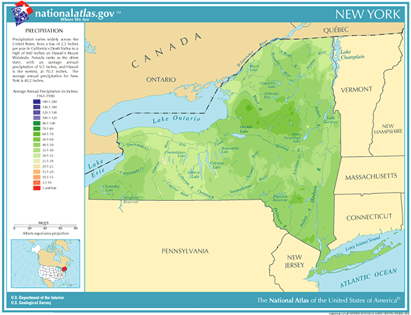
NY Precipitation (Colorized)

Slide 20
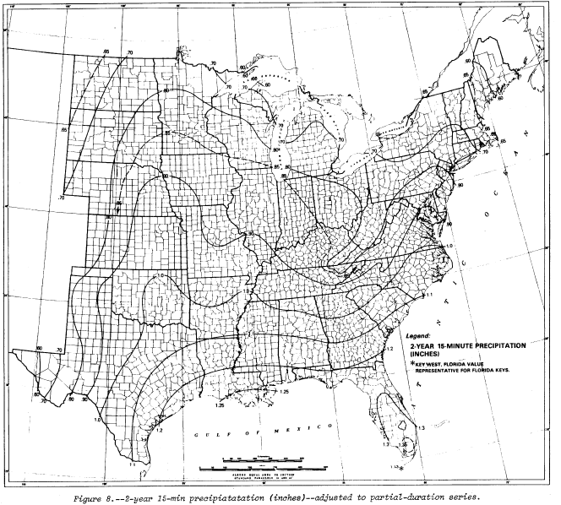
Hydro-35
Hydro-35
Data is displayed in the form of isohyetal lines on geographical maps (total amount of rainfall in inches for a specific storm duration and for a specific recurrence interval)

Slide 21
Determining Intensity
Previous map--- shows 1” of water in 15 minutes. Convert to intensity.
4” of water in 60 minutes
Intensity is 4” per hour

Slide 22
Determining Intensity Example 2
6” of precipitation falls in 2 hours
Rainfall intensity is __ per hour?

Slide 23
IDF
Intensity (inches/hour)
Storm Duration (minutes or hours)
Storm Frequency (once every XX years)

Slide 24
Questions Part 1
What are the units of rainfall intensity (English system)?
With respect to the phrase “2-year, 30 minute”. What does the 2-year refer to? What does the 30 minutes refer to?

Slide 25
Hydro-35 Handout
Older outdated document but includes methods used for Project 1
Storm durations <= 1 hour
Gave out as handout and available on lectures

Slide 26
Break

Slide 27
IDF Curves
Intensity-Duration-Frequency
Rainfall Intensity (inches per hour)
Storm Duration (how long the storm lasts)
Frequency of storm return

Slide 28
Hydro-35 (Historical)
Contains precipitation info for storms with a very short duration (<= 1 hour)
Other documents TP-40 (eastern US), Atlas 2, NOAA Atlas, etc. cover longer durations and other geographical areas.

Slide 29
Updated Electronic Data
NOAA’s NWS Precipitation Frequency Data Server
https://hdsc.nws.noaa.gov/pfds/

Slide 30
Hydro-35 Summary
200 weather stations
60 years of record
Includes isohyetal maps showing precipitation total for the following storm durations and frequencies:
Storm Durations (5, 15 and 60 minutes)
Frequencies (2 and 100-years)
Equations are also given to determine data for frequencies between 2 and 100 years (5,10, 25, 50) and for other storm durations (10 and 30-minutes)

Slide 31
Creating an IDF Curve using Hydro-35
Locate your particular area of interest
Calculate average intensities for:
2-yr frequency (5, 15, and 60 minutes)
100-yr frequency (5, 15, and 60 minutes)
Obtain other values from equations on page 28
Graph results (use xy scatter)

Slide 32
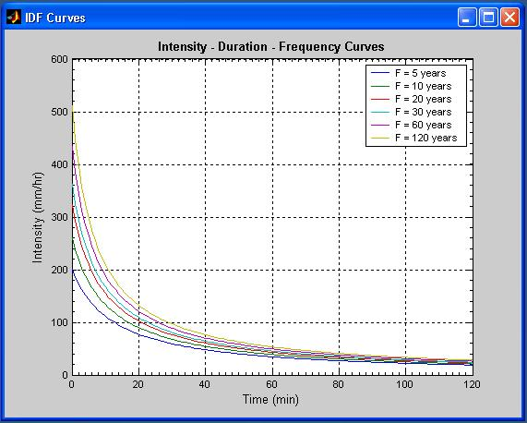
Example IDF Curve
http://www.mathworks.com/matlabcentral/fileexchange/9740-intensity-duration-frequency-curves

Slide 33
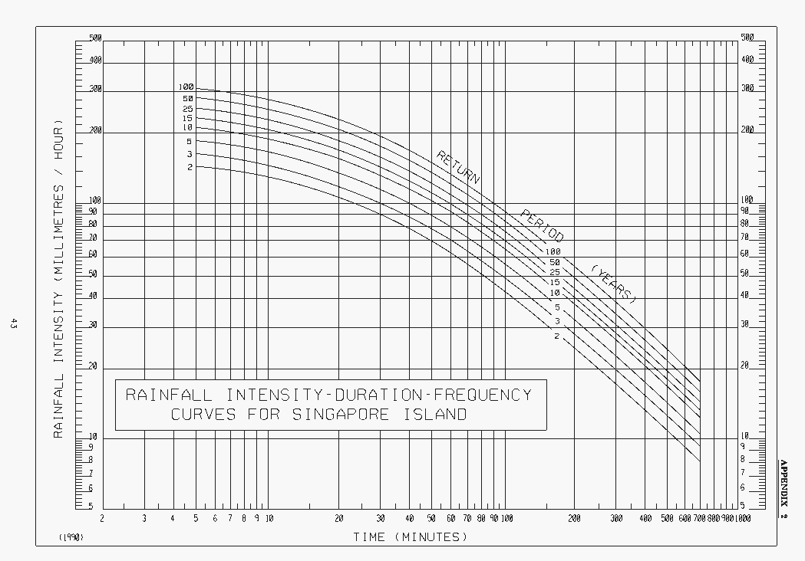
Example IDF Curve: Logarithmic
http://www.pub.gov.sg/general/code/Pages/SurfaceDrainagePart2-7.aspx

Slide 34
Design Frequencies
It is not economically feasible to provide protection against the largest flood that could occur.
For large projects (bridges/dams) a 100-yr frequency is often used
For smaller projects design year depends on agency, type of facility, etc.

Slide 35
NYSDOT
Cross-Drainage
Interstates/major arterials 50-yr
Minor arterials, collectors, local (lower if justified)
10 to 25-yr is common
Check 100-yr
Roadside Surface Drainage System
Pipes, inlets, gutters 10 (arterials) or 5-yr (local/collector)
Underpasses 50-yr (collectors/local 25-yr)
Ditches
Depth 25 (or 10 for minor arterials/collectors/local)
Velocity 10 (or 5 for minor arterials/collectors/local)

Slide 36
Statistics
Precipitation graphs are based on statistics and include the element of frequency (a 2-yr storm theoretically happens once every 2 years)
The probability (P) of precipitation amounts equaling or exceeding a return frequency (Tr) is: P=1/Tr

Slide 37
Example
The probability of precipitation amounts equaling or exceeding a 2-yr storm is
P=1/2=0.5=50%
In other words, each year there is a 50% chance that precipitation will exceed that of a 2-yr storm

Slide 38
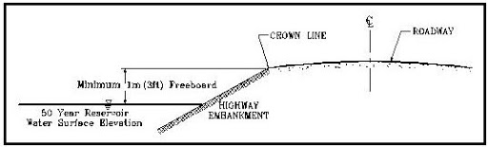
Relationship to design
If culverts are designed to pass flows of annual probability P, then it implies that on average P*N culverts will be overtopped each year, where N is the total number of culverts.
If a county has 100 culverts and they’re designed for a 2-yr frequency then on average 50 culverts will be topped each year
Discuss concept of freeboard

Slide 39
Probabilities over Time
What if you want to know the probability (J) of an event (F) occurring over a specified interval of time (N)?
J=1-(1-P)^{N}
Where P=1/F

Slide 40
Probabilities over Time: Proof
What if you want to know the probability (J) of a 100-yr event (F) occurring over a period (N)?
Probability each year that event occurs (P) = 1/F
Probability each year that event does not occur=(1-P)
Probability that event does not occur over a time period (N)=(1-P)^{N}
Probability (J) that event does occur over a time period (J)=1-(1-P) ^{N}
*If you have an event that has a probability of 0.01 of "happening" in a given trial, and so a probability of 0.99 of "not happening", then (1- 0.01)^10 is the probability it does NOT happen in 10 consecutive trials. (1- 0.99)^10= 0.01^10 is the probability it DOES happen in all ten trials. They don't add to 1 because there are many other things that could happen: happen in the first trial but not in other trials, happen on the first and third trial but not on other trials, etc. "happen on all trials" and "happen on no trials" do not exhaust all the possible outcomes.

Slide 41
Probabilities over Time Example
What is the probability of a 100-year flood occurring over the 10-yr interval it will take to build a dam?
J=1-(1-P)^{N}
J=1-(1-.01)¹⁰
J=9.6%
Answer: There is a 9.6% chance that the 100-yr event will be equaled or exceeded during the next 10 years

Slide 42
Questions Part 2
With respect to an IDF curve:
What is I? Units?
What is D? Units?
What is F? Units?
If you use Hydro-35 can you directly obtain intensities? If not, what do you have to do to get the intensity numbers?

Slide 43
Go over:
Project 1 (Develop IDF Curves)
Precipitation Server:
https://hdsc.nws.noaa.gov/pfds/

Slide 44
Next Lecture
Hyetographs

