Slide 1
Determining Peak Design Flows:

Slide 2
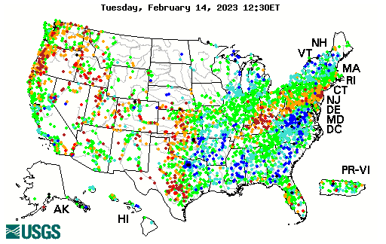
Gaged Stations (USGS)
http://waterdata.usgs.gov/ny/nwis/rt

Slide 3
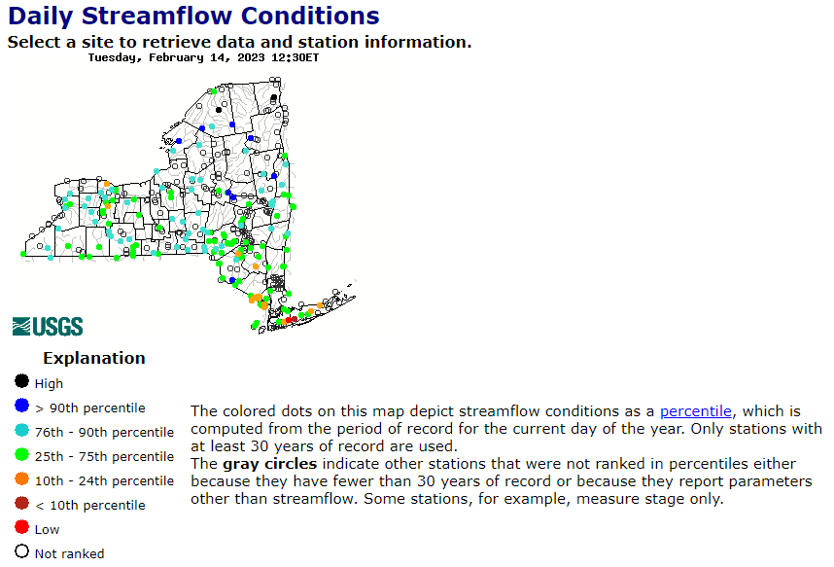
Gaged Streamflow Stations (USGS)
http://waterdata.usgs.gov/ny/nwis/rt

Slide 4
Various Methods
Statistical Analysis of Streamflow Records
Transfer Methods (using gaged data to estimate an ungaged location)
Regional Methods (region-specific equations developed based on areas, slopes, etc)
Models (Rational method/TR-55)
Higher-Level Models (TR-20; HEC-RAS)

Slide 5
Rational Method

Slide 6
Learning Outcomes
Use the rational method to estimate peak flows:
  Determine watershed boundaries and areas
  Determine tc, slopes, length
  Choose appropriate rational coefficients
  Calculate a weighted rational coefficient
  Determine the average intensity using an IDF curve
  Utilize the equation to determine peak flow

Slide 7
Assumptions
Rainfall intensity is uniform over the drainage basin during the duration of the rainfall
*Maximum runoff rate occurs when the rainfall lasts as long or longer than the time of concentration (if storm is shorter than the tc then not all the drainage area is utilized; if the storm lasts longer than the tc then the intensity if lower)
The frequency for rainfall and runoff are equal

Slide 8
General Use of Rational Method
Generally used for small drainage basins
Do not use the rational method for drainage areas larger than 100-200 acres
Rational method not applicable if there is significant ponding (ponds, wetlands) within the drainage area

Slide 9
Derivision
Assume a storm duration = time of conc.
Volume of runoff assuming no infiltration
= avg. intensity*drainage area*storm duration
=I*A*Tc

Slide 10
Theoretical runoff hydrograph
Area under hydrograph = ½ *2Tc*Qp=Tc*Qp

Slide 11
Derivision of Rational Method
Volume of rain = Volume observed as Runoff
I*A*Tc=Tc*Qp
Qp=IA
To account for infiltration/evaporation/storage add a coefficient C (C<1)
Qp=CIA

Slide 12
Equation: Q=CIA
Q-peak flow (cfs) where:
C-runoff coefficient (dimensionless)
I-average rainfall intensity (in/hr)
A-drainage area basin (acres)

Slide 13
Do units make sense?
acre-in/hr = cfs?
Check units:
1 acre-in/hr = 1.008 cfs

Slide 14
Basic Steps to Estimate Peak Flow Rational Method (Q=CIA)
Determine the drainage area (in acres)
Determine the time of concentration (sheet, shallow concentrated and open channel)
Set the storm duration equal to the time of concentration and determine the average storm intensity from IDF Curve
Determine the rational coefficient C (may need weighted average)
Select a frequency (return period)
Use rational method equation (Qp=CIA) to estimate peak flow

Slide 15
C-Typical Values (by surface)
Forested 0.059-0.2
Asphalt 0.7-0.95
Brick 0.7-0.85
Concrete 0.8-0.95
Shingle roof 0.75-0.95
Lawns, well drained (sandy soil)
up to 2% slope 0.05-0.1
2% to 7% slopes 0.10-0.15
over 7% slope 0.15-0.2
Lawns, poor drainage (clay soil)
up to 2% slope 0.13-0.17
2% to 7% slopes 0.18-0.22
over 7% slope 0.25-0.35
Driveways, walkways 0.75-0.85
Ref: Civil Engr. Ref. Manual, 6th ed., Michael Lindeburg, PE, Professional Publications, Inc. ISBN: 0-921045-45-0

Slide 16
C-Typical Values (by use)
Farmland or Pasture 0.05-0.3
Unimproved 0.1-0.3
Parks or Cemeteries 0.1-0.25
Railroad Yard 0.2-0.4
Playgrounds (not asph or conc) 0.2-0.35
Business Districts
neighborhood 0.5-0.7
city (downtown) 0.7-0.95
Residential
single family 0.3-0.5
multi-plexes, detached 0.4-0.6
multi-plexes attached 0.6-0.75
suburban 0.25-0.40
apartments, condominiums 0.50-0.70
Industrial
light 0.5-0.8
heavy 0.6-0.9
Ref: Civil Engr. Ref. Manual, 6th ed., Michael Lindeburg, PE, Professional Publications, Inc. ISBN: 0-921045-45-0

Slide 17
Rational Coefficient C
Must be weighted if you have different area types within the drainage area
Drainage area = 8 acres:
2 acres; C=0.35 (residential suburban)
6 acres; C=0.2 (undeveloped-unimproved)
Weighted C=[(2)(.35)+(6)(.2)]/8 = 0.24

Slide 18
Break

Slide 19
Basic Steps to Estimate Peak Flow Rational Method (Q=CIA)-Continued
Determine the drainage area (in acres)
Determine the time of concentration (sheet, shallow concentrated and open channel)
Set the storm duration equal to the time of concentration and determine the average storm intensity from IDF Curve
Determine the rational coefficient C (may need weighted average)
Select a frequency (return period)
Use rational method equation (Qp=CIA) to estimate peak flow

Slide 20
Example:
Determine the peak flow for a 100-acre watershed in central NY (mostly forested). Assume the intensity is 3” per hour.
What is the peak flow if the watershed is developed into light industrial usage? Assume the intensity is 3” per hour.

Slide 21
Example-undeveloped:
C=0.2 (0.1+0.3)/2 (see slide 15-unimproved)
I=3” per hour (given)
A=100 acres (given)
Q=CIA = 60 cfs

Slide 22
Example-developed:
C=0.65 (0.5+0.8)/2 (see slide 15-light industrial)
I=3” per hour (given)
A=100 acres (given)
Q=CIA = 195 cfs
In reality, the peak could be higher, since the time of concentration would likely decrease (which would increase the intensity)

Slide 23
Detention Structures
Store runoff temporarily and then release it in a controlled manner to limit the peak flow leaving a site
  Mitigates destructive effects of increased runoff
  May improve water quality
  May increase recharge

Slide 24
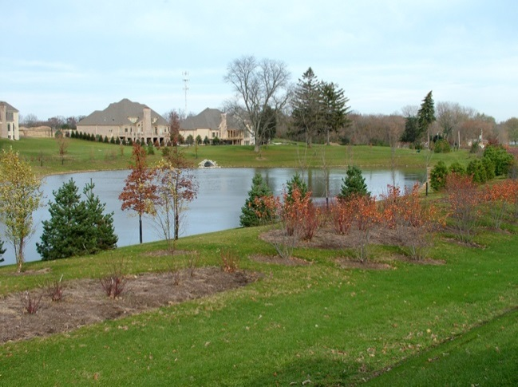
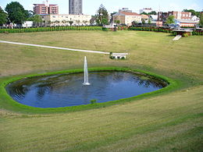
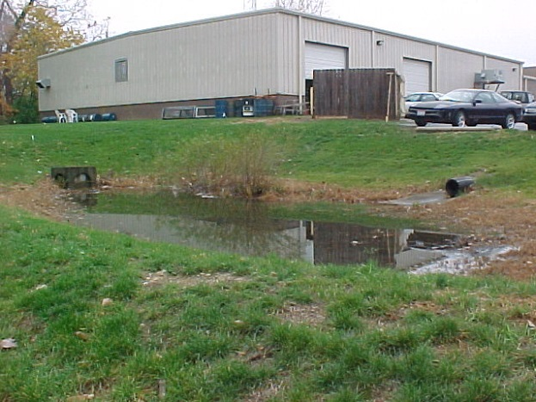
Detention Structures-Pictures
http://www.answers.com/topic/boneyard-creek
http://www.schefloweng.com/subdivision.html
http://environmentalengineering.net/pictures/catwood_wet.jpg

Slide 25
Detention Structure Characteristics
Basically a tank or pond
Complex because water coming in (inflow hydrograph) is not constant
Water going out is not constant (single or multistaged outlet structure where Qout varies based on water elevation in the structure)
Water elevation in the structure is not constant

Slide 26
Midterm---Next Week
Thursday (March 5)
Open book/open notes
Individual Work
You should be able to:
  Delineate watershed areas
  Read and interpret IDF curves
  Interpret hydrographs (check to determine if it is a unit hydrograph given a Drainage Area)
  Calculate probabilities (for one year and over a time period)

