Slide 1
Stormwater Pollution Prevention Plans

Slide 2
Objectives
Know the brief legislative background of stormwater discharges
Know what a SWPPP is and what is included in a SWPPP

Slide 3
Definitions
SWPPP-Stormwater Pollution Prevention Plan
NPDES-National Pollutant Discharge Elimination System
SPDES-State Pollutant Discharge Elimination System
MS4-Municipal Separate Storm Sewer System
NOI-Notice of Intent
Blue Book-”New York Standards and Specification for Erosion and Sediment Control”

Slide 4
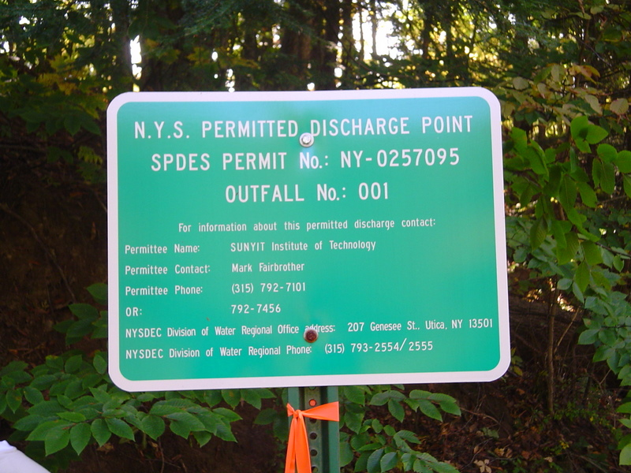
Sign for SPEDES Permit

Slide 5
History
Water Quality Act-1987
First regulations dealing with discharge of stormwater
Phase I Stormwater Regulations-1990
NYSDEC is local permitting authority
NYSDEC issued 2 general permits-1993
Industrial Site Runoff
Construction Projects > 5 acres (Phase I)
Phase II Stormwater Regulations-1999
Apply to Construction Projects > 1 acre

Slide 6
On-Line References
New York State Stormwater Management Design Manual (Draft 22)
NY Standards and Specifications for Erosion and Sediment Control (Blue Book)

Slide 7
General Permit
Operator must submit NOI
Operator must prepare SWPPP (water quality and quantity control)
Operator is responsible for implementing all measures outlined in the SWPPP
Inspections every 7 days and after a storm event of 0.5 inches or more
Inspection summaries prepared by a “qualified professional” must be posted for view by the public.
NYSDEC can fine up to $25,000 per day of violation

Slide 8
Maintaining Water Quality
No increase in turbidity that will cause a substantial visible contrast to natural conditions
No increase in suspended, colloidal and settleable solids that will cause deposition or impair the waters for their best usages
No residue from oils and floating substances, nor visible oil film, nor globules of grease

Slide 9
Erosion Factors
Soil Type
Higher potential – silt and fine sand
Lower potential –clays and organics
Vegetative Cover
Topography
Climate
Season

Slide 10
SWPPP-Contents
Standards for Construction Activities
Background project info
Site Map
Soil Description
Construction Phasing Plan
Pollution Prevention Measures
Description of Construction and Waste Materials
Temporary and Permanent Structural and Vegetative Measures

Slide 11
SWPPP-Contents (contents)
Map showing control measures
Details of control measures
Identify temporary measures to be converted to permanent control measures
Maintenance Schedule
Name of receiving water
Description of structural practices used to divert flows
Description of existing data that describes the stormwater runoff characteristics at the site

Slide 12
Commonly Used SWPPP Measures
Construction Entrance
Mulching/Seeding
Silt Fences
Straw Bale Dikes
Drop Inlet Protection
Stone Check Dams
Prefabricated Check Dams

Slide 13
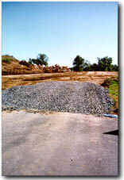
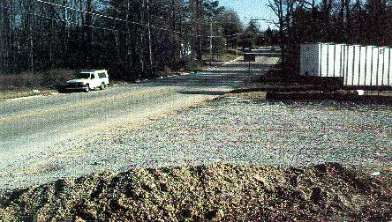
Construction Entrance
http://pasture.ecn.purdue.edu/~sedspec/sedspec/images/construction.jpg
http://www.harfordcountymd.gov/dpw/eng&const/WaterResources/Images/Sedimentcont2.jpg

Slide 14
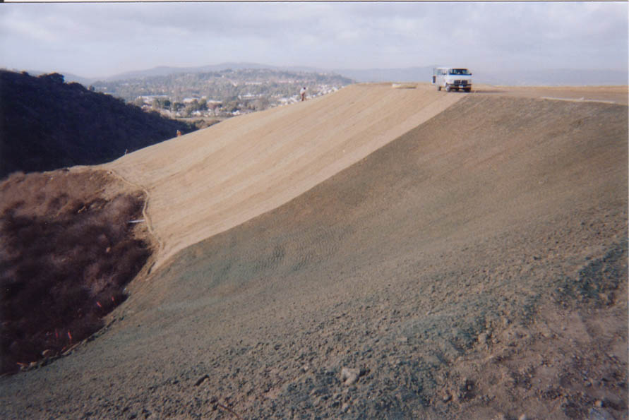
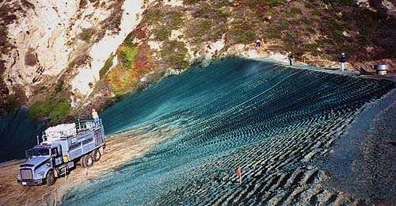
Erosion Control (Mulching/Seeding)
http://www.terra-mulch.com/photos/11-11.JPG
http://www.ssseeds.com/ecb/photos/WS05/images/WS05%202-1%20Over%20Mulch.jpg

Slide 15
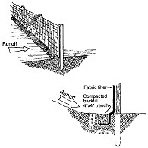
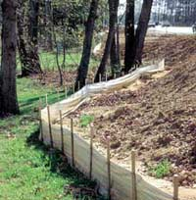
Silt fences
www.acfenvironmental.com/ bmp_siltfence.htm
www.forestry.state.ar.us/ bmp/appn_soil.html

Slide 16
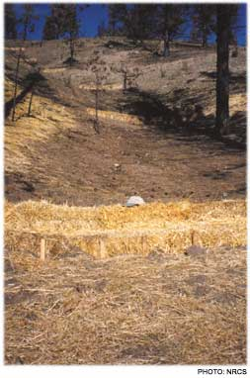
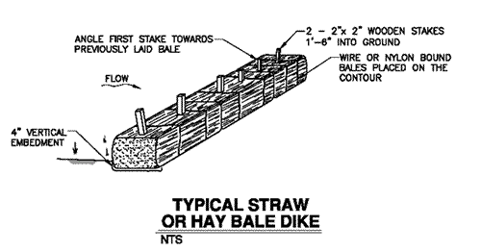
Straw Bale Dikes
http://www.salmonhabitat.org/images/v3f52b.gif
http://www.forester.net/images/ec_0103_p78_top.jpg

Slide 17
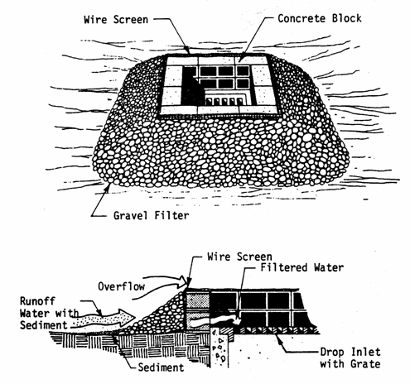
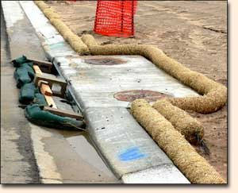
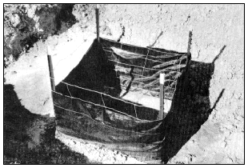
Drop Inlet Protection
http://unix.eng.ua.edu/~rpitt/Class/Erosioncontrol/Module8/Module8_files/image050.gif
http://www.greatamericantec.com/images/inlet.jpg

Slide 18
From “Blue” Book

Slide 19
Blue Book—Storm Drain Inlet Protection
Type I Excavated Drop Inlet Protection
Type II Fabric Drop Inlet Protection
Type III Stone & Block Drop Inlet Protection
Type IV Curb Drop Inlet Protection

Slide 20
Blue Book—Type I Excavated Drop Inlet Protection

Slide 21
Blue Book— Type II Fabric Drop Inlet Protection

Slide 22
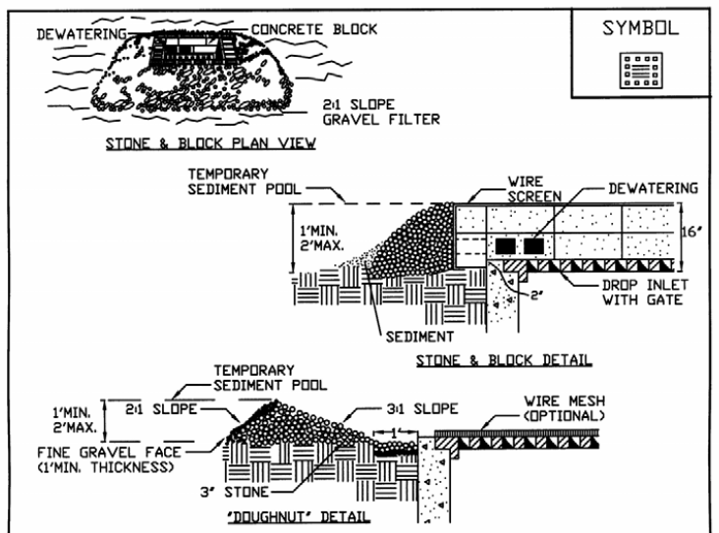
Blue Book— Type III Stone & Block Drop Inlet Protection-1

Slide 23
Blue Book— Type III Stone & Block Drop Inlet Protection-2

Slide 24
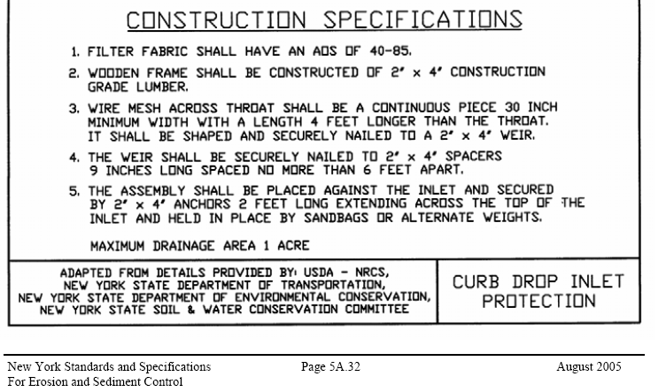
Blue Book— Type III Stone & Block Drop Inlet Protection-3

Slide 25
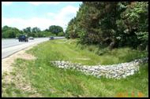
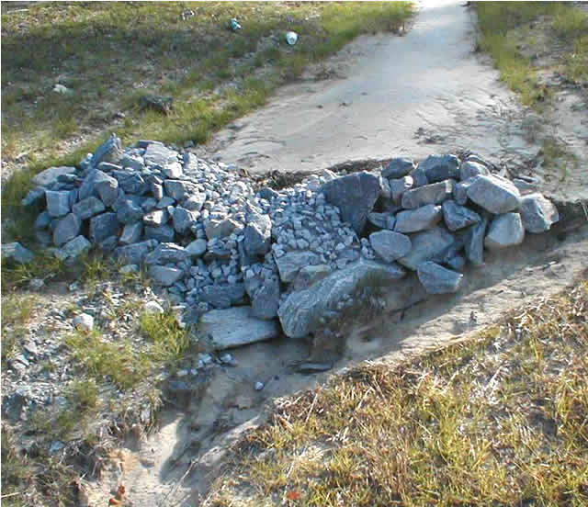
Stone Check Dams
http://www.ncc-swnpdes.com/images/stone_creek_dam.jpg
http://www.dfr.state.nc.us/images/wq/glossary/rockcheckdam.jpg

Slide 26
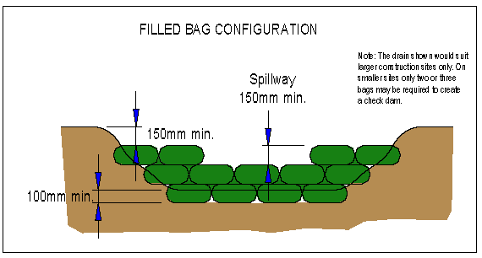
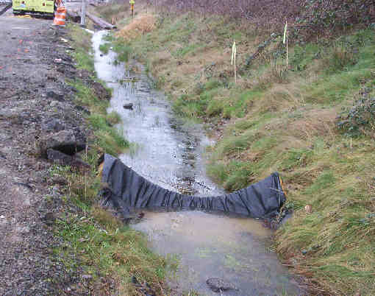
Other Check Dams
http://www.lakemac.infohunt.nsw.gov.au/erosion/images/09051.gif
http://www.wsdot.wa.gov/NR/rdonlyres/BA478915-1B80-4188-BB59-37358244CBDF/0/CheckDam_Jan05.jpg

Slide 27
Site Plan/Inspection Report
Shows erosion control measures in relation to site
Indicates areas that need permanent measures
Indicates other action items based on inspection

Slide 28
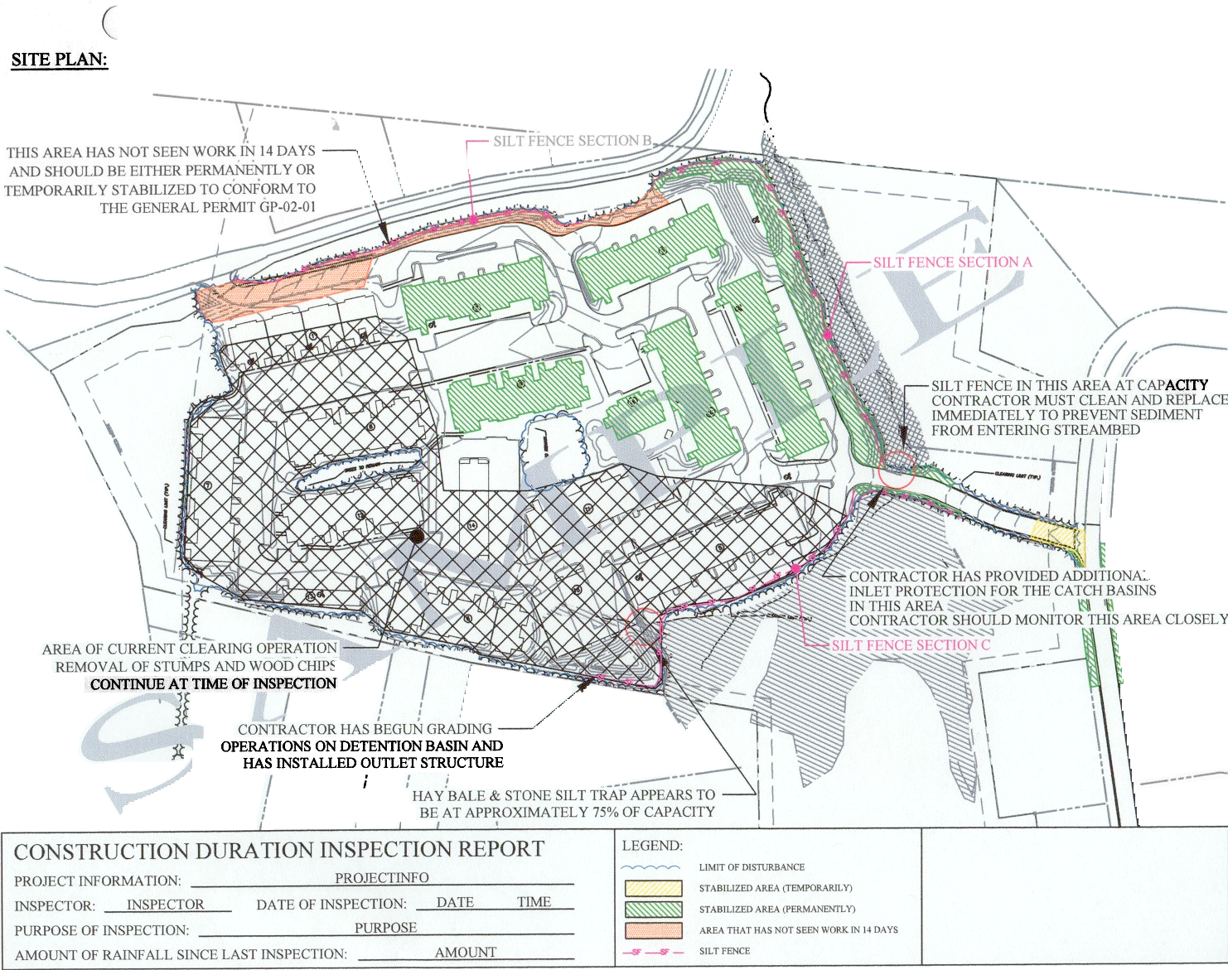
SPEDES Site Plan Example

