Slide 1
TR-55
Urban Hydrology for Small Watersheds

Slide 2
Simplified methods for estimating runoff and peak discharge for small urban/urbanizing watersheds
Ch 1 Intro
Ch 2 Estimating Runoff
Ch 3 Time of Concentration
Ch 4 Peak Runoff Method
Ch 5 Hydrograph Method
Ch 6 Storage Volumes for Detention Basins

Slide 3
Chapter 5 Tabular Hydrograph Method
Can be used to estimate runoff from nonhomogenous watersheds
Input:
  Same as Chapter 4 for each subarea
  Tt-travel time for each routing reach

Slide 4
Steps
Use Worksheet 5a to calculate/summarize info on each subarea
Use worksheet 5b to route the various subareas

Slide 5
Limitations
Accuracy decreases as complexity increases
Accuracy (+/- 25%)
Where possible, compare to gaged data
TR-20 (not TR-55) should be used if:
  Tt > 3hours
  Tc for any subarea > 2 hours
  Drainage areas differ by a factor of 5 or more
  Entire hydrograph is needed for detailed flood routings
  Peak discharge time must be determined accurately

Slide 6
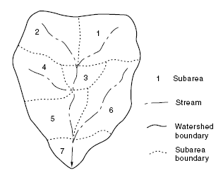
Subareas 1 & 2 routed through 3,5 and 7
Subareas 3 & 4 routed through 5 & 7
Subareas 5 & 6 routed through 7
Proposed subdivision in 5, 6 and 7

Slide 7
Table 5-1 Initial abstraction as a function of curve number
Ia/P values are then calculated

Slide 8
Exhibit 5 tables (4 different exhibits based on the 4 rainfall distribution types)
Prerouted using ATT-KIN method
Tables give unit peak discharge (multiply by DA and Q to get Discharge)
Ia/P values are rounded off to the nearest 0.1, 0.3 or 0.5 (or interpolated)
Travel time must be rounded off to table values

Slide 9
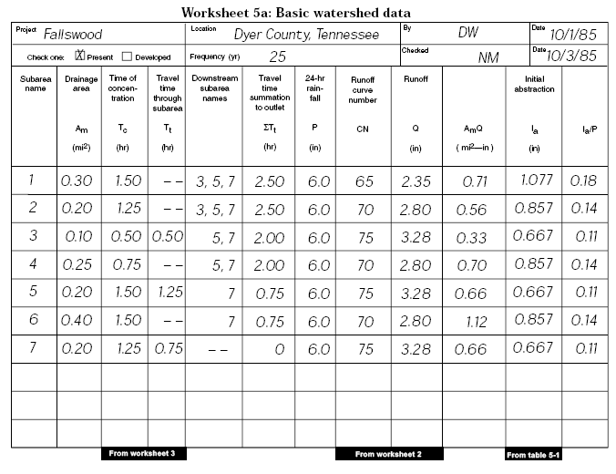
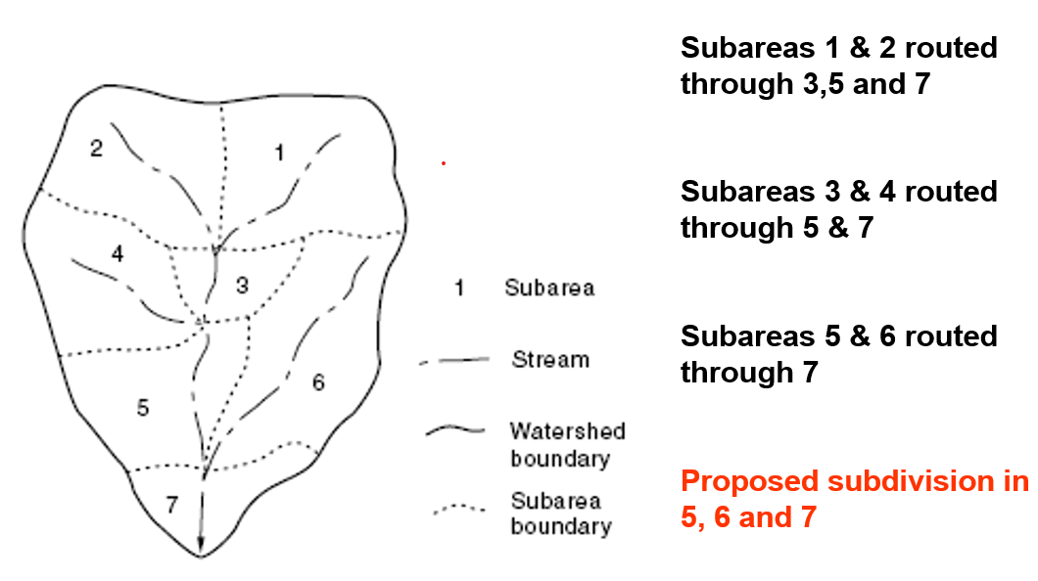

Slide 13
Impact of Development
Peak flow is higher after development
Peak flow occurs earlier after development

Slide 14
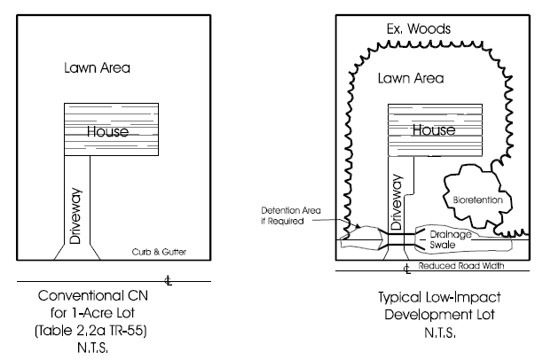
Low Impact Development
http://www.epa.gov/nps/lid/
http://www.lowimpactdevelopment.org/
http://www.lid-stormwater.net/

Slide 15
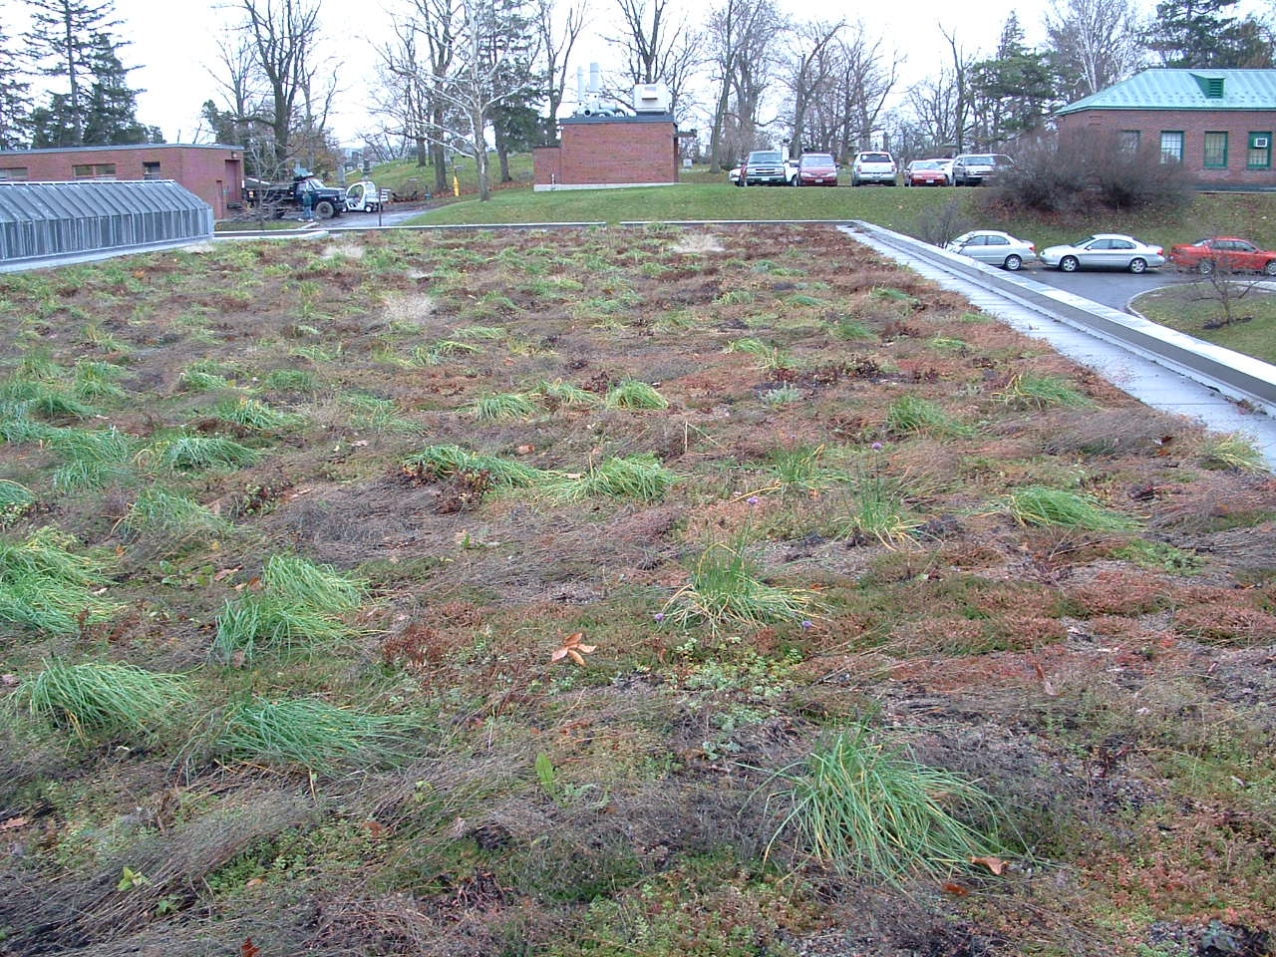
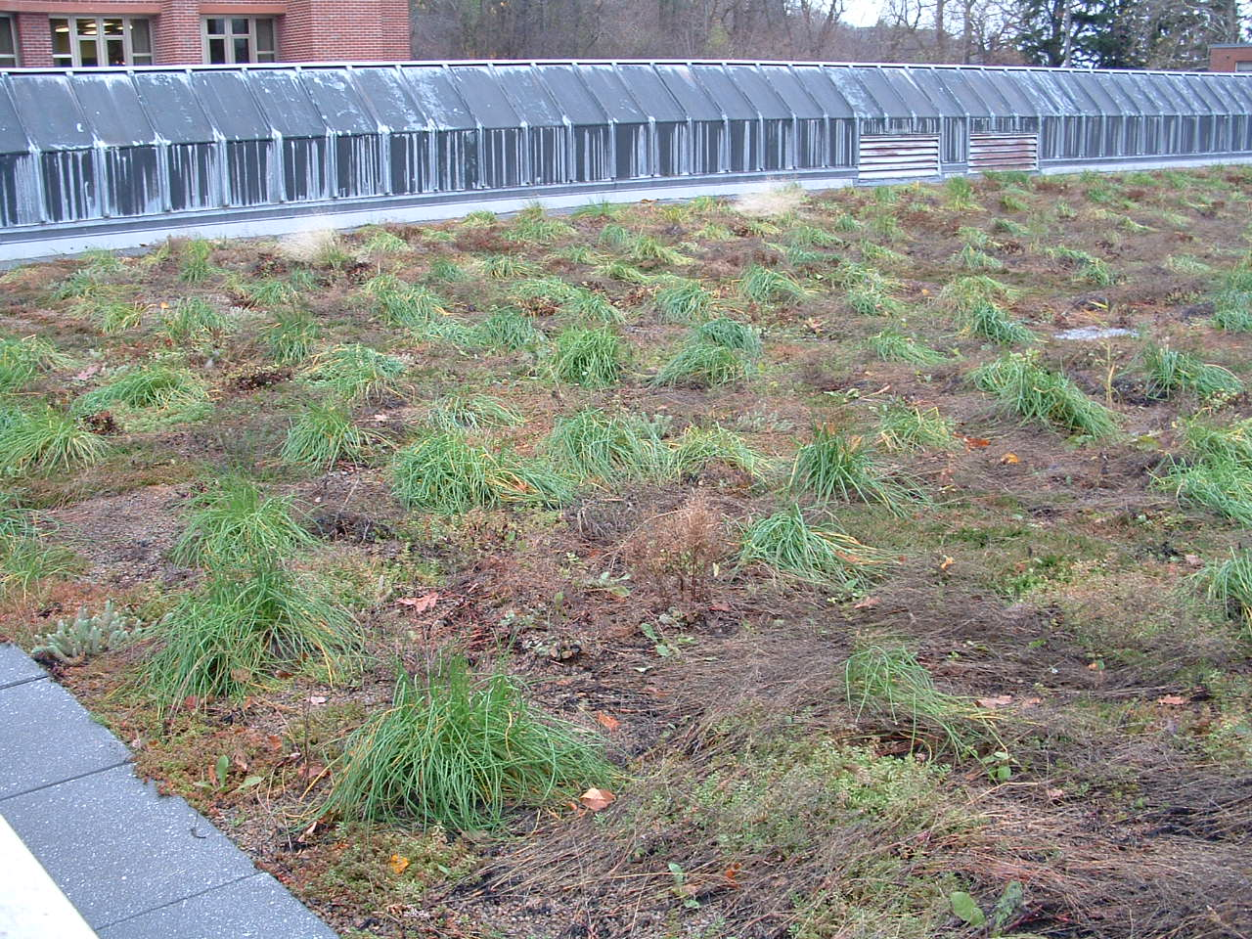
Green Roofs

Slide 16
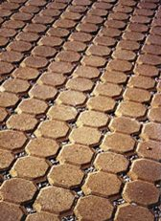

Permeable/Porous Concrete Pavers
http://www.concretenetwork.com/concrete/porous_concrete_pavers/

Slide 17
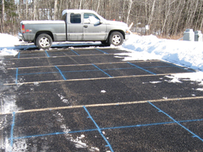
Pervious Pavements in Cold Weather

Slide 18
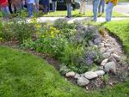
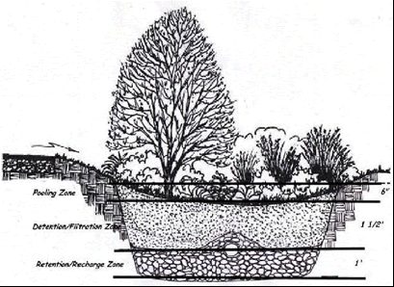
Rain Gardens

Slide 19
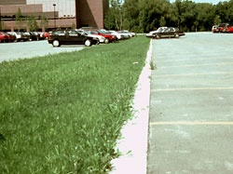
Grass Swales

Slide 20
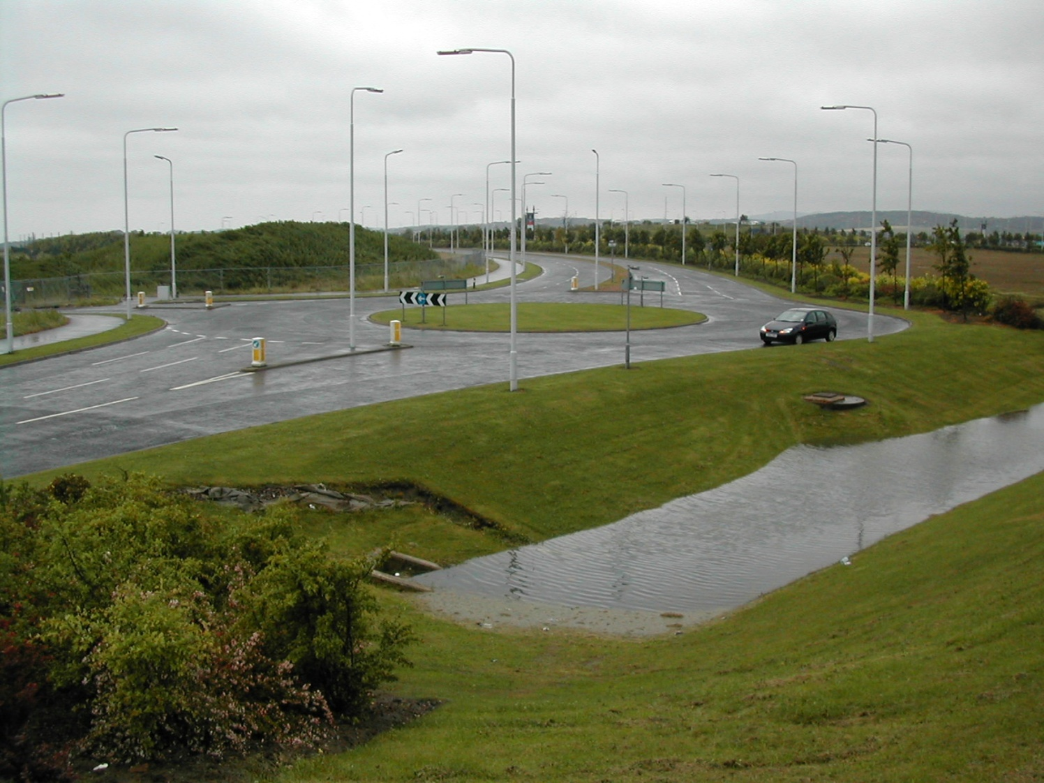
Detention/Retention Basins

Slide 21
Break

Slide 22
Ch 6 Estimating Storage Volumes for Detention Basins
Approximate method (+/-25% storage error)
Can be used for single and multi-staged outflow structures
Worksheet 6a-estimate storage volume given desired peak outflow
Worksheet 6b-estimate peak outflow given storage volume

Slide 23
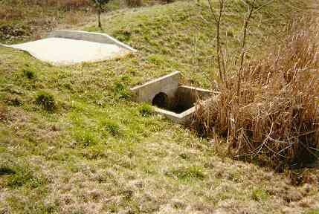
Detention Outlet Structures
Single Stage (culvert or orifice)
Multi-Staged to handle different flows
Combination of orifices &/or weirs

Slide 24
Orifices and Weirs

Slide 25
Figure 6-1 Approximate Routing

Slide 26
Example 6-1
Single-Stage Outflow
75-Acre Development
Developed Peak flow is 360 cfs (Q₂₅)
Present channel can handle only 180 cfs w/o significant damage
Storage-elevation curve is given-see worksheet
Determine storage volume of a detention basin
Assuming a rectangular weir, determine the weir length needed to limit the flow to 180 cfs

Slide 27
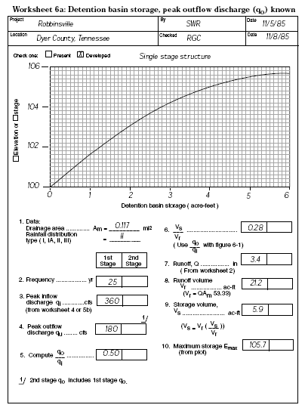
Worksheet 6A

Slide 28
Determining weir length (don’t need to do for class; covered in CTC 261)
Flow=3.2*Weir Length*(Weir Head)^{1.5}
180=3.2*Weir Length*(5.7) ^{1.5}
Weir Length=4.1 feet
Notes:
  Weir head=max. storage elevation-crest elev.
  A weir length greater than 4.1 feet would let more than 180 cfs into the drainage channel

Slide 29
Example 6-3
10-Acre Development
Existing peak flow is 35 cfs
Developed peak flow is 42 cfs (24-hr, Q₁₀₀)
Detention basin volume is 35,000 cubic feet
Estimate peak outflow

Slide 30
Worksheet 6B

