Slide 1
TR-55
Urban Hydrology for Small Watersheds

Slide 2
Simplified methods for estimating runoff for small urban/urbanizing watersheds
Ch 1 Intro
Ch 2 Estimating Runoff
Ch 3 Time of Concentration
Ch 4 Peak Runoff Method
Ch 5 Hydrograph Method
Ch 6 Storage Volumes for Detention Basins

Slide 3
Appendices
A-Hydrologic Soil Groups
B-Rainfall Data
C-TR-55 Program (old; outdated)
D-Worksheet Blanks
E-References

Slide 4
TR-55
PDF is available at
http://www.hydrocad.net/tr-55.htm
Software (WinTR-55) available at http://www.nrcs.usda.gov/wps/portal/nrcs/detail/national/ndcsmc/?cid=stelprdb1042198
(Generally better not to use for this class)

Slide 5
Objectives
Students should be able to:
  Estimate peak flows by hand using the TR-55 manual/methods and forms.
  Obtain preliminary soil information from the NRCS database.

Slide 6
TR-55 (General)
Whereas the rational method uses average rainfall intensities the TR-55 method starts with mass rainfall (inches-P) and converts it to mass runoff (inches-Q) using a runoff curve number (CN)
CN based on:
  Soil type
  Plant cover
  Amount of impervious areas
  Interception
  Surface Storage
Similar to the rational method coefficient C--the higher the CN number the more runoff there will be (CN scale: 0-100; rational coefficient C: 0-1)

Slide 7
TR-55 (General-2)
Mass runoff is transformed into
  peak flow (Ch 4) or
  Partial hydrograph (Ch 5) using unit hydrograph theory and routing procedures that depend on runoff travel time through segments of the watershed

Slide 8
Rainfall Time Distributions
TR-55 uses a single storm duration of 24 hours to determine runoff and peak volumes
TR-55 includes 4 synthetic regional rainfall time distributions:
  Type I-Pacific maritime (wet winters; dry summers)
  Type IA-Pacific maritime (wet winters; dry summers-less intense than I)
  Type II-Rest of country (most intense)
  Type III-Gulf of Mexico/Atlantic Coastal Areas
Rainfall Time Distribution is a mass curve
Most of upstate NY is in Region II

Slide 9
Rainfall Distribution Types -US

Slide 10
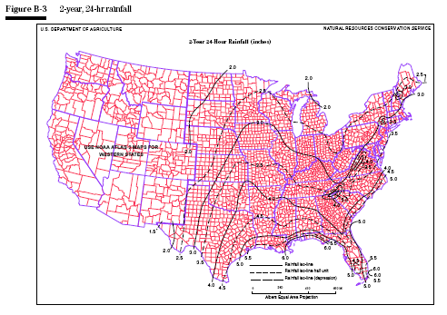
Appendix B
24-hr rainfall data for 2,5,10,25,50,and 100 year frequencies
Hint: You can always use the precipitation server to get updated data and exact numbers. https://hdsc.nws.noaa.gov/pfds/

Slide 11
Limitations of TR-55
Methods based on open and unconfined flow over land and in channels
Graphical peak method (Ch 4) is limited to a single, homogenous watershed area
For multiple homogenous subwatersheds use the tabular hydrograph method (Ch 5)
Storage-Routing Curves (Ch 6) should not be used if the adjustment for ponding (Ch 4) is used

Slide 12
Ch 2 Determine Runoff
Curve Number Factors:
Hydrologic Soil Group
Cover Type and Treatment
Hydrologic Condition
Antecedent Runoff Condition (ARC)
Impervious areas connected/unconnected to closed drainage system

Slide 13
Hydrologic Soil Group
A-High infiltration rates
B-Moderate infiltration rates
C-Low infiltration rates
D-High runoff potential

Slide 14
Soil Maps
GIS accessible maps are at http://websoilsurvey.nrcs.usda.gov/app/
Hints:
AOI (polygon; double click to end)
Soil Data Explorer
Soil Properties and Qualities
Soil Qualities and Features
Hydrologic Soil Group
View Rating
Printable Version

Slide 15
Cover Type and Treatment
Urban (Table 2-2a)
Cultivated Agricultural Lands (Table 2-2b)
Other Agricultural Lands (Table 2-2c)
Arid/Semiarid Rangelands (Table 2-2d)

Slide 16
Hydrologic Condition
Poor
Fair
Good
Description in table 2-2 b/c/d

Slide 17
Antecedent Runoff Condition (ARC)
Accounts for variation of CN from storm to storm
Tables use average ARC

Slide 18
Impervious/Impervious Areas
Accounts for % of impervious area and how the water flows after it leaves the impervious area
  Is it connected to a closed drainage system?
  Is it unconnected (flows over another area)?
If unconnected
  If impervious <30% then additional infiltration will occur
  If impervious >30% then no additional infiltration will occur

Slide 19
Table 2-2a Assumptions
Pervious urban areas are equivalent to pasture in good conditions
Impervious areas have a CN of 98
Impervious areas are connected
Impervious %’s as stated in Table
If assumptions not true then modify CN using Figure 2-3 or 2-4

Slide 20
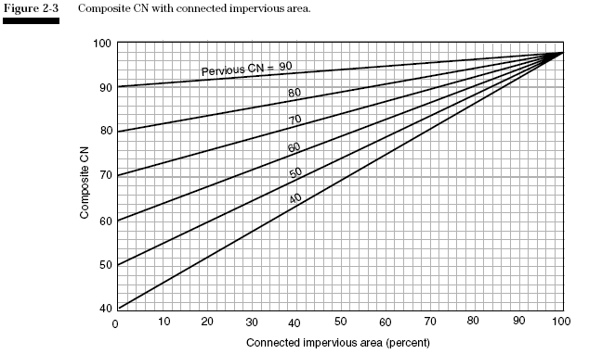
Modifying CN using Figure 2-3
If impervious areas are connected but the impervious area percentage is different than Table 2-2a then use Figure 2-3

Slide 21
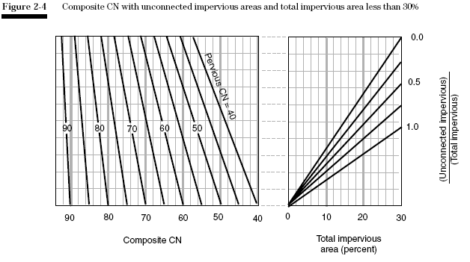
Modifying CN using Figure 2-4
If impervious area < 30% but not connected then use Figure 2-4

Slide 22
Determining Q (runoff in inches)
Find rainfall P (Appendix B)
Find Q from Figure 2-1
Or Table 2-1

Slide 23
Determining Q (Table 2-1)

Slide 24
Equation
S is maximum potential retention of water (inches)
S is a function of the CN number
0.2S is assumed initial abstraction

Slide 25
Limitations
CN numbers describe average conditions
Runoff equations don’t account for rainfall duration or intensity
Initial abstraction=0.2S (agricultural studies)
  Highly urbanized areas—initial abstraction may be less
  Significant storage depression---initial abstraction could be more
CN procedure less accurate when runoff < 0.5”
Procedure overlooks large sources of groundwater
Procedure inaccurate when weighted CN<40

Slide 26
TR-55 Example

Slide 27
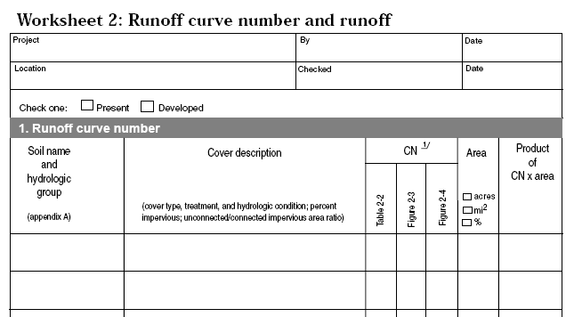
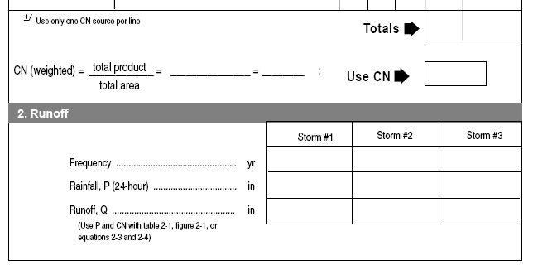
TR-55: 2

Slide 28
Examples
Example 2-1 (undeveloped):
  Impervious/Pervious doesn’t apply
Example 2-2 (developed):
  Table assumptions are met
Example 2-3 (developed):
  Table assumptions not met (Figure 2-3)
Example 2-4 (developed):
  Table assumptions not met (Figure 2-4)

Slide 29
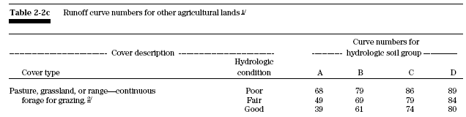
Example

Slide 30
Example-1

Slide 31
Example-2

Slide 32
Examples 2-2
Example 2-2:
  Land is subdivided into lots
  Table assumptions are met

Slide 33
Example
2-2b

Slide 34
EX

Slide 35
Example 2-3
Example 2-3:
  Land is subdivided into lots
  Table assumptions are not met
  Table assumes 25% impervious; actual is 35% impervious
    The runoff should be higher since impervious is increased

Slide 36
Example 2-3 b

Slide 37
Using Figure 2-3
Pervious CN’s were 61 and 74
  Open space; good condition; same as first example
Start @ 35%
Go up to hit CN 61 & 74 curves
Go left to determine new CN=74 & 82

Slide 38
Example Fig2-3b

Slide 39
Example 2-4
Example 2-4:
  Land is subdivided into lots
  Table assumptions are not met
  Actual is 25% impervious but 50% is not directly connected and flows over pervious area
  Use Figure 2-4
    The runoff should be lower since not all the impervious surface is connected (water flows over pervious areas and allows more water to infiltrate)

Slide 40
Example
2-4
Worksheet 2

Slide 41
Using Figure 2-4
Pervious CN is 74
  Open space; good condition; same as first example
50% unconnected
Start @ the bottom (right graph) @ 25%
Go up to 50% curve
Go left to pervious CN of 74
Go down to read composite CN of 78

Slide 42
Example – Figure 2-4

Slide 43
Example Comparison
Undeveloped
Developed (25% impervious connected
Developed (35% impervious connected)
Developed (25% impervious but only 50% connected)
Roff=2.81”
Roff=3.28”
Roff=3.48”
Roff=3.19”

Slide 44
Break

Slide 45
Time of Concentration & Travel Time
Chapter 3
Sheet flow
Shallow Concentrated Flow
Channel Flow
Use Worksheet 3

Slide 46
Example
Worksheet 3
We have already covered this Worksheet

Slide 47
Chapter 4: Graphical Peak Discharge
Worksheet 4
Inputs:
  Drainage Area
  CN (from worksheet 2)
  Time of concentration (from worksheet 3)
  Appropriate Rainfall Distribution (I/IA/II/III) App B
  Rainfall, P (worksheet 2)
  Runoff Q (in inches) from worksheet 2
  Pond & Swamp Adjustment Factor (Table 4-2)

Slide 48
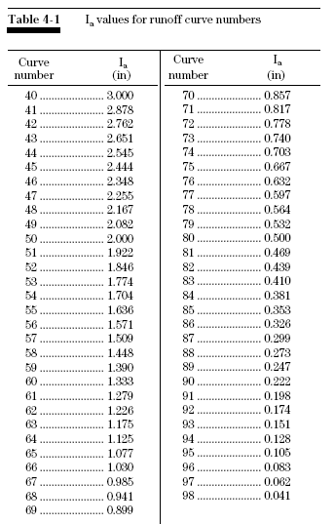
Ch 4 Calculations using Table 4-1
Find initial abstraction
Function of CN #
Find in Table 4-I
Calculate Ia/P

Slide 49
Ch 4 Calculations
Determine peak discharge (cubic feet per square mile per inch of runoff) from Exhibit 4-I, 4-IA, 4-II or 4-III by using the Ia/P ratio and the time of concentration

Slide 50
TR-55 Exhibit 4-II

Slide 51
Pond & Swamp Adjustment
Table 4-2

Slide 52
Compute Peak Flow
Peak flow=Unit peak flow * Inches of Runoff * Drainage Area * Pond/swamp Adjustment Factor

Slide 53
TR-55 Worksheet 4

Slide 54
Limitations-Worksheet 4
Watershed must be hydrologically homogenous
One main stream (not branched)
No reservoir routing
Pond/swamp adjustment factor applied only if not in the time of concentration path
Can’t use if Ia/P values are outside range of 0.1-0.5
Not accurate if CN<40
Tc between 6 minutes and 10 hours

