Slide 1
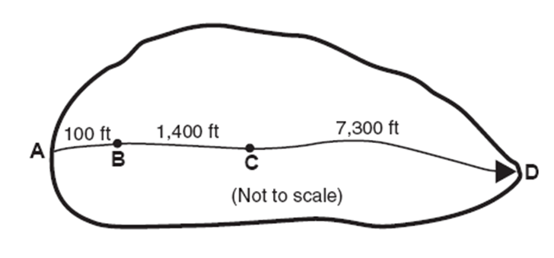
Time of Concentration

Slide 2
Objectives
Know how to calculate time of concentration
Know why it’s important to be able to determine the time of concentration

Slide 3
Definition
Time required for runoff to travel from the hydraulically most distant point on a watershed to another point of interest within the watershed

Slide 4
Factors
Surface roughness
Channel shape and flow patterns
Slope
Urbanization generally increases the runoff velocities and therefore decreases the time of concentration

Slide 5
Importance
Rational method
Calculate time of concentration, t_{c}
Set storm duration = t_{c}
Use IDF curve to find rainfall intensity
TR-55 Method
Calculate time of concentration, t_{c}
Look up unit peak discharge on the appropriate Exhibit 4-#

Slide 6
Typical Values for Tc < 50 Acres
5 minutes to 30 minutes

Slide 7
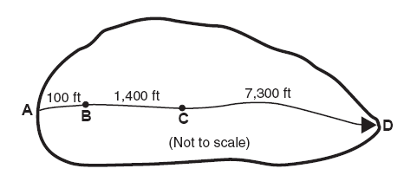
Water can move through a watershed as:
Sheet flow (max of 300 ft; ---usually 100 ft)
Shallow concentrated flow
Open channel flow
Gutter
Ditch
Swale
Creek
All three or some combination

Slide 8
Examples
Urban
Sheet flow from back end of a residential lot
Open channel flow once water drops over the curb and into a gutter
Rural
Sheet flow in upper part of watershed
Shallow concentrated flow as water forms rivulets
Open channel flow (ditch/creek)

Slide 9
Calculating Tc
Calculate Tc for each type of flow and add together
See the following TR-55 worksheet to be used for all Tc calculations in this class!!

Slide 10
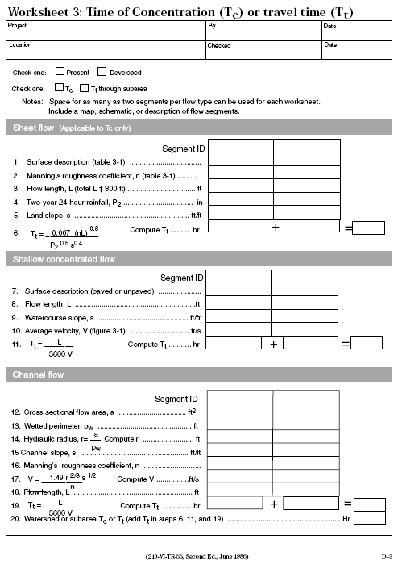
TR-55 Worksheet 3

Slide 11
Sheet Flow
Manning’s Kinematic Solution
See TR-55, pg 3-3 & equation 3-3
Kinematic Wave Equation
FAA Method
Nomograph
Refer to https://www.roanokecountyva.gov/DocumentCenter/View/209/Chapter_4_Hydrology (pg 11)
IN CLASS (use #1)

Slide 12
1-Manning’s Kinematic Solution
T_{t}=[0.007(nL)^{.8}]/[P₂^{.5} S^{.4}]
T_{t} is travel time (hrs)
n-Manning’s coefficient for sheet flow (dimensionless - must use Table 3-1 in TR-55)
L is flow length (ft)
P₂ is 2-yr, 24-hr rainfall (in)
TR-55 Appendix B, Figure B-3 or
Local IDF curve (change intensity to inches)
S is slope (decimal format)

Slide 13
2-Kinematic Wave Equation (NYSDOT)
t_{co}=[56(L_{o})^{.6} (n)^{.6}]/[S_{o}^{.3} i^{.4}]
t_{co} is travel time (sec)
n-Manning’s coefficient (dimensionless)
L_{o} is overland flow length (ft)
i is rainfall intensity for a desired frequency (in/hr)
TR-55 Appendix B (change inches to intensity) or
Local IDF curve
S_{o} is overland slope (decimal format)

Slide 14
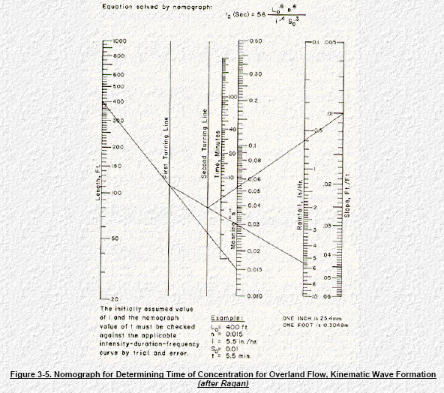
Nomograph for Sheet Flow

Slide 15
Kinematic Wave Equation
Includes the rainfall intensity for a desired frequency
Must use iterative approach
Assume a rainfall intensity
Calculate travel time
Set storm duration = travel time
Look up intensity from IDF curve and compare to assumed value
If intensity differs go back to step 1

Slide 16
3-FAA Equation
t=[1.8(1.1-C)(L_{o})^{.5} ]/[S^{.333}]
t is travel time (min)
C-rational coefficient (dimensionless)
See Appendix C-1 of your book
L_{o} is overland flow length (ft)
S_{o} is overland slope (decimal format)

Slide 17
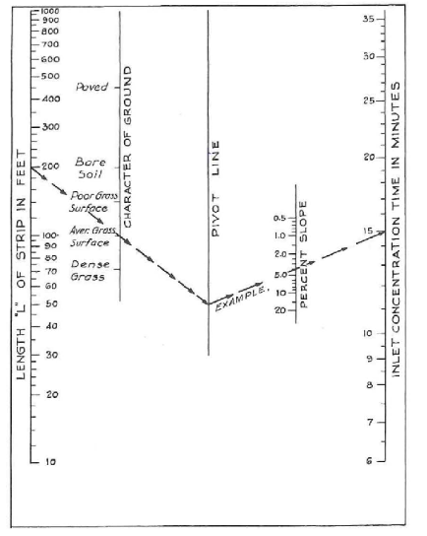
4-Nomograph
Length
Ground character
Paved
Bare soil
Poor/Avg/Dense Grass
Percent slope
http://sanantonio-tx.elaws.us/code/udc_apxh_ch5_5.4_sec5.4.1

Slide 18
Example
Dense Grass (n=0.24, C=0.2)
Flow Length (200 ft)
Location (SUNY Poly; 2-yr 24-hr duration)
Slope (3%)

Slide 19
Example: Manning’s Kinematic Solution
T_{t}=[0.007(nL)^{.8}]/[P₂^{.5} S^{.4}]
T_{t}=[0.007(.24*200)^{.8}]/[2.5^{.5}*.03 ^{.4}]
n=.24
L=200 ft
P₂ = 2.5 in (TR-55; Figure B-3)
S = .03
T_{t}=0.398 hours = 24 minutes

Slide 20
Example: Kinematic Wave Equation
t_{co}=[56(L_{o})^{.6} (n)^{.6}]/[S_{o}^{.3} i^{.4}]
Assume 1-hr; 2-yr frequency (i=1”/hr)
t_{co}=[56(200)^{.6} (.24)^{.6}]/[.03^{.3*}1^{.4}]
t_{co}=1640 seconds = 27 minutes
Intensity for 30-min; 2-yr storm =1.6”/hr
Intensities don’t match; try again

Slide 21
Kinematic Wave- IDF Curve is needed

Slide 22
Kinematic Wave-Trial/Error (Tc=9 minutes)
Assumed I | Time of Conc. | Actual i
1 in/hr | 28 minutes | 1.6 in/hr
1.6 | 17 | 2.4
2.4 | 11 | 3.1
3.1 | 9 | 3.1

Slide 23
Example: FAA Equation
t=[1.8(1.1-C)(L_{o})^{.5} ]/[S^{.333}]
t=[1.8(1.1-.2)(200)^{.5} ]/[.03^{.333}]
C=.2
L_{o}=200 ft
S_{o} = .03
t = 41 min

Slide 24
Example: Nomograph
From nomograph C-2
Concentration time = 21 minutes
Length=200 ft
Dense Grass
Slope=3%
Note: had to extend pivot line

Slide 25
Example Results
Manning’s Kinematic
Kinematic Wave
FAA
Nomograph
24 minutes
9 minutes
41 minutes
21 minutes

Slide 26
Shallow Concentrated Flow
TR-55
page 3-2; Figure 3-1
page 3-3; Explanation
Appendix F - formulas
Derived from Manning’s equation
Determine average velocity (Fig 3-1)
Divide flow length by average velocity to obtain travel time

Slide 27
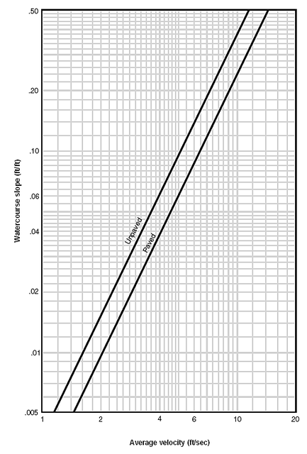
TR-55 Figure 3-1

Slide 28
Shallow Concentrated Flow
Equations
Velocity=16.1345*S^{0.5} Unpaved
Velocity=20.8282*S^{0.5} Paved
Assumptions
Unpaved: n=.05; hydraulic radius=0.4
Paved: n=.025; hydraulic radius=0.2

Slide 29
Document Work using TR-55 Worksheet 3

Slide 30
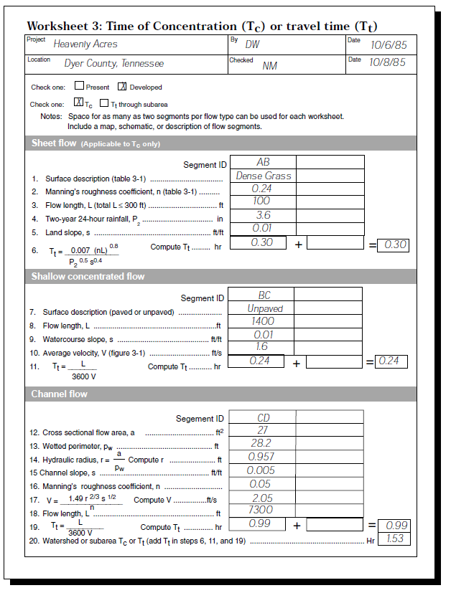
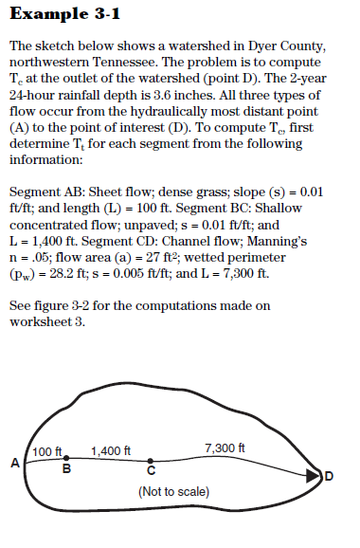
Example Worksheet 3

Slide 31
Questions
What is the definition of “time of concentration”
Name the 3 types of watershed flow?
What form do you use for tc calculation in this class?
Length/velocity results in what unit?

Slide 32
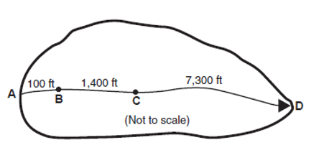
Break
We covered time of concentration for:
sheet flow (A-B)
shallow concentrated flow (B-C)
Next—Time of Concentration for open Channel Flow (C-D)
Remember-always use TR-55 Worksheet 3 for documentation

Slide 33
Open Channel Flow
Manning’s Equation (TR-55, page 3-4)
Calculate average velocity
Divide flow length by average velocity to obtain travel time
How do we determine “velocity”?

Slide 34
Manning’s Equation
Irish Engineer
“On the Flow of Water in Open Channels and Pipes” 1891
Empirical equation
History: http://manning.sdsu.edu/\

Slide 35
Uniform Flow in Open Channels
Water depth, flow area, discharge and velocity distribution at all sections throughout the entire channel reach remains unchanged.
The energy grade line, water surface line, and the channel bottom lines are all parallel to each other
No acceleration (or deceleration)

Slide 36
Manning’s Equation: Flow---English
Q=A(1.49/n)(R_{h}^{2/3})(S)^{.5}
Q is flow rate (cfs)
n-Manning’s coefficient (dimensionless)
Rh is hydraulic radius (ft)
Wetted area / wetted perimeter
S is slope (decimal format)

Slide 37
Manning’s Equation: Flow---Metric
Q=A(1/n)(R_{h}^{2/3})(S)^{.5}
Q is flow rate (cms)
n-Manning’s coefficient (dimensionless)
R_{h} is hydraulic radius (m)
Wetted area / wetted perimeter
S is slope (decimal format)

Slide 38
Manning’s Equation: Velocity----English
Divide both sides by area
V=(1.49/n)(R_{h}^{2/3})(S)^{.5}
V is velocity (fps)
n-Manning’s coefficient (dimensionless)
Rh is hydraulic radius (ft)
Wetted area / wetted perimeter
S is slope (decimal format)

Slide 39
Manning’s Equation: Velocity-----Metric
V=(1/n)(R_{h}^{2/3})(S)^{.5}
V is velocity (meter/sec)
n-Manning’s coefficient (dimensionless)
Rh is hydraulic radius (m)
Wetted area / wetted perimeter
S is slope (decimal format)

Slide 40
Manning’s Coefficient Typical Values
Flowmaster
Another Reference:
http://www.lmnoeng.com/manningn.htm

Slide 41
Hydraulic Radius
Wetted area / wetted perimeter
Easy to calculate for circular pipes full or half-full, and use trig to calculate triangular or trapezoidal channels
Easiest to use software (Bentley flowmaster)

Slide 42
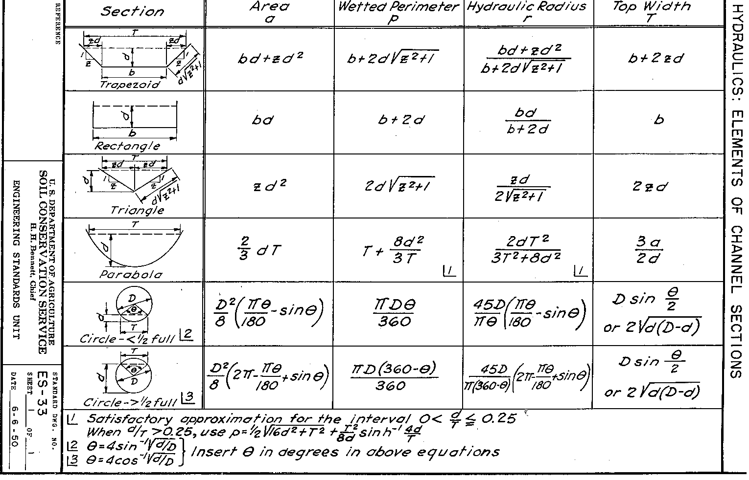
SCS (now NRCS) Channel Calculations

Slide 43
Example-Find V
Find the velocity of a rectangular channel 5’ wide w/ a 5% grade, flowing 1’ deep. The channel has a stone and weed bank (n=.035).
A=5 sf; WP=7’; R_{h}=0.714 ft
S=.05
V=7.6 fps

Slide 44
Example-Find time
If velocity = 7.6 ft per second and length of channel = 500 feet then time traveled in channel =l/v=500/7.6=
Time traveled=66 seconds = 1.1 minutes

Slide 45
Flowmaster
Use flowmaster to solve previous example.
Note: The depth is unknown because you are in the process of trying to find the peak flow, so assume 1 foot or 1 meter. The velocity is not usually sensitive to the depth.

Slide 46
Time of Concentration Calculations
For this class (homework, projects, etc.) use worksheet 3 from the TR-55 Document
Page D-3 (to print out blank form)
Also show picture of lengths and include flowmaster report

Slide 47
Notes on Manning’s n for Worksheet 3
For sheet flow use n on Table 3-1.
For channel flow use typical n values for open channels.
See worksheet –next slide

Slide 48
TR-55 Worksheet 3 Image

Slide 49
Flowmaster software availability
Can use flowmaster for Manning’s equation (channel flow)
Labs 1159/G143 or download on your own computer
Click on Bentley folder, Click on Flowmaster; On left use trapezoidal channel

Slide 50
Introduce Project 2
Simplified Stormwater Design

Slide 51
Next Lecture
Rational Method for Determining Peak Flow

