Slide 1
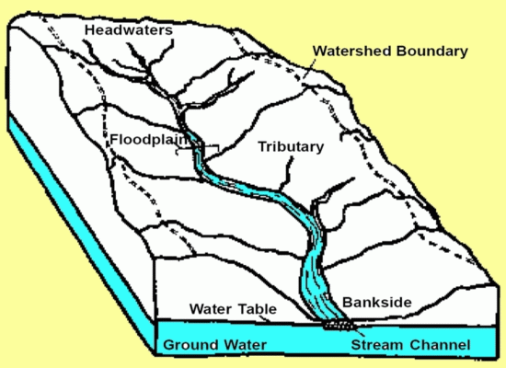
Watersheds

Slide 2
Outcomes
Read a contour map
Delineate a watershed
Determine slopes/lengths
Determine a drainage area

Slide 3
We All Live in a Watershed
When water runs off your property where does it go?

Slide 4
Importance of Watershed Protection
Pollutants can enter waterbodies
Silt from construction sites, farms, erosion
Septic system waste
Fertilizers, pesticides
Road salt
Other pollutants (industry/commercial)

Slide 5
Watershed Protection
SPDES (stormwater pollution discharge and elimination system)
Watershed action plans
Public Involvement (stewardship)

Slide 6
Watershed Delineation
Any particular point on a water channel (stream, ditch, gutter, etc.) has an associated watershed area
The boundaries of a watershed are ridge lines (high points)
You can identify ridge lines by contour lines on topographic maps

Slide 7
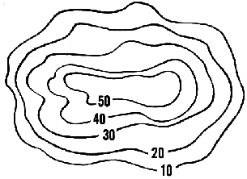
Contour Maps-Lines showing constant elevation

Slide 8
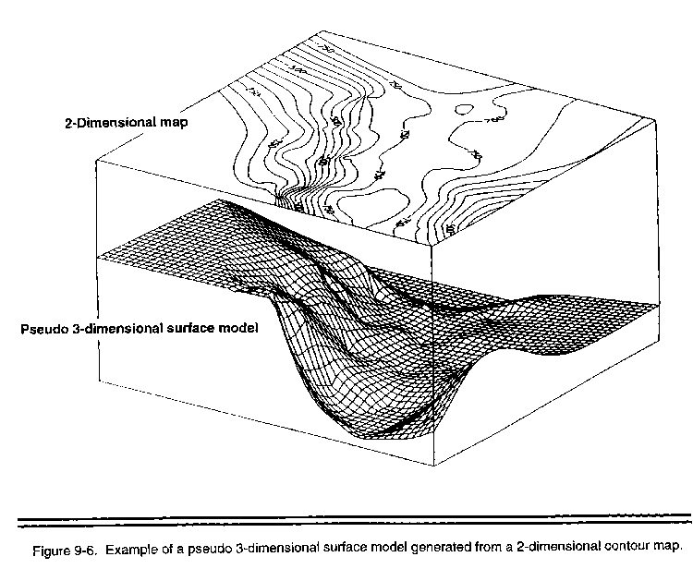
2d model of 3d surface

Slide 9
Hints for reading contour maps
Flow paths are perpendicular to contour lines (why?)
Streams---Contour lines are concave (think V’s)
Ridges----Contour lines are convex (think noses)
Peaks of mountains and depressions (swamps, ponds) usually show as small circular areas
Contour lines close together indicate steep slopes (why?)
Contour lines which are far apart indicate flat slopes (why?)
Highlight rivers/creeks to your point of interest (it also sometimes helps to highlight them outside your point of interest)
Ignore roads; ideally, any construction project shouldn’t shift water to another watershed

Slide 10
Steps-Delineating Drainage Areas
Identify your point of interest
Identify the channels/subchannels (V’s)
Identify the hill tops (circles)
Draw from hill-top to hill-top along the ridges (noses)

Slide 11
Delineate Watershed
Class Demonstration (see next slide)

Slide 12
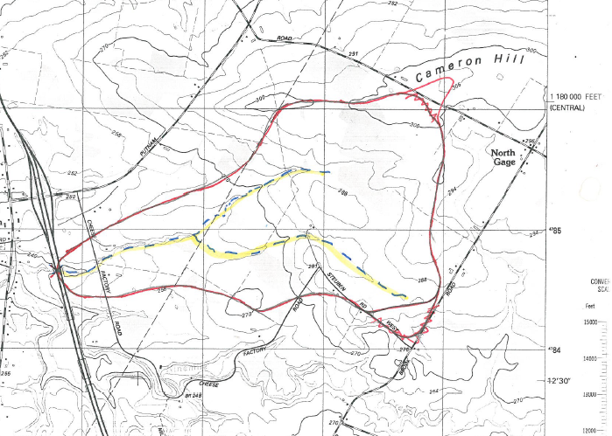
Watershed Delineation using USGS Map

Slide 13
Sub-Drainage Areas
Drainage areas may be broken up into sub-catchments (or sub-drainage) areas because:
Drainage areas are usually modeled as homogeneous systems
Streams are branched
Points of interest need to be isolated

Slide 14
Delineate Subareas
Handouts:
Delineating subareas for each reach

Slide 15
Break

Slide 16
Determining Drainage Areas
Stripping Method
Grid Method
Planimeter
Software Programs (GIS, Streamstats)

Slide 17
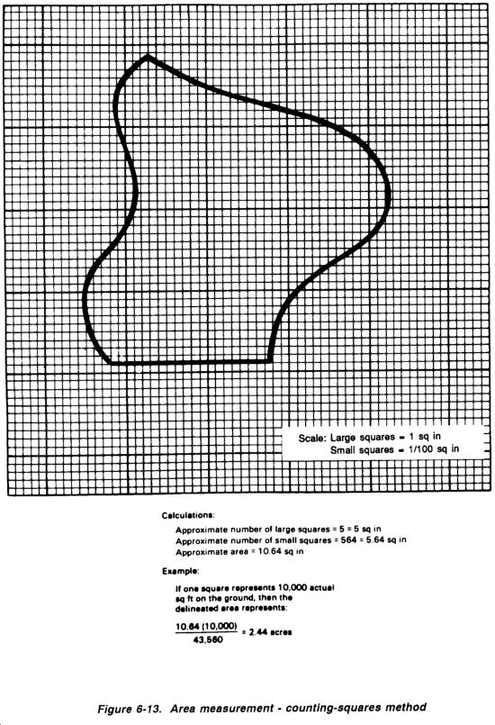
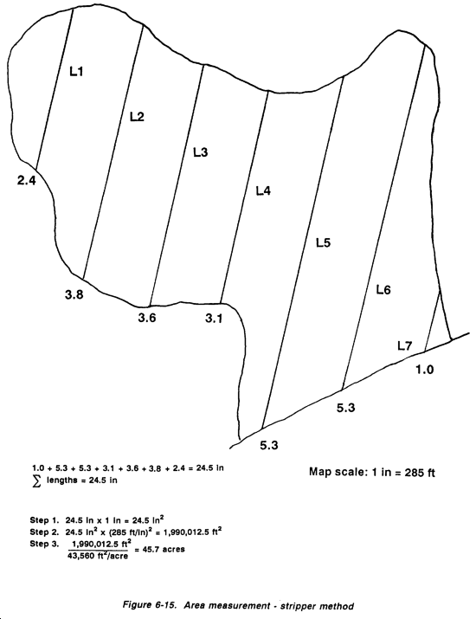
Stripping/Grid Methods Scale is important!
http://www.globalsecurity.org/military/library/policy/army/fm/5-430-00-1/fig6-13.gif

Slide 18
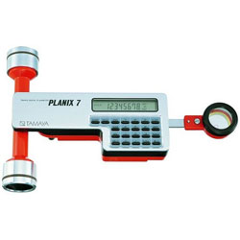
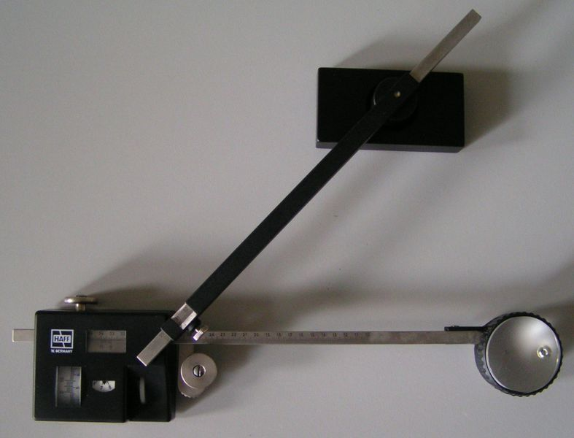
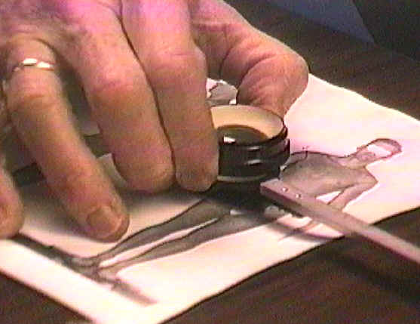
Planimeter

Slide 19
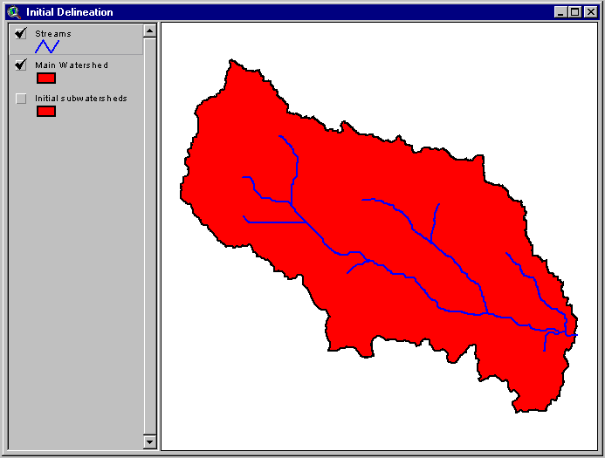
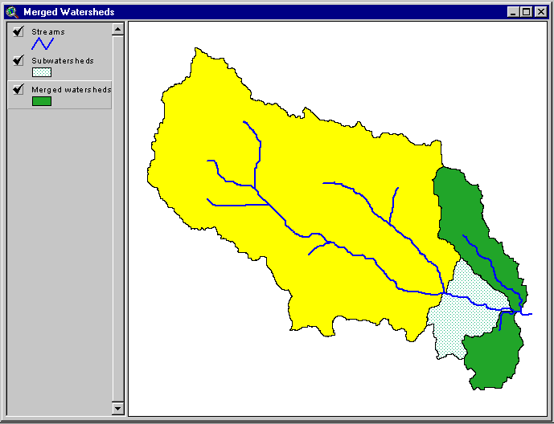
Software
http://gis.esri.com/library/userconf/proc99/proceed/papers/pap676/p6764.gif

Slide 20
Determining Stream Lengths
Edge of Paper Tic Method
String Method (non-stretch string)
Don’t use “as the crow flies”
Check scale (1”=2000’ or other)
20

Slide 21
Data Collection
Land Use
Soil Characteristics
Slope (overland and channel)
Channel/Overland flow lengths
% Impervious
Channel cross-sections
Roughness characteristics
Storage (ponds, swamps, wetlands)

Slide 22
Sources
Field reconnaisance
Aerial Photographs
NRCS Soil Maps
USGS Maps/Other Contour Maps
Planimetric mapping
Historical engineering studies
Survey Data
Soil Boring Data

Slide 23
Common Conversions
1 acre = 43,560 ft²
1mi² = 640 acres
1 hectare = (100 m)² = 10,000 m²
1 acre = 0.405 hectare
1 hectare = 2.46 acres
1 meter = 3.2808 feet
1 foot = 0.3045 meter

Slide 24
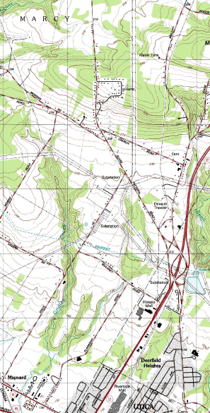
Downloading USGS Maps *.pdf
https://www.usgs.gov/programs/national-geospatial-program/topographic-maps

Slide 25
Other tools:
Image capture software:
Snipping Tool (on engineering computers)
In adobe reader use tools, select and zoom, snapshot tool, to capture images
USGS pdf’s---click on images, click off orthoimages to turn off the background photogrammetry

Slide 26
Streamstats
https://water.usgs.gov/osw/streamstats/
https://streamstats.usgs.gov/ss/

Slide 27
Other Sources
NRCS pdf – determining watershed
https://www.epa.gov/waterdata/hows-my-waterway
Watersheds - NYDEC

Slide 28
Next Lecture
Precipitation
Definition
What affects it?
Return period
Probability of an event occurring over a time interval
Design Frequencies
IDF Curves

