Slide 1
Review
Hydrostatic Forces on an Inclined, Submerged Surface
Magnitude of Force=Specific Weight*h-bar*area
Location=y-bar+(I-bar/(y-bar*area))
Buoyancy
Every submerged object has a buoyancy force and a weight force

Slide 2
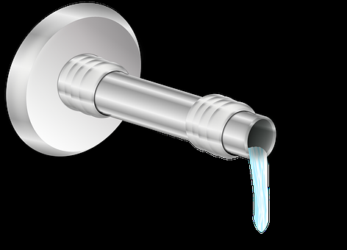
CTC 261
Flow in Pipes

Slide 3
Objectives
Be familiar with various ways to define fluid flow
Apply the continuity equation
Apply Bernoulli’s equation

Slide 4
Flow types
Uniform Flow: Velocity does not change from point to point within the channel reach
  Space criterion
Steady Flow: Velocity does not change with respect to time
  Time criterion
Uniform flows are mostly steady

Slide 5
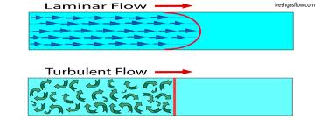
Turbulent and Laminar Flow
Turbulent – mixed flow; random movement
Laminar – smooth flow; fluid particles move in straight paths parallel to the flow direction
Flow of water through a pipe is almost always turbulent
http://freshgasflow.com

Slide 6
Reynold’s Number: Pipe Flow
Re=(Velocity*Diameter)/Kinematic viscosity
If Re<2000 then laminar
If Re>4,000 then turbulent
Between 2-4K????

Slide 7
Reynold’s # Example: Pipe Flow
Given:
Velocity=5 fps
Diameter=1 foot
Kinematic Viscosity @ 50F= 1.41E-5 (ft²/sec)
Re=354,610
Is flow laminar or turbulent?

Slide 8
Reynold’s Number: Open Channel Flow
Re=(Velocity*D)/Kinematic viscosity
Where D=the hydraulic radius (wetted area/wetted perimeter)
If Re<500 then laminar
If Re>2,000 then turbulent
Between 500-2000; transitional
Ref: Fluid Mechanics , 9th ed., Streeter, Wylie,Bedford

Slide 9
Reynold’s # Example: Open Channel Flow
Given:
Channel Width=5” (0.417 ft)
Channel Depth=2” (0.167 ft)
Velocity=0.2 ft/sec
Kinematic Viscosity @ 50F= 1.41E-5 (ft²/sec)
Hydraulic Radius=(0.417)(0.167)/(0.417+2(0.167))=.0927ft
Re=(0.2ft/sec)(.0927ft)/1.41E-5 ft²/sec=1300 (transitional)

Slide 10
Calculating Average Velocity
V=Q/A (velocity=flow/cross-sectional area)
and Q=V*A
Area must be perpendicular to flow!!!

Slide 11
Practice Example
A 24” diameter pipe carries water having a velocity of 13 fps. What is the discharge in cfs and in gpm?
Answer: 41 cfs and 18,400 gpm

Slide 12
Continuity
Q=A1*V1=A2*V2
If water flows from a smaller to larger pipe, then the velocity must decrease
If water flows from a larger to smaller pipe, then the velocity must increase

Slide 13
Continuity Example
A 120-cm pipe is in series with a 60-cm pipe. The rate of flow of water is 2 cubic meters/sec.
What is the velocity of flow in each pipe?
V₆₀=Q/A₆₀=7.1 m/s
V₁₂₀=Q/A₁₂₀=1.8 m/s

Slide 14
Storage-Steady Flows
Q in=Qout+(Storage/Discharge Rate)
Given:
Qin=20 cfs
Qout=15 cfs
Storage or discharge?

Slide 15
Storage-Steady Flows: Answer
Answer-Storage
Qin=20 cfs
Qout=15 cfs
Storage rate=5 cfs
If storage is in a tank what would you do to find the rate of rise?

Slide 16
Reservoir Storage Example
A river discharges into a reservoir at a rate of 400,000 cfs. The outflow rate through the dam is 250,000 cfs.
If the reservoir surface area is 40 square miles, what is the rate of rise in the reservoir?

Slide 17
Reservoir Storage Example (Answer)
Answer 11.5 ft/day
Find 3 reasons why this example is not very realistic.

Slide 18
Break

Slide 19
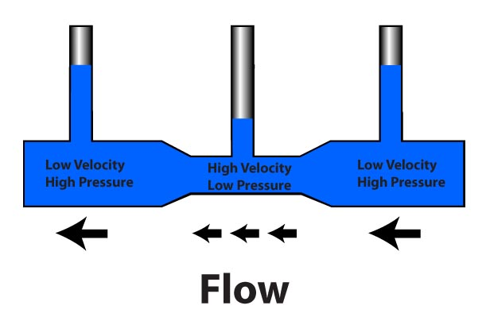
Bernoulli’s Equation
http://www.rcuniverse.com/magazine/article_display.cfm?article_id=455

Slide 20
Assumptions
Steady flow (no change w/ respect to time)
Incompressible flow
Constant density
Frictionless flow
Irrotational flow

Slide 21
3 Forms of Energy
Kinetic energy (velocity)
Potential energy (gravity)
Pressure Energy (pump/tank)

Slide 22
Kinetic Energy (velocity head)
V²/2g
Resulting units?

Slide 23
Pressure Energy (pressure head)
Pressure / Specific weight
Resulting units?

Slide 24
Potential Energy
Height above some datum
Units?

Slide 25
Units
Energy (ft or meters)
Energy units are usually the same as work:
ft-lb or N-m
What we’re using is specific energy (energy per lb of water or energy per Newton of water)

Slide 26
Example
Calculate the total energy in a pipeline with an elevation head of 10 ft, water pressure of 50 psi and a velocity of 2 fps?
  Potential energy = 10’
  Pressure head = 50 psi / 62.4 lb/ft³=115.4’
  Velocity head = 2²/(2*32.2) = 0.06’
10’ + 115.4’ + 0.06’ = 125’

Slide 27
Bernoulli’s equation in Words
Energy @ section 1 = Energy @ section 2

Slide 28
Reservoir Example (1/3)
Water exits a reservoir through a pipe. The WSE (water surface elevation) is 125’ above the datum (pt A) The water exits the pipe at 25’ above the datum (pt B).
What is the velocity at the pipe outlet?

Slide 29
Reservoir Example (2/3)
Point A:
  KE=0
  Pressure Energy=0
  Potential Energy=125’
Point B:
  KE=v²/2g
  Pressure Energy=0
  Potential Energy=25’ (note: h=100’)

Slide 30
Reservoir Example (3/3)
Bernoulli’s: Set Pt A energy=Pt B energy
  v²/2g=h
  v=(2gh)^{.5}
  Velocity=80.2 ft/sec

Slide 31
Energy Grade Line (EGL)
Graphical representation of the total energy of flow of a mass of fluid at each point along a pipe. For Bernoulli’s equation the slope is zero (flat) because no friction loss is assumed

Slide 32
Hydraulic Grade Line (HGL)
Graphical representation of the elevation to which water will rise in a manometer attached to a pipe. It lies below the EGL by a distance equal to the velocity head.
EGL/HGL are parallel if the pipe has a uniform cross-section (velocity stays the same if Q & A stay the same).

Slide 33
Hints for drawing EGL/HGL graphs
EGL=HGL+Velocity Head
EGL=Potential+Pressure+Kinetic Energies
HGL=Potential+Pressure Energies

Slide 34
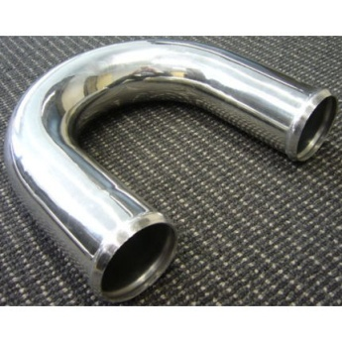
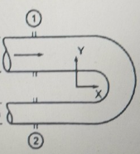
Reducing Bend Example (1/5)
Water flows through a 180-degree vertical reducing bend. The diameter of the top pipe is 30-cm and reduces to 15-cm. There is 10-cm between the pipes (outside to outside). The flow is 0.25 cms. The pressure at the center of the inlet before the bend is 150 kPa. What is the pressure after the bend?

Slide 35
Reducing Bend Example (2/5)
Find the velocities using the continuity equation (V=Q/A):
Velocity before bend is 3.54 m/sec
Velocity after bend is 14.15 m/sec

Slide 36
Reducing Bend Example (3/5)
Use Bernoulli’s to solve for the pressure after the bend
Kinetic+Pressure+Potential Energies before the bend = the sum of the energies after the bend
Potential energy before bend = 0.325m
Potential energy after bend=0m (datum)
The only unknown is the pressure energy after the bend.

Slide 37
Reducing Bend Example (4/5)
The pressure energy after the bend=60 kPA
Lastly, draw the EGL/HGL graphs depicting the reducing bend

Slide 38
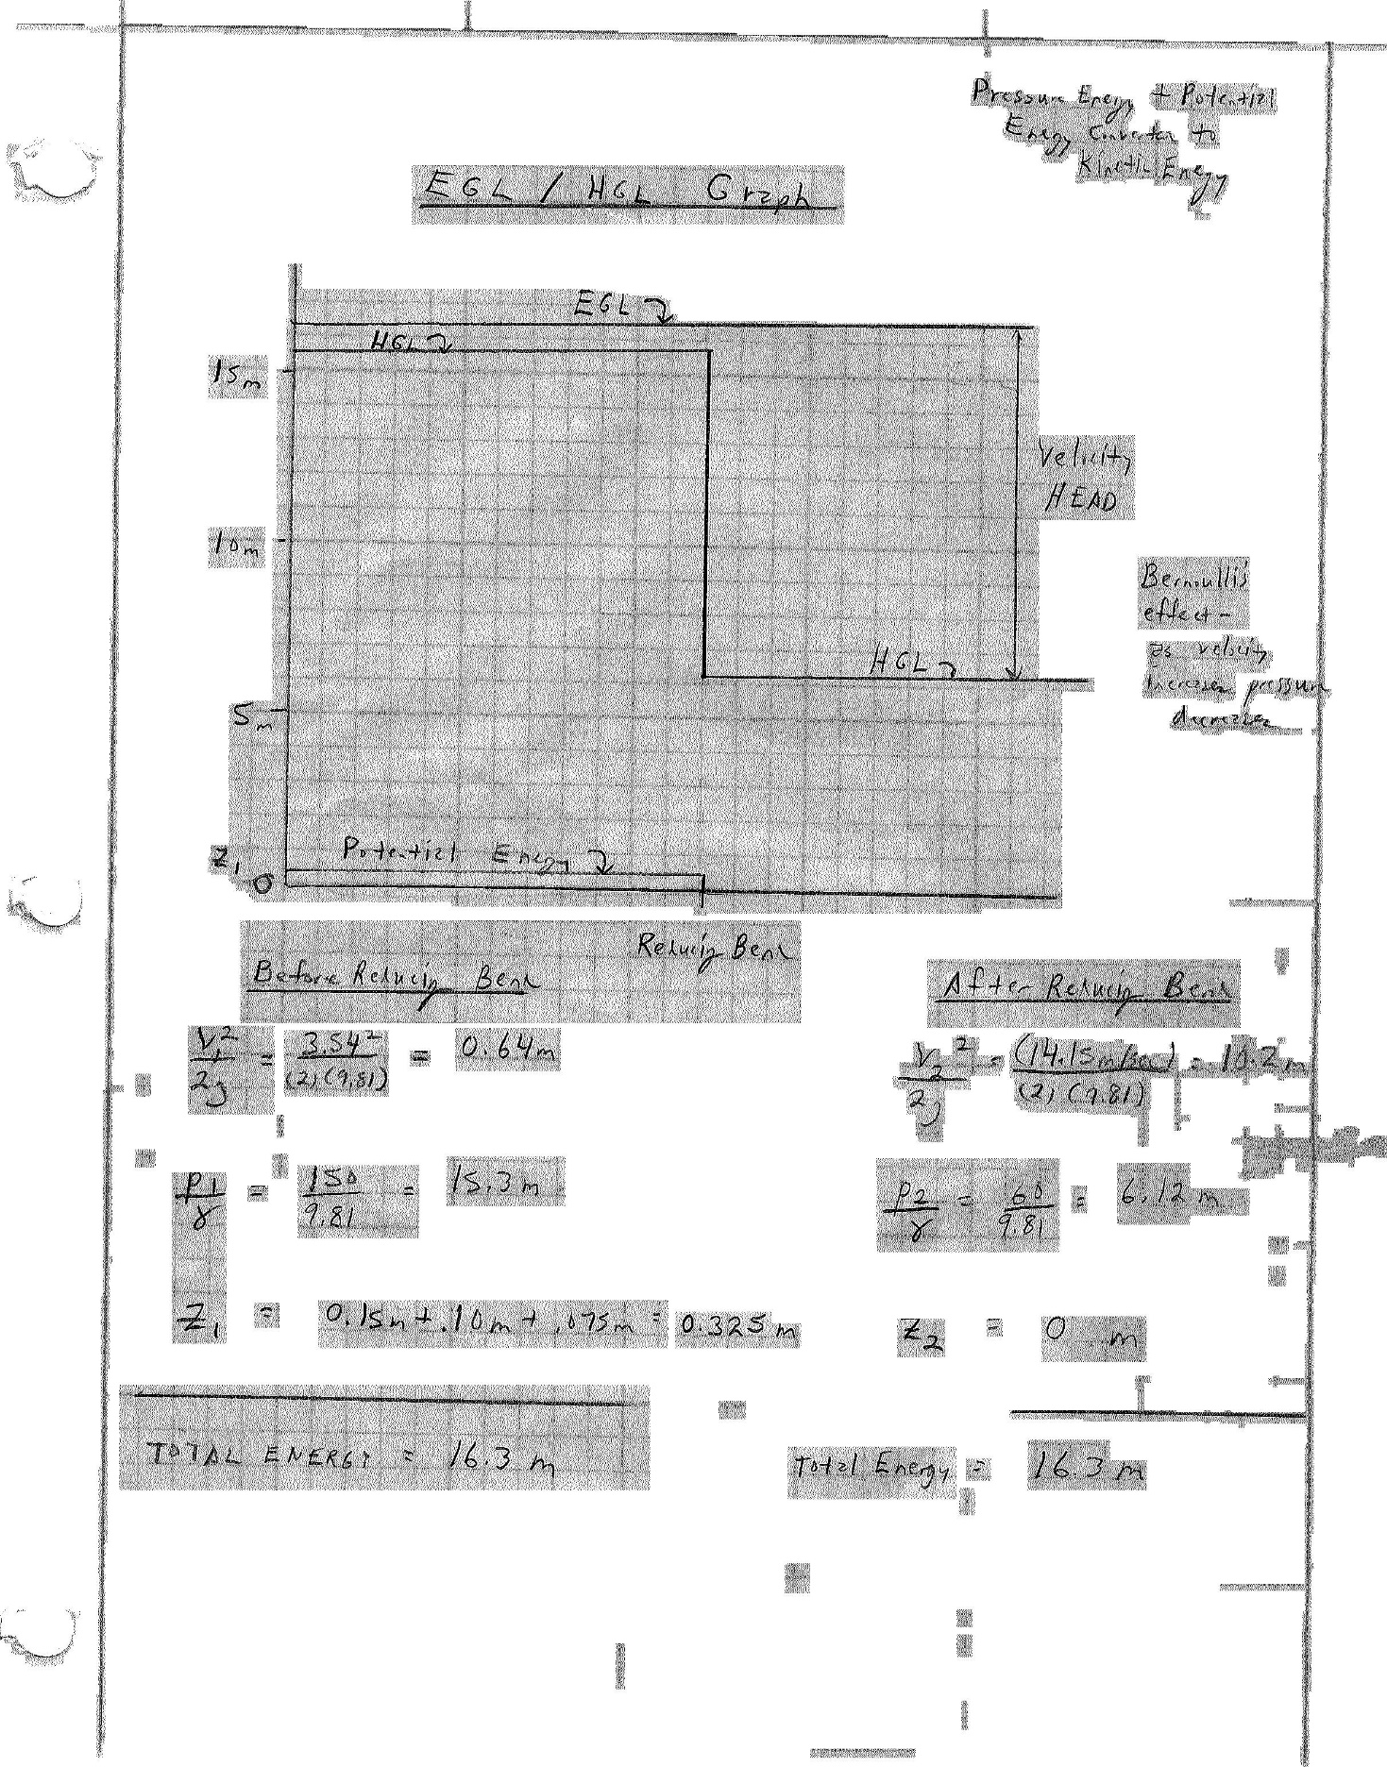
Reducing Bend Example (5/5)

Slide 39
Next Lecture
Energy equation
Accounts for friction loss, pumps and turbines (in addition to kinetic energy, pressure energy potential energy)

