Slide 1
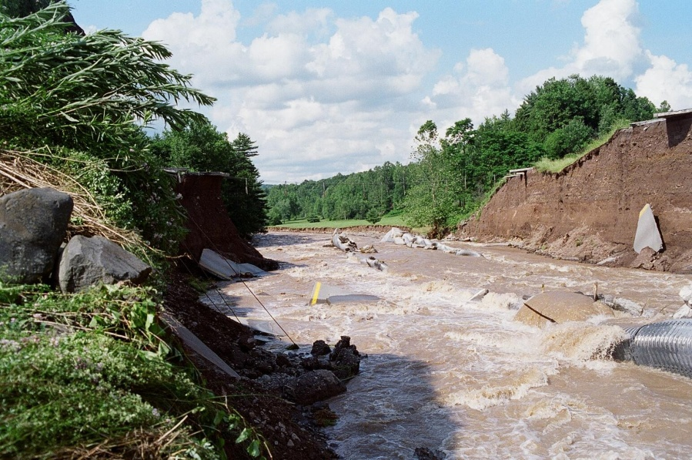
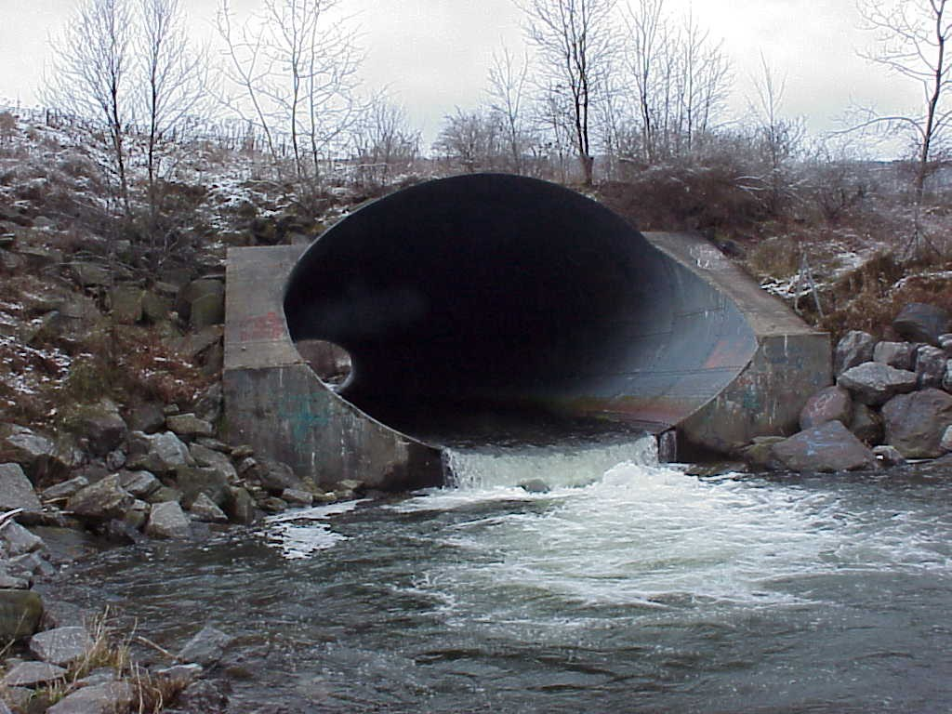
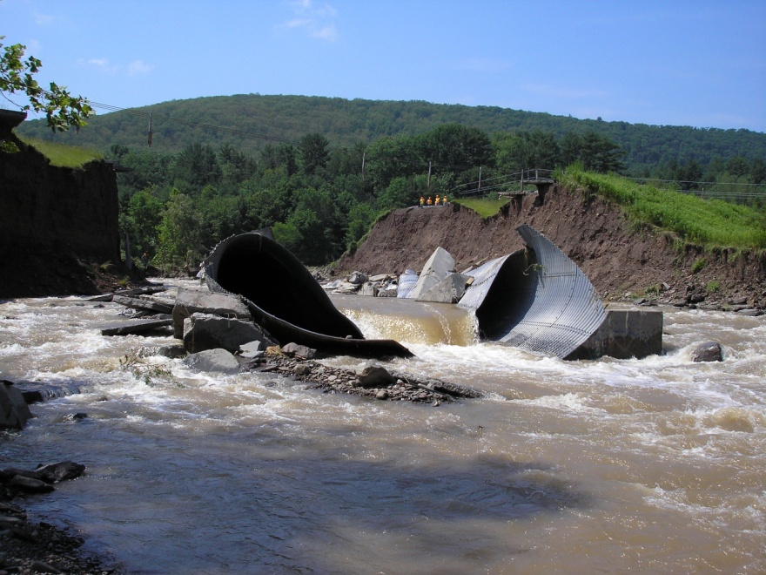
CTC 261 Culvert Basics

Slide 2
Objectives
Students should have the ability to:
Describe the different materials used for culverts
Describe inlet and outlet control
Determine the headwater depth for inlet control

Slide 3
Hydraulic Design of Highway Culverts
USDOT/FHWA
HDS 5 (highway design series #5)
HDS 5 (2005/2012 versions) available at:
https://people.sunypoly.edu/~barans/classes/ctc261/lectures.html
Most of the images in this powerpoint presentation were taken from HDS 5

Slide 4
Culvert
Hydraulically short conduit which conveys stream flow through a roadway embankment or past some other type of flow obstruction

Slide 5
Culvert Design
Conduit placed under a road to carry water from one side to the other
Designed to pass a design flow w/o overtopping the road

Slide 6
Culvert Flow
Complex
Pressure flow
Open channel flow
Combination
Variables
Slope
Pipe Diameter, Length and Roughness
Entrance Design
Exit Design

Slide 7
Culvert Shapes

Slide 8
Culvert Materials

Slide 9
Culvert Materials-other
Corrugated Aluminum
Plastic
Polyethylene
Polyvinylchloride (PVC)
Stone

Slide 10
Inlet Types

Slide 11
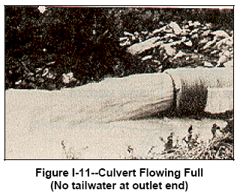
Culvert Hydraulics
Complete theoretical analysis is difficult
Flow conditions vary from culvert to culvert
Flow conditions vary over time
May flow full or partly full
Flow control-inlet or outlet
HDS approach is to analyze culvert for both types of flow control and design for minimum performance

Slide 12
Flow Conditions
Full Flow (pressure) – rare
Partly Full (free surface) Flow
Subcritical
Critical
Supercritical
Evaluate flow regime via Froude #
Fr<1 Subcritical – Smooth flow, tranquil, low velocities
Fr=1 Critical Flow (point of minimum specific energy)
Fr>1 Supercritical – Swift, rapid, high velocities

Slide 13
Headwater (HW)
Depth of upstream water surface measured from invert of culvert entrance
Should not exceed edge of shoulder elevation (account for freeboard)
Should not be so high as to cause flooding problems

Slide 14
Headwater (HW_{o})
Depth of upstream water surface measured from invert of culvert outlet

Slide 15
Tailwater (TW)
Depth of downstream water surface measured from invert of culvert outlet
Usually determined by backwater calc’s.
Sometimes (and for this class) determined by normal depth calculations

Slide 16
Outlet Velocity
Outlet velocities are usually higher than in natural channel (constriction)
High velocities can cause streambed scour and bank erosion

Slide 17
Performance Curves
Plot of HW depth or elevation versus flow rate
Inlet control curves
Outlet control curves

Slide 18
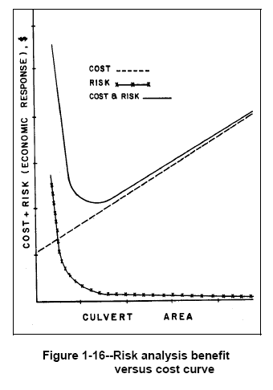
Economics
Risk:
Decreases w/ larger culvert
Cost:
Increases w/ larger culvert
Usually use a Design Frequency

Slide 19
Inlet Control
Inlet controls (or limits) the flow
Harder for flow to get through the entrance of the culvert than it is to flow through the remainder of the culvert

Slide 20
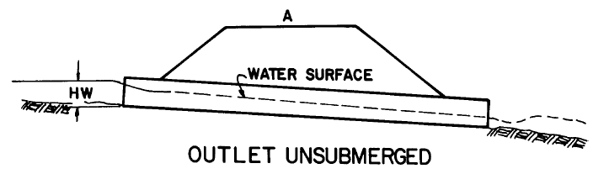
Inlet Control –A
Barrel flow is partly full and supercritical (below critical depth)
Critical depth occurs just d/s of culvert entrance
Flow approaches normal depth @ outlet end

Slide 21
Inlet Control –B
Flow d/s of inlet is supercritical (below critical depth)
Hydraulic jump occurs in the barrel
Note that submergence of outlet does not assure outlet control

Slide 22
Inlet Control –C
Barrel flow is partly full and supercritical (below critical depth)
Critical depth occurs just d/s of culvert entrance
Flow approaches normal depth @ outlet end

Slide 23
Inlet Control –D (rare)
Median drain provides ventilation/stable conditions
Hydraulic jump occurs in the barrel
Note that full-flow doesn’t occur even though inlet/outlet are submerged

Slide 24
Increasing inlet performance Beveled edges at entrance

Slide 25
Increasing inlet performance Square Edges/Curved Edges

Slide 26
Fall-Depressing the culvert entrance below the natural stream bed

Slide 27
Tapered Entrances

Slide 28
Outlet Control
Outlet controls (or limits) the flow
Harder for flow to negotiate length of culvert than it is to get through the inlet (entrance)

Slide 29
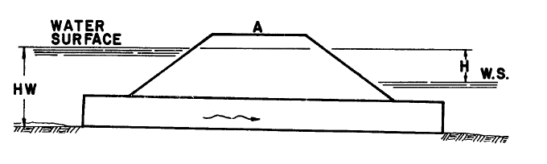
Outlet Control –A (rare)
Pressure Flow
Full Flow
Most culverts don’t operate this way
Inlet/Outlet Submerged

Slide 30
Outlet Control –B
Full Flow
Inlet not fully submerged

Slide 31
Outlet Control –C
Submerged inlet / unsubmerged outlet
Requires high HW
Outlet velocities usually high

Slide 32
Outlet Control –D (Typical)
Inlet submerged
Outlet unsubmerged
Critical depth occurs just u/s of outlet
Low TW

Slide 33
Outlet Control –E (typical)
Flow is subcritical (laminar)
Inlet and outlet are unsubmerged

Slide 34
Break

Slide 35
Factors that Influence Inlet/Outlet Control

Slide 36
Data Requirements-Hydrology
Stream gage/regression/rational method/TR-55
Same as above
Stream gage/ synthetic methods
Peak Flow
Check Flow
Hydrograph
Storage routing

Slide 37
Data Requirements Site Data
Culvert Location
Waterway Data
Cross Sections
Long. Slope
Resistance
Roadway Data
Cross Section
Profile
Culvert Length
Maps
Field Surveys
Roadway Plans

Slide 38
Data Requirements Design Headwater
Critical pts
Surrounding bldgs
Regulatory Constraints
Arbitrary Constraints
Roadway plans
Maps/plans/photos
Floodplain/flood insurance regs
State or local regs

Slide 39
Inlet Hydraulics
Entrance Unsubmerged (weir)
Entrance Submerged (orifice)
Transition (in between; poorly defined)

Slide 40
Weir and Orifice Flow Equations

Slide 41
Hydraulics-Energy Equation (EGL)
HW and TW depths and elevations
Velocity head (u/s & d/s)
Head losses
Friction loss through the barrel
Entrance/Exit losses
Bend/Junction/Grate losses

Slide 42
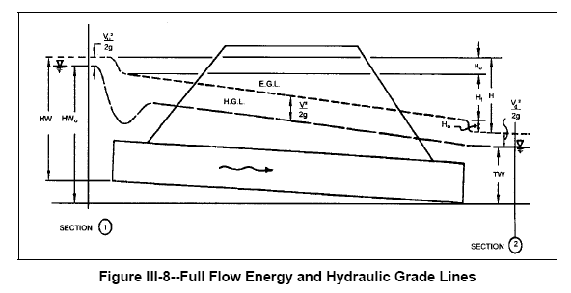
Energy and Hydraulic Grade Lines

Slide 43
Definitions: Head (Friction) Losses
H_{e}-entrance loss
H_{f}-friction loss through the barrel
H_{o}-exit loss
Other potential losses due to bends, junctions and grates
Summarize the losses to calculate the total energy required to “push” water through the barrel

Slide 44
Definitions: Velocity
V_{u}-channel velocity upstream of the culvert
V-velocity through culvert barrel
V_{d}-channel velocity downstream of the culvert
V_{u}/V_{d} are often assumed to be minimal and left out of the equations

Slide 45
Roadway Overtopping

Slide 46
Modeling Roadway Topping
Water flows through the culvert
Water also flows over the road – model as a broad crested weir
Topping usually occurs on sag curve
Represent sag w/ a single horizontal line
Represent sag w/ a series of lines

Slide 47
Culvert Design Form
Page 344 of HDS-5
Calculate HW elev based on inlet/outlet control

Slide 48
Culvert Design Form-Use for Class

Slide 49
Culvert Design Steps
Summarize all known data
Select a preliminary culvert material, shape, size and entrance type
Perform inlet control calculations
Perform outlet control calculations
If HW elevation is too high, then go back to step 2

Slide 50
Inlet Control
First step is to determine HW/D from charts
Chart 1B (Concrete Pipe-English)
Chart 2B (Corrugated Metal Pipe-English)
Chart 3B (Circular Pipe-Beveled Ring)
Chart 8B (Box Culverts) –D is box culvert Ht
Note: Must calculate Q per foot of culvert box width
Multiply by Diameter or Box Culvert Height to get HW

Slide 51
HW versus different ends
Dia=42” (3.5)
Q=120 cfs
Square edge with headwall
HW/D=2.5
HW=8.8’
Groove end with headwall
HW/D=2.1
HW=7.4’
Groove end projecting
HW/D=2.2
HW=7.7’

Slide 52
First Homework
Show only inlet control calculations.
Read and use HDS-5
Use the culvert form from HDS-5 (2005)-larger-page 344
For CBC calculate Q/width of box

Slide 53
Next Lecture
Culvert Design Form Outlet control

