Slide 1
CTC 261 Culvert Design
Plan, Profile and Cross-Section

Slide 2
Objectives
Students will be able to:
Describe three types of horizontal culvert crossings
Evaluate culvert alternatives with respect to a vertical profile
Describe design elements that must be considered when designing a culvert

Slide 3
Culvert Design
Hydraulics/Material Type (covered in lecture last week)
Location
Profile
Cross Section
Strength
Method of Construction
Cost

Slide 4
Horizontal Alignment
Perpendicular to road
  Shorter
  Easy to build
  May require channel relocation
Skewed
  Longer
  More complex to build
  Channel relocation may not be needed

Slide 5
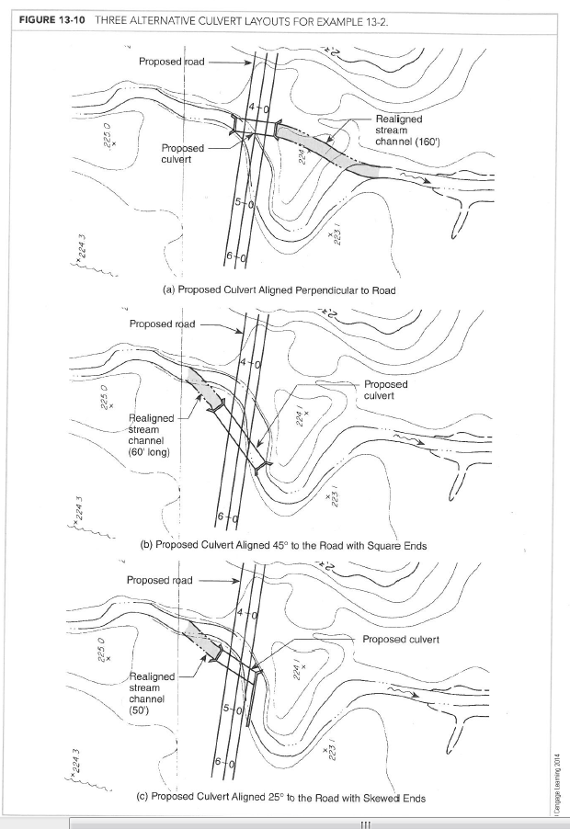
Horizontal Layout: Alternative Locations
No skew (realign channel 160’ ds)
45 deg skew (realign channel 60’ us)
25 deg skew (realign channel 50’ us and long headwall downstream)

Slide 6
Profile
Draw profile to help determine what size culvert will work
  Show existing/proposed grade of roadway centerline
  Show proposed culverts
  Scale is typically exaggerated in vertical direction

Slide 7
Profile Example
See next slide (two options)
Shows twin 13’span x 4’height (Trial 4) (104 sq ft)
Shows 12’span x 6’ height (Trial 5) (72 sq ft)
Note that profile would need to be higher (more fill) for Trial 5

Slide 8
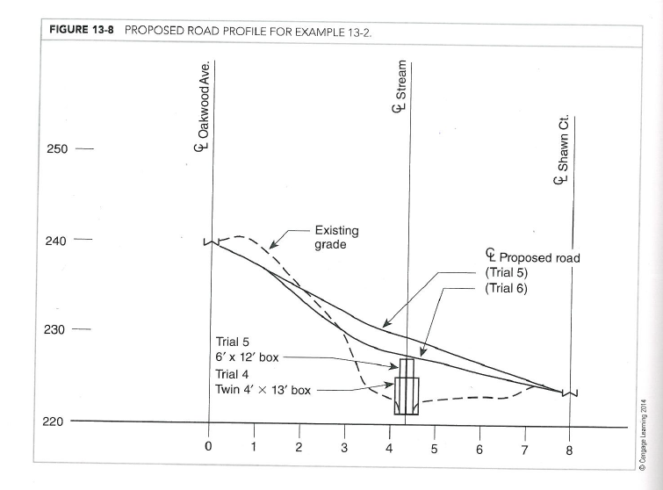
Vertical Layout: Alternative Sizes

Slide 9
Cross-Section
Draw cross-section (perpendicular to road) to help determine structure length

Slide 10
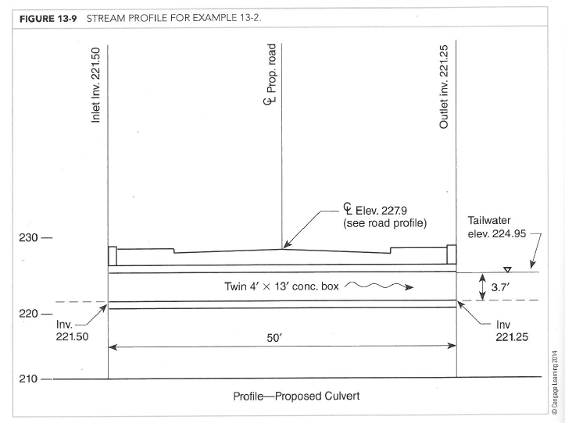
Cross-Section

Slide 11
Culvert Design Overall Example

Slide 12
Culvert Example
Determine Design Flow
Frequency & Duration: Q₁₀₀, 24-hr storm
Method: NRCS (SCS; TR-55)
(DA/Soils/Precipitation Data/Land Use/Cover, etc.)
Q₁₀₀=100 cfs

Slide 13
Culvert Example-2
Determine Allowable Headwater (AHW) and Tailwater (TW)
AHW by local regs is limited to the upstream culvert crown
Use Manning’s equation (Q₁₀₀) & solve for normal depth via trial and error
TW=3.7 feet

Slide 14
Culvert Example-3
Type of culvert: CBC w/ 45-deg wingwalls and a square edge entrance---trial and error

Slide 15
Trial & Error (AHW=Inlet Crown)
Trial culvert (Span by Ht) | Calc.HW | Comments
8’ x 4’ | 11.6’ | >4’; not acceptable
16’ x 4’ | 5’ | >4’; not acceptable
Double 12’x4’ | 4.1’ | >4’; not acceptable
Double 13’x4’ | 4.0’ | acceptable
12’x6’ | 5.82’ | acceptable, but HW is higher & more damaging to adjacent property owners

Slide 16
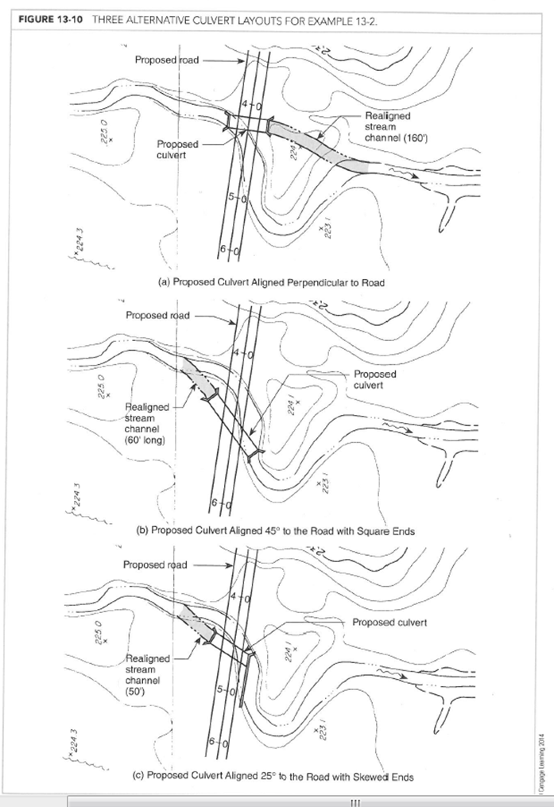
Culvert Alternatives
Determine horizontal layout
Alt. | Description | Disadvantage
Alt A | No skew; 50’length Channel Realigned 160’ | Significant stream reloc.
Alt B | 45-deg skew; 95’length Channel Realigned 60’ | Longer barrel length
Alt C | 25-deg skew; 50’ length Channel Realigned 50’ | Not aligned DS

Slide 17
Break

Slide 18
Culvert Replacement Considerations
Same location/new location
Same size/new size
Same material/different material
Maintenance of traffic during replacement

Slide 19
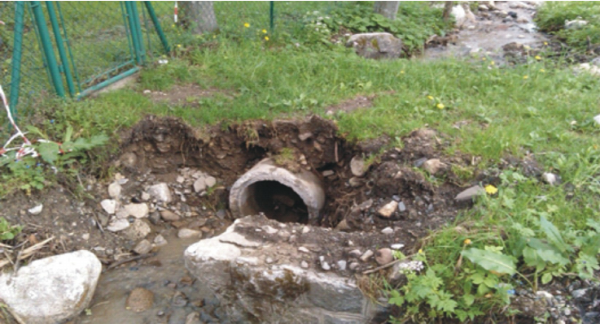
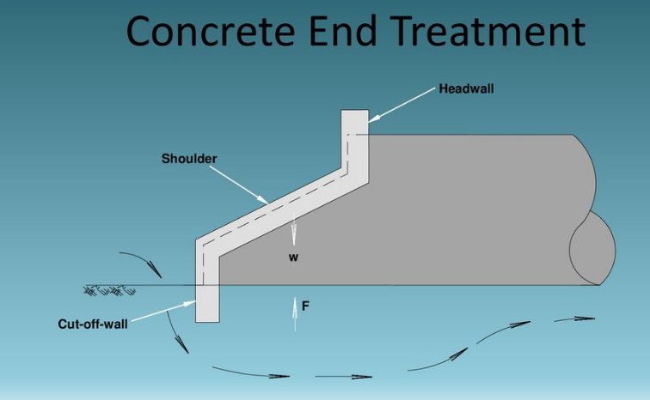
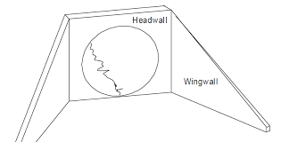
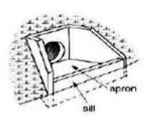
Erosion at Inlet
Scour @ inlets
Prevention
  Paved Apron
  Cutoff Walls
  Headwalls
  Wingwalls

Slide 20
Erosion at Outlet
Scour @ outlets (very common)
  Velocity higher than natural channel
  Difficult to predict
  Local scour (limited d/s distance)
  General stream degradation
Prevention
  Riprap
  Energy Dissipators
  Preformed scour holes

Slide 21
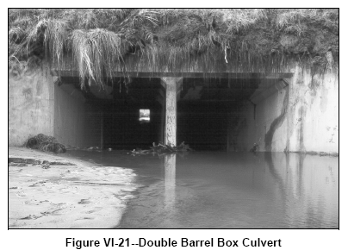
Sedimentation
If culvert aligned w/ natl. channel-not usually a problem
Multiple barrels and culverts w/ depressions are susceptible

Slide 22
Debris Control
Routine maintenance may be adequate
May need to Intercept/Deflect or Pass

Slide 23
Economics
Service Life-Same as roadway
Comparison between bridge/culvert
  Culverts less expensive
  Culverts may cause more flooding
  Bridge maintenance costs usually higher
  Bridges usually more aesthetic
Comparison between materials & shapes
Risk Analysis

Slide 24
Structural
Structural analysis
  Embankments (dead loads)
  Traffic load (live loads)
  Hydrostatic/hydrodynamic forces
  Bedding/Backfill is important
Flotation & Anchorage
  Uplifting forces can cause damage (buoyancy)
Endwalls/Headwalls (retaining walls)

Slide 25
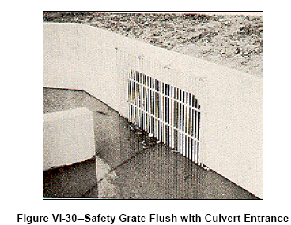
Safety
Grates
  Traversable for vehicles
  Keep out children
  Debris may be a problem
Inlets/Outlets
  Locate outside clear zones
  Guide railing may be needed

Slide 26
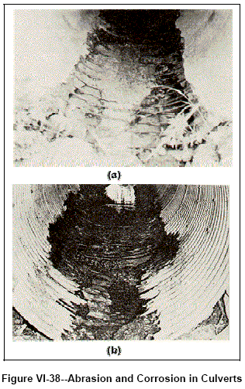
Culvert Durability
Abrasion
  High velocities carry rocks
  Use concrete or lining
  Oversize culvert & bury invert
Corrosion
  Steel corrodes pH<6 or >10
  Metal susceptible in clay or organic mucks
  Concrete susceptible to seawater, sulfates, Mg salts
  Use Al in saltwater
  Use linings
  Vary concrete mix

Slide 27
Environmental Considerations
Prevent sediments/oils, etc. from entering streams/wetlands during construction
Fish stream
  Undisturbed streambed
  Oversize structure and reproduce natural streambed
  Multiple barrels to handle different flows

Slide 28
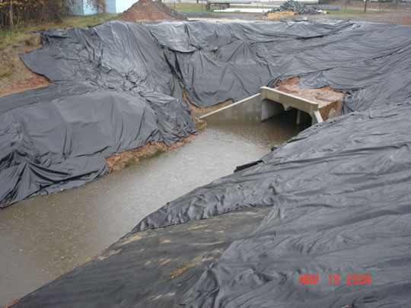
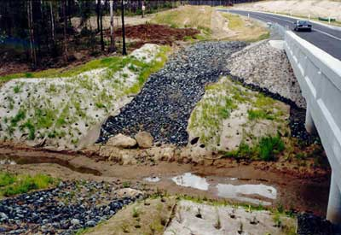
Erosion Control During Construction

Slide 29
Installation Details (203-04 and 203-05)
https://www.dot.ny.gov/main/business-center/engineering/cadd-info/drawings/standard-sheets-us-repository/203-04.pdf
https://www.dot.ny.gov/main/business-center/engineering/cadd-info/drawings/standard-sheets-us-repository/203-05_2016-09-01.pdf

