Slide 1
Culvert Hydraulics using the Culvert Design Form

Slide 2
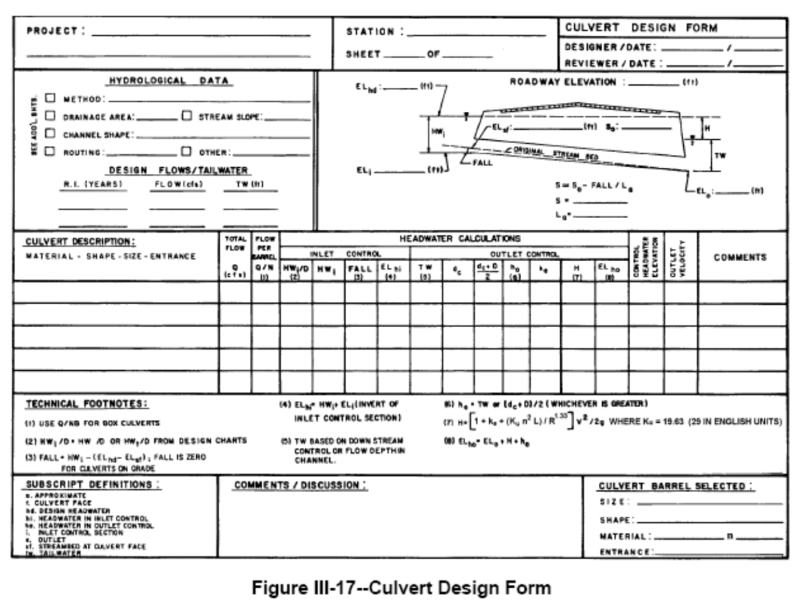
Objectives
Know how to use the culvert design form to evaluate and size simple culverts (page 344 of 2005 HDS 5)

Slide 3
Culvert Design Form

Slide 4
Step 1
Summarize all known data and select a preliminary culvert size, shape and entrance type

Slide 5
Step 2
Choose a culvert type and size

Slide 6
Step 3-Inlet Control Calculations
Inlet control calculations
Determine HW/D from Design Charts
Calc HW depth
Calc Fall (don’t do for this class)
Calc the Elev of the HW for inlet control

Slide 7
Step 4-Outlet Control Calculations
Outlet control calculations
Determine TW depth
Determine critical depth
Find the average of critical depth and diameter
Determine depth from culvert outlet invert to HGL
Determine all head losses
Calc the Elev of the HW for outlet control

Slide 8
Step 5-Evaluate Results
Higher of the two elevations designates control
Choose larger culvert if the highest elevation is unacceptable

Slide 9
Example Problem 1 (pg 56 of HDS5-2005)
Q₂₅=200 cfs
Natural channel slope=1%
TW=3.5 ft
L=200 ft
Natl streambed elev. @ entrance = 100 ft
Shoulder Elev=110 ft (2-ft freeboard)
Evaluate 72” (6’) CMP (45 deg bevel)

Slide 10
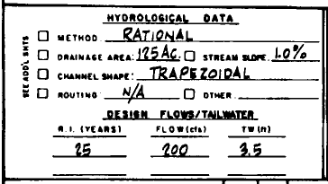
Culvert Design Form Data

Slide 11
Step 2 Inlet Control Calculations
HW/D from Design Chart 3B = 0.96
HW=0.96*6’=5.8’
A =45 deg bevel, pg 27
B =33.7 deg bevel

Slide 12
Step 3-Inlet Control Calculations Calculate Fall—Assume Fall=0 for this class
Max. Available HW depth = 108-100= 8’
Fall = Calc HW depth – Available HW depth
5.8’-8’= -2.8 ft
Fall is negative; therefore set fall = 0
Note: If fall is + then the invert must be lowered to allow enough head to “push” desired Q through the culvert

Slide 13
Step 3-Inlet Control Calculations Calculate HW Elev for inlet control
EL_{hi}=HW_{i}+EL_{i}
5.8 ft+100 ft = 105.8 feet

Slide 14
Step 4-Outlet Control Calculations TW Depth
Determine TW depth
Backwater calculations (not covered in this class) or find normal depth using Manning’s equation (or Flowmaster)
Given as 3.5’

Slide 15
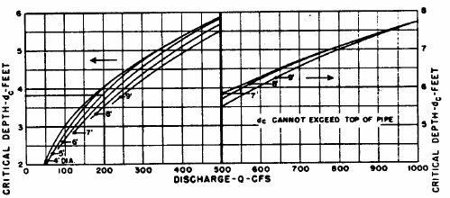
Step 4-Outlet Control Calculations Critical Depth in Culvert (could also use flowmaster)
Determine Critical Depth (Chart 4A) 3.8’

Slide 16
Step 4-Outlet Control Calculations Find average of dc + D
(3.8+6)/2 = 4.9’
Average of critical depth and diameter of pipe

Slide 17
Step 4-Outlet Control Calculations Determine ho
h_{o} is the depth from the culvert outlet invert to the hydraulic grade line
Larger of:
TW (3.5’) or
Avg. of (d_{c} & D-4.9’) ---See Figure III-9 (D)

Slide 18
Step 4-Outlet Control Calculations Find Entrance Loss Coefficient, K_{e}
K_{e}= 0.2

Slide 19
Outlet Control Head Losses
Can use Chart 6
Line D/Ke
Line Q/Turning Pt
H=2.6’

Slide 20
Step 4-Outlet Control Calculations Calculate HW Elevation
Outlet Invert Elev + Head Losses + h_{o}
98+2.6+4.9
HW elevation based on outlet control = 105.5’

Slide 21
Step 5 Evaluate Results
Culvert is operating under inlet control 105.8
There is still 2 ft of head available (compare to 108)
Try a smaller culvert

Slide 22
Outlet Velocity – Inlet Control (pg 50)
Velocity at normal depth (in the culvert barrel) is assumed to be the outlet velocity
Use Manning’s equation (by hand or using Flowmaster and solve for normal depth)
Calculate depth which gives a Q of 200 cfs
Velocity = 9.2 cfs

Slide 23
Outlet Velocity- Outlet Control page 50
Use critical depth if TW<critical depth
Use TW if TW is between critical depth and top of barrel
Use full depth of barrel if TW is above top of barrel

Slide 24
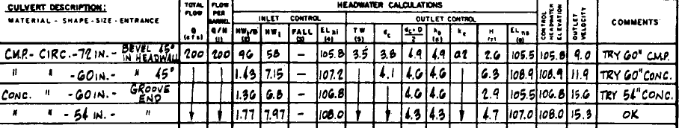
Culvert Design (Allowable HW is 108.0’)

Slide 25
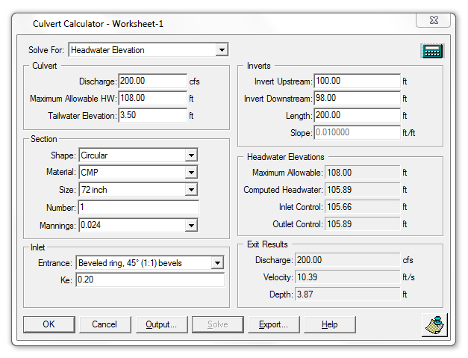
Culvert Master (Quick Calculator)

Slide 26
Culvert Design
Multiple structures
For 2 pipes or boxes of same size, etc. determine Q/2 and evaluate 1 pipe (or box)
For concrete box culvert
6’ x 5’ (span x height)
Q/H = Flow per foot of span
D = height of culvert box (5’)

Slide 27
Break

Slide 28
Chapter VI – Special Considerations Flow Control & Measurement
Irrigation Canals
Stormwater Management Ponds
Cooling Waterchannels
Use routing to determine inflow into any pond upstream of culvert

Slide 29
Chapter VI – Special Considerations Low Head Installations
Convey water under a roadway w/ min. HW and energy loss
Usually found in irrigation systems
Sag culverts sometimes used

Slide 30
Chapter VI – Special Considerations Bends – Horizontal or Vertical

Slide 31
Chapter VI – Special Considerations Junctions

Slide 32
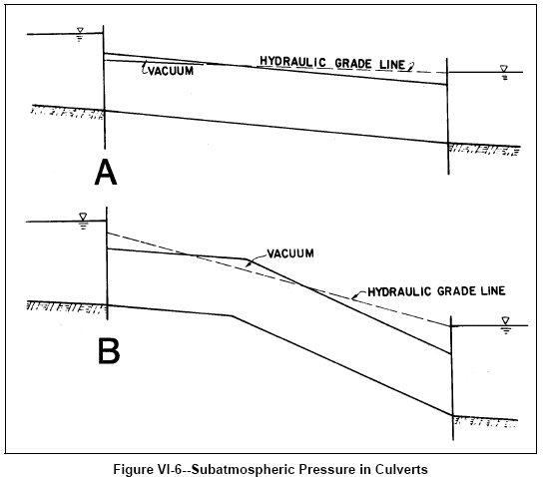
Chapter VI – Special Considerations Siphons (vacuum)-rarely designed

Slide 33
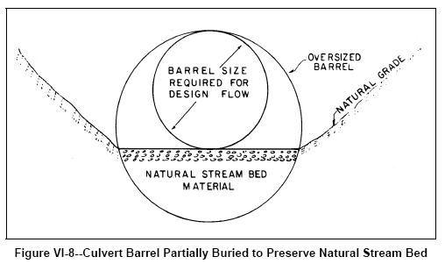
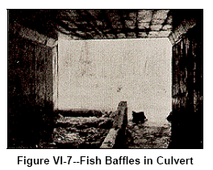
Chapter VI – Special Considerations Fish Passage

