Slide 1
CTC 261
Energy Equation

Slide 2
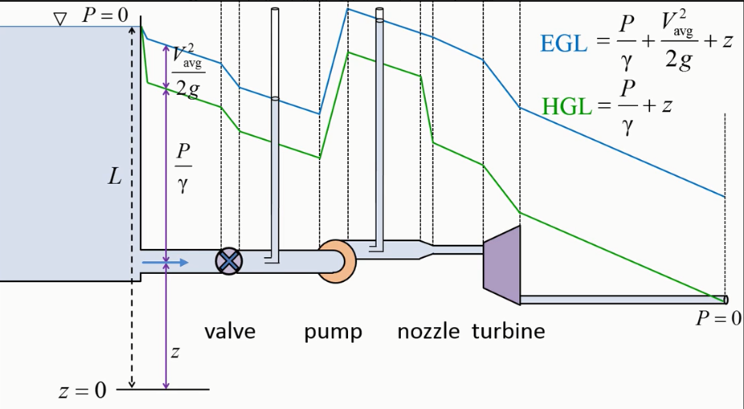
Review
Bernoulli’s Equation
Kinetic Energy-velocity head (V²/2g-units of ft)
Pressure energy-pressure head (P/Specific weight-units of ft)
Potential Energy (height above some datum-units of ft)
EGL/HGL graphs
Energy grade line (all energy added)
Hydraulic grade line (EGL-velocity head or potential energy + pressure head)

Slide 3
Objectives
Apply the energy equation (Bernoulli’s—add pumps/turbines/friction loss)
Incorporate head (friction) losses into EGL/HGL graphs
Calculate friction loss using the Darcy-Weisbach equation
Calculate other head losses (bends/valves, etc)

Slide 4
Energy Equation
Incorporates energy supplied by a pump, energy lost to a turbine, and energy lost due to friction
There are two major types of friction losses:
1. pipe friction
2. other head losses (bends, valves, contractions, entrances, exits, etc)

Slide 5
Pumps, turbines, friction loss
Pump adds energy
Turbine-loss of energy out of the system (but converted to useful energy)
Friction loss-loss out of the system as heat

Slide 6
Energy Equation in Words
PE+Pressure+KE+Pump Energy=
PE+Pressure+KE+Turbine Losses+Head Losses

Slide 7
Energy/Work/Power
Work = force*distance (in same direction)
Power = work/time
Power=pressure head*specific weight*Q
Watt=Joule/second=1 N-m/sec
1 HP=550 ft-lb/sec=746 Watts

Slide 8
Hints for drawing EGL/HGL graphs
EGL=HGL+Velocity Head
Friction in pipe: EGL/HGL lines slope downwards in direction of flow
A pump supplies energy; abrupt rise in EGL/HGL
A turbine decreases energy; abrupt drop in EGL/HGL
When pressure=0, the HGL=EGL=water surface elevation
Steady, uniform flow: EGL/HGL are parallel to each other
Velocity changes when the pipe dia. Changes
If HGL<pipe elev., then pressure head is negative (vacuum-cavitation)

Slide 9
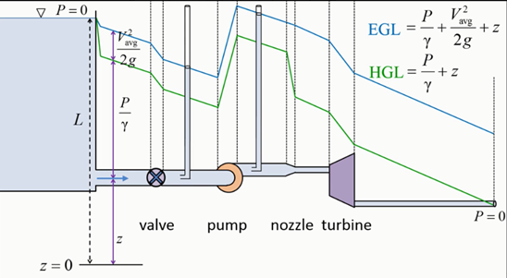
EGL/HGL example

Slide 10
Energy Examples
1. Pump Example
2. Reservoir Example (pumped storage)

Slide 11
Energy Equation-Pump Example-1
A pipe is 50-cm in diameter and carries water at a rate of 0.5 cms. Before a pump, the elevation of the pipe is 30 meters in elevation and the pressure is 70 kPa. After the pump, the pipe is 40 meters and 350 kPa. Assume the head loss is 3 meters.
What power in kilowatts and horsepower must be supplied to the flow by the pump?

Slide 12
Energy Equation-Pump Example-2
Calculate velocities before and after pump:
Before & after pump velocity=2.55 m/sec
If velocities are the same then what????

Slide 13
Energy Equation-Pump Example-3
PE+Pressure+Pump Energy=
PE+Pressure+Losses (other)

Slide 14
Energy Equation-Pump Example-4
Before pump:
Pressure=70 kPa
Potential energy=30m
Power supplied by pump=?
After pump:
Pressure=350 kPA
Potential energy=40 m
Head loss=3m (unclear-assume pump head loss)

Slide 15
Energy Equation-Pump Example-5
Solve for energy supplied by pump:
41.5 meters
28.5 m (increase pressure from 70-350 kPa)
10 m (increase in elev of 10m after pump)
3 m (overcome friction loss)
What power in kilowatts and horsepower must be supplied to the flow by the pump?

Slide 16
Energy Equation-Pump Example-6
What power in kilowatts and horsepower must be supplied to the flow by the pump?
Power=head*specific weight*Q
Power=206 kilowatts
Power=276 horsepower

Slide 17
Reservoir Example
A pump draws water from a reservoir, where the WSE=520 ft, and forces the water through a pipe 5,000 feet long and 1 foot in diameter.
The pipe then discharges the water into a reservoir with WSE=620 ft.
The flow rate is 7.85 cfs and the head loss is 77.6 feet.
Determine the head supplied by the pump and the power supplied to the flow.

Slide 18
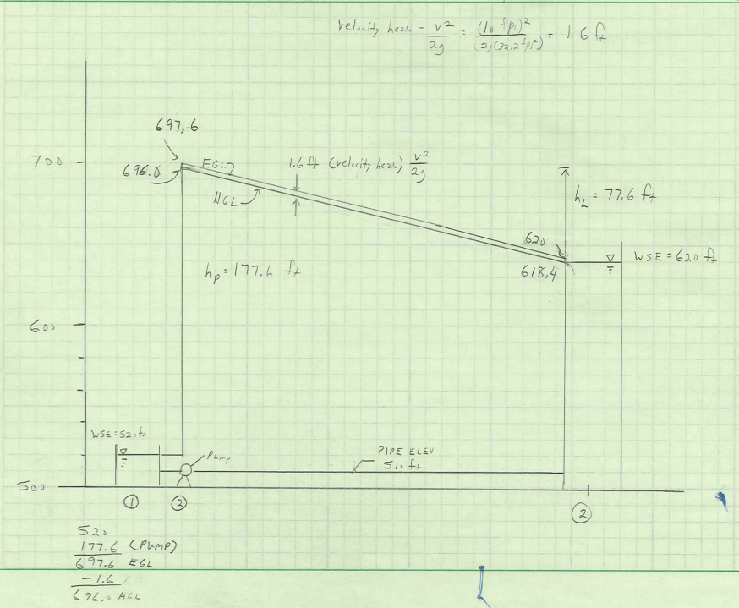
Reservoir Example Answers
Head supplied by the pump is 177.6 ft (100’ to raise water to an increased elevation and 77.6’ to overcome friction loss in the pipe)
Power supplied by the pump=158 hp

Slide 19
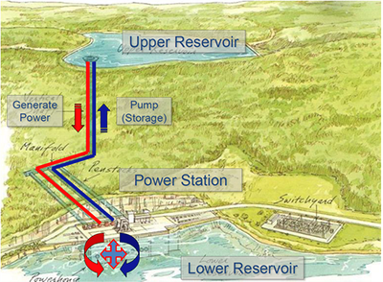
Pumped Storage
Energy use is not steady
Coal/gas/nuclear plants operate best at a steady rate
Hydropower can be turned on/off more easily, and can accommodate peaks
Pumping water to an upper reservoir at night when there is excess energy available “stores” that water for hydropower production during peak periods

Slide 20
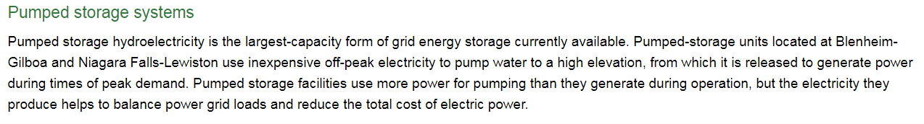
Pumped Storage-NY

Slide 21
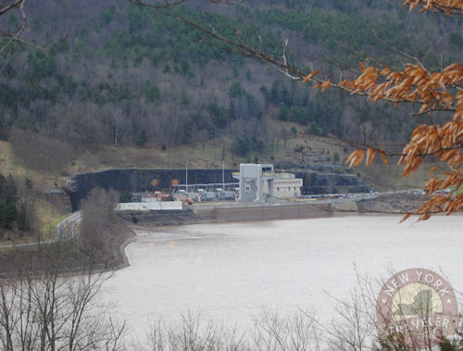
Pumped Storage-Gilboa
Blenheim-Gilboa Hydro Power Station
https://en.wikipedia.org/wiki/Blenheim%E2%80%93Gilboa_Hydroelectric_Power_Station

Slide 22
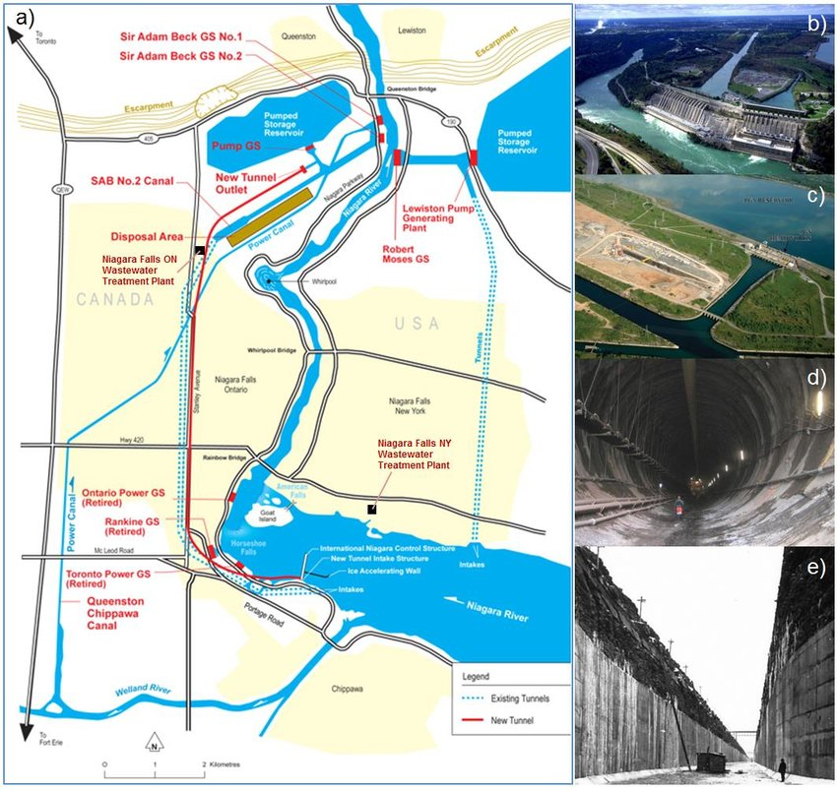
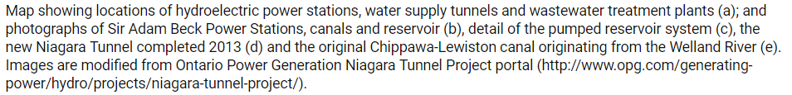
Pumped Storage-Lewiston

Slide 23
Break
We covered the Energy Equation—which is the Bernoulli’s equation plus 3 more energy types (pumps, turbines and friction)
Next—We will expand on friction (break into two types-pipe friction and others)

Slide 24
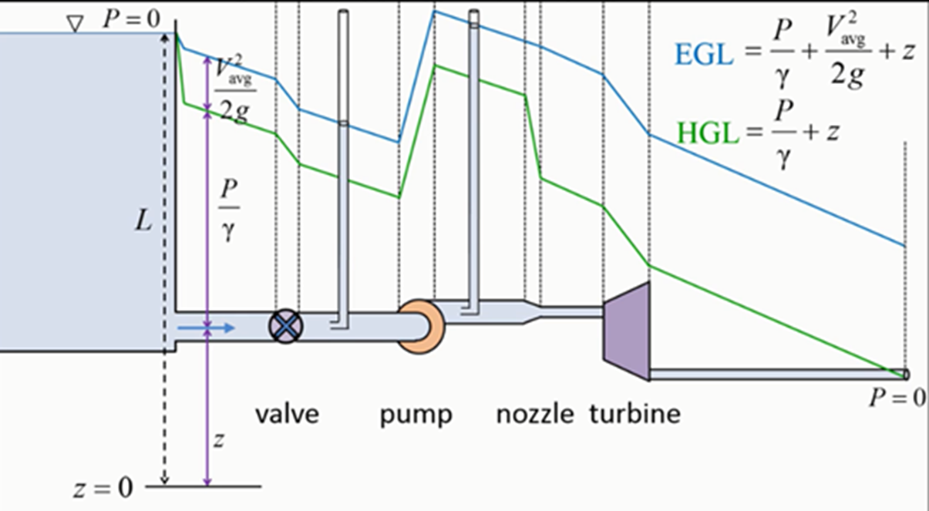
Head (Friction) Losses
Flow through pipe:
EGL/HGL lines slope
Other head losses:
Entrances, Valves-(Sharp drops in EGL)

Slide 25
Studies have found that resistance to flow in a pipe is:
Independent of pressure
Linearly proportional to pipe length
Inversely proportional to some power of the pipe’s diameter
Proportional to some power of the mean velocity
If turbulent flow, related to pipe roughness
If laminar flow, related to the Reynold’s number

Slide 26
Head Loss Equations
Darcy-Weisbach
Theoretically based
Hazen Williams
Frequently used-pressure pipe systems
Experimentally based
Chezy’s (Kutter’s) Equation
Frequently used-sanitary sewer design
Manning’s Equation
26
Notes:
26

Slide 27
Darcy-Weisbach
h_{f}=f*(L/D)*(V²/2g)
Where:
f is friction factor (dimensionless) and determined by Moody’s diagram (handout)
L/D is pipe length divided by pipe diameter
V is velocity
g is gravitational constant

Slide 28
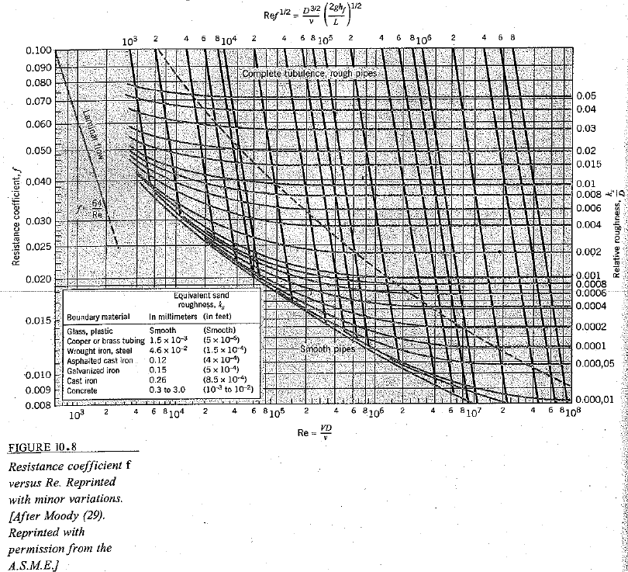
Moody Diagram
For Class Use Only: Origin Not Verified!!!
28
Notes:
28

Slide 29
Moody’s Diagram
For Class Use Only: Origin Not Verified!!!
29
Notes:
29

Slide 30
Problem Types
Determine friction loss
Determine flow
Determine pipe size
Some problems require iteration (guess f, solve for v, check for correct f)

Slide 31
Example Problems
PDF’s are available on Brightspace, Content:
Determine head loss given Q (ex 10.4)
Find Q given head loss (ex 10.5)
Find Q (iteration required) (ex 10.6)
31
Notes:
31

Slide 32
Find Head Loss Per Length of Pipe
Water at a temperature of 20-deg C flows at a rate of 0.05 cms in a 20-cm diameter asphalted cast-iron pipe. What is the head loss per km of pipe?
Calculate Velocity (1.59 m/sec)
Compute Reynolds’ # and ks/D (3.2E5; 6E-4)
Find f using the Moody’s diagram (.019)
Use Darcy-Weisbach (head loss=12.2 per km of pipe)
32
Notes:
32

Slide 33
Diagram
For Class Use Only: Origin Not Verified!!!

Slide 34
Find Q given Head Loss
The head loss per km of 20-cm asphalted cast-iron pipe is 12.2 m. What is Q?
Can’t compute Reynold’s # so calculate Re*f^{1/2} (4.4E4)
Compute ks/D (6E-4)
Find f using the Moody’s diagram (.019)
Use Darcy-Weisbach & solve for V (v=1.59 m/sec)
Solve Q=V*A (Q=-.05 cms)
34
Notes:
34

Slide 35
Moody
For Class Use Only: Origin Not Verified!!!
35
Notes:
35

Slide 36
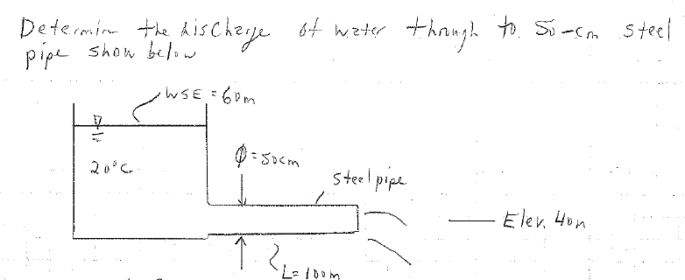
Find Q: Iteration Required
Similar to another problem we did previously; however, in this case we are accounting for friction in the outlet pipe
36
Notes:
36

Slide 37
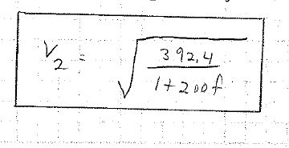
Iteration
Compute ks/D (9.2E-5)
Apply Energy Equation to get the Relationship between velocity and f
V2=[(delta h*2g)/(1+f*L/d)]^.5
Iterate (guess f, calculate Re and find f on Moody’s diagram). Stop if solution matches assumption. If not, assume your new f and repeat steps).
37
Notes:
37

Slide 38
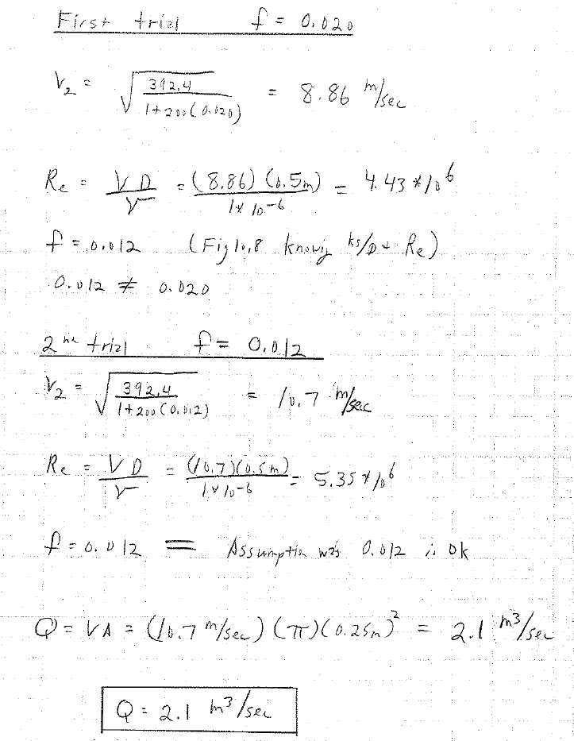
Iterate
38
Notes:
38

Slide 39
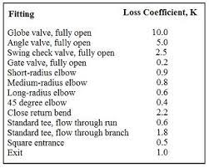
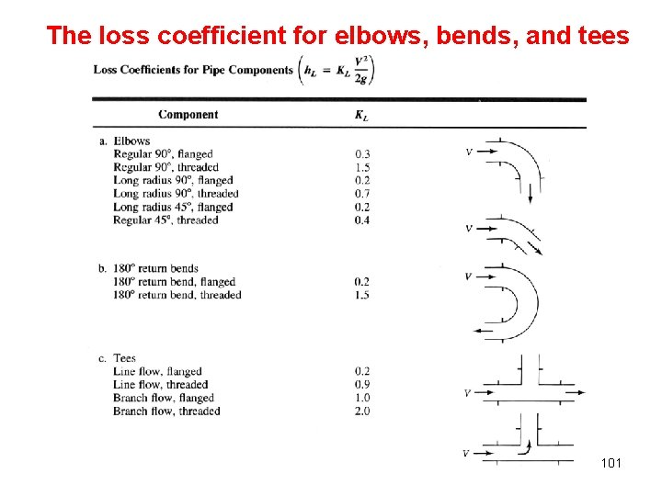
Other head losses
Inlets, outlets, fittings, entrances, exits
General equation is h_{L}=kV²/2g
K tables available at various
sources

Slide 40
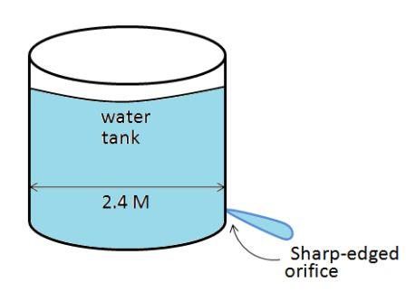
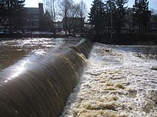
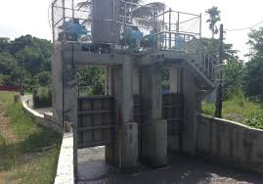
Next class
Orifices
Weirs
Sluice Gates

