Slide 1
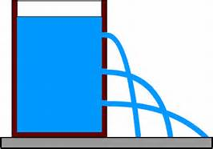
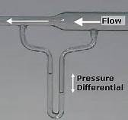
CTC 261 Hydraulics Fluid Statics

Slide 2
Objectives
Define the difference between absolute and gage pressure
Calculate hydrostatic pressures and resultant force on a horizontal plane surface
Convert between pressure and pressure head
Solve manometer problems
Calculate resultant force and location on a vertical plane surface due to hydrostatic pressures

Slide 3
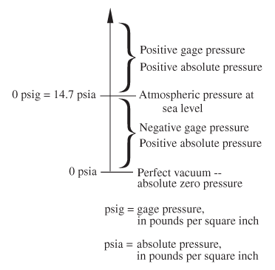
Absolute Pressure
Absolute pressure is measured in reference to a vacuum or zero pressure. Pressure at sea level is 1 atmosphere, 101.3 kPa, or 14.70 psi.
Pressures measured by an absolute pressure transducer are always positive because these devices are referenced to a perfect vacuum in which absolute pressure is zero. Zero referencing is accomplished by completely evacuating and sealing the interior or reference side of the transducer.

Slide 4
Gage Pressure
Gage pressure is measured in reference to atmospheric pressure at mean sea level. Pressures measured by a gage-pressure transducer are positive for pressures greater than sea-level pressure and negative for pressure less than sea-level pressure. Thus, atmospheric pressure measurements above sea-level datum are negative because atmospheric pressure decreases with altitude.
Sea-level referencing is accomplished by sealing the interior or reference side of the transducer to atmospheric pressure at sea level. The term "gage pressure" is sometimes used to describe pressure measurements referenced to ambient atmospheric pressure other than to sea level.

Slide 5
Pressure
Vacuum pressure is the difference between atmospheric pressure and absolute pressure (vacuum pressure is always below atmospheric pressure)
Absolute pressure = Gage Pressure + Atmospheric Pressure
In civil engineering, gage pressure is what’s normally used (but best to specify your units as psig or psia)

Slide 6
Hydrostatic Pressure
Pressure which a fluid exerts on an object or container wall
Always acts through the center of pressure and is normal to the exposed surface
Hydrostatic pressure varies linearly with depth and is a function of depth and specific weight only

Slide 7
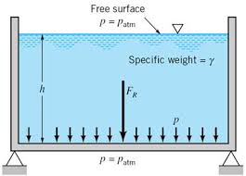
Hydrostatic Pressure and Resultant Force on a Horizontal Plane Surface
Pressure is uniform because the depth of liquid is the same across the plane surface
Pressure=Specific weight * depth (height)

Slide 8
Hydrostatic Pressure on a Horizontal Plane Surface
Cylinder of water 1 foot high; area = 1 ft²
What is the pressure at the bottom of the cylinder?
P=Specific Wt * Height of Water
P=62.4 #/ ft²
F=Pressure * Area
F=62.4 #
8
Notes:
8

Slide 9
Force on Horizontal Plane Surface
9
The magnitude of the force is 62.4#
Where does it act?
Notes:
9

Slide 10
Calculating Resultant Force
Magnitude of the force = pressure * area
Location of the force is at the centroid of the horizontal plane surface
Centroids of some simple shapes can be found on Brightspace (see content)

Slide 11
Pressure and Pressure Head
In civil engineering water pressure (psi) is often expressed in terms of water head (ft)

Slide 12
Converting Pressure to Pressure Head
Pressure Head = Pressure/Specific Weight
Example:
Atmospheric pressure = 14.7 psia
(14.7 psia)(144 in²/ft²)/(62.4#/ft³)=33.9 ft H₂O
The specific weight of Hg is 13.6 therefore the pressure head in terms of Hg would be 2.49 ft

Slide 13
Water is Heavy!!!
13
Meat Man
http://www.youtube.com/watch?v=gmafAiLHUXI
Meat Man @ 300’ of water depth (approx.135 psi)
P=64.1 #/ft³ * 300 ft*/144 in² per ft² = 133.5 psi
http://www.youtube.com/watch?v=LEY3fN4N3D8&NR=1
Notes:
13

Slide 14
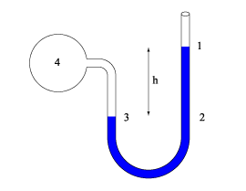
Manometer Principles
Point 1: Pressure=0 (gage)
Point 2: Pressure=h*specific weight of liquid
Point 3: Pressure=Pressure @ 2
Point 4: Pressure=Pressure @ 3 –d*specific weight of liquid in vessel 4
d
As you go down pressure increases.
As you go up pressure decreases.
As long as you know pressure at some point, fluid properties and key depths you can determine pressures at all other points.

Slide 15
Conundrum-----
On board

Slide 16
Break

Slide 17
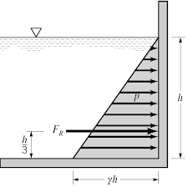
Hydrostatic Pressure on a Vertical, Rectangular Plane Surface
Pressure varies since height of fluid varies
Pressure distribution is linear
Resultant force = average pressure * surface area

Slide 18
Vertical, rectangular plane surface
18
Consider a dam section 1’ wide and 10’ deep
What is the pressure distribution and resultant force of the water pressure?
Pressure @ top = 0
Pressure @ bottom = 624 #/ft²
Average Pressure = 312 #/ ft²
Notes:
18

Slide 19
Vertical Rectangular Plane Surface
19
Magnitude of force = Avg Pressure * Area
F= 312 #/ ft² * (10’x1’) =3,120#
Where is the resultant force located?
Centroid of the dam (10’by 1’ rectangle) or
Centroid of the pressure distribution (triangle w/ 0 #/ ft² at the top and 624 #/ ft² at the bottom )?
Notes:
19

Slide 20
ANSWER
Because the pressure varies with depth the resultant force does not act at the centroid of the surface (rectangle), but acts at the centroid of the pressure distribution (triangle)

Slide 21
Example (1/2)
21
Assume that freshly poured concrete exerts a hydrostatic force similar to that exerted by a liquid of equal specific weight
What is the force acting on one side of a form that is 8’V by 4’H used for pouring a basement wall
Notes:
21

Slide 22
Example (2/2)
Assume concrete specific wt = 150#/ft³
Area = 8’x4’=32 ft²
Avg Pressure =(0*150+8*150)/2=600#/ft²
F=Avg Pressure*Area=600*32
F=19,200# = 9.6 tons
Acting 2/3*8’=5.33’ from top
22
Notes:
22

Slide 23
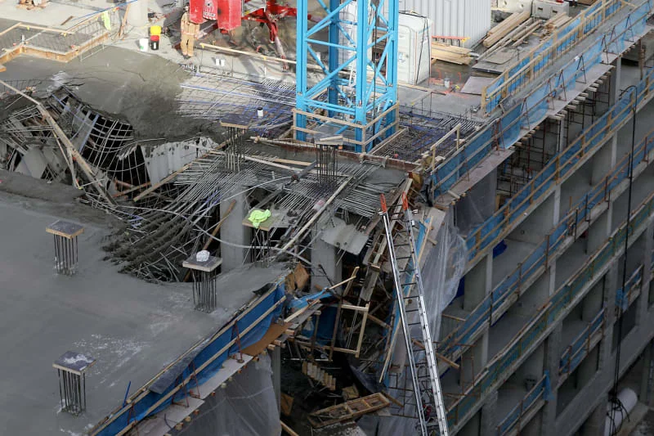
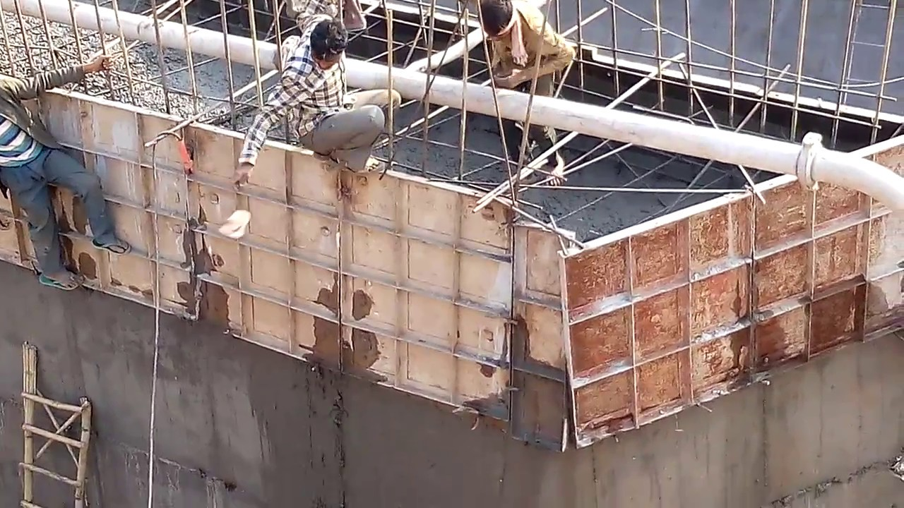
Form Failures

Slide 24
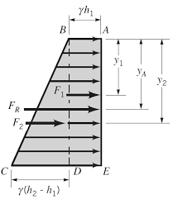
Submerged Vertical Rectangular Plane Surface
Is the pressure distribution still a triangle?

Slide 25
Answer to Previous Example
For a submerged vertical rectangular plane surface the pressure distribution is a trapezoid (since the height is not zero at the top of the surface)

Slide 26
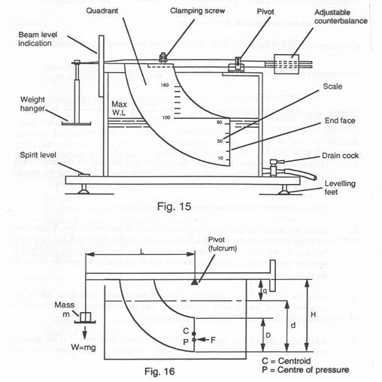
Submerged Planar Surface

Slide 27
Next Lecture
Fluid Statics on an inclined, submerged surface
Buoyancy

