Slide 1
CTC 261
Hydrostatics (water at rest)
Determine resultant force and location for a submerged, inclined planar surface
Buoyancy

Slide 2
Review
Fluid properties
Pressure (gage and atmospheric)
Converting pressure to pressure head
Resultant forces on a horizontal, planar surface
Center of pressure
Resultant forces on vertical, rectangular surfaces

Slide 3
Objectives
Know how to calculate hydrostatic pressure on an inclined, planar surface
(we covered horizontal and vertical plane surfaces during the last lecture but this method doesn’t work for inclined or non-vertical planar surfaces-like a triangle or trapezoidal gate)
Understand buoyancy and solve buoyancy problems

Slide 4
Inclined, submerged plane surface

Slide 5
Determine five different parameters
1. Centroid, area, and moment of inertia about the centroid of the planar surface
2. h-bar --measured from the water surface straight down to the centroid of the planar surface
3. y-bar --measured from the water surface down to the centroid of the planar surface and is measured along the incline

Slide 6
Hydrostatic forces on inclined, submerged planes
Magnitude of Force
  F=Specific Wt *h-bar*Area
Center of Pressure Location (from water surface along incline)
  y_{cp}=y-bar+(I-bar/(y-bar*Area))

Slide 7
Hydrostatic forces on inclined, submerged planes-Basic Steps
Determine centroid
Determine surface area
Determine Moment of Inertia (about centroid)
Determine h-bar
Determine y-bar
Use equations to determine static pressure resultant and location
Apply statics to determine other forces (such as a force required to open a gate, etc.)

Slide 8
Inclined Plane “Method”
Also can se this method to determine hydrostatic forces on vertical gate that is not rectangular.
See examples in Brightspace, Content, Fluid Statics Examples

Slide 9
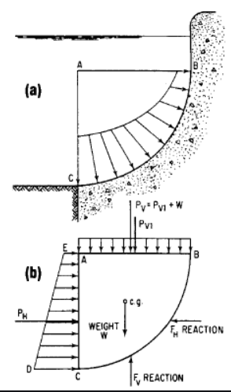
Higher-level topic (curved surfaces)
Forces on curved surfaces
(not covered in this class)

Slide 10
Break

Slide 11
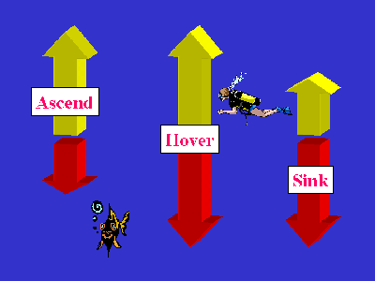
Buoyancy-what is it
http://scubaexpert.blogspot.com/2007/03/buoyancy-what-is-it-and-why-is-it.html

Slide 12
Buoyancy
Buoyancy is the uplifting force exerted by water on a submerged solid object
The buoyant force is equal to the weight of water displaced by the volume
If the buoyant force is > than the weight of the object, the object will float. If < object will sink. If equal (hover)

Slide 13
Buoyancy-Basic Steps
Draw the FBD
Identify all buoyant forces
Identify all weight forces
Identify other forces (pushing, pulling)
Apply equilibrium equation in the y-direction

Slide 14
Buoyancy-Other Hints
Every submerged object has a buoyant force and a weight force. Just because an object is light, don’t ignore the weight. Just because an object is heavy and dense, don’t ignore the buoyant force.
If the weight is noted “in water” then the buoyant force is already accounted for

Slide 15
Buoyancy-Example (1/3)
A 50-gal oil barrel, filled with air is to be used to help a diver raise an ancient ship anchor from the bottom of the ocean. The anchor weighs 400-lb in water and the barrel weight 50-lb in air.
How much weight will the diver be required to lift when the submerged (air-filled barrel) is attached to the anchor?

Slide 16
Buoyancy-Example (2/3)
Draw the FBD: on board
Identify all buoyant forces:
  Anchor—already accounted for
  Barrel-50 gal/(7.48 gal/ft³)*64.1#/ft³=428#
Identify all weight forces
  Anchor-400#
  Barrel-50#
Sea water has a higher specific weight than fresh water http://hypertextbook.com/facts/2002/EdwardLaValley.shtml

Slide 17
Buoyancy-Example (3/3)
Identify other forces (pushing, pulling)
  Pulling up of diver (unknown)
Apply equilibrium equation in the y-direction
  Diver Force=400+50=428=22 #
Answer=Just over 22#

Slide 18
Question #1
What is the difference between the weight of an object in air and the weight of an object in water?

Slide 19
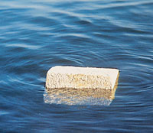
Buoyancy Homework Problem: Show work involved to get the answer
A block of wood 30-cm square in cross section and 60-cm long weighs 318N.
How much of the block is below water?
Answer: 18cm
http://www.cement.org/basics/concreteproducts_acc.asp

Slide 20
Higher-Level Topic-Stability
Stability
  How stable is an object floating in the water.
  If slightly tipped, does it go back to a floating position or does it flip over?

Slide 21
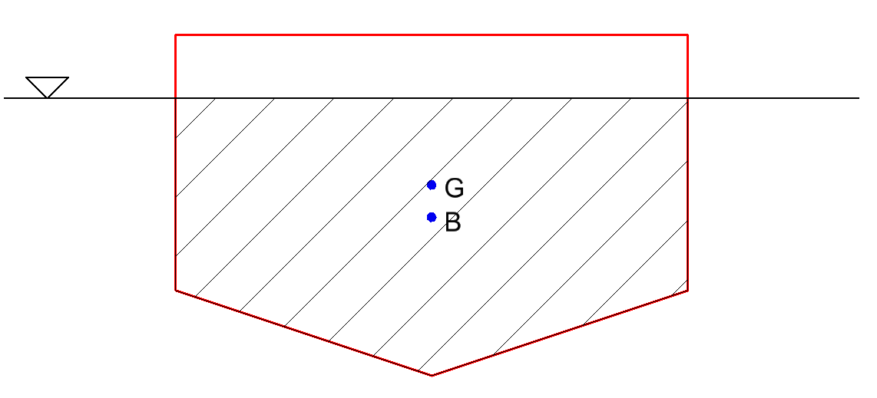
Stability of a Floating Object
G-The weight force (due to gravity) acts down through the center of gravity of the object
B-Buoyant force acts upward through the center of gravity of the displaced volume (patterned area)

Slide 22
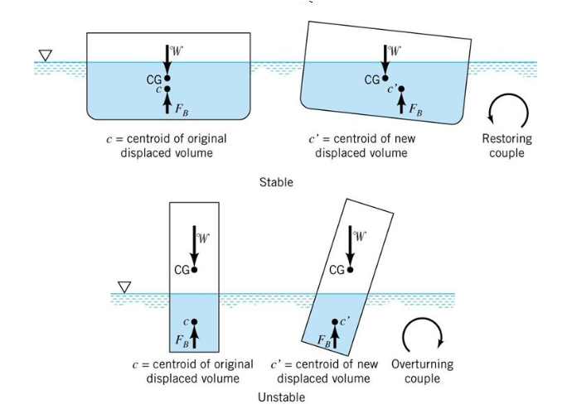
Stability when “tipped”

Slide 23
Miscellaneous
https://www.sailingscuttlebutt.com/2024/08/27/former-bayesian-captain-offers-insight/

Slide 24
Next Lecture
Fluid Flow

