Slide 1
CTC 261 Hydraulics Introduction
It’s no coincidence that a meter---not one-millionth of a meter and not ten thousand meters—is, roughly speaking, the size of a person. It’s about twice the size of a baby and half the size of a fully grown man. It would be rather strange to find that the basic unit we use for common measurements was one-hundredth the size of the Milky Way or the length of an ant’s leg.
Lisa Randall, Professor of Theoretical Physics, Harvard
Knocking on Heaven’s Door, 2011, ISBN 978-0-06-172372-8

Slide 2

Class Requirements
On-Web: http://people.sunypoly.edu/~barans/
Syllabus
Schedule
Lectures
Grades
Brightspce
Homework Assignments/Drop Boxes
“Lab” Materials and Drop Boxes
Check prereq (224 or equiv)

Slide 3
Objectives
Class requirements
Discuss the definition of hydraulics
Be familiar with common fluid properties

Slide 4
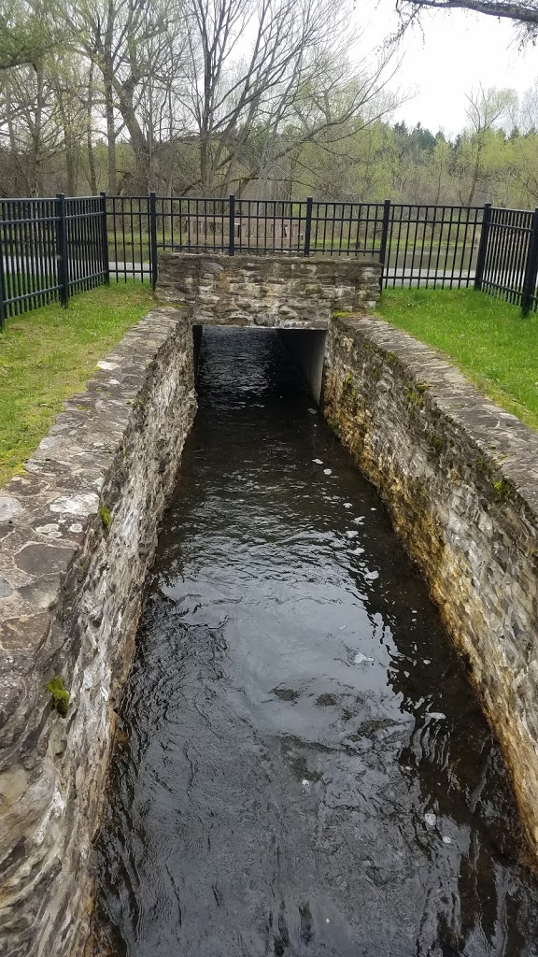

Fluid Mechanics
Science that deals with the action of forces on fluids
Pratt’s Falls Park

Slide 5

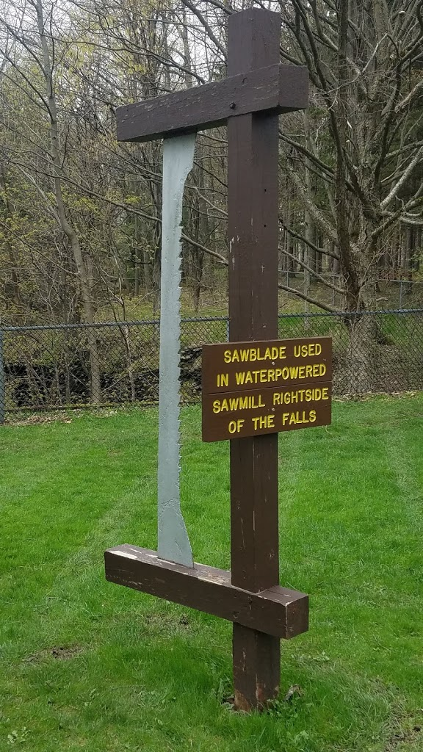
Fluid
Continuously deforms

Slide 6
Hydrodynamics vs Gas Dynamics
Noncompressible
No change in density
Mathematically easier
Compressible
Significant density change
Mathematically more difficult

Slide 7
Hydraulics
An extension of fluid mechanics in which many empirical relationships are applied and simplifying assumptions made to achieve practical engineering solutions

Slide 8
Significance in Civil Engineering
Water systems
Wastewater systems
Open channel flow
Dams
Erosion Control
Hydraulic Structures
Bridges
Culverts
Ditches
Retaining structures

Slide 9
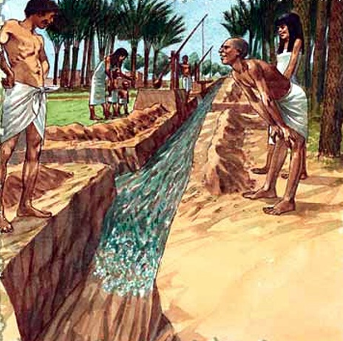

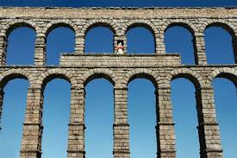
History
5,000 years ago | Irrigation | Egypt
2,500 BC | Bamboo pipes | China
200 BC | Lead/Bronze Pipes | Rome
Romans built many stone aqueducts, many of which are still standing.
Utilization of theory began after 1850. Before that, designs were rule-of-thumb.

Slide 10
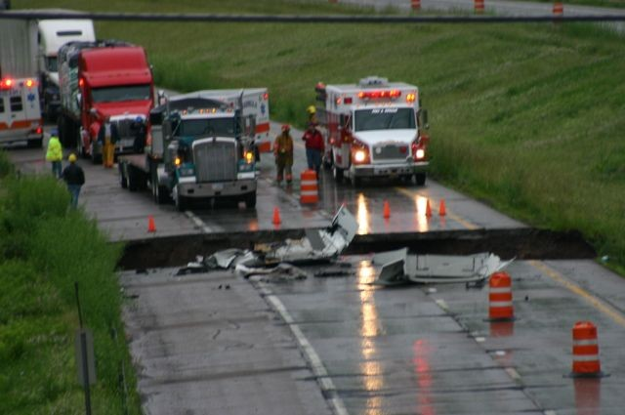
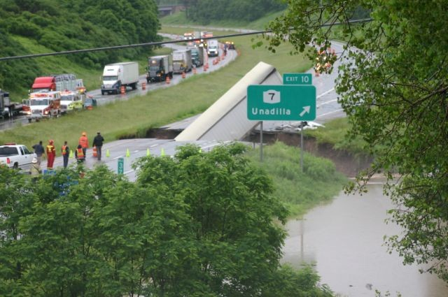
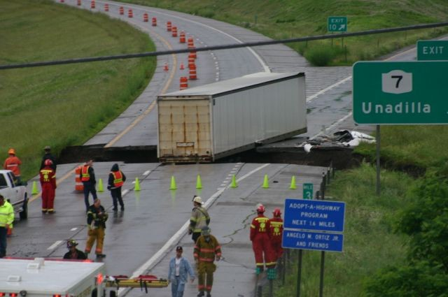
Loss of Culvert
Loss of Culvert due to flooding on I-88
June 28,2006
Two truckers were killed

Slide 11
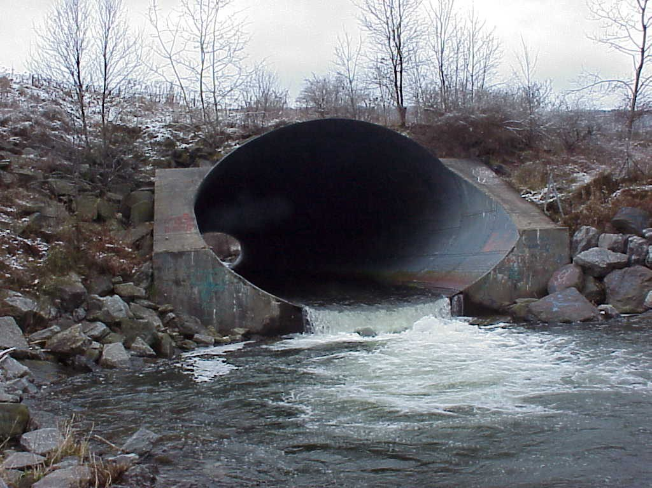
Downstream View

Slide 12
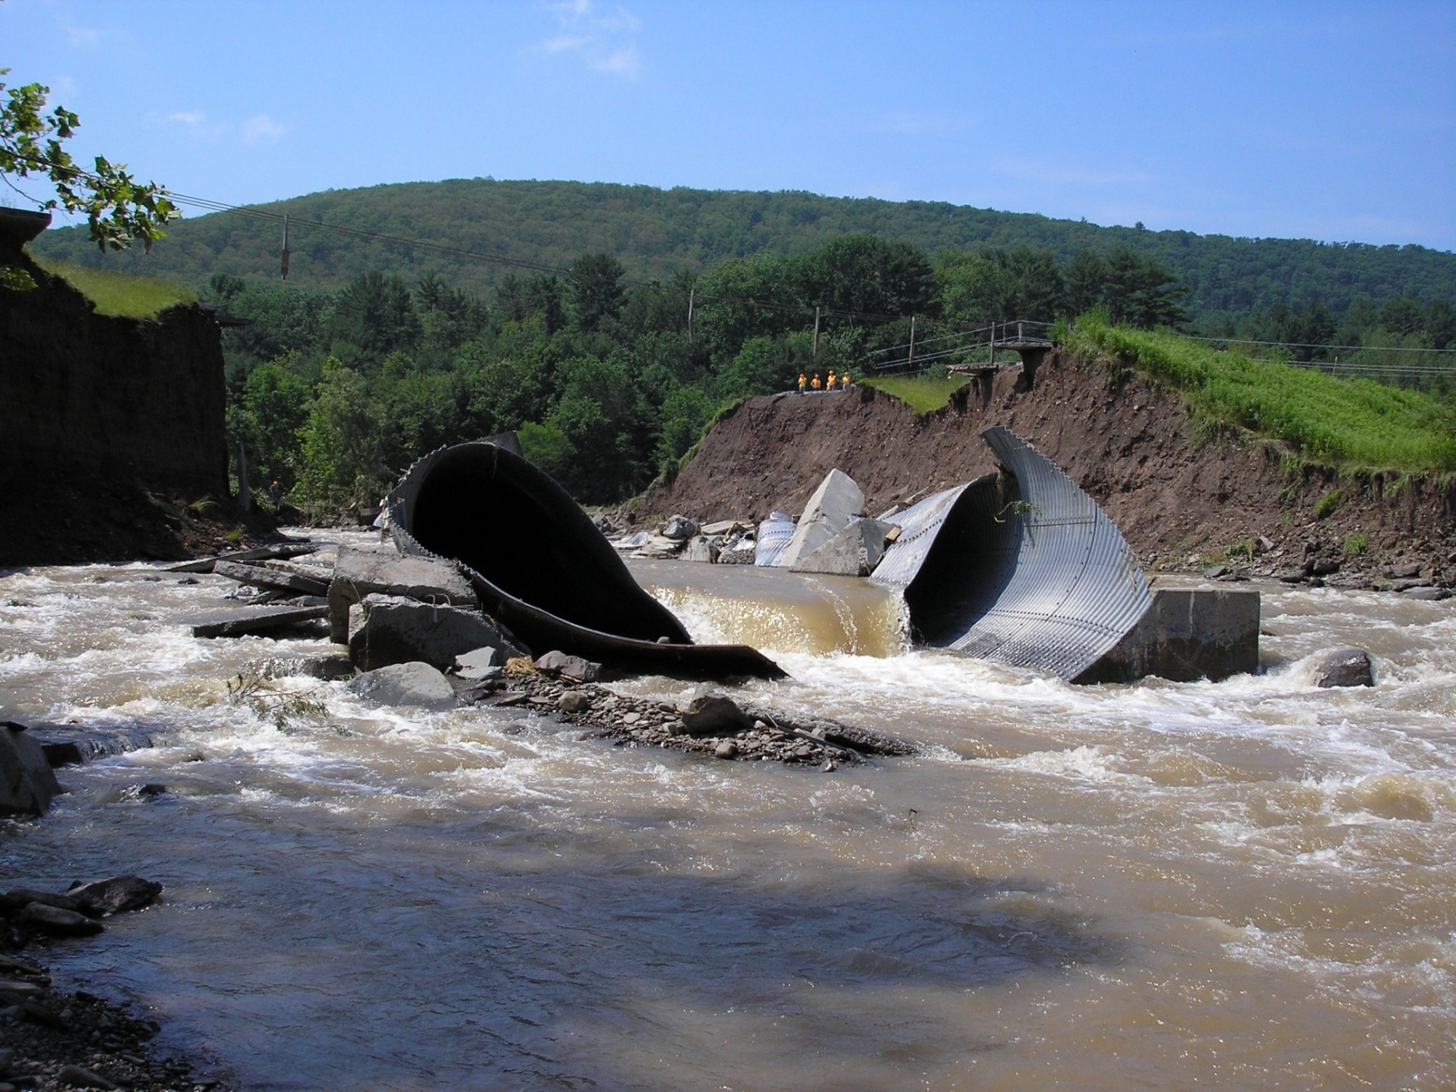
Collapse Culvert

Slide 13
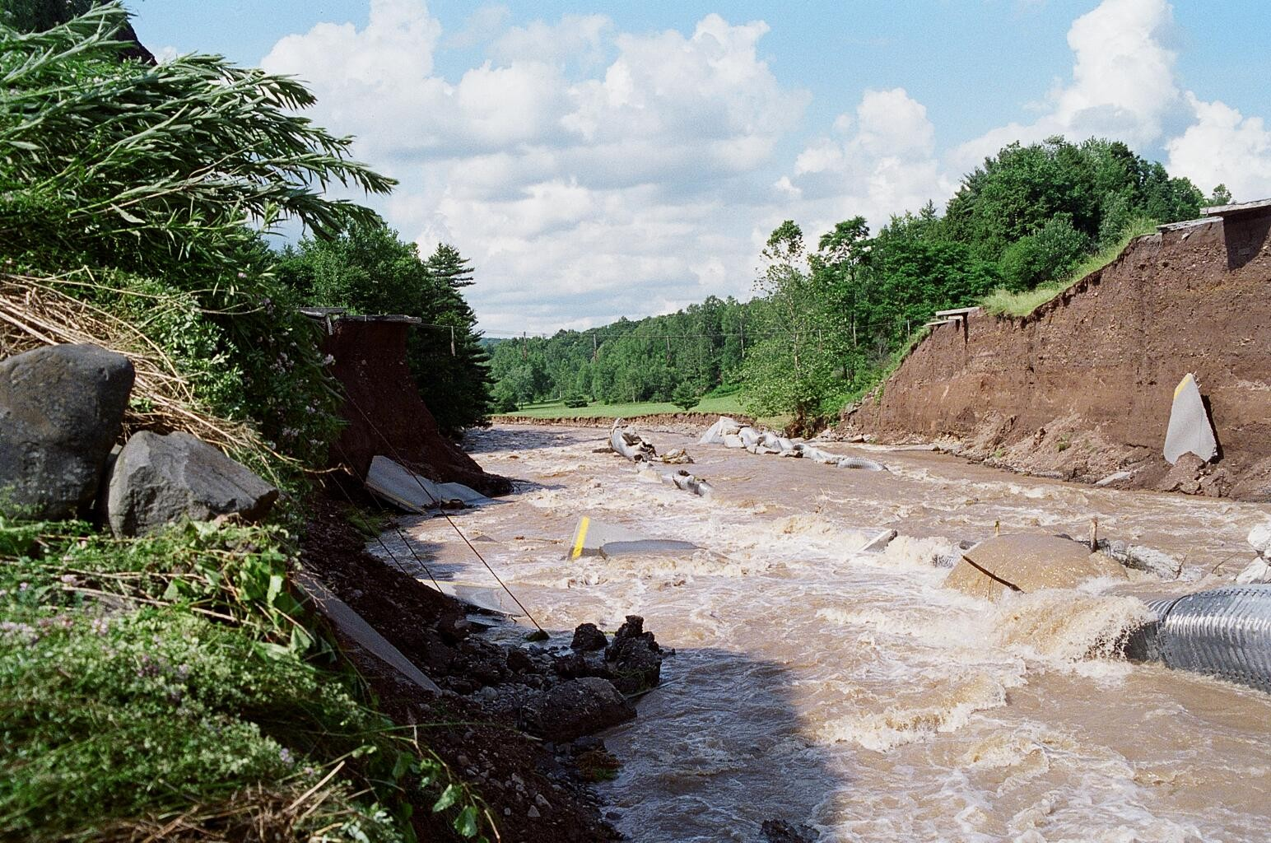
View after Culvert Loss

Slide 14
Break

Slide 15
Common Fluid Properties
 | SI | USC/FPS
Temperature | K (273+C) | F
Mass | Kg | Slug
Length | Meter (m) | Foot (ft)
Time | Second (sec) | Second (sec)
Force | N (kg-m/sec²) | Lb (slug-ft/sec²)
Pressure | Pascal (N/m²) | Psi

Slide 16
Other common units
 | SI | USC/FPS
Gravity Constant | 9.81 m/sec² | 32.2 ft/sec²
Specific Weight, Water (force per unit volume) | 9.81 kN/m³ (0-10 deg C) | 62.4 #/ft³ (40-60 deg F)
Mass Density, Water (mass per unit volume) | 1000 kg/m³ (0-10 deg C) | 1.94 slugs/ft³ (40-70 deg F)
Specific Gravity | Specific weight of a liquid / specific weight of water (at some std. temp.)

Slide 17
Other common units
 | SI | USC/FPS
Kinematic Viscosity (area/time) | 1.31E-6 m²/sec 10 deg C | 1.22E-5 ft²/sec 60 deg F
Dynamic (Absolute) Viscosity (force-time/area) | 1.32E-3 N-sec/m² (10 deg C) | 2.36E-5 #-sec/ft² (60 deg F)
Kinematic Viscosity=Dynamic Viscosity/Density or Kinematic Viscosity*Density=Absolute Viscosity
https://www.cscscientific.com/csc-scientific-blog/whats-the-difference-between-dynamic-and-kinematic-viscosity

Slide 18
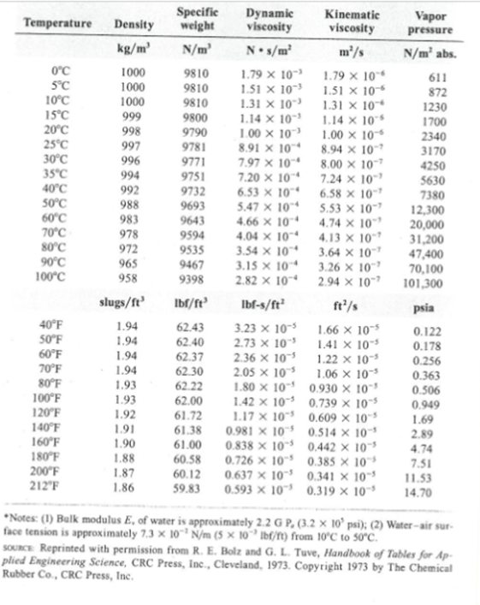
Water Properties
Water properties are a function of temperature/pressure
See Brightspace, Content for the water properties table to be used in this class.

Slide 19
Other Fluid Properties – Thermodynamics
Specific Heat (Joule per Kelvin-kg)
Specific Internal Energy (Joule per kg)
Specific Enthalpy (kJ/kg)

Slide 20
Elasticity of Water
Amount of deformation for a given pressure change (bulk modulus of elasticity)
Water is essentially incompressible (although it is approximately 100 times more compressible than steel)
See http://hyperphysics.phy-astr.gsu.edu/hbase/permot3.html for equation relating to pressure and volume change

Slide 21
Water Elasticity
What pressure is required to reduce the volume of water by 0.5% (.005)?
Using equation the pressure required is approximately 1,600 psi
(3/4 of a ton per square inch)

Slide 22
Viscosity
Related to resistance of shear forces
Newtonian fluid: linear relationship between shear stress and the rate of deformation (gases and most liquids)
Non-Newtonian fluid: nonlinear relationship (thick, long-chained hydrocarbons)
High Viscosity: honey, tar
Low Viscosity: water, air

Slide 23
Viscosity
For a Newtonian fluid
Shear stress(F/A)=Viscosity*Shear Rate
Shear rate (velocity gradient) is the rate at which one layer moves relative to an adjacent layer (change in velocity divided by change in distance)

Slide 24
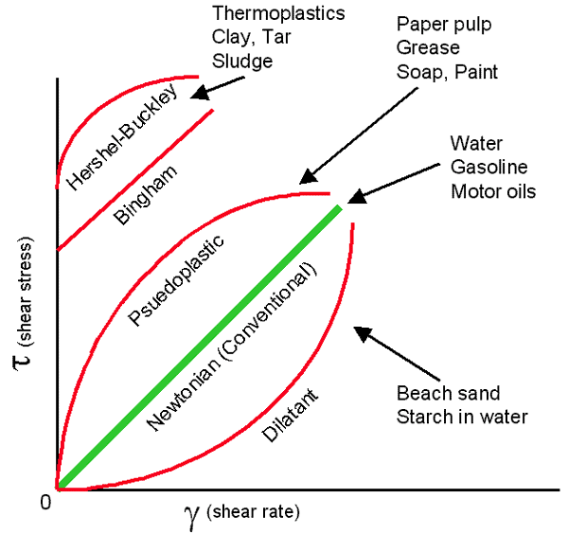
Newtonian vs Non-Newtonian

Slide 25
Non-Newtonian Fluid
http://www.youtube.com/watch?v=cuzn8wh8Fys&feature=related

Slide 26
Viscosity-Units
Dynamic (absolute)
Units are N-sec/m² or lb-sec/ft²
Kinematic
Dynamic viscosity divided by mass density
Units are m²/sec or ft²/sec

Slide 27
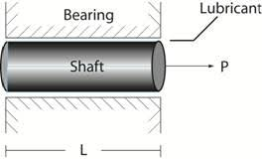
Viscosity-Example
A Newtonian fluid is in the clearance between a shaft and a bearing. When a force of 600N is applied to the shaft parallel to the bearing sleeve, the shaft attains a speed of 1 m/s. If a 1500-N force is applied what speed will the shaft attain?

Slide 28
Viscosity
For a Newtonian fluid
Shear stress(F/A)=Viscosity*Shear Rate
Answer:
Speed (sheer rate) would be proportional to the force since the area, viscosity and distance between bearing sleeve and shaft are constant. Therefore Speed =2.5 m/sec (1500/600)

Slide 29
Brightspace-See HW assignment
Show students

Slide 30
Next Lecture
Fluid Statics
Absolute/gage pressure
Hydrostatic pressure on horizontal surfaces
Converting pressure to pressure head
Defining center of pressure
Hydrostatic pressure on vertical surfaces

