Slide 1
CTC 261
Measuring Flows/Velocities

Slide 2
Review
Energy Equation
  Kinetic Energy-velocity head (V²/2g-ft)
  Pressure energy-pressure head (P/Specific weight-ft)
  Potential Energy (height above some datum-ft)
  Energy added via pump
  Energy lost via turbine
  Friction losses (Pipe and other friction losses)
EGL/HGL graphs (accounting for friction)
  Energy grade line (all energy added)
  Hydraulic grade line (EGL-velocity head)

Slide 3
Objectives
Know devices used to measure flow:
Pitot Tube (stream flow)
Current Meter (stream flow)
Venturi Meter (pipe flowing full)
Parshall Flume (open channel flow)

Slide 4
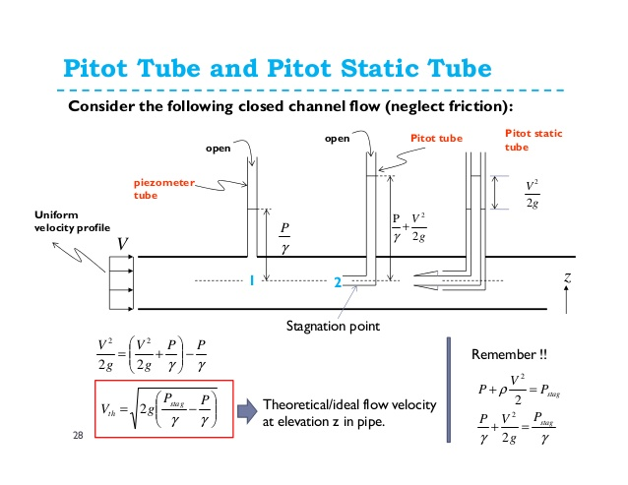
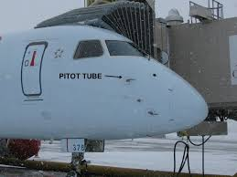
Pitot Tube (not common for water velocity)
Open-ended tube with a 90 degree bend (simplest form)
Water in tube will rise due to velocity head (h=v2/2g). If you measure h then you can solve for velocity

Slide 5
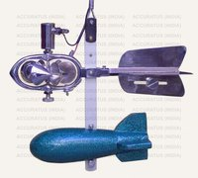
Current Meter (common for stream flows)
Number of rotations can be converted to velocity
Velocity measurements taken at 60% of depth (close to average velocity) at various width across a cross-section. Then an overall average is obtained weighted by area of sectors (see page 71)

Slide 6
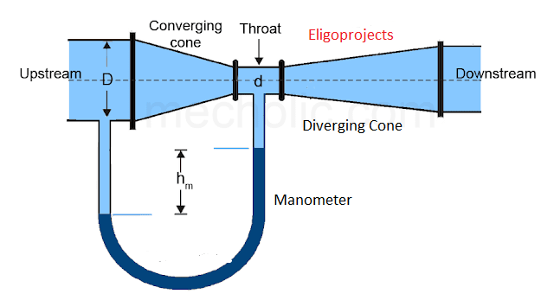
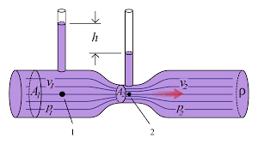
Venturi Meter
Carefully designed constriction (throat diameter) where pressure differential is used to measure flow.
Equation is on page 72
Equation used is based on the Energy/Continuity Equations

Slide 7
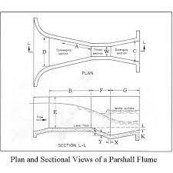
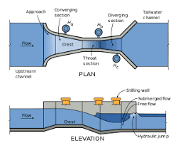
Parshall Flume (Common)
Carefully designed constriction that produces critical depth.
Discharge equations are based on a water depth (H) in a design monitoring well.
Flume must be placed in a straight uniform section of the channel free of downstream obstructions.

Slide 8
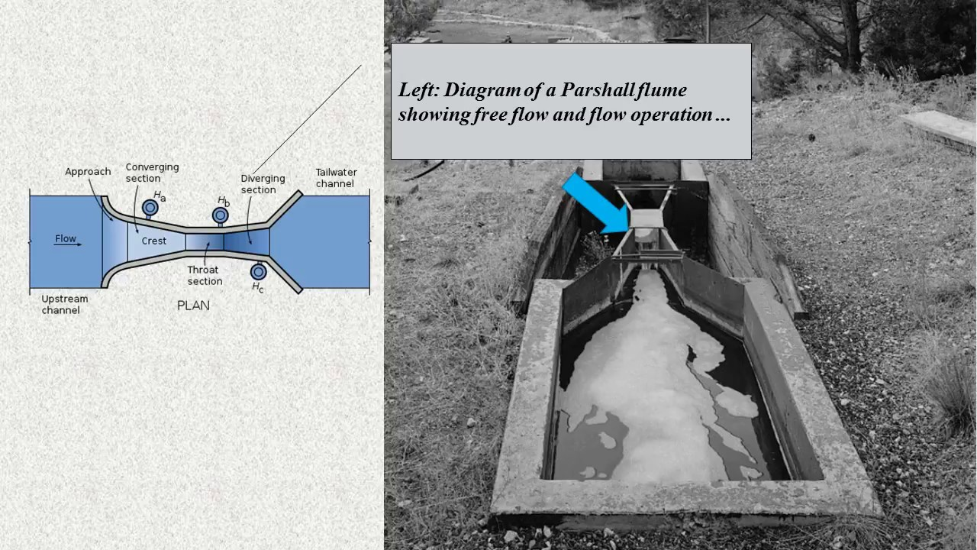
Parshall Flume Sketch and Photograph

Slide 9
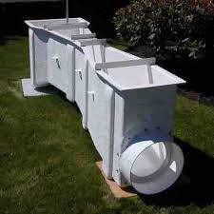
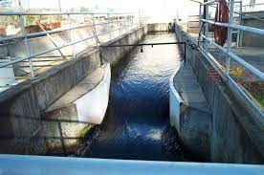
Parshall Flume Pictures

