Slide 1
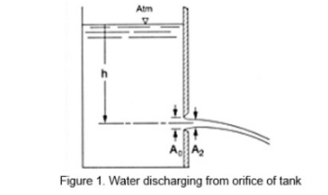
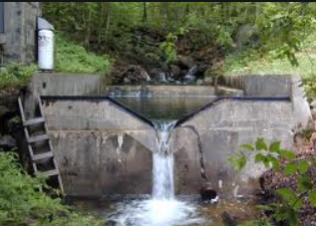
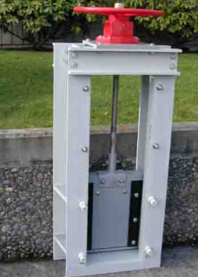
CTC 261 Review
Hydraulic Devices
Orifices
Weirs
Sluice Gates
Siphons
Outlets for Detention Structures

Slide 2
This Week:
Open Channel Flow
Uniform Flow (Manning’s Equation)
Varied Flow

Slide 3
Objectives
Students should be able to:
Use Manning’s equation for uniform flow calculations
Calculate Normal Depth by hand
Calculate Critical Depth by hand
Utilize Flowmaster software for open channel flow problem-solving

Slide 4
Open Channel Flow
Open to the atmosphere
Creek/ditch/gutter/pipe flow
Uniform flow-EGL/HGL/Channel Slope are parallel
velocity/depth constant
Varied flow-EGL/HGL/Channel Slope not parallel
velocity/depth not constant

Slide 5
Uniform Flow in Open Channels
Water depth, flow area, Q and V distribution at all sections throughout the entire channel reach remains unchanged
The EGL, HGL and channel bottom lines are parallel to each other
No acceleration or deceleration

Slide 6
Manning’s Equation
Irish Engineer
“On the Flow of Water in Open Channels and Pipes” (1891)
More:
http://www.engineeringtoolbox.com/mannings-roughness-d_799.html
https://www.hydrologystudio.com/pulp-friction/
https://www.h2ometrics.com/manning-equation/

Slide 7
Manning’s Equation-English Solve for Flow
Q=AV=(1.486/n)(A)(R_{h})^{2/3}S^{1/2}
Where:
Q=flow rate (cfs)
A=wetted cross-sectional area (ft²)
R_{h}=hydraulic radius=A/WP (ft)
WP=wetted perimeter (ft)
S=slope (ft/ft)
n=friction coefficient (dimensionless)

Slide 8
Manning’s Equation-Metric Solve for Flow
Q=AV=(1/n)(A)(R_{h})^{2/3}S^{1/2}
Where:
Q=flow rate (cms)
A=wetted cross-sectional area (m²)
R_{h}=hydraulic radius=A/WP (m)
WP=wetted perimeter (m)
S=slope (m/m)
n=friction coefficient (dimensionless)

Slide 9
Manning’s Equation-English Solve for Velocity
V=(1.486/n)(R_{h})^{2/3}S^{1/2}
Where:
V=velocity (ft/sec)
A=wetted cross-sectional area (ft²)
R_{h}=hydraulic radius=A/WP (ft)
WP=wetted perimeter (ft)
S=slope (ft/ft)
n=friction coefficient (dimensionless)

Slide 10
Manning’s Equation-Metric Solve for Velocity
V=(1/n)(R_{h})^{2/3}S^{1/2}
Where:
V=flow rate (meters/sec)
A=wetted cross-sectional area (m²)
R_{h}=hydraulic radius=A/WP (m)
WP=wetted perimeter (m)
S=slope (m/m)
n=friction coefficient (dimensionless)

Slide 11
Manning’s Friction Coefficient
http://www.lmnoeng.com/manningn.htm
Typical values:
Concrete pipe: n=.013
CMP pipe: n=.024

Slide 12
Triangular/Trapezoidal Channels
Must use trigonometry to determine area and wetted perimeters

Slide 13
Pipe Flow
Hydraulic radii and wetted perimeters are easy to calculate if the pipe is flowing full or half-full
If pipe flow is at some other depth, then tables/figures/software are usually used

Slide 14
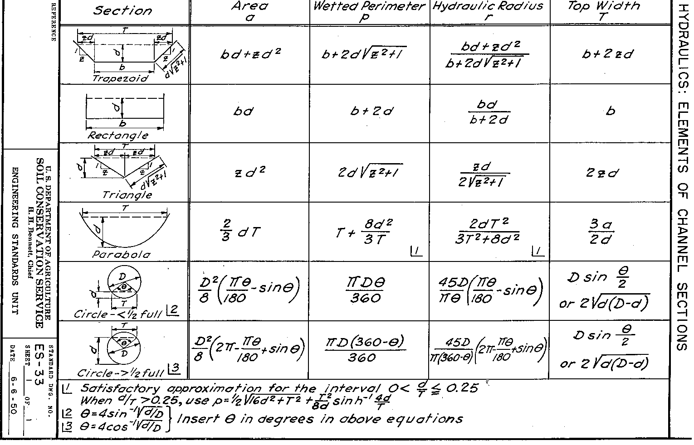
SCS Table

Slide 15
Example-Find Q
Find the discharge of a rectangular channel 5’ wide w/ a 5% grade, flowing 1’ deep. The channel has a stone and weed bank (n=.035).
A=5 sf; WP=7’; R_{h}=0.714 ft
S=.05
Q=38 cfs

Slide 16
Example-Find S
A 3-m wide rectangular irrigation channel carries a discharge of 25.3 cms @ a uniform depth of 1.2m. Determine the slope of the channel if Manning’s n=.022
A=3.6 sm; WP=5.4m; R_{h}=0.667m
S=.041=4.1%

Slide 17
Friction loss
How would you use Manning’s equation to estimate friction loss?

Slide 18
Using Manning’s equation to estimate pipe size
Size pipe for Q=39 cfs
Assume full flow
Assume concrete pipe on a 2% grade
Put R_{h} and A in terms of Dia.
Solve for D=2.15 ft = 25.8”
Choose a 27” or 30” RCP

Slide 19
Break

Slide 20
Normal Depth
Given Q, the depth at which the water flows uniformly
Use Manning’s equation
Must solve by trial/error (depth is in area term and in hydraulic radius term)

Slide 21
Normal Depth Example
Find normal depth in a 10.0-ft wide concrete rectangular channel having a slope of 0.015 ft/ft and carrying a flow of 400 cfs.
Assume n=0.013 (concrete)

Slide 22
Normal Depth Example Table
Assumed D (ft) | Area (sqft) | Peri. (ft) | Rh (ft) | Rh^.66 | Q (cfs)
2.00 | 20 | 14 | 1.43 | 1.27 | 356
3.00 | 30 | 16 | 1.88 | 1.52 | 640
2.15 | 21.5 | 14.3 | 1.50 | 1.31 | 396

Slide 23
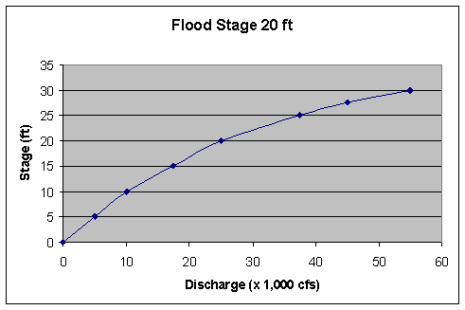
Stream Rating Curve
Plot of Q versus depth (or WSE)
Also called stage-discharge curve

Slide 24
Specific Energy
Energy above channel bottom
Depth of stream
and
Velocity head

Slide 25
Depth as a function of Specific Energy
Rectangular channel
Width is 6’
Constant flow of 20 cfs

Slide 26
Specific Energy: Table Derivision

Slide 27
Specific Energy Curve

Slide 28
Critical Depth
Depth at which specific energy is at a minimum
Other than critical depth, specific energy can occur at 2 different depths
Subcritical (tranquil) flow d > d_{c}
Supercritical (rapid) flow d < d_{c}

Slide 29
Critical Velocity
Velocity at critical depth

Slide 30
Critical Slope
Slope that causes normal depth to coincide w/ critical depth

Slide 31
Calculating Critical Depth
a³/T=Q²/g
A=cross-sectional area (sq ft or sq m)
T=top width of channel (ft/m)
Q=flow rate (cfs or cms)
g=gravitational constant (32.2/9.81)
Rectangular Channel—Solve Directly
Other Channel Shape-Solve via trial & error

Slide 32
Critical Depth (Rectangular Channel)
Width of channel does not vary with depth; therefore, critical depth (d_{c}) can be solved for directly:
d_{c}=(Q²/(g*w²))^{1/3}
For all other channel shapes the top width varies with depth and the critical depth must be solved via trial and error (or via software like flowmaster)

Slide 33
Froude Number
F=Vel/(g*D)^{.5}
F=Froude #
V=Velocity (fps or m/sec)
D=hydraulic depth=a/T (ft or m)
g=gravitational constant
F=1 (critical flow)
F<1 (subcritical; tranquil flow)
F>1 (supercritical; rapid flow)

Slide 34
Varied Flow
Rapidly Varied – depth and velocity change rapidly over a short distance; can neglect friction
hydraulic jump
Gradually varied – depth and velocity change over a long distance; must account for friction
backwater curves

Slide 35
Hydraulic Jump-Why
Occurs when water goes from supercritical to subcritical flow
Abrupt rise in the surface water
Increase in depth is always from below the critical depth to above the critical depth

Slide 36
Hydraulic Jump-Details
Velocity and depth before jump (v₁,y₁)
Velocity and depth after jump (v₂,y₂)
Although not in your book, there are various equations that relate these variables. Specific energy lost in the jump can also be calculated.

Slide 37
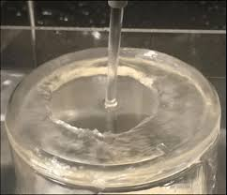
Hydraulic Jump-Example Links
http://krcproject.groups.et.byu.net/
http://www.lmnoeng.com/Channels/HydraulicJump.php
Circular hydraulic jump https://www.researchgate.net/figure/A-representative-circular-hydraulic-jump-formed-when-a-vertical-water-jet-impinges-on-a_fig1_338609088

Slide 38
Varied Flow Slope Categories
M-mild slope
S-steep slope
C-critical slope
H-horizontal slope
A-adverse slope

Slide 39
Varied Flow Zone Categories
Zone 1
Actual depth is greater than normal and critical depth
Zone 2
Actual depth is between normal and critical depth
Zone 3
Actual depth is less than normal and critical depth

Slide 40
Water-Surface Profile Classifications
H2, H3 (no H1)
M1, M2, M3
C1, C3 (no C2)
S1, S2, S3
A2, A3 (no A1)

Slide 41
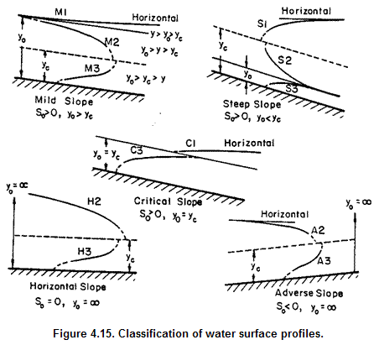
Water Surface Profiles http://www.fhwa.dot.gov/engineering/hydraulics/pubs/08090/04.cfm

Slide 42
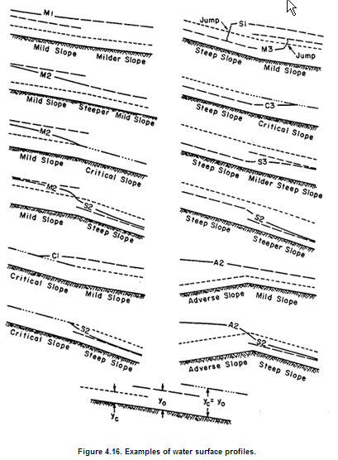
Water Surface Profiles-Change in Slope http://www.fhwa.dot.gov/engineering/hydraulics/pubs/08090/04.cfm

Slide 43
Backwater Profiles
Usually by computer methods
HEC-RAS
Direct Step Method
Depth/Velocity known at some section (control section)
Assume small change in depth
Standard Step Method
Depth and velocity known at control section
Assume a small change in channel length

