Slide 1
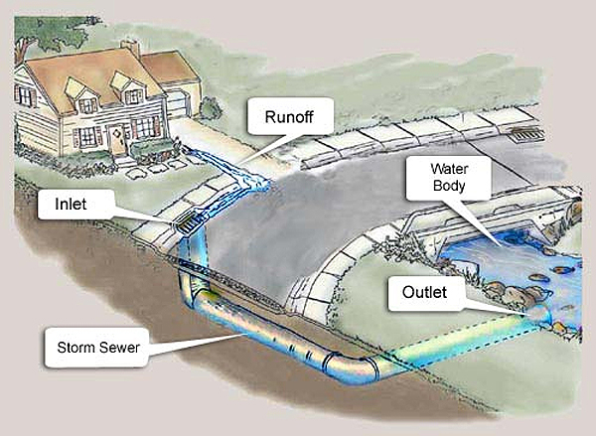
CTC 261 Hydraulics Storm Drainage Systems

Slide 2
Objectives
Ability to:
Understand the steps for storm drainage design
Design riprap downstream of pipe outlet

Slide 3
References:
Urban Drainage Design Manual 4th Edition
HEC-22 (hydraulic engineering circular)
Publication Year: 2024

Slide 4
Two Concerns
Preventing excess spread of water on the traveled way
Design of curbs, gutters and inlets
Protecting adjacent natural resources and property
Design of outlets

Slide 5
Gutter Capacity
Q is determined via rational method
Slopes are based on the vertical alignment and pavement cross slope (normal and superelevated values)
Usually solving for width of flow in gutter and checking it against criteria

Slide 6
Gutter Capacity Calculation
Modified form of Manning’s equation
Manning’s roughness coefficient
Width of flow (or spread) in the gutter
Gutter cross slope
Gutter longitudinal slope
Equation or nomograph
Inlets placed where spread exceeds criteria

Slide 7
Gutter Capacity Equation
Q=(0.376/n)*S_{x}^{1.67}S^{0.5}T^{2.67}
Where:
Q=flow rate (cms)
N=manning’s roughness coefficient
S_{x}=cross slope (m/m)------decimal
S=longitudinal slope (m/m)-----decimal
T=width of flow or spread in the gutter (m)

Slide 8
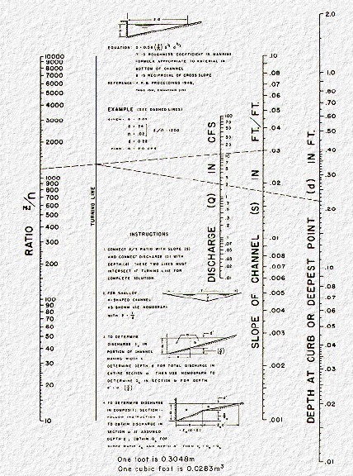
Gutter Flow Nomograph

Slide 9
Spread
Interstates/freeways-should only encroach on shoulder
For other road classifications, spread should not encroach beyond ½ the width of the right most travel lane
Puddle depth <10 mm less than the curb height
Can utilize parking lanes or shoulder for gutter flow

Slide 10
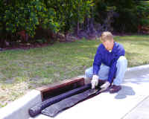
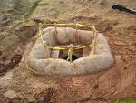


Inlets
Curb-opening inlet
No grate (not hydraulically efficient; rarely used)
Gutter Inlet
Grate only-used if no curb (common if no curb)
Slotted (rarely used)
Combination Inlet
Used w/ curbs (common for curbed areas)

Slide 11
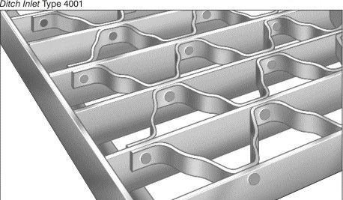
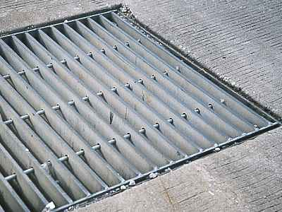

Grates
Reticuline
Rectangular
Parallel bar

Slide 12
Interception Capacity
Depends on geometry and characteristics of gutter flow
Water not intercepted is called carryover, bypass or runby
On-grade (percent efficiency)
Sag location
Acts as a weir for shallow depths and as an orifice for deeper depths

Slide 13
Factors for Inlet Location
Drainage areas/spread
Maintenance
Low points
Up-grade of intersections, major driveways, pedestrian crosswalks and cross slope reversals to intercept flow

Slide 14
Storm Drainage System Layout Basic Steps
Mark the location of inlets needed w/o drainage area consideration
Start at a high point and select a trial drainage area
Determine spread and depth of water
Determine intercepted and bypassed flow
Adjust inlet locations if needed
With bypass flow from upstream inlet, check the next inlet

Slide 15
Design
Software
By hand w/ tables
Hydrology
Areas, runoff coefficients, Time of Conc, Intensity
Hydraulics
Pipe length/size/capacity/Velocity/Travel time in pipe

Slide 16
Example Calculation Tables

Slide 17
Closed Systems - Pipes
Flow can be pressurized (full flow) or partial flow (open channel)
Energy losses:
Pipe friction
Junction losses
Manholes

Slide 18
Closed Systems – General Rules
18” minimum
Use grades paralleling the roadway (minimizes excavation, sheeting & backfill)
Min. velocity=3 fps
At manholes, line up the crowns (not the inverts)
Never decrease the pipe sizes or velocities
Use min. time of conc of 5 or 6 minutes

Slide 19
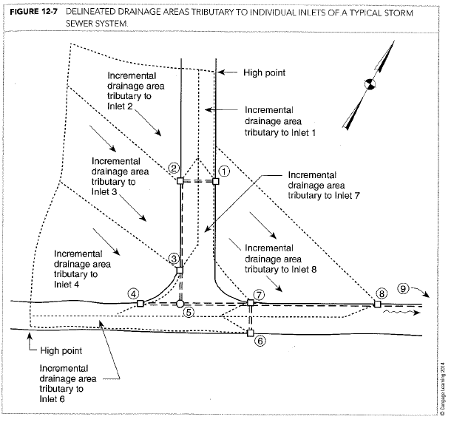
Example-Incremental Drainage Areas

Slide 20
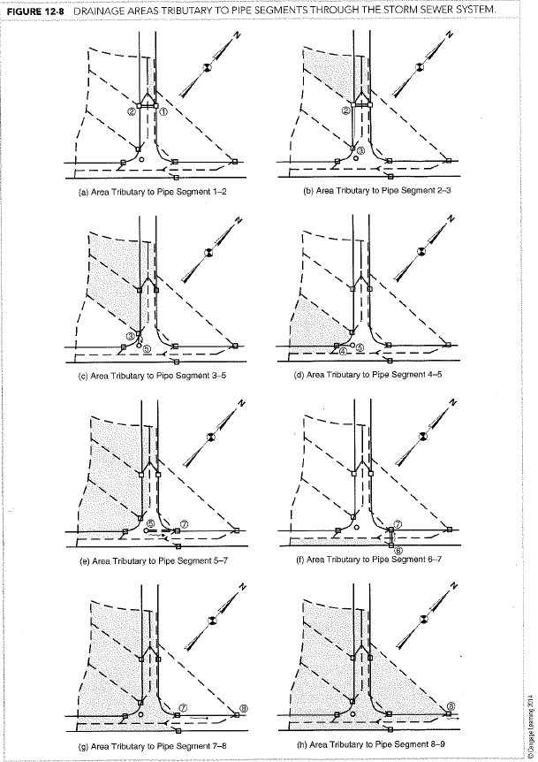
System Example

Slide 21
Summary Data for Each Inlet
Inlet | Incr. DA (acres) | Incr. Tc (min) | Incr C
1 | .07 | 6 | 0.95
2 | .46 | 10 | 0.45
3 | .52 | 10 | 0.48
4 | .65 | 9 | 0.41
5 (MH) | n/a | n/a | n/a
6 | .10 | 6 | 0.95
7 | .15 | 6 | 0.95
8 | .70 | 14 | 0.38

Slide 22
Pipe Segment 1-2
From IDF curve in Appendix C-3 & tc=6 min; i=5.5 in/hr
Q=CIA
Q=(0.95)(5.5)(0.07)
Peak Q = 0.37 cfs

Slide 23
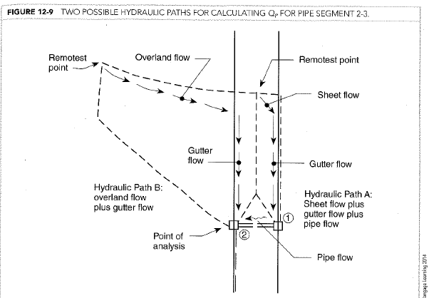
Hydraulic Paths for Pipe 2-3

Slide 24
Pipe Segment 2-3 (Longest Tc)
Find longest hydraulic path- see previous
Path A: 6 min+0.1min=6.1 minutes
Travel time from table
Path B: 10 minute (longest tc: 10>6.1)
Using IDF and tc=10 min, i=4.3 inches/hr
Area=Inlet areas 1+2 =.07+.45=0.53 acres

Slide 25
Pipe Segment 2-3 (peak flow)
Find composite runoff coefficient:
(0.95*.07+0.45*.46)/0.53=0.52
Q=CIA
Q=0.52*4.3*0.53
Qp=1.2 cfs

Slide 26
Hydraulic Paths for Pipe 3-5

Slide 27
Pipe Segment 3-5 (Longest Tc)
Find longest hydraulic path- see ovrhd
Path A: don’t consider
Path B: 10 min+0.6 min=10.6 minutes
Path C: 10 minutes
Using IDF and tc=10.6 min, i=4.2 inches/hr
Area=Inlet areas 1+2+3 =.07+.45+0.52 = 1.05 acres

Slide 28
Pipe 3-5 (peak flow)
Find composite runoff coefficient:
(0.95*.07+0.45*.46+0.48*0.52)/1.05=0.50
Q=CIA
Q=0.50*4.2*1.05
Qp=2.2 cfs

Slide 29
Pipe Table (using App A charts) (25-yr storm; n=0.015)
Pipe Seg | Qp (cfs) | Length (ft) | Slope (%) | Size (in) | Capacity (full-cfs) | Vel. (fps) | Travel Time (min)
1-2 | .37 | 30 | 2 | 12 | 4.4 | 3.4 | 0.15
2-3 | 1.2 | 200 | 3.25 | 12 | 5.8 | 5.6 | 0.6
3-5 | 2.2 | 25 | 2.5 | 12 | 5.0 | 6.0 | 0.1

Slide 30
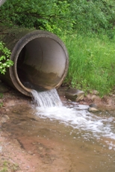
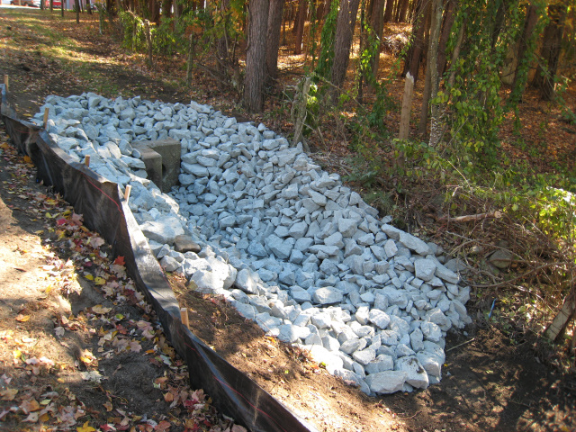
Storm System Outfalls

Slide 31
Storm System Outfall
Point where collected stormwater is discharged from the system to the receiving body of water.
Outfall at stream bank (headwall in bank)
Channel connecting outfall with stream (headwall located outside of bank)
Outfall discharged onto stream overbank (similar to 2 but no channel; use for wetlands)

Slide 32
Permissible Velocities (based on soil texture)
Values range from:
2.5 fps for Sand/Sandy Loam (noncolloidal)
To 6 fps for shale
If velocities are outside range then erosion control measures are warranted

Slide 33


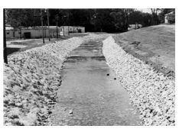
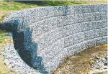
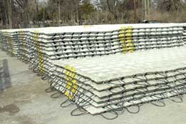
Outfall Erosion Control
Reduce Velocity
Energy Dissipator
Stilling Basin
Riprap
Erosion Control Mat
Sod
Gabion

Slide 34
Erosion Control-Riprap
Various Design Methods/Standards
Type of stone
Size of stone
Thickness of stone lining
Length/width of apron

Slide 35
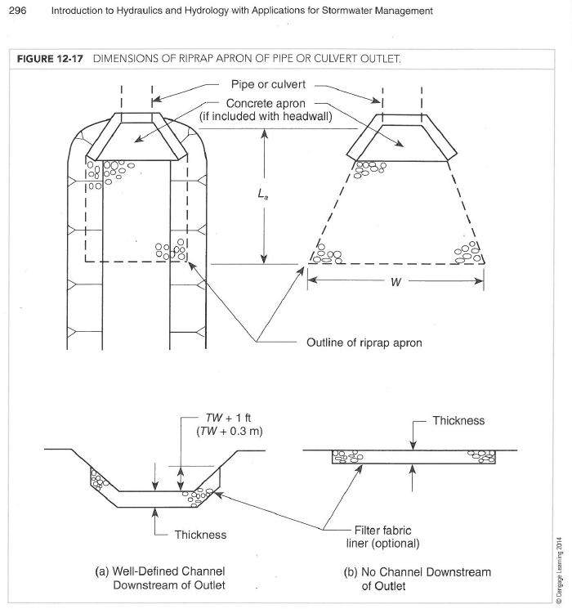
From class book (out of print):

Slide 36
Erosion Control-Riprap Type of stone
Hard
Durable
Angular (stones lock together)

Slide 37
Riprap-Basic Steps
Determine velocity
Determine TW (use culvert)
Determine type of stone
Determine median stone size
Determine apron length
Determine apron width
Provide plan/section

Slide 38
Erosion Control-Riprap Size of Stone
D₅₀ = (0.02/TW)*(Q/D₀)^{4/3}
TW is Tailwater Depth (ft)
D₅₀ is Median Stone Size (ft)
D₀ is Maximum Pipe or Culvert Width (ft)
Q is design discharge (cfs)

Slide 39
Erosion Control-Riprap Length of Apron
TW > ½ D_{o}
TW < ½ D_{o}
See page 295 for equations

Slide 40
Erosion Control-Riprap Width of Apron
Channel Downstream
Line bottom of channel and part of the side slopes (1’ above TW depth)
No Channel Downstream
TW > ½ D_{o}
TW < ½ D_{o}
See page 295-296 for equations

