Slide 1
CTC 261 Hydraulic Devices

Slide 2
Objectives
Calculate flow through an orifice
Calculate flow over a weir
Calculate flow under a gate
Know how to compute discharge ratings for detention basin outlet structures

Slide 3
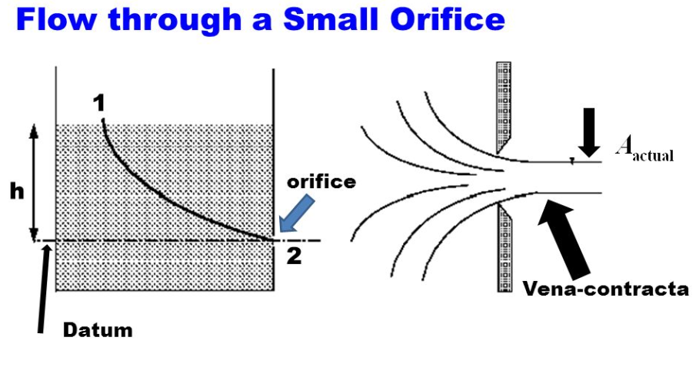
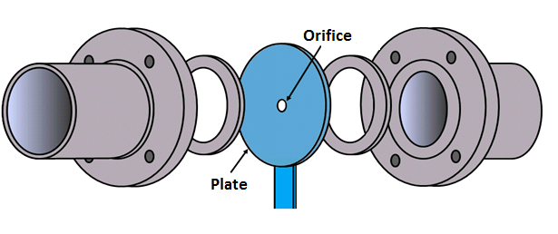
Orifices
Hole in a wall/pipe through which water flows
Square edge
Beveled edge

Slide 4
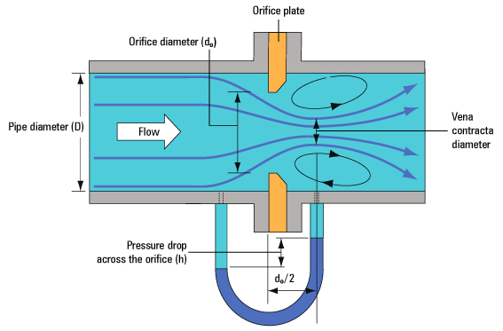
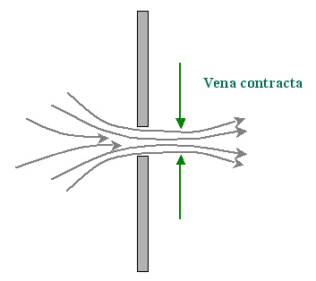
Orifice
When water flows through an orifice the water contracts with a smaller area than the physical orifice opening (vena contracta)

Slide 5
General Orifice Equation
Q=ca(2gh)^{.5} This should look familiar!!
Where:
Q=discharge (cfs or cms)
c=discharge coefficient (0.62 often used)
a=cross-sectional orifice area (sq ft or sq meters)
h=total head (ft or m)
g=gravitational constant (32.2 or 9.81)

Slide 6
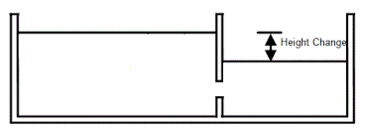
Orifice Discharge
Free Discharge
Submerged Discharge
Equation is the same. Head for the submerged discharge is the difference between upper and lower water surfaces

Slide 7
Orifice-Free Discharge
Given: Dia=6”, WSE=220.0 ft;
Elev of orifice centerline=200.0 ft
Q=ca(2gh)^{.5}
Q=0.62*0.196*(2*32.2*20)^{.5}
Q=4.4 cfs

Slide 8
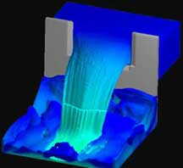
Weir
Horizontal surface over which water is allowed to flow
Used to regulate and measure flows
Can have 0,1 or 2 contractions
http://www.flow3d.com/appl/weir.htm

Slide 9
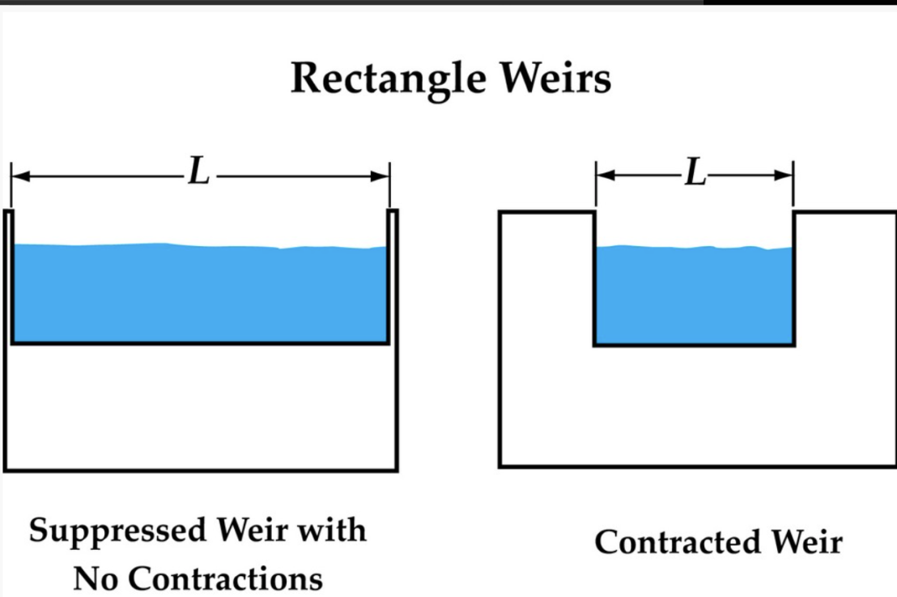
Contracted Weirs

Slide 10
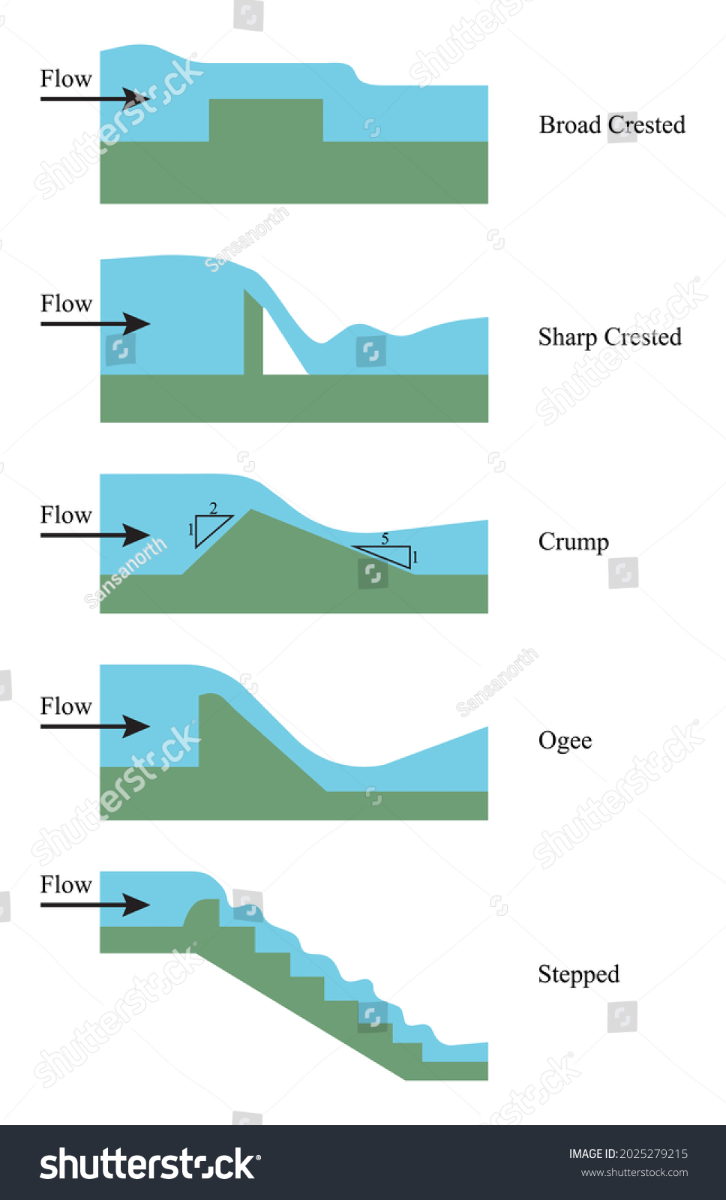
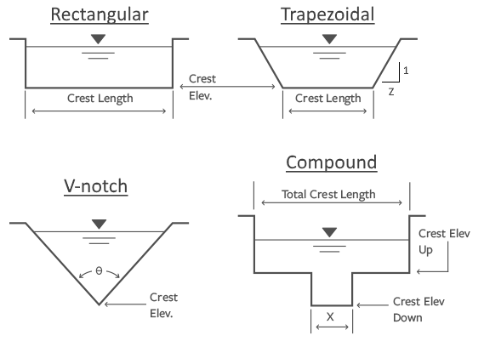
Many Weir-types (sharp or broad, cross-section channel shape, weir longitudinal shape)

Slide 11
Rectangular, Sharp-Crested Weir
Q=cLH^{3/2}
Q-flow (cfs)
c-adjusted discharge coefficient (careful)
c=3.27+0.4(H/P) where P is ht of weir above channel bottom
L-effective crest length, ft
L=L’-0.1nH
L’=actual measured crest length and n=# of contractions
H-head above crest, ft

Slide 12
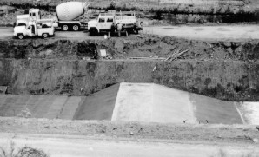
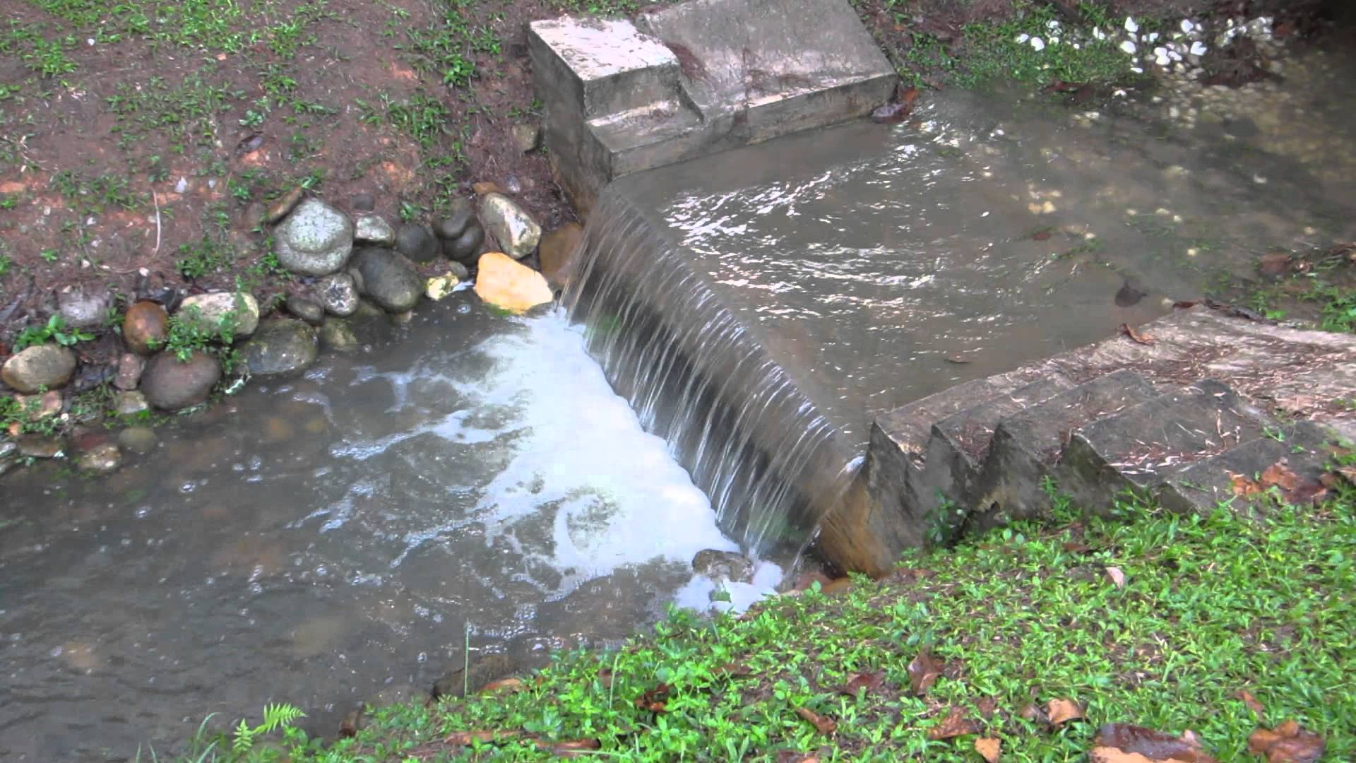
Rectangular, Broad-Crested Weir
Q=cLH^{3/2}
Q-flow (cfs)
c-discharge coefficient https://epg.modot.org/index.php/File:749_Broad-Crested_Weir_Coefficients.pdf
L-crest length, ft
H-head above crest, ft
Note: Don’t adjust broad-crested weirs for contractions

Slide 13
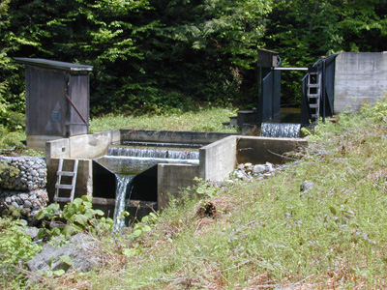
V-Notch or Triangular Weir
Q=c*tan(angle/2)*H^{5/2}
c = 2.5 (but should calibrate)

Slide 14
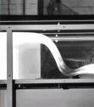
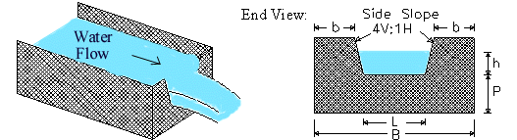
Other Weir Types
Cipoletti (trapezoidal)
Ogee (dam spillway)
youngiil.co.kr
www.lmnoeng.com

Slide 15
Weir/Orifice Equations

Slide 16


Flow under a gate
Sluice gate, head gate, diversion gate
Depending on conditions, flow can be flat, have a hydraulic jump or be submerged
Flow is modeled as an orifice
Typical c=0.7 to 0.85 but should be determined experimentally

Slide 17
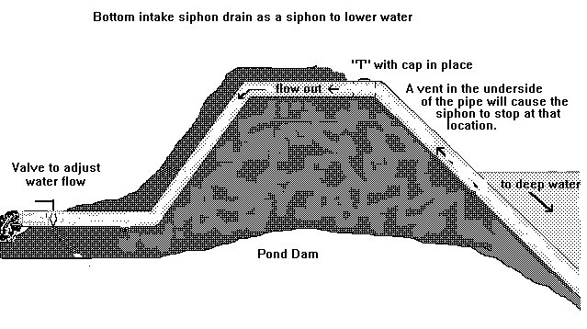
Siphon flow
Closed conduit that rises above the hydraulic grade line
Has practical problems

Slide 18
Break

Slide 19
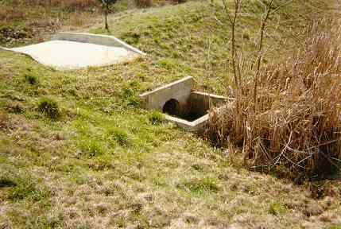
Detention Outlet Structures
Single Stage (culvert or orifice)
Multi-Staged to handle different flows
Combination of orifices &/or weirs

Slide 20
Single Stage Outlet Example
An outlet consisting of a 12” pipe is proposed for a detention basin. The invert of the pipe is 320.0 feet and the top of berm is 325.0 ft. Compute the discharge rating for the outlet.
Area=0.785 sq ft
Assume c=0.62
Use orifice equation: Q=ca(2gh)^{.5}

Slide 21
Single Stage Outlet Example
WSE (ft) | h (to c/l of pipe) | Q out (cfs)
320 | 0 | 0
321 | 0.5 | 2.8
322 | 1.5 | 4.8
323 | 2.5 | 6.2
324 | 3.5 | 7.3
325 | 4.5 | 8.3

Slide 22
Single Stage Discharge Curve

Slide 23
Multi-Stage Outlet
4” Orifice @ elevation 560’
Weir w/ L=1.5’ @ elevation 562.67’
Weir w/ L=12.5’@ elevation 563.67’

Slide 24
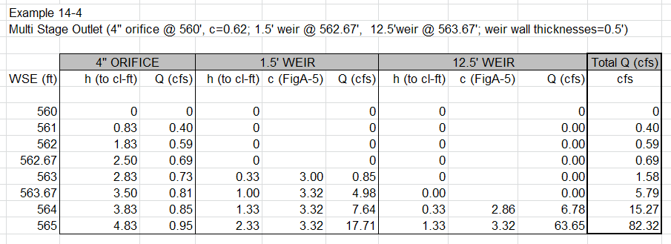
Multistage Outlet

Slide 25
Stage DischargeCurve-Multiple Outlets

Slide 26
Check Details
Check outflow pipe to make sure it can handle outflow
Orifice would be submerged at some point, impacting h (Note----Q is insignificant compared to the weir flow)

