Slide 1
Review
Professionalism:
Career planning
Resume
Interviewing
Responsibilities
Communication
Professional Licensing
New York State Laws Governing Professional Licensing

Slide 2
Objectives
Know why it is important to study ethics
Understand the distinction between business and personal ethics
Understand various codes of ethics (IEEE, NSPE, ASME, ASCE, AICHE)----covered in midterm

Slide 3
Professionalism in the Workplace
Engineering Technology Ethics
http://opinionator.blogs.nytimes.com/2013/02/17/on-ethnocentrism/?hp
“………..re-examine our beliefs and practices, become alert to weaknesses and inconsistencies in our own thinking, discover something plausible in a culturally unfamiliar point of view and, in so doing, become better than the ethnocentric creatures that we are”

Slide 4
Personal Ethics Discussion
Where does your ethical “structure” come from?
http://phys.org/news192693376.html
http://www.npr.org/blogs/health/2014/09/18/349514734/life-s-unfair-but-chimps-and-humans-know-when-to-even-the-score

Slide 5
What Values are Important to You?
Handout
In Life?-----pick top 3 (L)
At Work?-----pick top 3 (W)
No Names

Slide 6
Story Roundrobin
When is the first time that you can remember an “ethical dilemma”
Examples:
---you questioned what was right or wrong (or disagreed w/ others)
---you did something according to your own ethics even though someone else in authority told you to do otherwise

Slide 7
Engineering Ethics
Chapter 1: Introduction
Chapter 2: Professionalism and Codes of Ethics
Chapter 3: Understanding Ethical Problems
Chapter 4: Ethical Problem-Solving Techniques
Chapter 5: Risk, Safety, and Accidents
Chapter 6: The Rights and Responsibilities of Engineers
Chapter 7: Ethical Issues in Engineering Practice
Chapter 8: Doing the Right Thing

Slide 8
Ch 1. Introduction
Importance and Definitions

Slide 9
Importance?
Better to be prepared than surprised
Legal aspects
Complexity
Not black and white
Can affect your job

Slide 10
Business & Personal Ethics
Business—Choices on an organizational level
Personal—Choices on an individual level
Is there overlap????
Should there be overlap???

Slide 11
Ethics and Law
Ethical and legal
Ethical but illegal
Law not yet changed to reflect new realities
Legal but not ethical
Law not yet changed to reflect new realities

Slide 12
Use Problem Solving Process
Define problem
Come up w/ different alternatives
Evaluate the alternatives

Slide 13
Ch 2: Codes of Ethics

Slide 14
SUNY Poly Code of Conduct https://sunypoly.edu/sites/default/files/student%20conduct/Student-Handbook2017-18.pdf
Plagiarism
Inappropriate collaboration
Dishonesty in examinations
Dishonesty in papers and reports
Work done for one course and submitted to another
Falsification of data
Interference with another student’s work
Copyright violation
Other Miscellaneous

Slide 15
Codes of Ethics
Express the rights, duties and obligations of the members of the profession (framework; not a recipe)
Appendix A of your book:
IEEE
NSPE
ASME
ASCE
AIChE
Japan Society of Civil Engineers

Slide 16
Ch 3: Ethical Theories
Moral Theory Definition:
A moral theory defines terms in uniform ways and links ideas and problems together in consistent ways
Utilitarianism –Act and Rule
Cost-Benefit Analysis
Duty and Rights Ethics
Virtue Ethics

Slide 17
Trolley Problem
A trolley is running out of control down a track. In its path are five people who have been tied to the track by a mad philosopher. Fortunately, you could flip a switch, which will lead the trolley down a different track to safety. Unfortunately, there is a single person tied to that track. Should you flip the switch or do nothing?

Slide 18
Modified Trolley Problem
As before, a trolley is hurtling down a track towards five people. You are on a bridge under which it will pass, and you can stop it by dropping a heavy weight in front of it. As it happens, there is a very fat man next to you - your only way to stop the trolley is to push him over the bridge and onto the track, killing him to save five. Should you proceed?

Slide 19
Utilitarianism
"the good of the many outweighs the good of the few, or the one"
“one for all”
Actions are good if they serve to maximize human well-being
Focus is on maximizing the well-being of society as a whole (even though individuals can be negatively impacted)
Negatives:
No emphasis on individuals
Must know what leads to the ‘greater good”

Slide 20
Utilitarianism-Two Types
Act
Individual actions
Rules can be broken if it leads to the most good
Rule
Moral rules are important
Adhering to the rules ultimately leads to the most good

Slide 21
Benefit-Cost Analysis
Do benefits outweigh the costs?
Negatives
Not truly an ethical analysis tool
Not always easy to place a $ sign on all benefits
Who reaps the benefits?
Who pays the costs?

Slide 22
Duty and Right Ethics
"The good of the one outweighed the good of the many."
“all for one”
Actions are good when they respect the rights of individuals
List of duties that respect individuals
Individuals have fundamental rights that others have a duty to respect
Negatives
How do you resolve individual versus group conflicts
Doesn’t account for overall good

Slide 23
Virtue Ethics
Actions are considered right if they support good character traits (such as responsibility, honesty, competency, loyalty, trustworthiness, fairness, caring, citizenship, respect)
Behavior should be the same-personal and business
Negatives
Harder to apply
Virtues should not lead to negative consequences

Slide 24
Ethics problem-solving
Analyze a problem using different methods
If answers are different using different methods then careful analysis and weighting is needed
Individual rights often take precedence. Even one death is “one too many”

Slide 25
Ch 4: Problem-Solving Techniques
Understand all issues
Factual (knowns)
Conceptual (meaning of ideas)
Moral (which moral issue applies)
Line Drawing Techniqe (+ and - on each end)
Evaluate alternatives with respect to where they fall on the line
Flow Chart Technique
Solving Conflicts (importance, compromise, bite the bullet)

Slide 26
Line Drawing
Positive Paradigm: Unambiguously morally acceptable
Negative Paradigm: Unambiguously not morally acceptable
Develop alternatives and place them between the two extremes. Which are closer to the “positive”?
Review examples on pages 59-62

Slide 27
Line Drawing (Book Example)
In 994-95 it was discovered and widely reported that the latest version of the Intel Pentium chip had flaws. At first, Intel sought to hide this information, but later came around to a policy of offering computer chips in which the flaw had been corrected.
Define positive and negative paradigms:
Negative Paradigm (sell defective products)
Positive Paradigm (product should be as advertised)

Slide 28
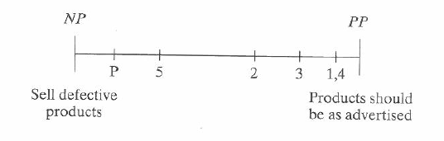
Line Drawing (Book Example)
Brainstorm hypothetical examples and place them on the line diagram:
Flaw in chip, but is truly undetectable and won’t affect any customer applications.
Flaws in chip, customer is informed, but no help is offered.
Warning label says that the chip should not be used for certain applications
Recall notices are sent out, and all flawed chips are replaced.
Replacement chips offered only if the customer notices the problem
Place actual/proposed action amongst the hypothetical examples:

Slide 29
Flow Charting
Useful when problem involves a sequence of events or consequences
Be objective
Review examples on page 62-63
Flowchart info and MS Word Template:
http://asq.org/learn-about-quality/process-analysis-tools/overview/flowchart.html

Slide 30
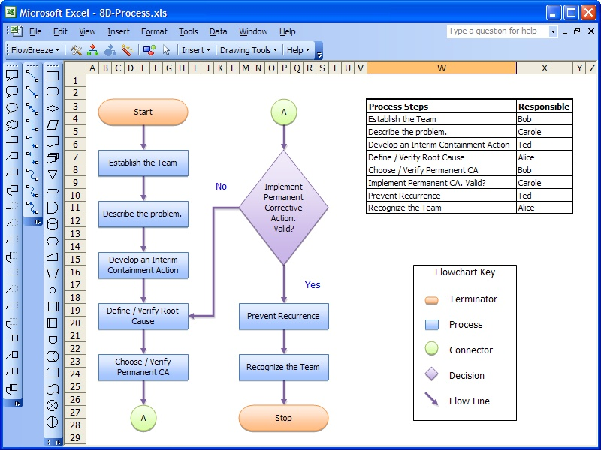
http://www.freebusinesssoftware.org/business-software___flowbreeze-2.2-coupons_.html

Slide 31
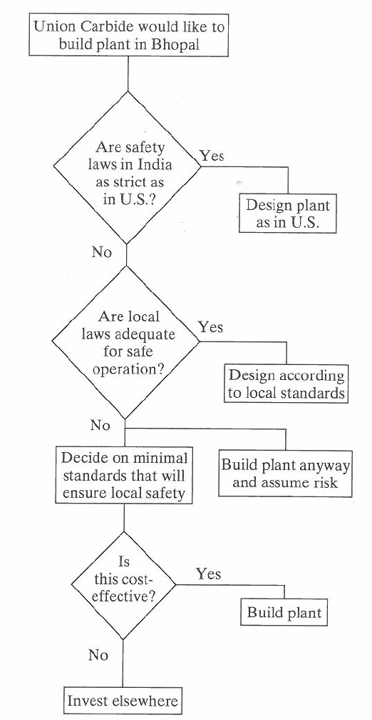
Flow Charting: Book Example

Slide 32
Ch 4: Gift/Bribe/Kickback
Assigned homework will cover these topics
Current event related to these topics:
Federal Complaint (Bribes)
New York State Complaint (Combination in Restraint of Trade and Competition in violation of General Business Law)

Slide 33
Ch 5: Risk, Safety and Accidents
Engineer’s duty is to protect the safety and well-being of the public
Safety and risk factors:
Voluntary and involuntary
Consequences (short-term versus long-term)
Expected probability
Reversible effects
Threshold levels of risk
Delayed versus immediate risk

Slide 34
Designing for Safety
Use PSP where safety is in the definition
Risk-benefit analysis (similar to cost-benefit analysis)

Slide 35
Accidents
Procedural, engineered or systemic
Procedural (most common; didn’t follow procedures)
Engineered (flaws in design)
Systemic (complex systems)
Better to prevent accidents
If accident occurs, thorough study needed, and results circulated

Slide 36
Ch 6: Rights and Responsibilities
Rights
Right of professional conscience
Responsibilities
Confidentiality
Proprietary information
For how long?
Conflict of Interest
Financial interest impacts judgment

Slide 37
Whistleblowing
When?
Need
Proximity
Capability
Last Resort
Be prepared to lose your job

Slide 38
Ch 7: Ethical Issues
Environment
Sustainability
Computers
Ethics and Research

Slide 39
Ch 8: Doing the Right Thing
Can avoid disasters
Takes effort and commitment
Excuses for not doing the right things
Not my job
Someone else will do it
Don’t have a crystal ball

Slide 40
Homework Assignment-Individual Due one week from today-blackboard
Read Chapter 4 (problem-solving techniques)
Answer the following end-of-chapter questions:
4.1 and 4.2 (gift/bribe)
4.11 through 4.14(bribery/kickback)
Be sure to include a copy of the original questions
Do the homework in Microsoft Word and drop off in Blackboard as .pdf
For problems 4.1 & 4.2 use only 1 line drawing and 1 flow chart to include all the scenarios (at least 13 scenarios-see bullets on top of page 66)
Problem 4.14-- (include a line diagram). Revise 1st sentence to “What is the ethical status of a campaign contribution given to a politician? Is this always a bribe?”

Slide 41
Presentation (Individual)
Research your assigned chapter, case study, and case study questions. Prepare a .ppt presentation (for date assigned—see schedule) on your case study and answers to questions (10 minutes in length)
I encourage you to use outside sources (if info is available)
Submit electronic copies of the .ppt via Blackboard dropoff.
In summary—explain the background of the case, copy the questions, provide your answers (with supporting statements).

Slide 42
Presentation Case Study & Questions
Ch. 1: Space Shuttle Challenger Disaster (1.4-1.13)
Ch 2: Intel Pentium Chip (2.7-2.16)
Ch 2: Paradyne (2.20-2.26)
Ch 3: Bhopal (3.6-3.13)
Ch 3: Aberdeen Three (3.14-3.22)
Ch 4: Cell Phones (4.3-4.10)
Ch 5: Hurricane Katrina (5.2-5.9)
Ch 5: Teton Dam (5.29-5.34)
Ch 5: Hyatt Walkway Collapse (5.18-5.22)
Ch 5: DC-10 (5.35-5.41)
Ch 5: Nanotech (5.47-5.50)
Ch 5: Tokaimura Criticality Accident (5.51-5.55)
Ch 6: Bart (6.5-6.13)
Ch 6: Goodrich Brake (6.17-6.23)
Ch 7: Isleta Water (7.19-7.22)
Ch 7: Cold Fusion (7.26-7.28)
Ch 8: Headlight (8.8-8.11) ‘
Ch 8: Crash Testing (8.12-8.15)

Slide 43
Values Summary
The majority of students list different values for life/work
Only 3 students (3 classes) chose exact same values for life/work

Slide 44
Life
Work
Fall 16
Family (8)
Fun (6)
Success (4)
Relationships (4)
Love (2)
Loyalty (2)
Passion (2)
Winning (1)
Education (1)
Money (1)
Honesty (1)
Earth (1)
Power (1)
Creativity (1)
Trust (1)
Success (8)
Money (6)
Team Work (4)
Trust (3)
Passion (3)
Relationship (3)
Honesty (2)
Creativity (1)
Community (1)
Power (1)
Winning (1)
Fun (1)

Slide 45
Life
Work
Fall 15
Team Work (5)
Devotion (4)
Trust (4)
Passion (3)
Creativity (3)
Success (3)
Education (2)
Community (1)
Honesty (1)
Loyalty (1)
Money (1)
Relationship (1)
Security (1)
Earth (1)
Faith (1)
Family (9)
Trust (4)
Love (3)
Education (3)
Loyalty (2)
Relationships (2)
Truth (2)
Honesty (1)
Fun (1)
Earth (1)
Devotion (1)
Security (1)
Faith (1)

Slide 46
Life
Work
Spr 15
Team Work (7)
Success (5)
Trust (4)
Honesty (3)
Education (3)
Loyalty (3)
Money (2)
Devotion (2)
Passion (2)
Creativity (2)
Community (2)
Relationship (2)
Truth (2)
Security
Honesty
Earth
Family (9)
Trust (5)
Success (4)
Loyalty (3)
Love (3)
Creativity (3)
Education (3)
Honesty (2)
Relationships (2)
Fun (2)
Earth (2)
Devotion (2)
Community (2)
Truth

Slide 47
Life
Work
Fall 14
Family (11 )
Fun (6)
Love (4)
Success (4)
Trust (4)
Relationships (2)
Honesty (3)
Loyalty (1)
Creativity (1)
Devotion (1)
Truth (1)
Success (7)
Team Work (7)
Money(4)
Honesty (3)
Fun (3)
Trust (3)
Education (1)
Family (1)
Loyalty (1)
Passion (1)
Security (1)
One person listed same 3 for life/work

Slide 48
Life
Work
Fall 13
Family (13)
Fun (7)
Love (6)
Success (6)
Honesty (3)
Trust (3)
Education (2)
Loyalty (2)
Community
Creativity
Passion
Success (9)
Team Work (8)
Education (5)
Honesty (4)
Trust (4)
Honesty (2)
Devotion (3)
Passion (3)
Money (2)
Creativity
Fun
Power
Profits
Relationships
Security

Slide 49
Life
Work
Spr 13
Family (12)
Success (6)
Trust (6)
Honesty (4)
Love (4)
Money (3)
Loyalty (3)
Relationships (2)
Fun (2)
Power
Earth
Change
Community
Education
Truth
Success (8)
Team Work (8)
Money (7)
Loyalty (4)
Trust (4)
Devotion (4)
Honesty (2)
Family (2)
Passion (2)
Change (2)
Security (2)
Creativity
Education
Profits

