Slide 1
CE 220 Professionalism
A pupil from whom nothing is ever demanded which he cannot do, never does all he can.
John Stuart Mill

Slide 2
Objectives
Understand the class requirements
Understand why “professionalism” is important
ETAC-ABET Requirements
EAC-ABET Requirements

Slide 3
Class Requirements
On-Web: www.sunyit.edu/~barans
Syllabus
Schedule
Lectures/Assignments
Grades
Drop off assignments in Angel

Slide 4
Why a Course on Professionalism?
College
Structured
Protected
Defined
Constant feedback
Real life
Unstructured
Complicated
Constant Change
Self-directed

Slide 5
Why a Course on Professionalism?
Employers value ethics/professionalism
Explore your values
What do you want to do with your life?

Slide 6
WARNING!!!!
Everyone has different viewpoints
Feel free to discuss your opinions in this class
Respect other’s viewpoints even though you may not share those viewpoints

Slide 7
Adland-Searching for the Meaning of Life on a Branded Planet by James Othmer
Quick exercise and show of hands!!!
Discussion

Slide 8
Accreditation: EAC/ETAC-ABET http://www.abet.org/
ETAC-Engineering Technology Accreditation Commission
EAC-Engineering Accreditation Commission
History http://www.abet.org/History/
In 1980, ECPD was renamed the Accreditation Board for Engineering and Technology (ABET) to more accurately describe its emphasis on accreditation. In response to the anticipated boom in computer science education, ABET helped establish the Computing Sciences Accreditation Board (now called CSAB) in 1985. CSAB is now one of ABET's largest member societies with more than 300 accredited programs. In 2005, ABET formally changed its name to ABET and no longer uses the title "Accreditation Board for Engineering and Technology." - See more at: http://www.abet.org/History/#sthash.RhZDATP3.dpuf

Slide 9
Accreditation Criteria
ETAC Criteria (2015-2016)
http://www.abet.org/etac-criteria-2015-2016/
EAC Criteria (2015-2016)
http://www.abet.org/eac-criteria-2015-2016/

Slide 10
ETAC-ABET: Student Outcomes-Criterion 3 (a-k)
Each program must demonstrate that graduates have:
a. an ability to select and apply the knowledge, techniques, skills, and modern tools of the disciplines to broadly-defined engineering technology activities;
b. an ability to select and apply a knowledge of mathematics, science, engineering, and technology to engineering technology problems that require the application of principles and applied procedures or methodologies;
c. an ability to conduct standard tests and measurements; to conduct, analyze, and interpret experiments; and to apply experimental results to improve processes;
d. an ability to design systems, components, or processes for broadly-defined engineering technology problems appropriate to program educational objectives;
e. an ability to function effectively as a member or leader on a technical team;
f. an ability to identify, analyze and solve broadly-defined engineering technology problems;
g. an ability to apply written, oral, and graphical communication in both technical and non-technical environments; and an ability to identify and use appropriate technical literature;
h. an understanding of the need for and an ability to engage in self-directed continuing professional development;
i. an understanding of and a commitment to address professional and ethical responsibilities including a respect for diversity;
j. a knowledge of the impact of engineering technology solutions in a societal and global context; and
k. a commitment to quality, timeliness, and continuous improvement.
Source: http://www.abet.org/etac-criteria-2015-2016/ (Student Outcomes: 2015-2016)
Note: Used for homework assignment

Slide 11
EAC-ABET: Student Outcomes-Criterion 3 (a-k)
Each program must demonstrate that graduates have:
a. an ability to apply knowledge of mathematics, science and engineering;
b. an ability to design and conduct experiments, as wells as to analyze and interpret data;
c. an ability to design a system, component, or process to meet desired needs within realistic constraints such as economic, environmental, social, political, ethical, health and safety, manufacturability, and sustainability;
d. an ability to function on multidisciplinary teams;
e. an ability to identify, formulate, and solve engineering problems;
f. an understanding of professional and ethical responsibility;
g. an ability to communicate effectively;
h. the broad education necessary to understand the impact of engineering solutions in a global, economic, environmental, and societal context;
i. a recognition of the need for, and an ability to engage in life-long learning;
j. a knowledge of contemporary issues; and
k. an ability to use the techniques, skills, and modern engineering tools necessary for engineering practice.
Source: http://www.abet.org/eac-criteria-2015-2016/ (Student Outcomes: 2015-2016)
Note: Used for homework assignment

Slide 12
EAC/ETAC Program Specific Requirements
Civil and Mechanical Engineering
http://www.abet.org/eac-criteria-2015-2016/
Civil and Mechanical Engineering Technology
http://www.abet.org/etac-criteria-2015-2016/
(Note: Used for homework)

Slide 13
SUNYIT Program Student Outcomes
Civil ET
http://sunyit.edu/undergraduate/civil-engineering-technology/accreditation/
Mechanical ET
http://sunyit.edu/undergraduate/mechanical-engineering-technology/etac-abet/
Civil Engr. Student Outcomes currently being developed/reviewed
Note: Not Used for homework assignment

Slide 14
How do we measure or assess these outcomes?
Rubrics
Surveys
Other Data

Slide 15
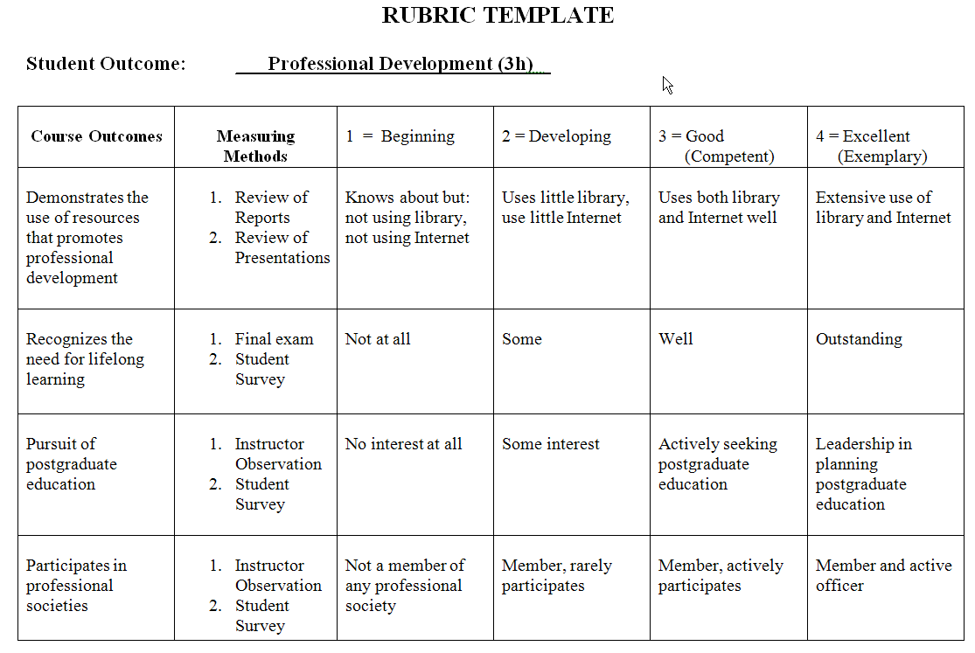

Slide 16
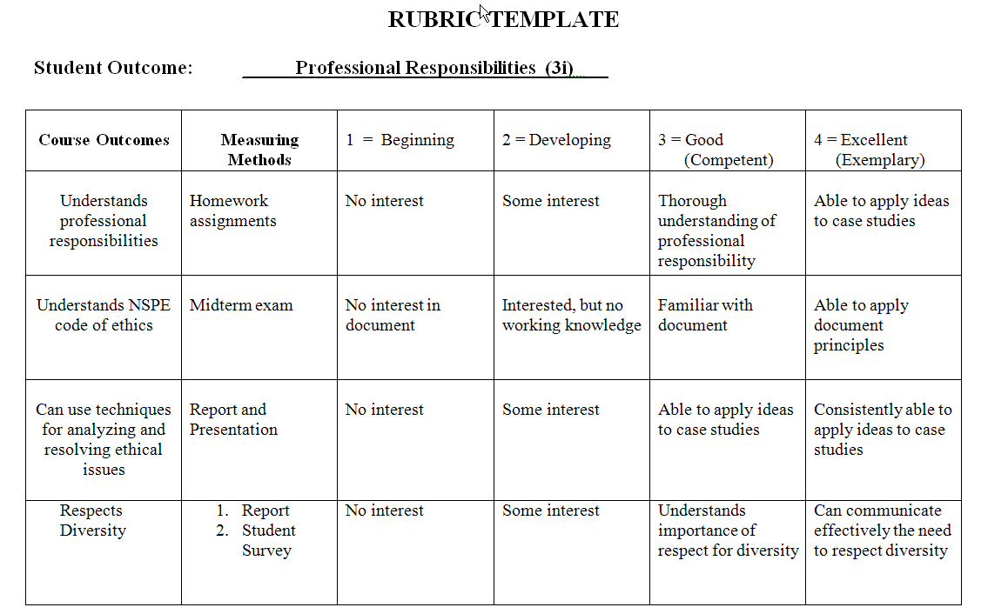

Slide 17
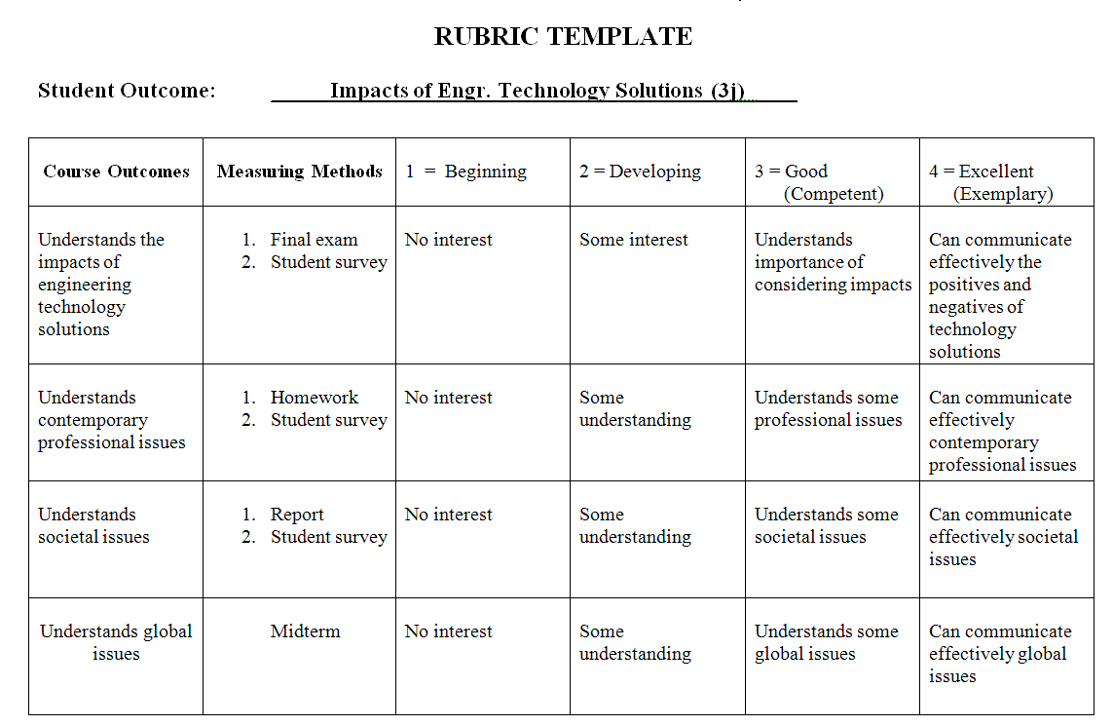

Slide 18
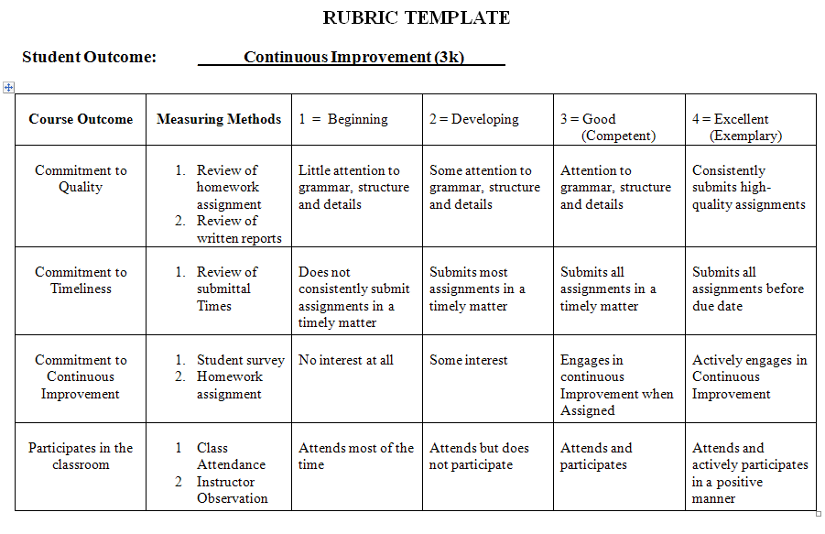

Slide 19
Service Requirement
Service Component (individual or groups)
Clubs
Church
Personal
Other
Can fulfill by joining student section of professional club
A group of students can get together for a service
Ideas: http://www.uticaod.com/latestnews/x1896978540/JANUARY-WISH-LIST-2013

Slide 20
E-Portfolio
New requirement
Start now
Due at end of semester (via Angel submission)
Use Google Sites (template: student website)
Must include class work (drawings, reports, project) in .pdf or.jpg format

Slide 21
HW Assignment (individual)
Look up EAC or ETAC-ABET 2015-2016 Criterion 3:
For the Criterion 3 student outcomes (a-k) list and discuss how well you feel you meet each outcome? Support your statements with details.
Look up EAC or ETAC-ABET 2015-2016 Program Criteria:
For each specific program criteria list and discuss how well you feel you meet each outcome? If the criteria is listed as a paragraph identify each separate item. Support your statements with details.
What would you like to learn/discuss in this course?
Drop off the assignment in PDF format via Angel

Slide 22
HW Assignment (individual)
Using online resources (undergraduate catalog, Banner records, DegreeWorks(?), and Historic Course Schedules) develop a draft schedule for completion of your degree.
Make sure you will have 128 credits
Make sure you meet general education requirements
Make sure you meet program requirements
Make sure you meet other requirements (example-CAD test requirements for CvET students)
Make sure you meet prerequisite requirements
Drop off the assignment in PDF format via Angel

Slide 23
Next Lecture
Professionalism

