Slide 1
CTC/MTC 301 Professionalism
A pupil from whom nothing is ever demanded which he cannot do, never does all he can.
John Stuart Mill

Slide 2
Objectives
Understand the class requirements
Understand why “professionalism” is important
ETAC-ABET Requirements (knowledgeable about requirements)
Ethical Theory and Tools

Slide 3
Class Requirements
On-Web: http://people.sunyit.edu/~barans/
Syllabus
Schedule
Lectures/Assignments
Grades
Drop off all assignments in Blackboard as .pdf (portable document format; in Word or Excel go to file, save as, .pdf)

Slide 4
Why a Course on Professionalism?
College
Structured
Protected
Defined
Constant feedback
Real life
Unstructured
Complicated
Constant Change
Self-directed

Slide 5
Why a Course on Professionalism?
Employers value ethics/professionalism
FE exam includes 3-6 questions on “Ethics and Professional Practice” http://ncees.org/wp-content/uploads/2015/07/FE-Civil-CBT-specs.pdf and http://ncees.org/wp-content/uploads/2015/07/FE-Mec-CBT-specs.pdf
Codes of Ethics (both civil and a-mechanical)
Professional Liability (both civil and d-mechanical)
Licensure; Ethical and Legal Considerations (c-mech)
Sustainability and Sustainable Design; Public Health, Safety and Welfare (e-Mech)
Professional Skills (public policy, management, and business)
Contracts and contract law; Agreements and Contracts (b-mech)
Explore your values and future professional goals

Slide 6
WARNING!!!!
Everyone has different viewpoints
Feel free to discuss your opinions in this class
Respect other’s viewpoints even though you may not share those viewpoints

Slide 7
A Question of Ethics
Hand out one article.
Class discussion
Hand out summer job survey
Break

Slide 8
Accreditation: ETAC-ABET http://www.abet.org/
ETAC-Engineering Technology Accreditation Commission
EAC-Engineering Accreditation Commission
History http://www.abet.org/History/
In 1980, ECPD was renamed the Accreditation Board for Engineering and Technology (ABET) to more accurately describe its emphasis on accreditation. In response to the anticipated boom in computer science education, ABET helped establish the Computing Sciences Accreditation Board (now called CSAB) in 1985. CSAB is now one of ABET's largest member societies with more than 300 accredited programs. In 2005, ABET formally changed its name to ABET and no longer uses the title "Accreditation Board for Engineering and Technology." - See more at: http://www.abet.org/History/#sthash.RhZDATP3.dpuf

Slide 9
Accreditation Criteria
ETAC Criteria (2017-2018)
http://www.abet.org/accreditation/accreditation-criteria/criteria-for-accrediting-engineering-technology-programs-2017-2018/
ETAC Criteria (2016-2017)
http://www.abet.org/accreditation/accreditation-criteria/criteria-for-accrediting-engineering-technology-programs-2016-2017/

Slide 10
ETAC-ABET: Student Outcomes-Criterion 3 (a-k): Current
Each program must demonstrate that graduates have:
a. an ability to select and apply the knowledge, techniques, skills, and modern tools of the discipline to broadly-defined engineering technology activities;
b. an ability to select and apply a knowledge of mathematics, science, engineering, and technology to engineering technology problems that require the application of principles and applied procedures or methodologies;
c. an ability to conduct standard tests and measurements; to conduct, analyze, and interpret experiments; and to apply experimental results to improve processes;
d. an ability to design systems, components, or processes for broadly-defined engineering technology problems appropriate to program educational objectives;
e. an ability to function effectively as a member or leader on a technical team;
f. an ability to identify, analyze, and solve broadly-defined engineering technology problems;
g. an ability to apply written, oral, and graphical communication in both technical and non-technical environments; and an ability to identify and use appropriate technical literature;
h. an understanding of the need for and an ability to engage in self-directed continuing professional development;
i. an understanding of and a commitment to address professional and ethical responsibilities including a respect for diversity;
j. a knowledge of the impact of engineering technology solutions in a societal and global context; and
k. a commitment to quality, timeliness, and continuous improvement.
Source: http://www.abet.org/accreditation/accreditation-criteria/criteria-for-accrediting-engineering-technology-programs-2016-2017/ (Student Outcomes: 2017-2018)
Note: Used for homework assignment

Slide 11
ETAC-ABET: Student Outcomes-Criterion 3 (a-k): Last Year
Each program must demonstrate that graduates have:
a. an ability to select and apply the knowledge, techniques, skills, and modern tools of the discipline to broadly-defined engineering technology activities;
b. an ability to select and apply a knowledge of mathematics, science, engineering, and technology to engineering technology problems that require the application of principles and applied procedures or methodologies;
c. an ability to conduct standard tests and measurements; to conduct, analyze, and interpret experiments; and to apply experimental results to improve processes;
d. an ability to design systems, components, or processes for broadly-defined engineering technology problems appropriate to program educational objectives;
e. an ability to function effectively as a member or leader on a technical team;
f. an ability to identify, analyze, and solve broadly-defined engineering technology problems;
g. an ability to apply written, oral, and graphical communication in both technical and non-technical environments; and an ability to identify and use appropriate technical literature;
h. an understanding of the need for and an ability to engage in self-directed continuing professional development;
i. an understanding of and a commitment to address professional and ethical responsibilities including a respect for diversity;
j. a knowledge of the impact of engineering technology solutions in a societal and global context; and
k. a commitment to quality, timeliness, and continuous improvement.
Source: http://www.abet.org/accreditation/accreditation-criteria/criteria-for-accrediting-engineering-technology-programs-2016-2017/ (Student Outcomes: 2016-2017)

Slide 12
ETAC/EAC Program Specific Requirements
Civil and Mechanical Engineering Technology
http://www.abet.org/accreditation/accreditation-criteria/criteria-for-accrediting-engineering-technology-programs-2017-2018/
(Note: “Above-Engr Tech” used for homework)
Civil and Mechanical Engineering
http://www.abet.org/accreditation/accreditation-criteria/criteria-for-accrediting-engineering-programs-2017-2018/

Slide 13
SUNY Poly Program Student Outcomes
Civil ET
https://sunypoly.edu/academics/majors-and-programs/civil-engineering-technology/civil-engineering-technology-etacabet.html
Mechanical ET
https://sunypoly.edu/academics/majors-and-programs/mechanical-engineering-technology/mechanical-engineering-technology-0.html
Note: Not Used for homework assignment

Slide 14
How do we measure or assess these outcomes?
Rubrics
Surveys
Other Data

Slide 15
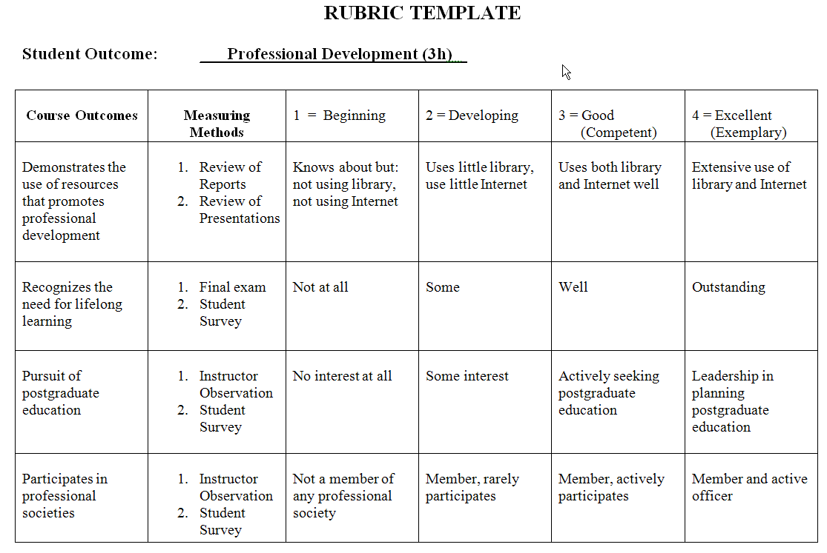

Slide 16
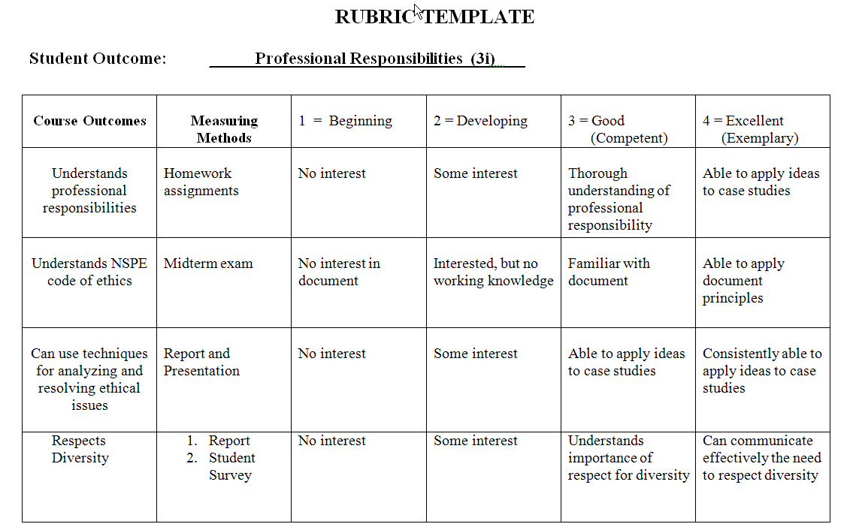

Slide 17
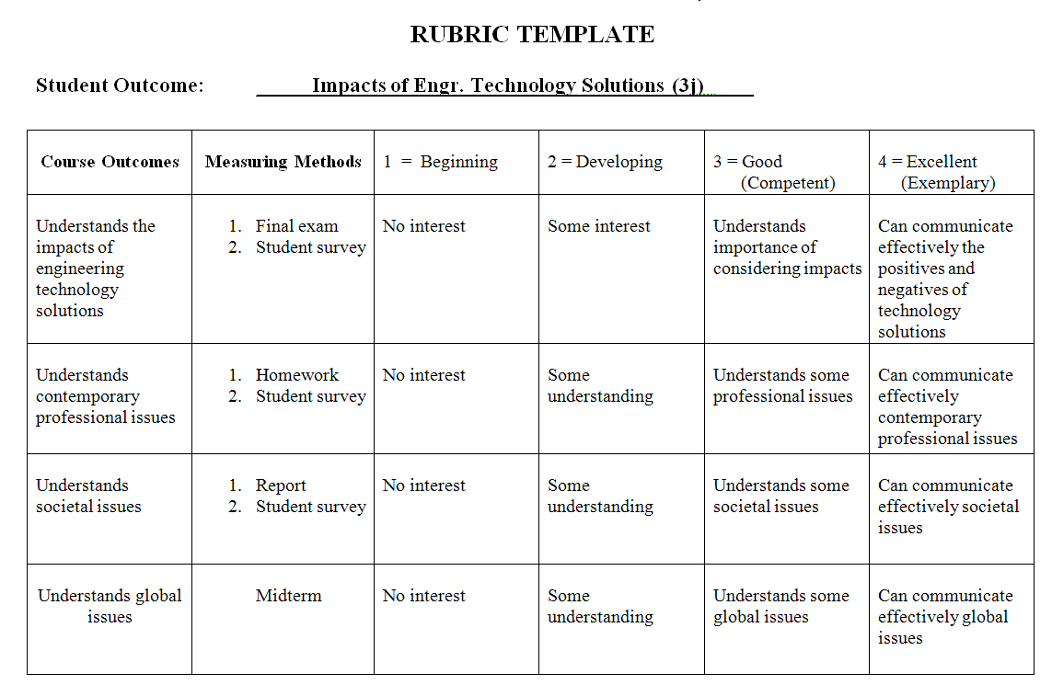

Slide 18
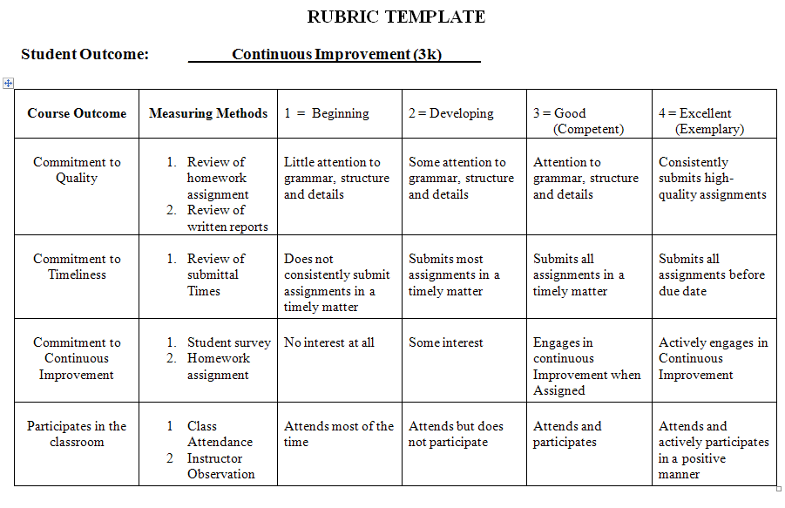

Slide 19
Service Requirement
Service Component (individual or groups)
Clubs
Church
Personal
Other
Can fulfill by joining student section of professional club
A group of students can get together for a service
Ideas: http://www.uticaod.com/news/20160601/june-wish-list

Slide 20
E-Portfolio
New requirement
Start now
Due at end of semester (via Blackboard submission)
Use Google Sites (template: student website)
Must include examples of class work (drawings, reports, projects) in .pdf or.jpg format
Example: https://sites.google.com/a/sunyit.edu/bianca-little/home

Slide 21
HW Assignment 1 (individual)
Look up ETAC-ABET 2017-2018 Criterion 3:
For the Criterion 3 student outcomes (a-k) list and discuss how well you feel you meet each outcome? Support your statements with details.
http://www.abet.org/accreditation/accreditation-criteria/criteria-for-accrediting-engineering-technology-programs-2017-2018/
(see Criterion 3: Student Outcomes)
Look up ETAC-ABET 2017-2018 Program Criteria:
For your specific program (Mechanical or Civil) list and discuss how well you feel you meet each program criteria outcome? If the criteria is listed as a paragraph identify each separate item. Support your statements with details.
http://www.abet.org/accreditation/accreditation-criteria/criteria-for-accrediting-engineering-technology-programs-2017-2018/ (see II: Program Criteria)
What would you like to learn/discuss in this course?
Drop off the assignment in PDF format via Blackboard before next week’s class

Slide 22
HW Assignment 2 (individual)
Using online resources (undergraduate catalog when you matriculated, banner records, DegreeWorks, and course schedules given to you) document requirements you have fulfilled and develop a draft schedule for completion of your degree.
Make sure you will have 128 credits (how many credits were transferred? How many have you completed? Does your draft schedule credits complete 128 credits?)
Make sure you meet general education requirements. Which courses have you taken/transferred that meet the 7 of 10 requirements and 30-credit minimum?
Make sure you meet program requirements (copy from the undergraduate catalog and list the courses that you have transferred/completed that meet the requirements.)
Make sure you meet other requirements (example-CAD test requirements for CvET students). For MET students have you made a C or better in each MTC course?
Make sure you meet prerequisite requirements when you show your schedule.
Drop off the assignment in PDF format via Blackboard

Slide 23
Next Lecture
Professionalism

