Slide 1
CTC 112
Intro to Microstation
Monday

Slide 2
Instructor/Student Introductions

Slide 3
Class Requirements
Class info at http://people.sunypoly.edu/~barans
Schedule
Assignments
Grades

Slide 4
Expectations
  Drawings turned in on-time
    due before class on Wednesday
    On Paper at beginning (plot to scale); later PDF?
  One CAD log per assignment
  Detailed description on CAD log
    New commands learned and used

Slide 5
Applications
Drafting preliminary design drawings
Drafting final design drawings
Report graphics

Slide 6
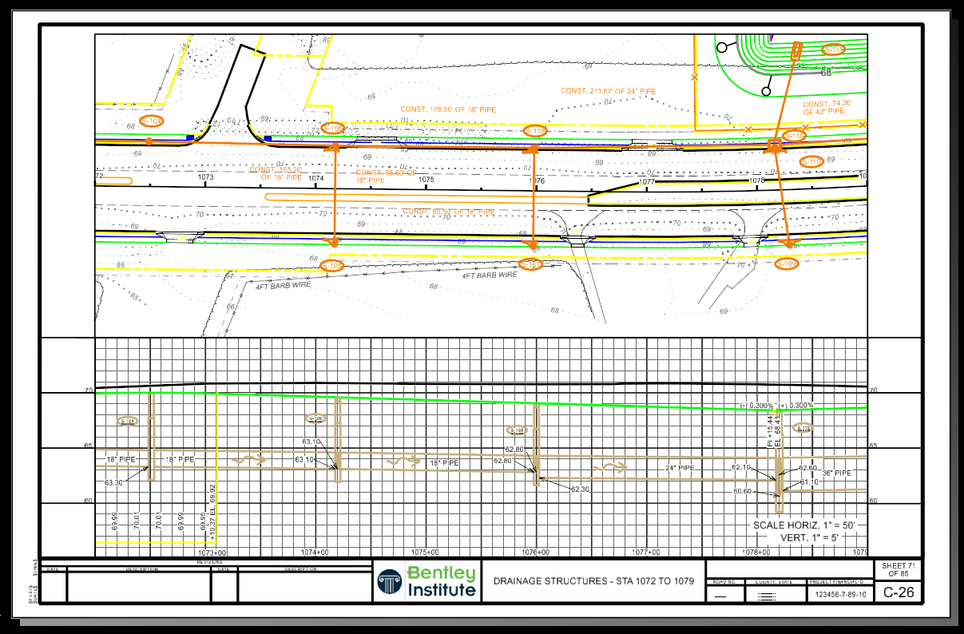

Slide 7
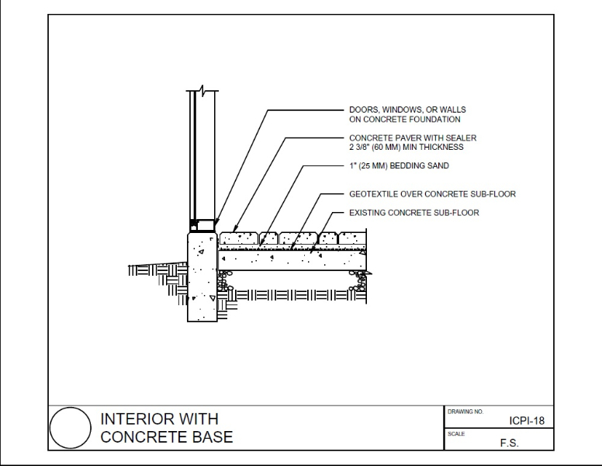

Slide 8
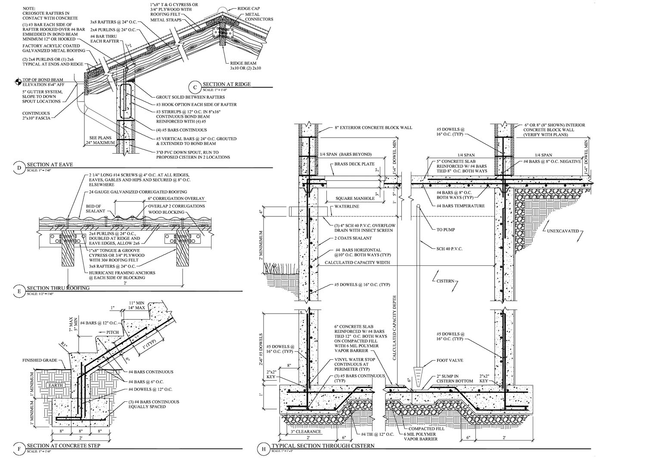

Slide 9
History
1963-MIT-SKETCHPAD
1964-IBM commercialized
1970’s (Rotate, delete, mirror)
1988-ProE
1990’s-SolidWorks
3D printers-2000’s
CAD-Computer Aided Drafting
CADD-Computer Aided Design and Drafting

Slide 10
CADD-Powerful Tool
Revolutionized drafting (no more ink)
Usually faster than hand drafting
Changes easily made
End product is consistent and professional

Slide 11
CADD-Powerful Tool
Takes time to learn software
Sometimes faster to do by hand
Requires a lot of “bookkeeping”
Software is expensive

Slide 12
Best Way to Learn
Practice, practice, practice
Make mistakes
Try new commands
Experiment
Interact with other users

Slide 13
Microstation V8I (Now CONNECT)
Available on engineering computers located in:
  1159/G143 (Donovan)
  B232, C201, C203 (Kunsela)
  Lab across from public safety
  Library
Available for download on your own computer (see Blackboard for directions)

Slide 14
Mouse
Left button is the data button
  Select commands
  Define points
  Accept point
  Identify elements
Right button is the reset/reject button
Press both---tentative button

Slide 15
Creating a File
Seed files have basic parameters already embedded in the file

Slide 16
Basics
Command window,menus,tool boxes
Viewing the file
Design Plane
Working units
Placing elements
Manipulating elements
Levels
Placing text

Slide 17
Saving Changes
Elements are automatically saved
To save settings, use “file, save settings”

Slide 18
Printing
Plot by placing a fence
Plot to a scale
I will require paper scaled drawings at first-need to learn “scales”. Later we may switch to PDF files dropped off in brightspace.

Slide 19
Standard Sheet Sizes
ANSI | ISO
A: 8.5 by 11 inches (for this class) | A4: 210 by 297 mm
B: 11 by 17 inches (1/2 of D) | A3: 297 by 420 mm
C: 17 by 22 inches (1/2 of E) | A2: 420 by 594 mm
D: 22 by 34 inches (NYSDOT) | A1: 594 by 841 mm
D1: 24 by 36 inches
E: 34 by 44 inches | A0: 841 by 1189 mm
E1: 30 by 42 inches

Slide 20
NYSDOT CADD Software Standards
https://www.dot.ny.gov/main/business-center/engineering/cadd-info/cadd-policy/cadd-software-standards
https://www.dot.ny.gov/main/business-center/engineering/cadd-info/cadd-policy

Slide 21
Important to Document Work
For this class a CAD log must accompany all drawings turned in class. See lectures for CAD log template.
For homework, create a CAD log (see lectures for template) and drop off as a pdf in Blackboard. The assignment is due Wed Sept 3.

Slide 22
Wednesday
Intro:
Create a new drawing (use 2D imperial)
Place lines/rectangles
Set active colors/line styles/weights
Delete Key

Slide 23
Drawing to a Coordinate System
Absolute (XY=)
Relative Rectangular (DL=)
Relative Polar (DI=Distance, Angle)
Absolute-from the origin
Relative-relative to the last point placed

Slide 24
Drawing to a Coordinate System
To open “Key-In” type in key-in in search box.
You can then “dock” it at the bottom of the screen.

Slide 25
Fill in Key-Ins
Turn in draft key-in worksheets 2-1, 2-2, 2-3 and 2-4 along with your first CAD log via brightspace.
See Brightspace for details

