Slide 1
CTC 112
3D Topics (midterm)
Printing in 3D
Raster Images

Slide 2
Topics
Manipulating Raster Images (2)
3d Printing (2)
Solids Modeling:
Primitives; using coordinates (2)
Composite Solids (Union, Intersection, Difference) (2)
Visualization:
Palettes (place materials by level) (2)
Lighting (2)
Defining Materials (2)
Rendering (2)

Slide 3
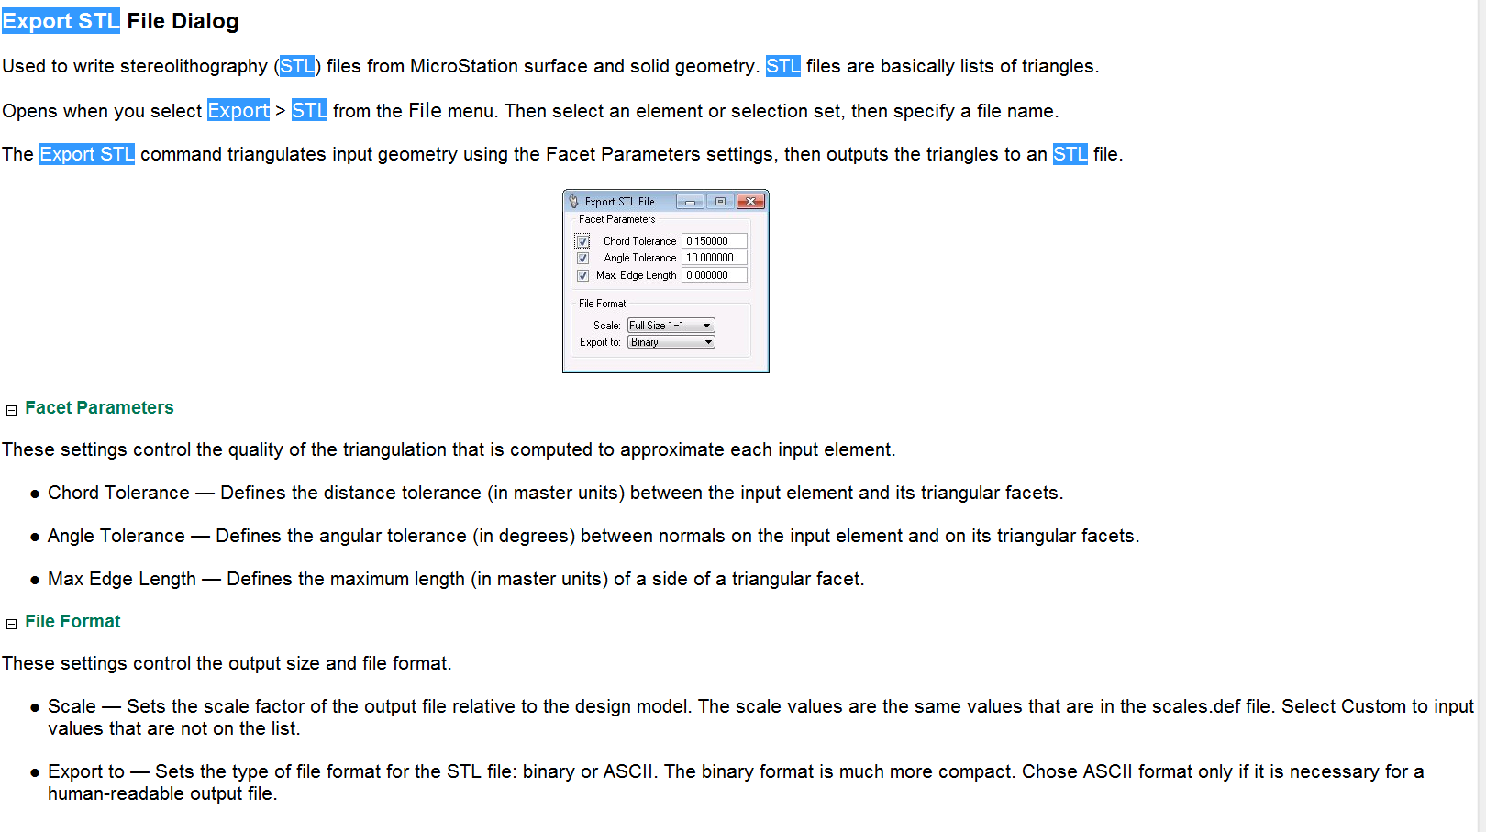
File, Export STL

Slide 4
Raster Images
..\SUNY Poly Campus.JPG
..\SUNY Poly Campus2.JPG

