Slide 1
Concrete Box Culverts (CBC)
Bar lists and estimates from standard design sheets

Slide 2
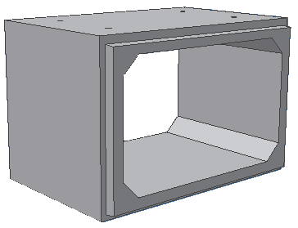
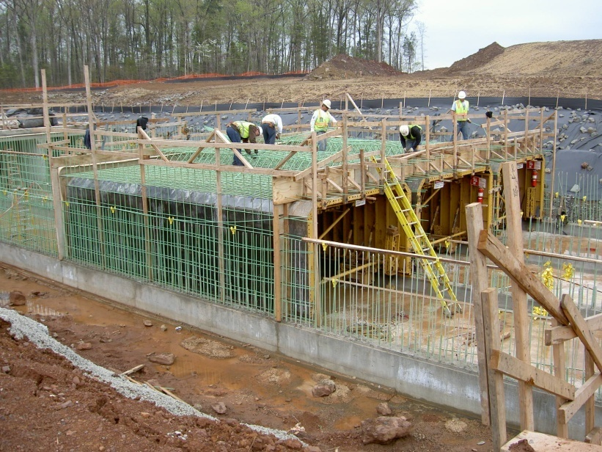
CBC
Mostly used as drainage structures
Used instead of multi-plate culverts or bridges
Can be cast-in-place (CIP) or precast
http://www.scurlockindustries.com/boxclvrt.html
http://www.metwashairports.com/dulles/1522.htm

Slide 3
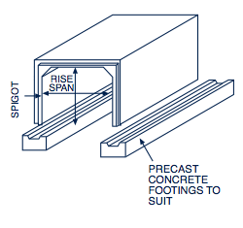
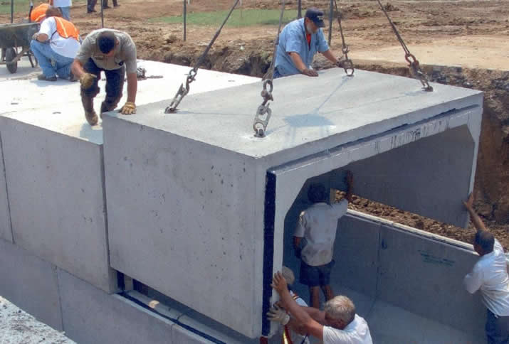
Open (3-sided) or Closed (4-sided)
Rock or Precast Concrete Footings-open box (minimizes environmental impact)
Earth or Granular Soil-Closed box (fish baffles can be added)
http://www.shawpipe.com/box_culvert.aspx
http://www.hansonsilo.com/images/box-culvert-install.jpg

Slide 4
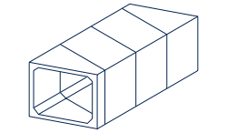
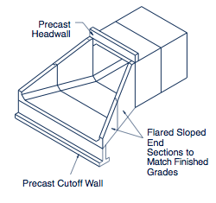
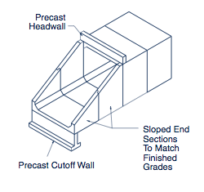
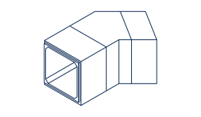
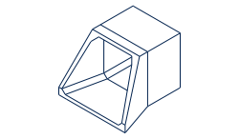
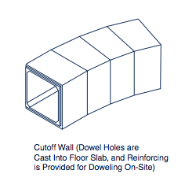
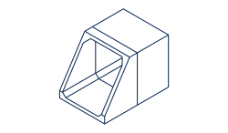
Other (wingwalls, cutoffs, curved..)
http://www.shawpipe.com/box_culvert.aspx

Slide 5
Standard Design Sheets-CBC
Section A-A, 1 (6x3 to 9x9)
  Type I bar ties walls & slabs together (2 pieces)
Section A-A,2 (10x5 to 17x8)
  Type II bars tie walls and slabs together (4 pieces)
Section A-A, 3 (10x9 to 20x20)
  Double row of bars in walls. Includes Type VII and type VIII bars
Notes:
Not for design!!!! Handouts are rescinded standard sheets given solely for education purposes (looking at details and deriving bar lists).
PDF design sheets are on Blackboard

Slide 6
Steel Bars-Miscellaneous
Minimum cover on non-prestressed steel (ACI 318)
  Cast against or permanently exposed to earth 3”
  Exposed to earth or weather
    #5 and smaller 1-1/2”
    #6 and larger 2”
Minimum cover is also shown on Handouts. Note says assume 2” unless otherwise shown, but we’ll assume 3” for end cover

Slide 7
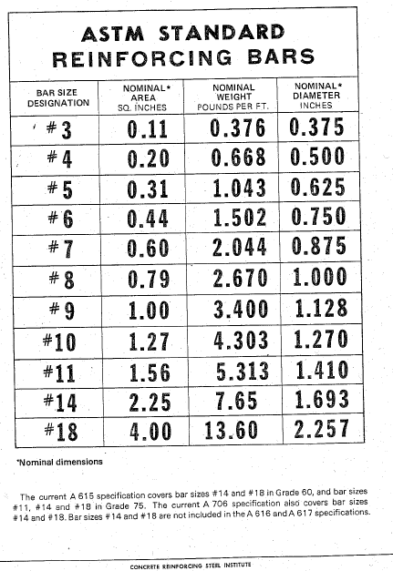

Slide 8
Steel Bars
Spacing vs # of Bars
(Dimension minus cover) divided by (minimum spacing) +1
2 ft @ 6” spacing would require 5 bars
24”-4”=20/6=4+1=5
Note: Otherwise spacing would be more than 6”

Slide 9
General Design Steps Using Standard Design Sheets
Determine flow (hydrology)
Determine span x height (hydraulics)
Determine skew
Determine height of fill (top of roadway to top of top slab of culvert)
Determine the following:
  Required wall thickness
  Slab thickness
  Bar Reinforcement
  Size and Spacing of Steel Bars

Slide 10
CBC Example
Height of Fill (HF) 5’
Span (S) 15’
Height (H) 8’
Length (L) 40’
Section A-A,2

Slide 11
CBC Example
Determine:
Top Slab Thickness (t)=12”
Wall Thickness (w)=12”
Bottom Slab Thickness (t+2”)=14”
Dimension “a”=5’-7”
Dimension “b”=3’-7”

Slide 12
CBC Example
Determine bar size and spacing:
Type I #5@18” (gave name to bar)
Type II #6@6”
Type III #7@6”
Type IV #5@12”
Type V #5@9”
Type VI #5@18”

Slide 14
CBC Example
Type I bars (#5 @ 18”) are straight bars which run the length of the barrel and are located in the walls:
Determine Dimension:
8’*12”/ft=96”-8”(bottom haunch)-4”(top haunch )-4”(cover)=80”
Determine # of Bars:
80”/18”=5+1=6 bars per wall *2 walls =12 bars
Determine bar length:
40’-6” (end cover)=39’-6”
Discussion on length & splices

Slide 15
Repeat for other bars
Type II bars are curved bars which tie slabs and walls together (dimensions are given in standard drawings)
Type III bars are straight bars which run the width of the span and are located in the top and bottom slabs. They overlap the walls
Type IV bars are straight bars which run the width of the span (don’t overlap walls) and are located in the top and bottom slabs

Slide 16
Repeat for other bars
Type V bars are straight bars which run the length of the barrel and are located in the top and bottom slabs near the type IV bars
Type VI bars are straight bars which run the length of the barrel and are located in the top and bottom slabs near the type III bars)

Slide 17
Determine Concrete Volume
Top Slab
Top Haunches
Side Walls
Bottom Slabs
Bottom Haunches
Volume=82 CY
Don’t subtract steel volume
Discuss staging

Slide 18
Bar List, Detailed Drawing, Estimate
Complete the bar list (#’s of steel)
Provide a detailed drawing specific to your project
Estimate

Slide 19
