Slide 1
Highway Drainage-Hydrology
Ch. 8

Slide 2
Objectives
Know what design frequency means
Know how to delineate a drainage area on a topographic map

Slide 3
Small Drainage Structures
Bridges: >20 feet span
Small Drainage Structures <= 20 ft span
Below Definition from NYSDOT Bridge Design Manual:
Bridge: A structure, including supports, erected over a depression or an
obstruction such as water, highway, or railway and having a track or
passageway for carrying traffic or other moving loads, and having an
opening measured along the center of the roadway of more than 20 ft.
between undercopings of abutments or spring lines of arches, or
extreme ends of openings for multiple boxes. Multiple pipe
configurations will qualify as bridges where the clear distance between
openings is less than half of the smaller adjacent opening, and the total
length along the center of the roadway is greater than 20 ft.

Slide 4
Roadside Surface Drainage System
Cross drainage structures
Roadside Surface Drainage System:
Gutters
Ditches
Closed roadway system

Slide 5
Legal Aspects-Protect:
The highway from rainfall and runoff
Adjacent land from discharge of artificially collected and concentrated flow from highway channels
Floodplains
Water quality and natural resources

Slide 6
Guidance for draining surface waters:
Keep existing drainage patterns (don’t divert)
Return drainage patterns to existing conditions
Establish natural patterns w/in ROW
Take d/s PE’s to the pt where velocities have returned to their natural state
Take u/s PE’s to provide storage for headwater
Improve d/s structures or create u/s storage areas
Improve existing structures which become inadequate by loss of u/s storage areas

Slide 7
State & Fed Laws/Regs
Wetlands
Wild, Scenic & Recreational Rivers
Coastal Zone
Floodplains
Water quality
Endangered Species
Fish & Wildlife

Slide 8
Drainage design
Determine the maximum (peak) runoff volume (in cfs) for a given design frequency
------hydrology
Size structure to carry the design flow
------hydraulics

Slide 9
Hydrology
Occurrence, distribution, and movement of water

Slide 10
Design Storm
Probability that a design storm will occur
Q₁₀ would occur theoretically once every 10 years (each year there would be a 10% probability that a storm will exceed the Q₁₀ flow).
Q₅₀ would occur theoretically once every 50 years (each year there would be a 2% probability that a storm will exceed the Q₅₀ flow).

Slide 11
Design Frequencies
Not economically feasible to design for all floods for every structure for any type of road

Slide 12
Design Storm Frequencies
Highway class | Culverts | Storm Drainage | Ditches
Interstates | 50 (check 100) | 10 (check 50 if sag) | 25
Princ. Arterials | 50 (Check 100) | 10 (check 50 if sag) | 25
Minor arterials & other | 50 (Check 100) | 5 (check 25 if sag) | 10

Slide 13
Type of Project vs Extent of Analysis
Construction on new
Reconstruction on existing
3R
Maintenance
Culvert replacement or relining
Complete analysis
Analysis for structures w/ flooding history or service life < design life
Analysis for structures w/ flooding history or in need of replacement
None needed
Complete analysis

Slide 14
Hydrologic Analysis
Preliminary Research
Field trip
Determine Peak Flows

Slide 15
1. Preliminary Research
Obtain topo maps
Determine soils
Obtain flood insurance data
Obtain existing data
Obtain aerial photos
Check field reconnaissance notes, historical records, record plans
Calculate preliminary flow rates

Slide 16
2. Initial Field Trip
Drainage patterns and areas
Land Use
Soil Types
Existing & previous floods
Location of detention structures

Slide 17
a. Drainage Patterns
Check that patterns coincide w/ what you have determined preliminarily

Slide 18
b. Land Use
Wooded, Crops, Pasture
Urban, Suburban or Rural
Undeveloped or Developed
If developed (% paved or roof area, % grass)
Potential for future development

Slide 19
c. Soils
Confirm soil types
Any soils subject to erosion?
Any channel banks that may need to be protected?
Rocks, clays, silts, wetlands, fragipan?

Slide 20
d. Flood conditions
Determine HWE
Interview locals
Check for deposition & scour
Check debris – velocity
Regional DEC office

Slide 21
e. Detention Features
Wetlands
Ponding areas
Reservoirs or lakes
Flood control dams
Highway embankments
Culvert locations

Slide 22
3. Determine peak flows
Drainage Area (Watershed)
Infiltration
Time of concentration
Slopes
Rainfall Intensity
Storage

Slide 23
We All Live in a Watershed
When water runs off your property where does it go?

Slide 24
Watershed
Any particular point on a water channel (stream, ditch, gutter, etc.) has an associated watershed area
The boundaries of a watershed are ridge lines (high points)
You can identify ridge lines by contour lines on topographic maps

Slide 25
Importance of Watersheds
Pollutants can enter waterbodies
Silt from construction sites, farms, erosion
Septic system waste
Fertilizers, pesticides
Road salt
Other pollutants (industry/commercial)

Slide 26
Watershed Protection
SPDES (stormwater pollution discharge and elimination system)
Watershed action plans
Public Involvement (stewardship)

Slide 27
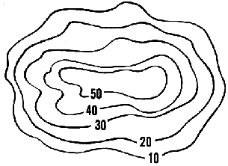
Contour Maps-Lines showing constant elevation

Slide 28
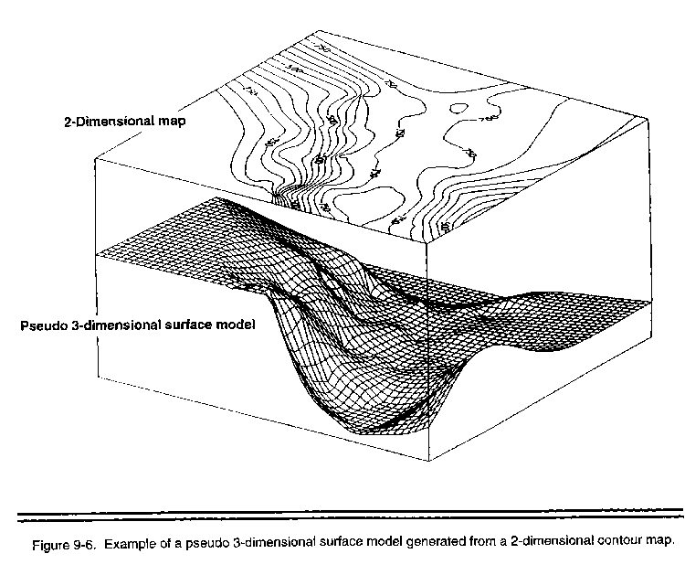

Slide 29
Hints-Delineating Drainage Areas
Flow paths are perpendicular to contour lines
Streams---Contour lines are concave (think V’s)
Ridges----Contour lines are convex (think noses)
Peaks of mountains and depressions (swamps, ponds) usually show as small circular areas
Contour lines close together indicate steep slopes
Contour lines which are far apart indicate flat slopes

Slide 30
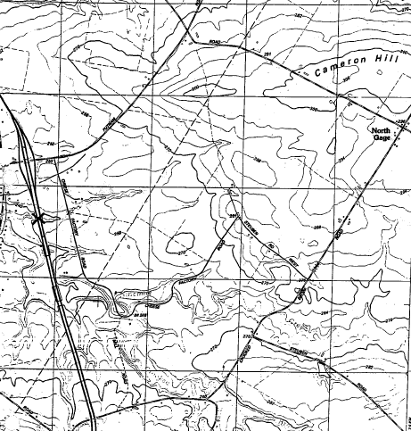

Slide 32
USGS Maps
English: Typically 1”=2000 ft (24,000 inches)
Another way to represent that same scale is:
1:24,000 (could be any units)
Also
1 acre=43,506 ft²
1 hectare=10,000 m²

Slide 33
Measuring Drainage Areas
Stripping Method
Grid Method
Planimeter
Software Programs (GIS)

Slide 34
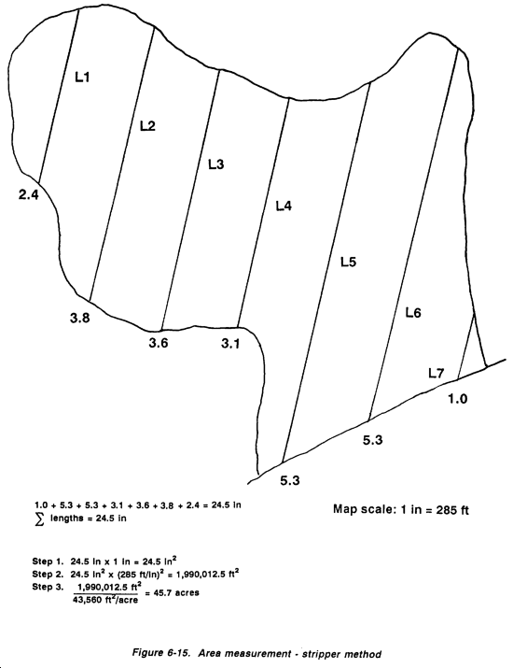
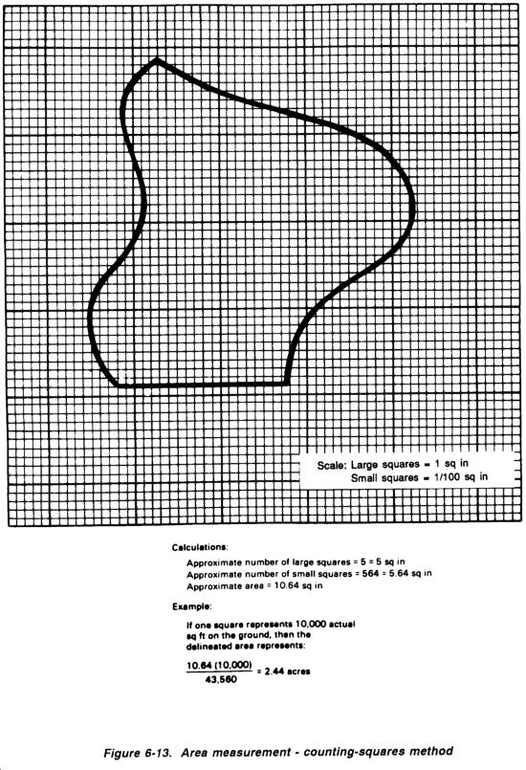
Stripping/Grid Methods
http://www.globalsecurity.org/military/library/policy/army/fm/5-430-00-1/fig6-13.gif

Slide 35
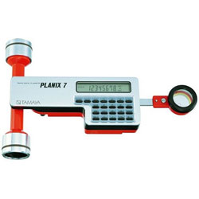
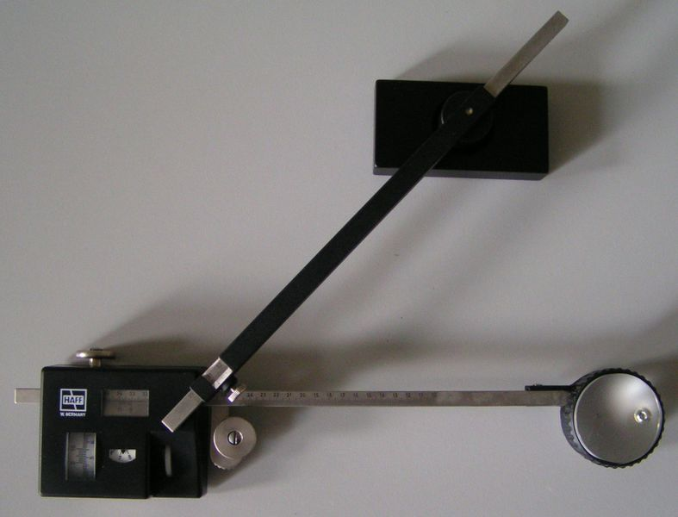

Planimeter

Slide 36
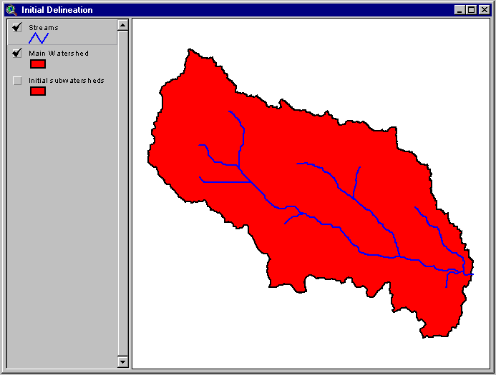
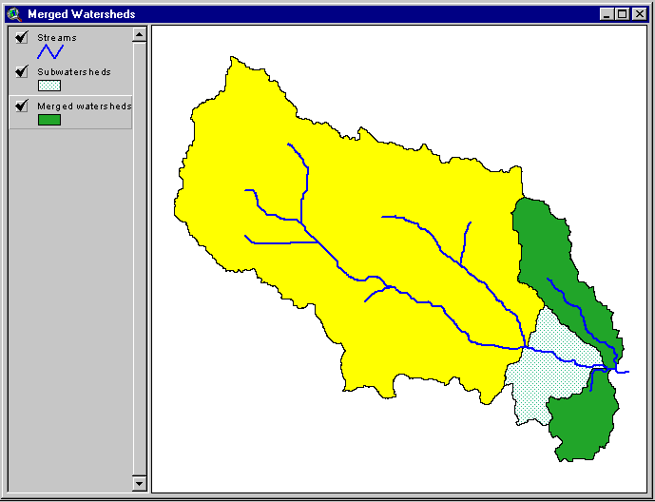
Software
http://gis.esri.com/library/userconf/proc99/proceed/papers/pap676/p6764.gif

Slide 37
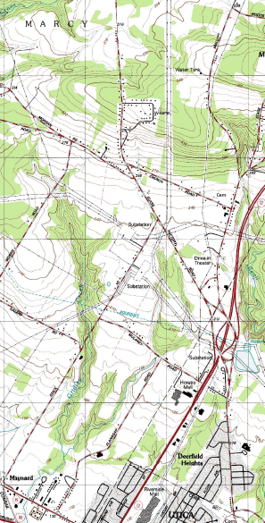
Dowloading USGS Maps *.pdf
http://store.usgs.gov/b2c_usgs/b2c/start.do

Slide 38
Other Sources
http://www.nh.nrcs.usda.gov/technical/WS_delineation.html
http://www.epa.gov/owow/watershed/
http://www.dec.ny.gov/lands/25563.html

