Slide 1
Highway Drainage: Determining Flow Rates
HDM Ch. 8

Slide 2
Objectives
Ability to determine the peak flow using the rational method

Slide 3
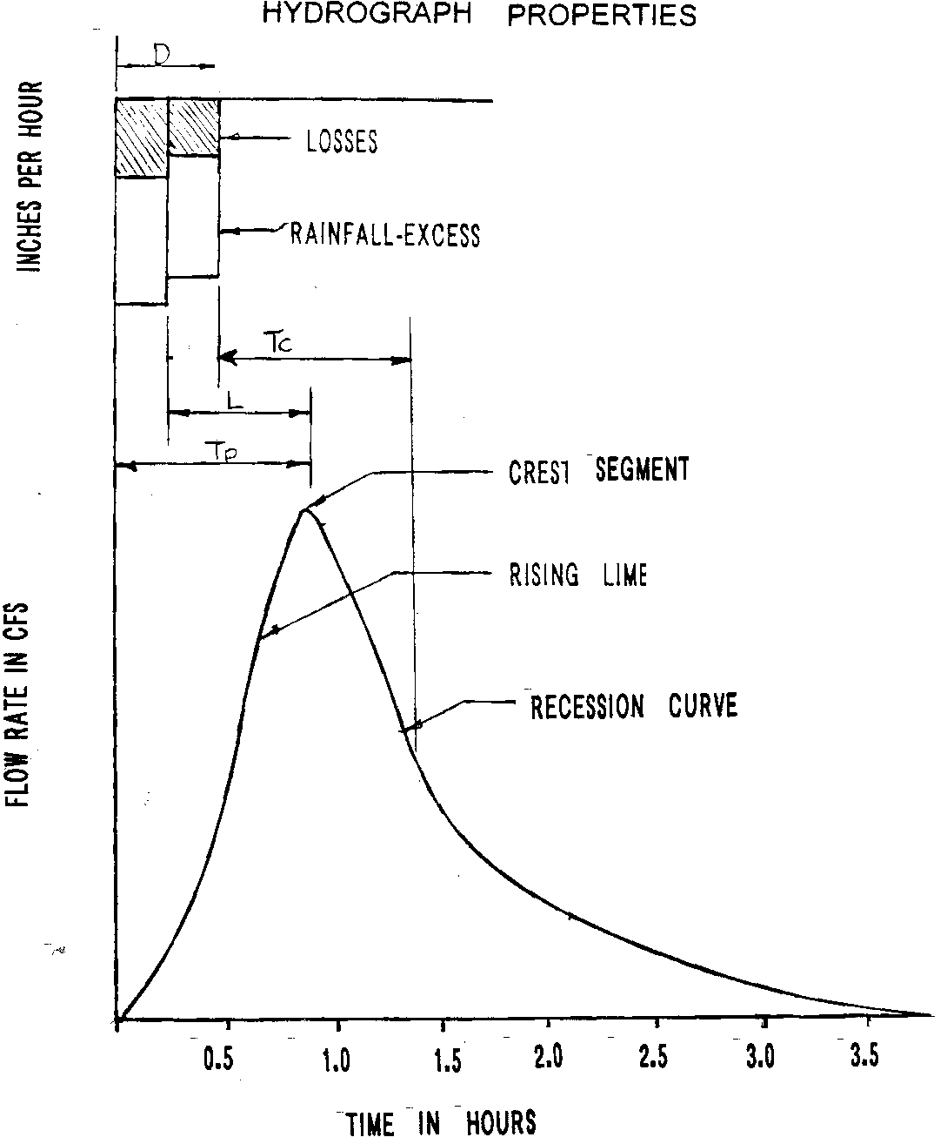

Slide 4
Design Flow Methods
Rational method
TR-55
Regression Equations
Historical Data
TR-20
HEC-RAS

Slide 5
Methods-Smaller drainage areas
Rational Method
  Drainage areas<200 acres
TR-55 (Technical Release-55)
  Drainage areas < 2,000 acres

Slide 6
Methods-Larger drainage areas
TR-20
  Large drainage areas broken into subareas
HEC-RAS (Hydraulic Engineering Circular-River Analysis System)

Slide 7
Rational Method (metric)
Q=kCIA
Q – peak discharge (m³/sec)
K- conversion factor= .00278 (cms-hr/ha-mm)
C-runoff coefficient (unitless)
I-rainfall intensity (mm/hr)
A-drainage area (hectares--100 square meters)

Slide 8
Rational Method (english)
Q=kCIA
Q – peak discharge (cfs)
K (conversion factor)=1 (cfs-hr / in-acre)
C-runoff coefficient (unitless)
I-rainfall intensity (in/hr)
A-drainage area (acres)

Slide 9
Rational Method
Rational Coefficient-C (Tables)
Rainfall intensity-I
  Time of concentration (need for I)
Drainage area-A (previous lecture)

Slide 10
Basic Steps to Estimate Peak Flow Rational Method
Determine Drainage Area (previous lecture)
Choose a value of C
Estimate time of concentration
  Overland (sheet) flow
  Shallow concentrated flow
  Open channel flow
Select a frequency (return period)
Determine the average storm intensity from IDF Curve
Use rational method equation to estimate peak flow

Slide 11
Rational Coefficient C

Slide 12
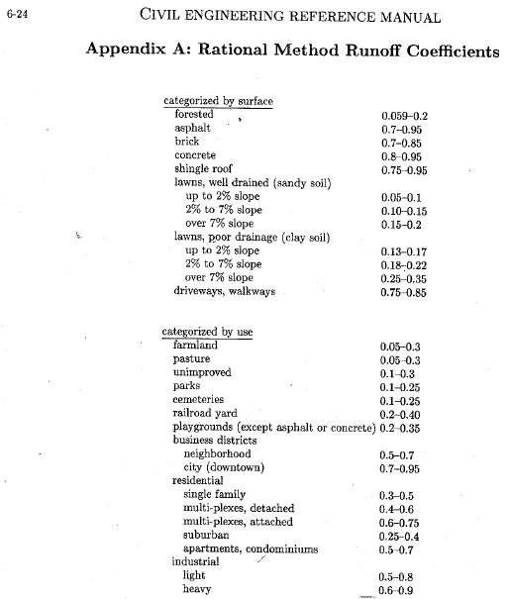
Example of Runoff Coefficient Table

Slide 13
Weighted Rational Coefficient
Must be weighted if you have different area types within the drainage area
Drainage area = 8 acres:
2 acres; C=0.35 (residential suburban)
6 acres; C=0.2 (undeveloped-unimproved)
Weighted C=[(2)(.35)+(6)(.2)]/8 = 0.24

Slide 14
Intensity I (“/hr)

Slide 15
To determine intensity:
Find the time of concentration
Set the storm duration equal to the time of concentration
Determine frequency
Use an IDF curve to determine the intensity

Slide 16
Time of Concentration
Time required for water to flow from the most distant part of a drainage area to the drainage structure

Slide 17
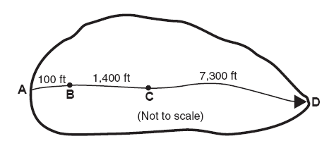
Water can move through a watershed as:
Sheet flow (max of 300’; usually 100’)
Shallow concentrated flow
Open channel flow
  Gutter
  Ditch
  Swale
  Creek
Some combination of above

Slide 19
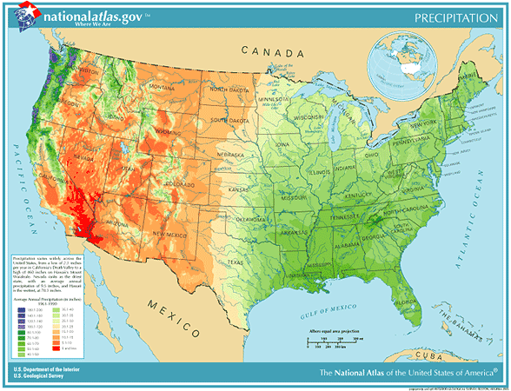

Slide 20
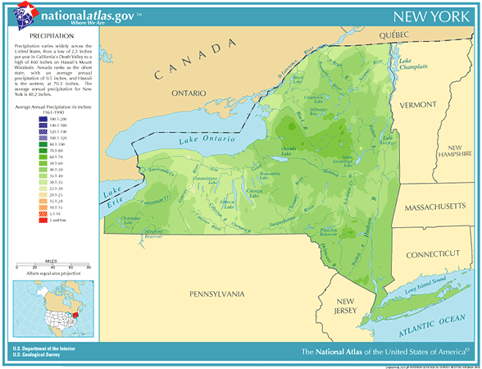

Slide 21
Design Frequencies
Not economically feasible to design for all floods for every structure for any type of road

Slide 22
Design Storm Frequencies
Highway class | Culverts | Storm Drainage | Ditches
Interstates | 50 (check 100) | 10 (check 50 if sag) | 25
Princ. Arterials | 50 (Check 100) | 10 (check 50 if sag) | 25
Minor arterials & other | 50 (Check 100) | 5 (check 25 if sag) | 10

Slide 23
IDF Curve
Rainfall Intensity
Storm Duration,
Rainfall Frequency

Slide 24
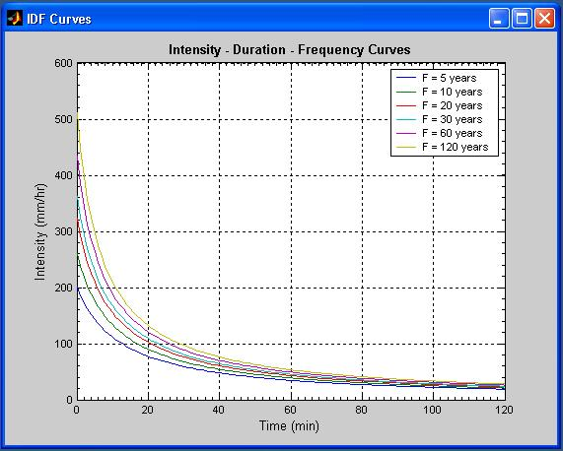
http://www.mathworks.com/matlabcentral/fileexchange/9740-intensity-duration-frequency-curves

Slide 25
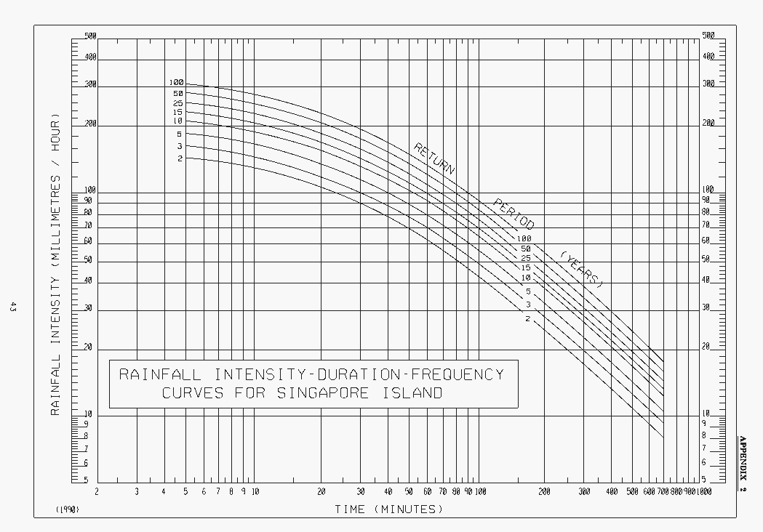
http://www.pub.gov.sg/general/code/Pages/SurfaceDrainagePart2-7.aspx

Slide 26
IDF Curve: Oneida County, NY

Slide 27
Example:
Determine the peak flow for a 100-acre watershed in central NY (mostly forested). Assume the intensity is 3” per hour.
What is the peak flow if the watershed is developed into light industrial usage? Assume the intensity is 3” per hour.

Slide 28
Example-undeveloped:
C=0.13 (reference table)
I=3” per hour (given)
A=100 acres
Q=CIA = 39 cfs

Slide 29
Example-developed:
C=0.65 (0.5+0.8)/2
I=3” per hour (given)
A=100 acres
Q=CIA = 195 cfs
In reality, the peak could be higher, since the time of concentration would likely decrease (which would increase the intensity)

Slide 30
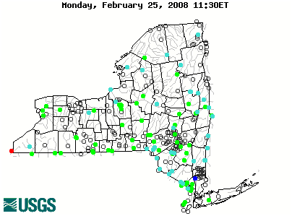
Gaged Stations – New York
http://waterdata.usgs.gov/ny/nwis/rt

Slide 31
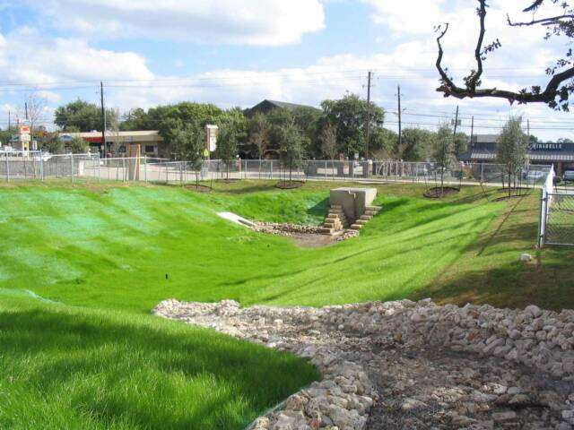
Detention Structures
Stores runoff temporarily and then releases it in a controlled manner to limit the peak flow leaving a site
  Mitigates destructive effects of increased runoff
  May improve water quality
  May increase recharge
http://www.tleng.net/Dentention_Pond.html#anchor_70

Slide 32
Detention Structures
Basically a tank or pond
Complex because water coming in (inflow hydrograph) is not constant
Water going out is not constant (single or multistaged outlet structure where Qout varies based on water elevation in the structure)
Water elevation in the structure is not constant

Slide 33
Quiz
What is the difference between a hydrograph and a peak flow?
What is the Rational Method equation? Q=?
What are the units of the rational coefficient?
What are the units of intensity?
What are the units of area?
What words to the letters IDF stand for?
What is the “time of concentration”?
What does frequency refer to?
How do you determine the storm duration?
What is the function of a detention structure?

