Slide 1
Horizontal Alignment Spiral Curves
CTC 440

Slide 2
From “20 Things you Didn’t know about Cars”, Discover Magazine, October 2012
In 1760 King George III housed around 30 horses in the Royal Mews stables in London. Today a typical compact car packs a 150-horsepower engine. So a suburban commuter has instant access to five times as much sheer muscle as the king who nearly crushed the American Revolution.
By the formal definition of horsepower (the power required to lift 33,000 pounds by one foot in one minute), a real horse musters only 0.7 horsepower.
Not only has the horse been outgunned by the car, it faces the further indignity of not being able to keep up with itself.
…The contact patches-the area of the tires that actually touch the road at any given moment-cover an area of just over 100 square inches for an average family sedan.
In other words, all of the accelerating, cornering, braking, and everything else that your four wheels do, happens on a piece of ground scarcely bigger than your own two feet.

Slide 3
Objectives
Know the nomenclature of a spiral curve
Know how to solve spiral curve problems

Slide 4
Spiral Curves
When driving over simple horizontal curves, there is an abrupt change from a tangent to a circular arc at the PC
Spirals are inserted between the arc and tangents to provide a gradual transition

Slide 5
Spiral Curves
One end of the spiral has an infinite radius. At the other end, the spiral radius equals that of the connecting arc
Typically the length of spirals on each size of the arc are the same

Slide 6
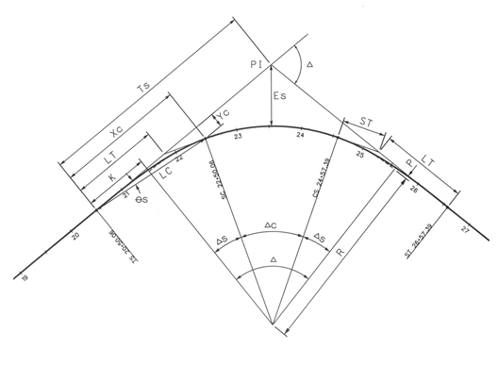
http://www.nh.gov/dot/cadd/msv8/spiral.htm

Slide 7
Spiral Curves
TS-tangent to spiral
SC-spiral to curve
CS-curve to spiral
ST-spiral to tangent

Slide 8
Spiral Curves
L_{s}-Length of spiral; also the distance from TS-SC and CS-ST (same as runoff length)
Obtain from Tables 3-2 & 3-2A
(tables are rescinded---- use only for class!!)
Note: 3-2 & 3-2A are a shortcut since Exhibit 5-15 is not available in english (use Tables 2-11 thru 2-14 (English) for super rates)

Slide 9
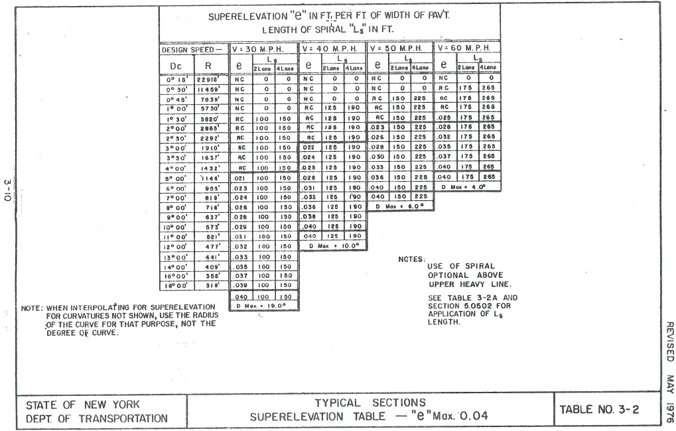
Rescinded—use only for this class!!

Slide 10
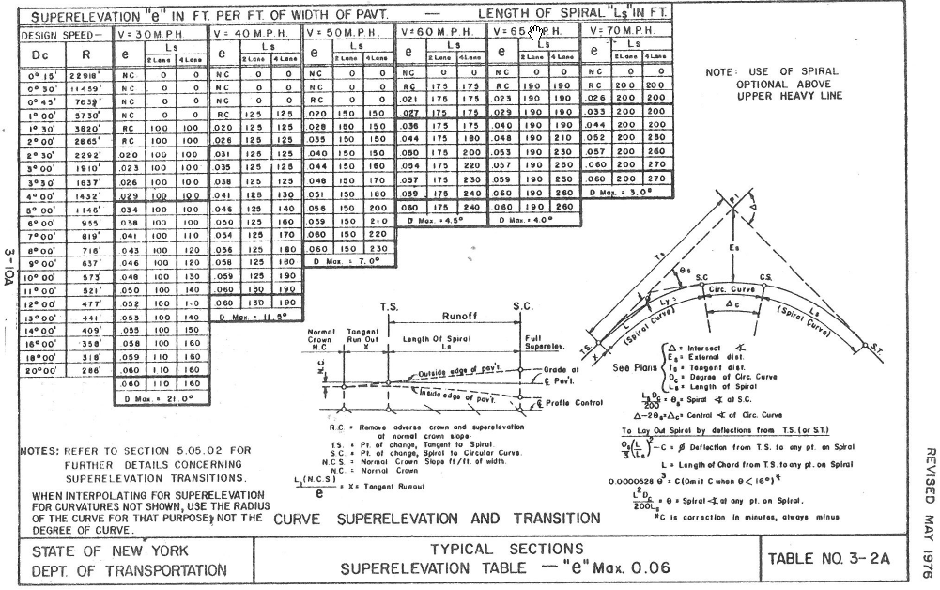
Rescinded—use only for this class!!

Slide 11
Spiral Curves
T_{s}-distance between the TS or ST and the PI
E_{s}-external distance between the PI and midpoint of the circular arc
Δ-Deflection angle between tangents
D_{c} -Degree of curvature of the circular arc
R_{c}-radius of the circular arc

Slide 12
Spiral Curves
Θ_{s}-central angle of spiral
Δ_{c}-central angle of the circular arc
L_{c} -length of the circular arc

Slide 13
Spiral Curves
P-offset, throw or shift-distance in which the circular curve must be moved inward in order to provide clearance for inserting the spiral
K-distance between TS & throw
K,P can also be thought of as the coordinates of the (tangent to curve) where a tangent to the circular curve becomes parallel to the entering/existing tangent

Slide 14
Spiral Curves
X_{c}-distance between TS & SC measured along the forward tangent
Y_{c}-distance between TS & SC measured perpendicular to the forward tangent
X_{c,}Y_{c} can also be thought of as the coordinates of the SC from the TS

Slide 15
Spiral Curves
LT-Long Tangent
ST-Short Tangent

Slide 16
Basic Equations
T_{s}=(R_{c}+P)*tan(1/2*Δ)+K
E_{s}=[(R_{c}+P)/cos(Δ/2)]-R_{c}
Θ_{s}=(Ls*Dc)/200
Δ_{c}= Δ-2* Θ_{s}
Lc=(100*Δ_{c})/D_{c}

Slide 17
Example Problem
Given:
Design speed=60 mph
e_{max} =0.06
Δ=20 deg
Dc=4 deg
TS STA 121+00
2-lane

Slide 18
Use worksheet: Found as .pdf in homework 4

Slide 21
Next lecture
Vertical Alignment

Slide 22
Review Questions
What do TS, SC, CS and ST stand for?
If you know the station of the TS what do you add to get the station of SC?
If you know the station of the SC what do you add to get the station of the CS?
If you know the station of CS what do you add to get the station of the ST?
K,P can be thought of the coordinates from what to what?
Xc, Yc can be thought of the coordinates from what to what?
What is the advantage of using spiral curves?
Does a spiral curve have a constant radius?
How do we define the spiral curve when setting a horizontal alignment?

