Slide 1
Aeration Tank Project
Speculator WWTP
Stephen Miller General Contractors 2021
By: Tyler Almy

Slide 2
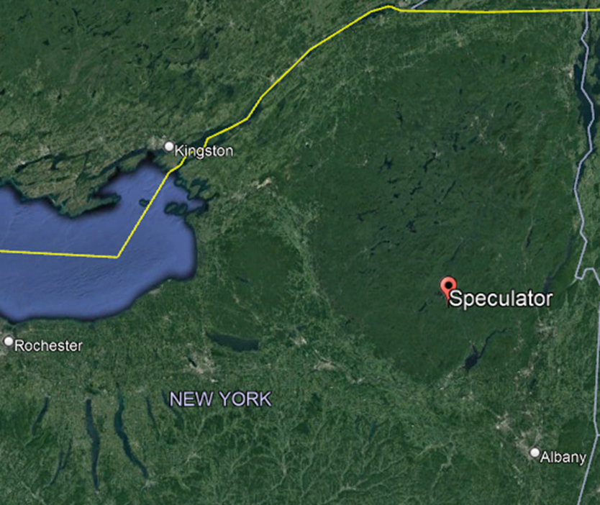
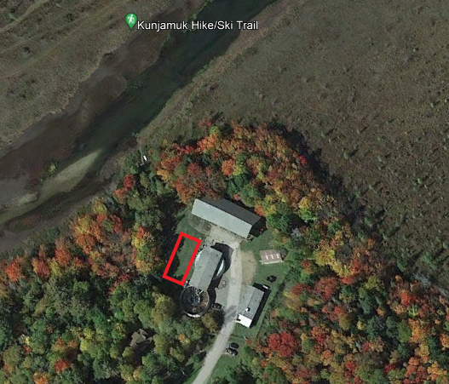
Speculator NY, Background
Speculator is a small town in the southern Adirondacks population of ~400 people, The town experiences population doubling from summer tourism and a Christian Retreat “Camp of The Woods”.
Speculator WWTP is a small facility that empties into the Kunjamuk, The red area is proposed location of new aeration tank. Tank will be 25’x50’x10’

Slide 3
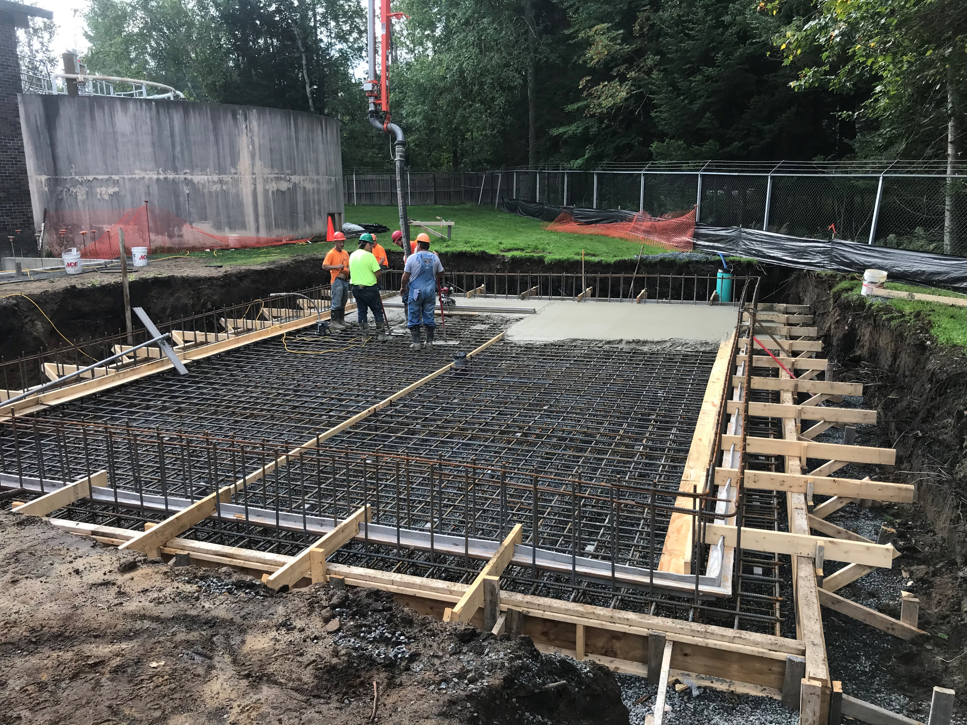
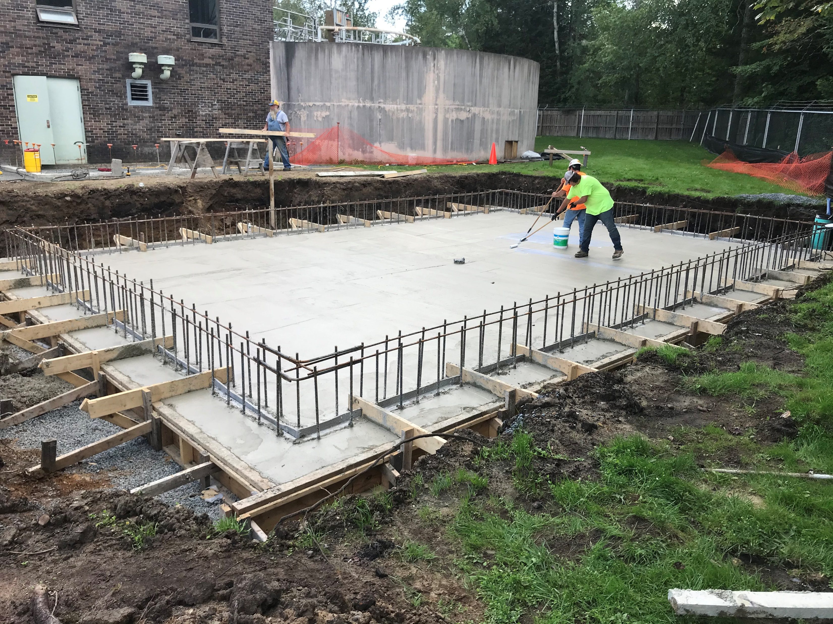
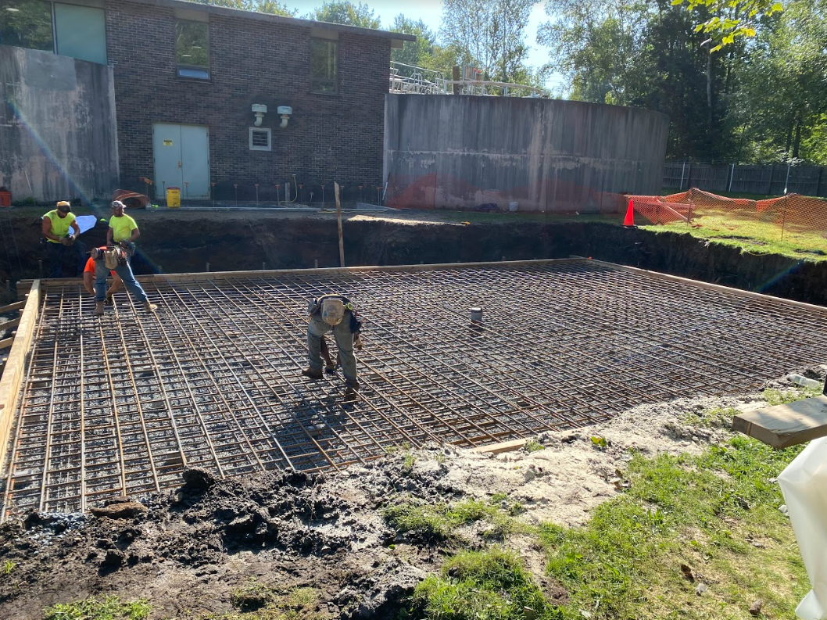
Tank Construction
Rebar for Floor of tank double grid of #6 (3/4”) and #8 (1”) in a 1’x1’ pattern at least 2” of coverage. Drain in center of tank draining toward building. Floor also acts as footing for structure. ~16” thick.
Pouring the floor with a pump truck slump max 4”. Upright rebar for walls 2x6s used to hold rubber water stop around the perimeter stopping passage of water through cold joint formed between floor and walls. Boards in the pour are used to help achieve final finish.
Finished floor getting cure-sealed to hold in moisture allowing for a controlled cure of floor. Finished floor has a bowl like structure directing water toward the drain in the center. The blue-green pipe of the right side of the picture is for a sump pump in dewatering of the hole.

Slide 4
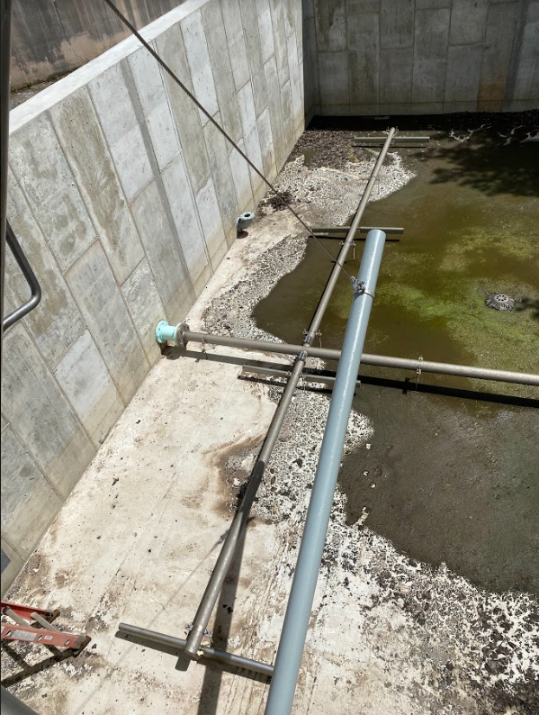
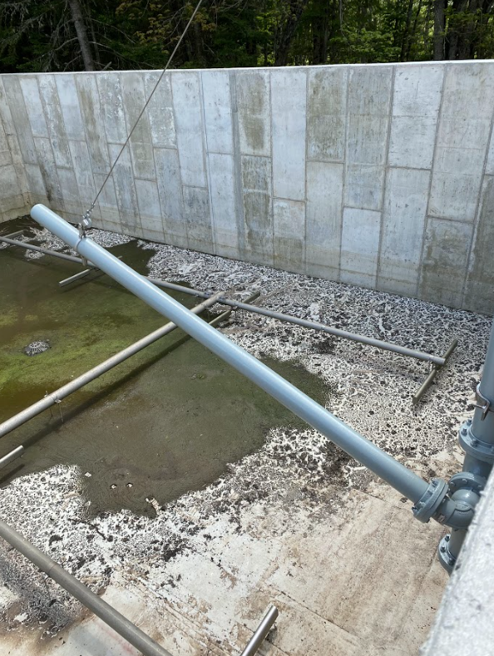
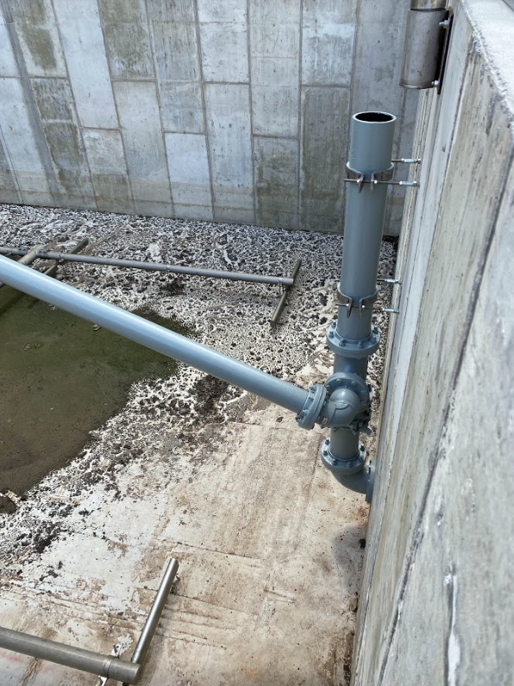
Finished Aeration Tank

Slide 5
Finished Aeration Tank
Water Outflow
Water Inflow
Decanter
Air Inlet
Bubbler System
Drain

Slide 6
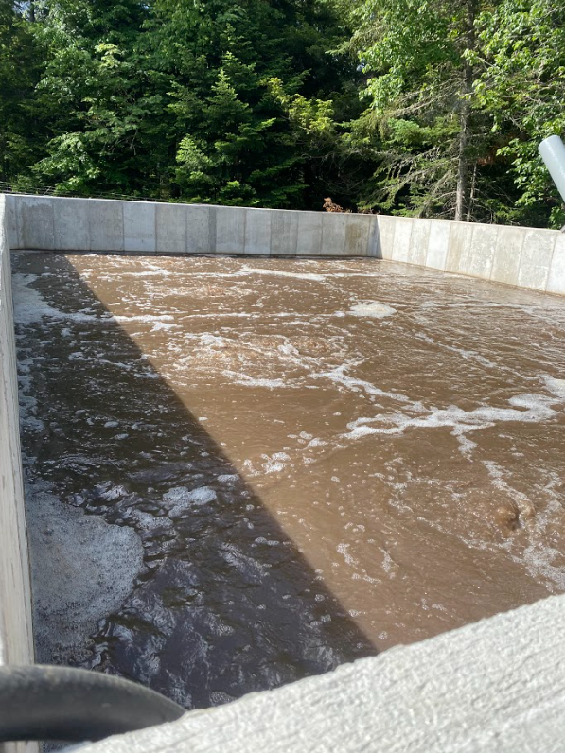
Aeration Tank in Use
First use of the completed tank.
The project was a bid job won for a price of ~$500,000 paid by a federal grant to the village of speculator.

