Slide 1
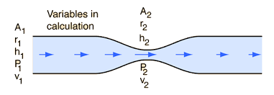
CTC 450
Bernoulli’s Equation
EGL/HGL

Slide 2
Preview
Bernoulli’s Equation
  Kinetic Energy-velocity head
  Pressure energy-pressure head
  Potential Energy
EGL/HGL graphs
  Energy grade line
  Hydraulic grade line

Slide 3
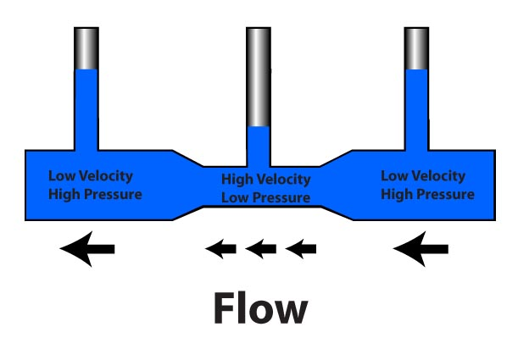
Bernoulli’s Equation
http://www.rcuniverse.com/magazine/article_display.cfm?article_id=455

Slide 4
Objectives
Apply Bernoulli’s equation
Creat EGL/HGL graphs

Slide 5
Assumptions
Steady flow (no change w/ respect to time)
Incompressible flow
Constant density
Frictionless flow
Irrotational flow

Slide 6
3 Forms of Energy
Kinetic energy (velocity)
Pressure Energy (pump/tank)
Potential energy (gravity)

Slide 7
Units
Energy (ft or meters)

Slide 8
Kinetic Energy (velocity head)
V²/2g

Slide 9
Pressure Energy (pressure head)
Pressure / Specific weight

Slide 10
Potential Energy
Height above some datum
Hint: It is best to set the datum=0 at the centerline of the lowest pipe

Slide 11
Bernoulli’s equation in words
Conservation of Energy
Energy @ point 1 = Energy @ point 2

Slide 12
Hints:
If there is a reservoir (or large tank) pick a point at the surface of the water. The kinetic energy and pressure energy are zero, leaving only the potential energy.
If water is discharging to the atmosphere pick a point just outside the pipe. The pressure energy=0.

Slide 13
Energy Grade Line
Graphical representation of the total energy of flow of a mass of fluid at each point along a pipe.
For Bernoulli’s equation the slope is zero (flat) because no friction loss is assumed

Slide 14
Hydraulic Grade Line
Graphical representation of the elevation to which water will rise in a manometer attached to a pipe. It lies below the EGL by a distance equal to the velocity head.
EGL/HGL are parallel if the pipe has a uniform cross-section (velocity stays the same if Q & A stay the same).

Slide 15
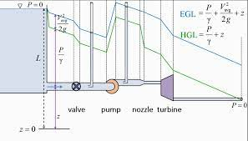
EGL/HGL Graphs
(complicated)

Slide 16
Hints for drawing EGL/HGL graphs
EGL=HGL+Velocity Head
EGL=Potential+Pressure+Kinetic Energies
HGL=Potential+Pressure Energies
Bernoulli’s equation assumes no friction loss; therefore the lines should not be sloped (Note: picture in last slide did account for friction—and was sloped)

Slide 17
Reservoir Example-Using Bernoulli’s Equation
Water exits a reservoir through a pipe. The WSE (water surface elevation) is 125’ above the datum (pt A) The water exits the pipe at 25’ above the datum (pt B).
What is the velocity at the pipe outlet?

Slide 18
Reservoir Example-2/3
Point A:
  KE=0
  Pressure Energy=0
  Potential Energy=125’
Point B:
  KE=v²/2g
  Pressure Energy=0
  Potential Energy=25’ (note: h=100’)

Slide 19
Reservoir Example (3/3)
Bernoulli’s: Set Pt A energy=Pt B energy
  v²/2g=h
  v=(2gh)^{.5} Have you seen this equation before?
  Velocity=80.2 ft/sec

Slide 20
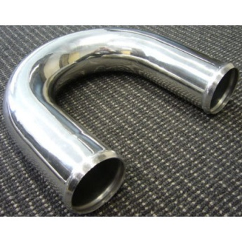
Reducing Bend Example (1/5)
(Bernoulli’s and EGL/HGL graph)
Water flows through a 180-degree vertical reducing bend. The diameter of the top pipe is 30-cm and reduces to 15-cm. There is 10-cm between the pipes (outside to outside). The flow is 0.25 cms. The pressure at the center of the inlet before the bend is 150 kPa. What is the pressure after the bend?

Slide 21
Reducing Bend Example (2/5)
Find the velocities using the continuity equation (V=Q/A):
Velocity before bend is 3.54 m/sec
Velocity after bend is 14.15 m/sec

Slide 22
Reducing Bend Example (3/5)
Use Bernoulli’s to solve for the pressure after the bend
Kinetic+Pressure+Potential Energies before the bend = the sum of the energies after the bend
Potential energy before bend = 0.325m
Potential energy after bend=0m (datum)
The only unknown is the pressure energy after the bend.

Slide 23
Reducing Bend Example (4/5)
The pressure energy after the bend=60 kPA
Lastly, draw the EGL/HGL graphs depicting the reducing bend

Slide 24
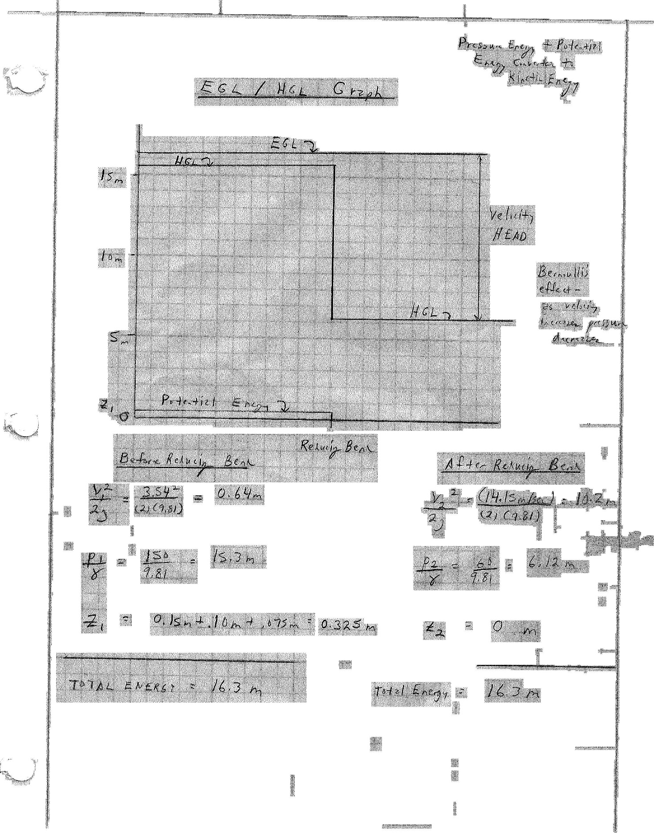
Reducing Bend Example (5/5)

Slide 25
EGL/HGL (on board)
Sketch assuming pipe diameter reduction
(velocity head increases; pressure decreases)
Sketch assuming pipe diameter increases
(velocity head decreases; pressure increases)
Sketch assuming a nozzle
(all pressure converted to velocity head)

Slide 26
Next Lecture
Energy equation (expanded Bernoulli’s equation)
Accounts for friction loss, pumps and turbines

