Slide 1
Review of Last Lecture
Chemistry Review
Concentrations
Equivalence (expressed as N or P)
Stoichiometry
Gas Solubility
Organic Compounds
Water quality tests

Slide 2
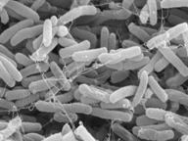
CTC 450 – Biology Concepts for Water and Wastewater Systems
Kingdom: Eubacterium Scientific Name: Escherichia coli Image Courtesy of: Shirley Owens, Center for Electron Optics, MSU Image Width: 9.5 microns Image Technology: SEM (Scanning Electron Microscope)
http://commtechlab.msu.edu/sites/dlc-me/zoo/zah0700.html

Slide 3
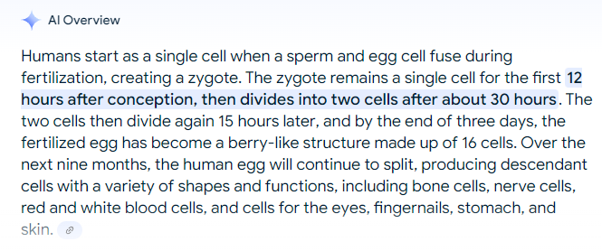

Slide 4
Objectives
Understand key biological organisms important to water/ww treament
Understand commonly used testing techniques
Know what BOD stands for, how it’s measured and why it’s important

Slide 5
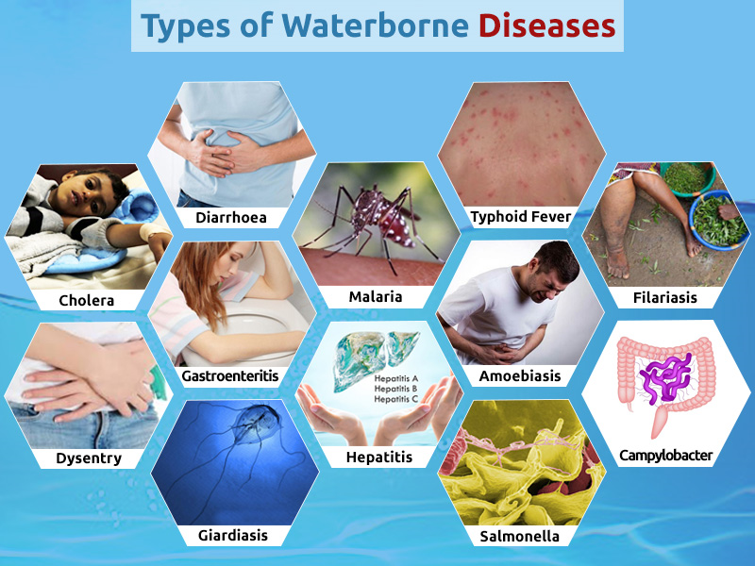
Waterborne Diseases

Slide 6
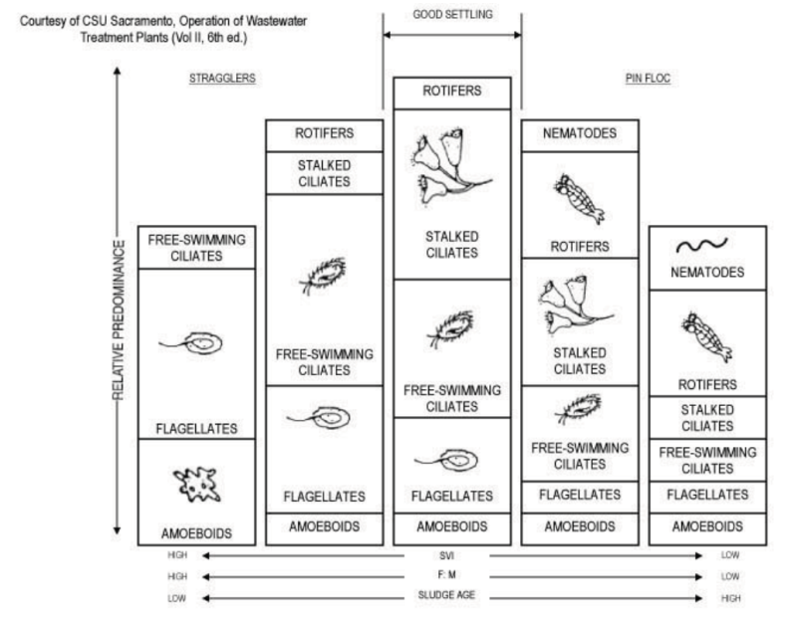
Microorganisms (Biological Treatment

Slide 7
Organisms
Bacteria
Fungi
Protozoa
Viruses
Algae
Helminths (parasitic worms)

Slide 8
Microbe Facts (-viruses) Ref: The Invisible Kingdom, Idan Ben-Barak, 2009, ISBN-13: 978-0-465-01887-1
One trillion microbes in a teaspoon of garden soil (10,000 species)
100,000 microbes on a sq cm of human skin
2-4 pounds of microbes on a healthy human body
E.Coli can reproduce 72x per day

Slide 9
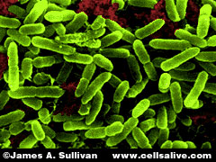
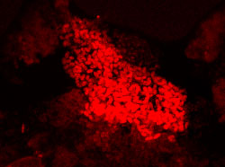
Bacteria
One-celled organisms that reproduce by binary fission
Two major groups:
Heterotrophs (Pseudomonas sp. shown)
Autotrophs
(Nitrobacter sp. shown)

Slide 10
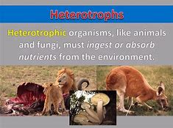
Heterotrophs
Use organic matter for energy and carbon
Aerobic
Facultative
Anaerobic

Slide 11
Aerobic
Input: Organics and Oxygen
Output: Carbon dioxide, water and energy

Slide 12
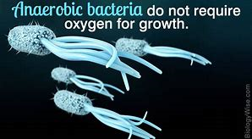
Anaerobic
Reduce nitrates, sulfates, or organics to obtain energy
Input: Organics, nitrates, sulfates
Outputs: Carbon dioxide, nitrogen, hydrogen sulfide, methane

Slide 13
Facultative
Can use oxygen (preferred since more energy is obtained) or can use anaerobic pathways
Active in both aerobic and anaerobic treatment processes
Yeast and many bacteria

Slide 14
Autotrophs
Use inorganic compounds for energy and carbon dioxide as a carbon source
Energy is used to break up carbon dioxide into carbon (used for building cells) and oxygen (byproduct)

Slide 15
Autotrophs
Earth 4.6 billion years
Radiometric 3.8/3.9 billion & some of those rocks are sedimentary rocks from erosion of even older rocks
3.5 billion--fossil evidence—autotrophs
Created mats called stromatolites
Photosynthesis – released oxygen (which eventually lead to our current atmosphere)

Slide 16
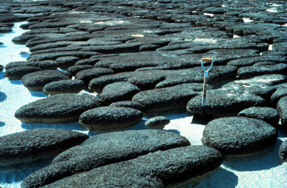
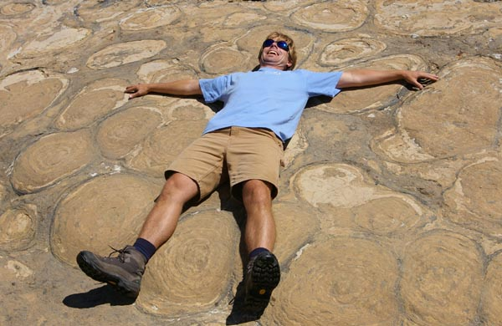
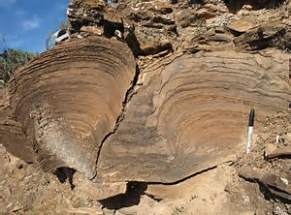
Autotrophs
http://gsc.nrcan.gc.ca/paleochron/03_e.php
An extremely important group
Stromatolites
http://www.nvcc.edu/home/cbentley/world_photos.htm
A geologist reacts enthusiastically to a world-class exposure of stromatolites. I'm imagining doing the backstroke in the Mesoproterozoic Belt Sea where these stromatolites grew. This is in Grinnell Glacier cirque, Glacier National Park, Montana. Up until about ten years ago, this outcrop was mantled by glacial ice, but now Grinnell Glacier has receded almost completely. While I feel sad that the glacier has died, I'm delighted at this view into the Precambrian world. Summer 2007.

Slide 17
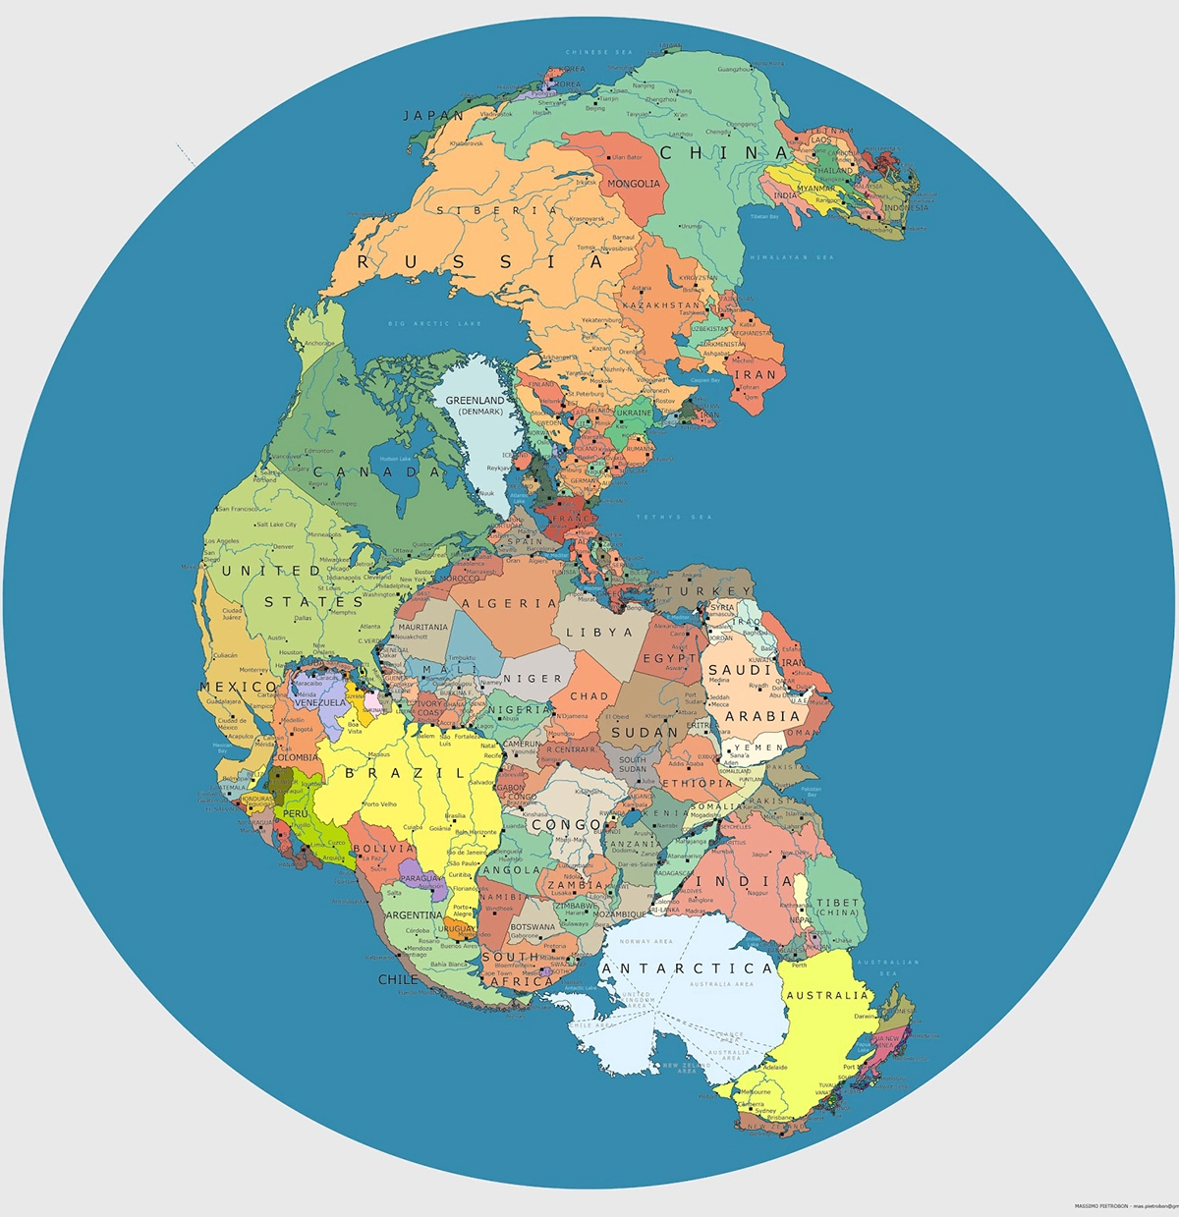
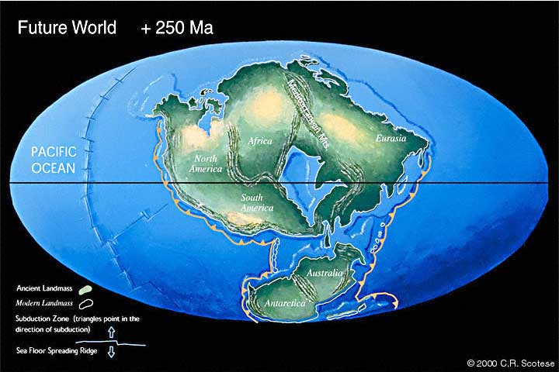
Pangea (300mya); Pangea Ultima

Slide 18
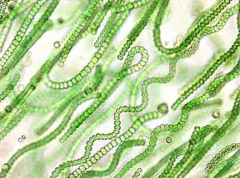
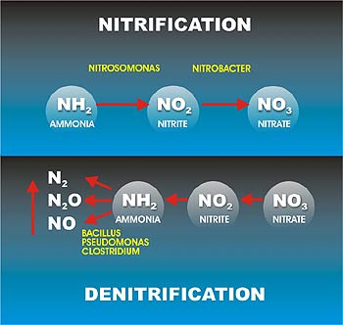
Autotrophs
Cyanobacteria
Plug water filters
Cyanotoxins (potential toxins in drinking water)
Nitrifying bacteria
Nitrosomonas: Ammonia to Nitrites
Nitrobacter: Nitrites to nitrates
Sulfur bacteria
Hydrogen sulfide to sulfuric acid
Can cause corrosion in pipes
Iron bacteria
Ferrous iron (2+) to Ferric (3+)
Causes taste and odor problems

Slide 19


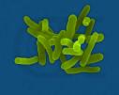
Waterborne Pathogenic Bacteria
Salmonella sp.
Vibrio Cholerae
Shigella sp.

Slide 20
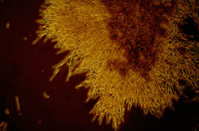
Fungi
Microscopic nonphotosynthetic plants including yeasts and molds
Molds are filamentous; in activated sludge systems they can lead to a poor settling floc

Slide 21
Protozoa/Simple Multi-Celled
Protozoa and other simple multi-celled organisms digest bacteria/algae
Important in secondary treatment of wastewater

Slide 22


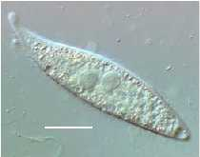
Protozoa
Protozoa Euplotes
rotifer
Amphileptus pleurosigma

Slide 23
Protozoa/Simple Multi-Celled
Giardia and Cryptosporidium are parasitic protozoa that can cause illness

Slide 24
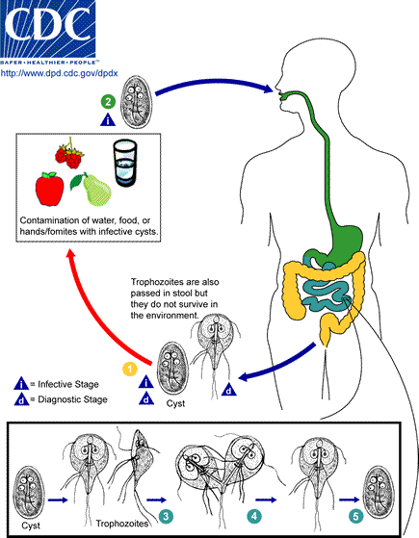
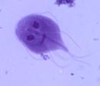
Giardia
giardia

Slide 25
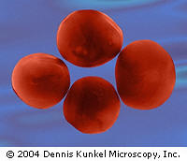
Cryptosporidium

Slide 26
Viruses
Parasites that replicate only in the cells of living hosts.
Several viruses cause illness and can be waterborne.

Slide 27
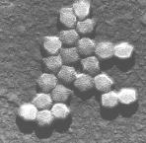
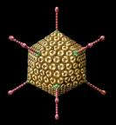
Adenoviruses

Slide 28

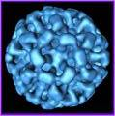
Caliciviruses

Slide 29

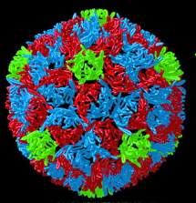
Poliovirus

Slide 30
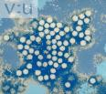
Hepatitis A virus

Slide 31
Algae
Simple photosynthetic plants
Algae are autotrophic, using carbon dioxide or bicarbonates as their carbon source

Slide 32
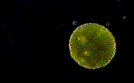
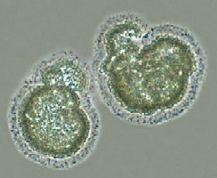
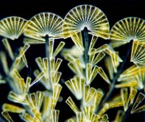
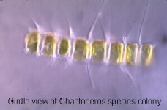
Algae Images
http://www.jochemnet.de/fiu/bot4404/BOT4404_5.html

Slide 33
Lakes/Algae
Oligotrophic-nutrient poor and biologically unproductive
Mesotrophic-Some aquatic plant growth; moderate populations of sport fish
Eutrophic-nutrient rich, tolerant fish that are less desirable

Slide 34
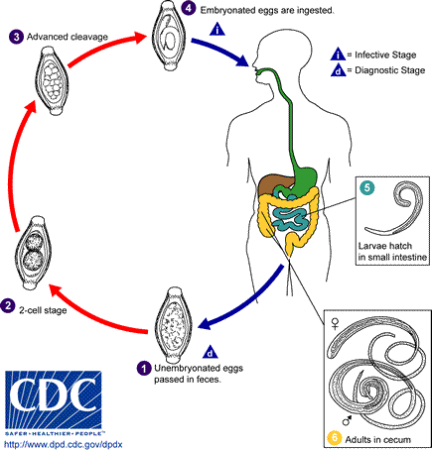
Whipworm

Slide 35


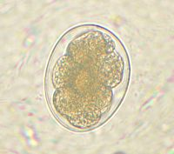
Hookworm

Slide 36
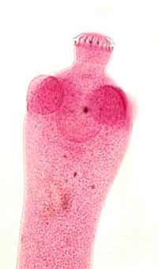
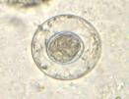
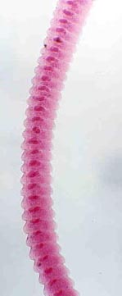
Dwarf Tapeworm

Slide 37
Factors Affecting Disease Transmission
Latency
Persistence
Infective Dose

Slide 38
Latency
Period of time between excretion of a pathogen and its becoming infective to a new host
No latency-viruses, bacteria, protozoa, a few helminths
Distinct latency-most helminths (Ascaris lumbricoides-10 days)

Slide 39
Persistence
Length of time that pathogen remains viable
Least to most: bacteria, viruses, protozoal cysts, helminth eggs (months)

Slide 40
Infective Dose
Number of organisms that must be ingested to result in disease
Viruses and protozans-low
Bacteria-medium
Helminth-single egg or larva
Definition: Median infective dose is dose required to infect half of those exposed

Slide 41
Pathogen Categories
I-nonlatent, low infective dose
viruses, protozoans, dwarf tapeworms
II-nonlatent, medium to high infective dose, moderately persistent
bacteria
III, Latent, persistent
Most helminths

Slide 42
Control by Pathogen Categories
Type I-infections transmitted where personal cleanliness and domestic hygiene are poor. Control: Improve cleanliness and environmental sanitation, including food prep, water supply and wastewater disposal.
Type II-Less likely to be transmitted by person-to-person. Wastewater collection, treatment and reuse are of greater importance, particularly if living standards are high enough to reduce person-to-person transmission
Type III-Less related to personal cleanliness. Important are cleanliness of vegetables grown in fields where reuse of wastewater is used.

Slide 43
Human Carriers
Proportion of healthy persons excrete pathogens
Minor or no remaining symptoms but pathogens excreted for months, years or a lifetime

Slide 44
Sanitation Workers
Wastewater should be considered potentially pathogenic; however…….
Studies show that waterborne diseases are no greater for sanitation workers than population as a whole
Safety precautions include:
Good personal hygiene
Prompt medical care if skin is broken
Precautionary tetanus shots

Slide 45
Testing for Pathogens
Viruses-special circumstances
Giardia/Cryptosporidium-filter
Coliform-multiple tube fermentation to get MPN (most probable number) or presence-absence

Slide 46
BOD-Biochemical Oxygen Demand
Commonly used test to define the strength of a wastewater
Quantity of oxygen utilized by microorganisms (mg/l)
Equations are based on initial and final DO measurements (5 days is std.)

Slide 47
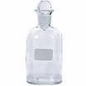
BOD Test
300-ml bottle
20C +/- 1C in air incubator or water bath
Dilution water is saturated w/ DO and contains phosphate buffer, magnesium sulfate, calcium chloride and ferric chloride
Test includes several dilutions as well as blanks

Slide 48
BOD equation (non-seeded)
BOD₅=(D₁-D₂)/P
BOD₅=BOD in mg/l
D₁=initial DO of the diluted wastewater sample approx. 15 minutes after preparation, mg/l
D₂=final DO of the diluted wastewater sample after a 5-day incubation, mg/l
P=decimal fraction of the wastewater sample used (ml of ww sample/ml volume of the BOD bottle)

Slide 49
BOD Rate constant
Important in designing secondary WW systems
Can be estimated graphically from BOD data
Typical value is 0.1-0.2 per day
Can calculate theoretical BOD at other time values from equation if constant is known or estimated

Slide 50
Unseeded BOD example
Data from unseeded domestic wastewater BOD test:
5 ml of WW in a 300-ml bottle
Initial DO of 7.8 mg/l
5-day DO of 4.3 mg/l
Compute BOD₅ and calculate BOD_{ult} assuming a k rate of 0.1 per day

Slide 51
Unseeded BOD Example
BOD₅=(D₁-D₂)/P
D₁=7.8 mg/l
D₂=4.3 mg/l
P= 5 ml / 300 ml
BOD₅=(D₁-D₂)/P=210 mg/l

Slide 52
Unseeded BOD example Calculate Ultimate BOD
BOD_{t}= BOD_{ult}(1-10^{-kt})
BOD₅= BOD_{ult}(1-10^{-kt})
210= BOD_{ult}(1-10^{-(0.1)(5)})
BOD_{ult}= 310 mg/l

Slide 53
BOD-seeded
Industrial ww may not have the biological organisms present to break down the waste
ww must be seeded with microorganisms to run the BOD test (a BOD test is also run on the seed itself)
BOD equation is modified to account for the oxygen demand of the seed

Slide 54
BOD equation (seeded)
BOD₅=[(D₁-D₂)-(B₁-B₂)f]/P
BOD₅=BOD in mg/l
B₁=DO of the diluted seed sample approx. 15 minutes after preparation, mg/l
B₂=DO of the seed sample after a 5-day incubation, mg/l
f=ratio of seed volume in seeded ww to seed volume in BOD test on seed(ml of seed in D₁/ml of seed in B₁)

Slide 55
Seeded BOD example
Data from a seeded meat-processing wastewater BOD test:
Estimated BOD of ww is 800 mg/l
D₁=8.5 mg/l and D₂=3.5 mg/l
Seed has a BOD of 150 mg/l
B₁=8.5 mg/l and B₂=4.5 mg/l
What sample portions should be used for setting up the middle dilutions of the ww and seed tests ? What is the ww BOD?

Slide 56
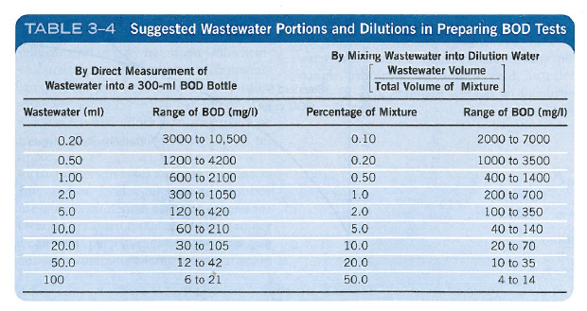
BOD Dilution Table

Slide 57
Seeded BOD example
Using Table 3-4:
For WW—add 1-2 ml (estimated BOD=800)
For seed—add 5-10 ml (estimated BOD=150)
Using BOD₅=(D₁-D₂)/P (& assuming delta D of 5 and solving for numerator in P):
Add 1.875 ml (round off to 2 ml) for ww
Add 10 ml of seed to BOD test of seed
10% of seed=1 ml added to ww BOD bottle as seed

Slide 58
Seeded BOD example
BOD₅=[(D₁-D₂)-((B₁-B₂)f)]/P
BOD₅=[(8.5-3.5)-(8.5-4.5)(1/10)]/(2/300)
BOD₅ =690 mg/l

Slide 59
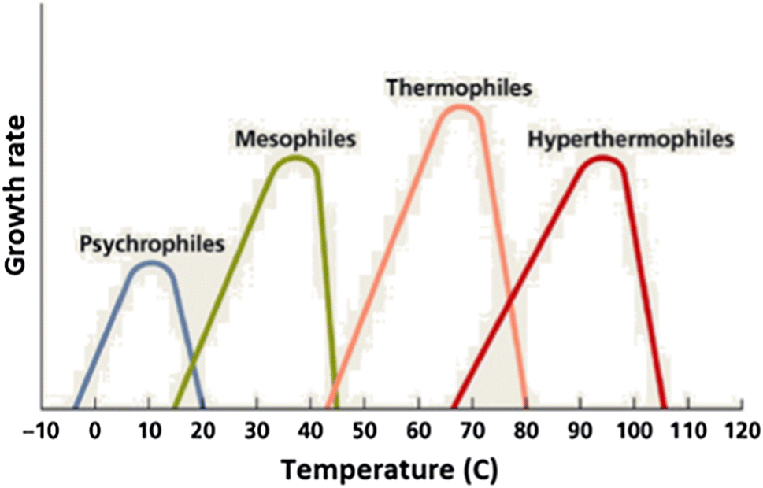
Temp Affects Growth Rate

Slide 60
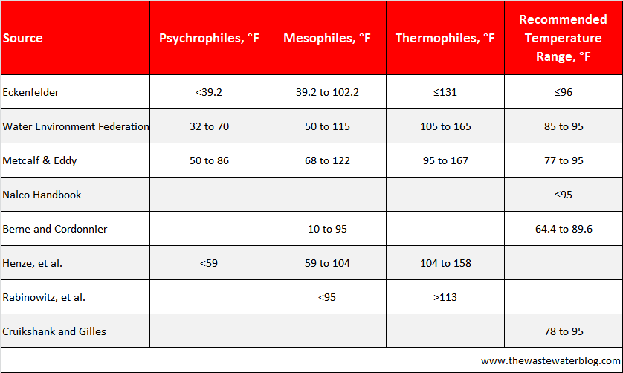
Temperature-Most WW systems operate in the mesophilic range

Slide 61
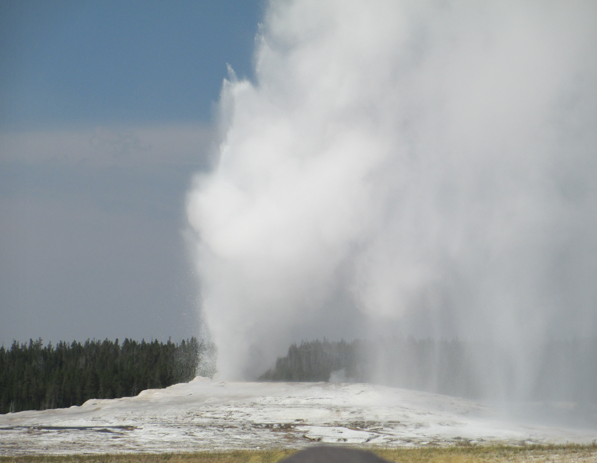
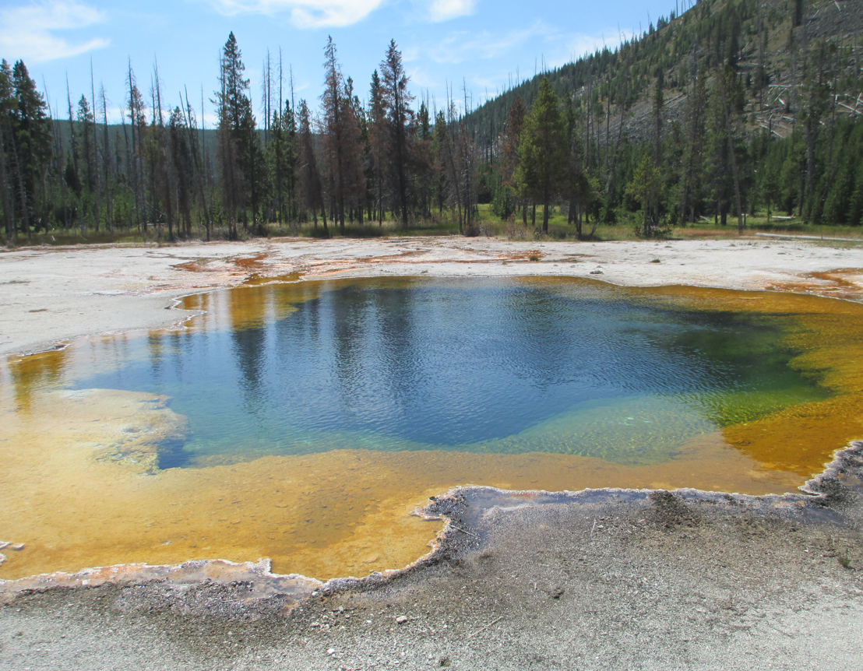
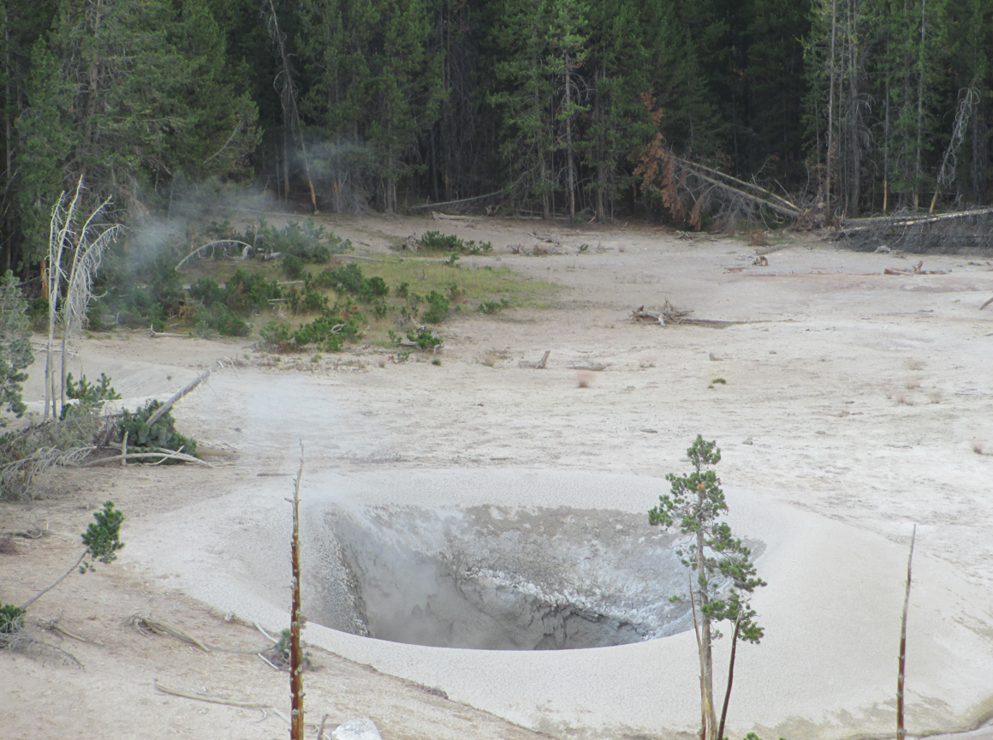
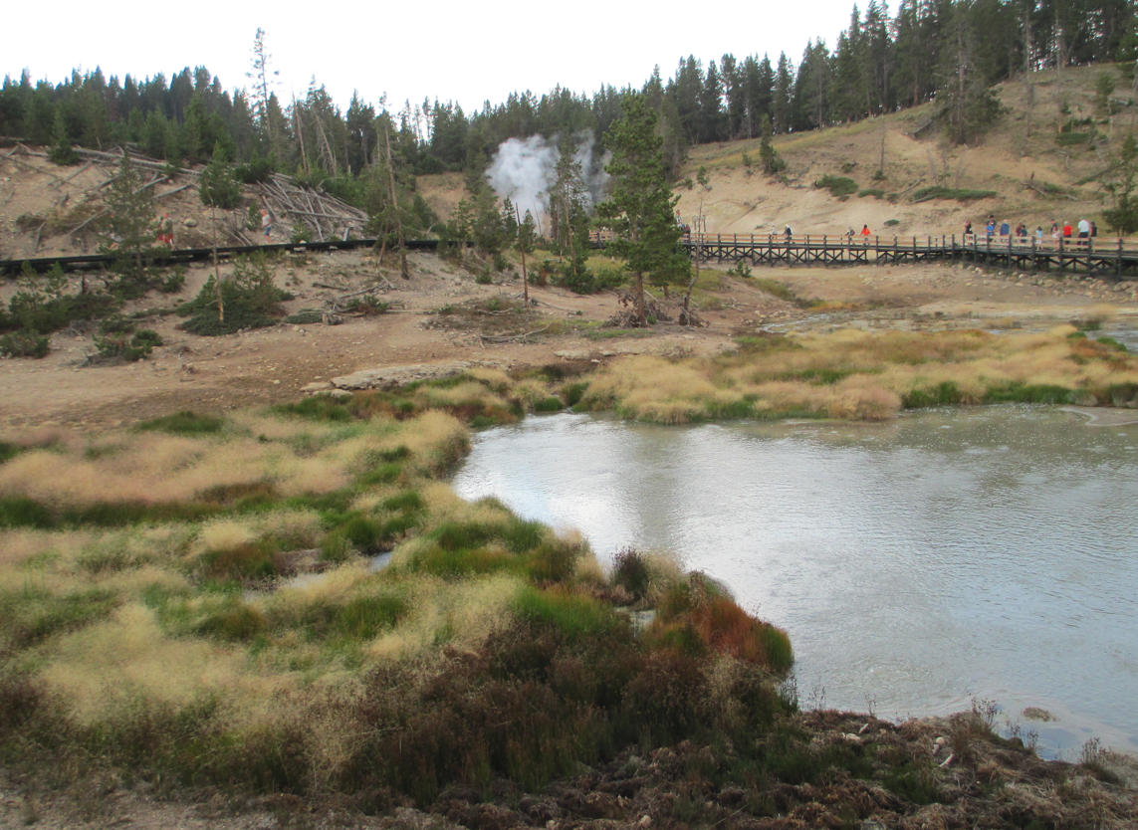
Yellowstone

Slide 62
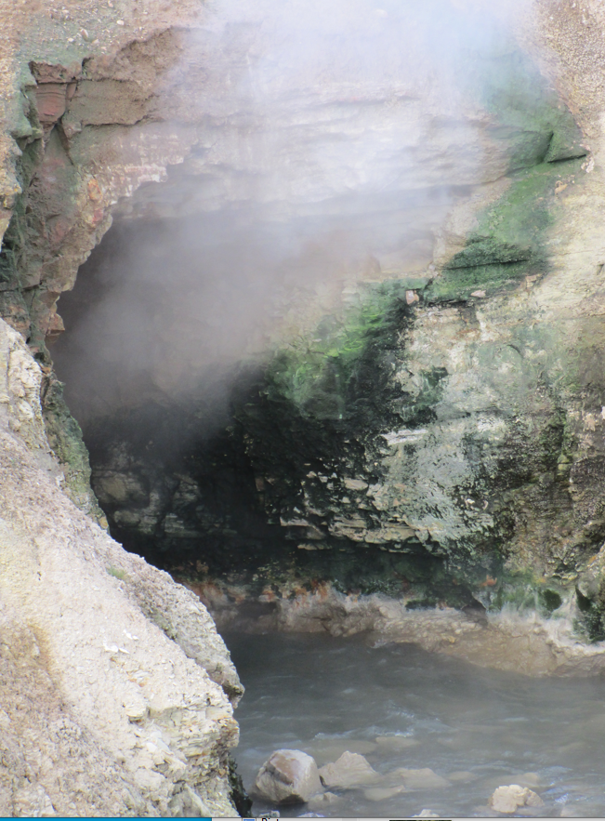
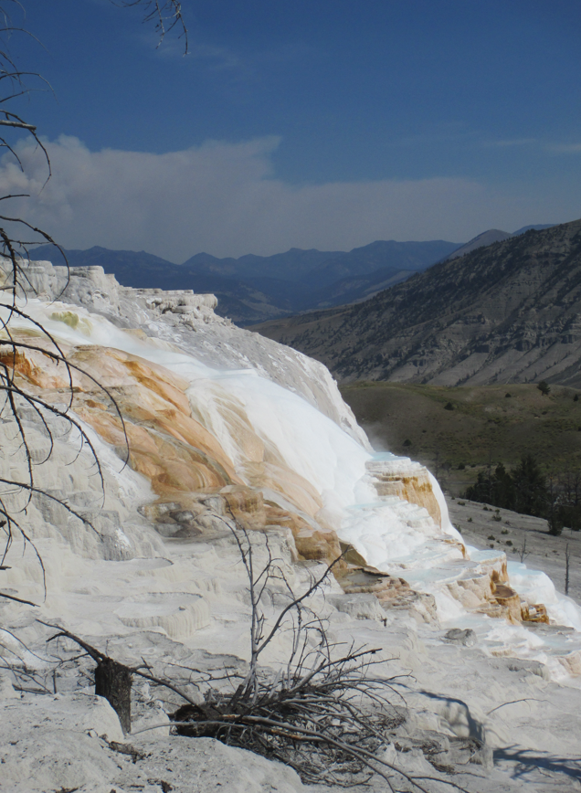
Yellowstone

Slide 63
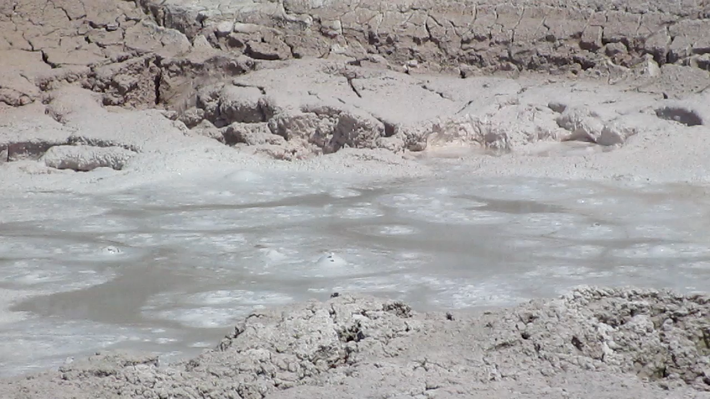
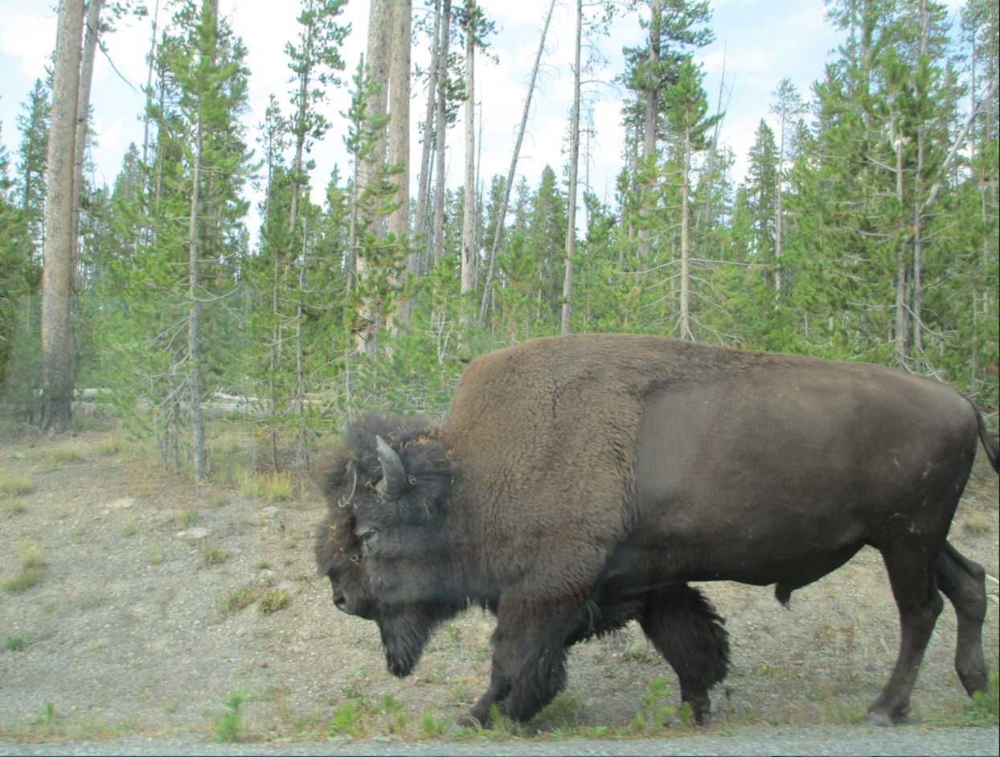
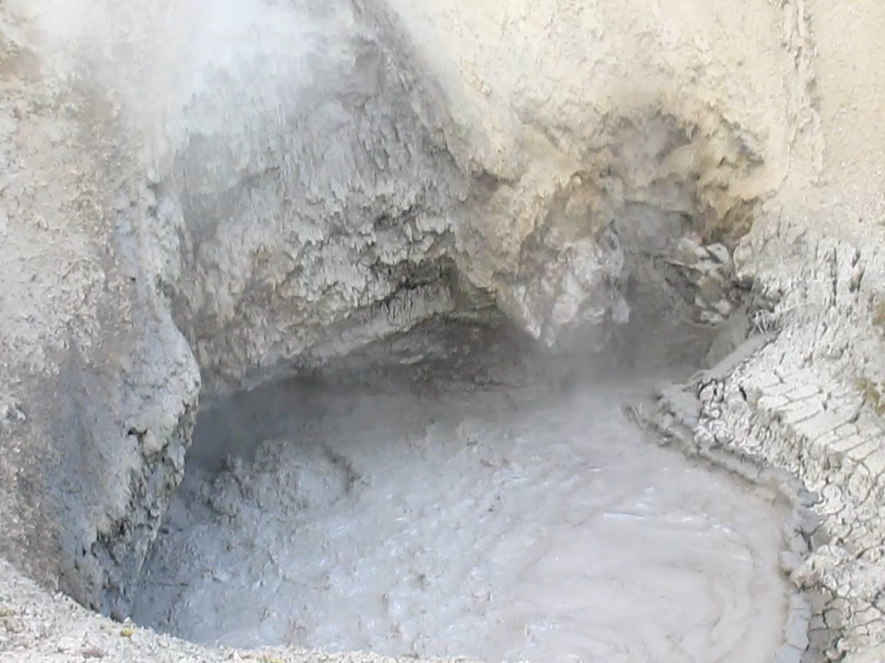
Yellowstone

Slide 64
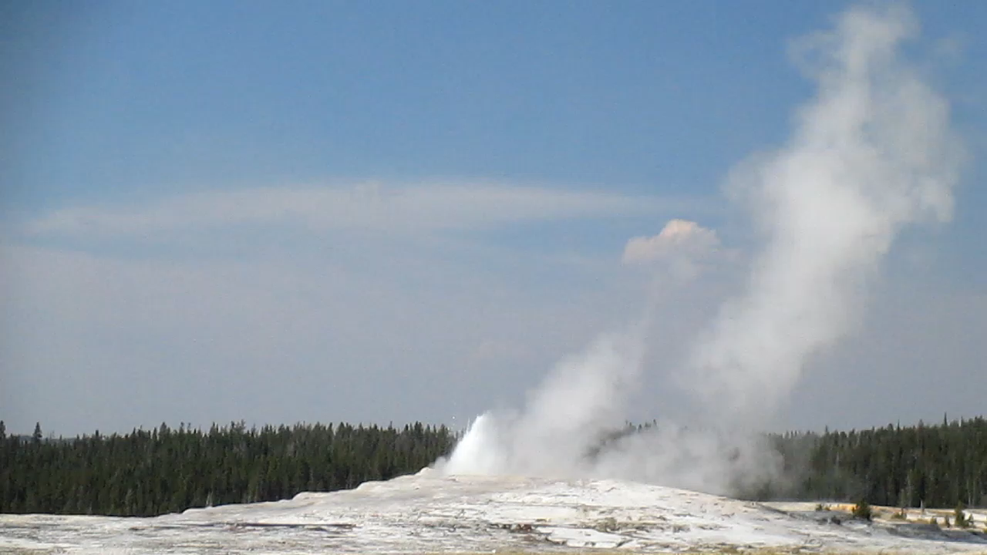
Old Faithful

