Slide 1
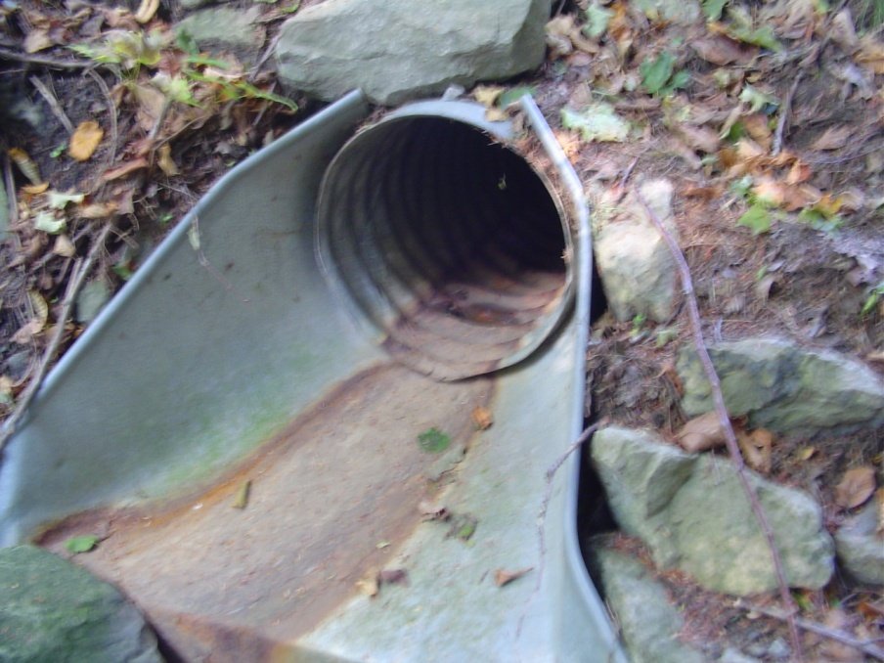
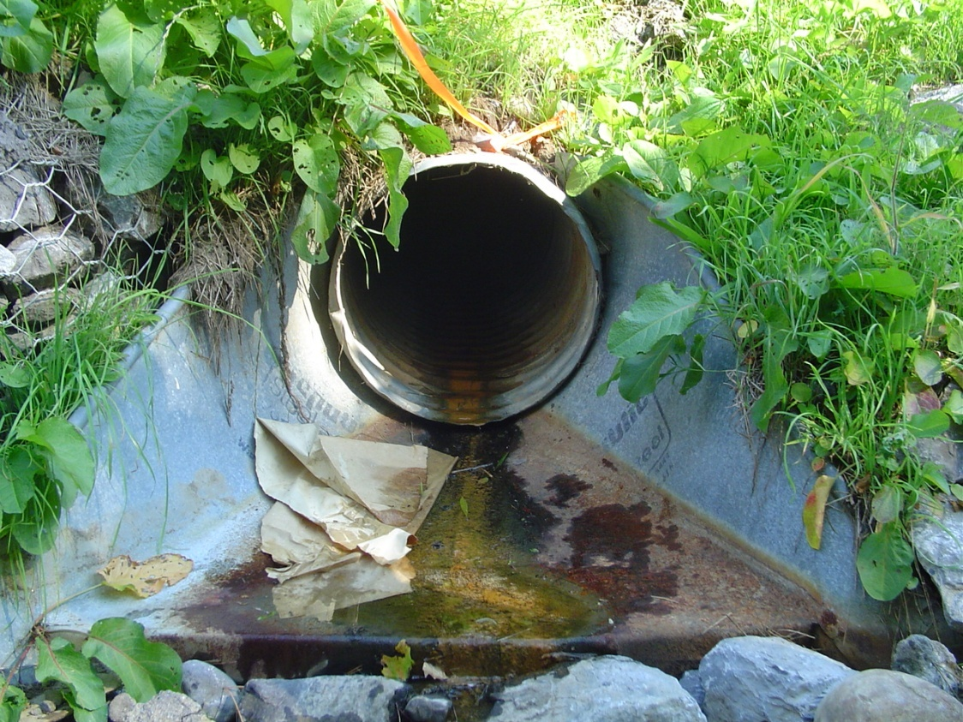
CTC 450-Water Quality

Slide 2
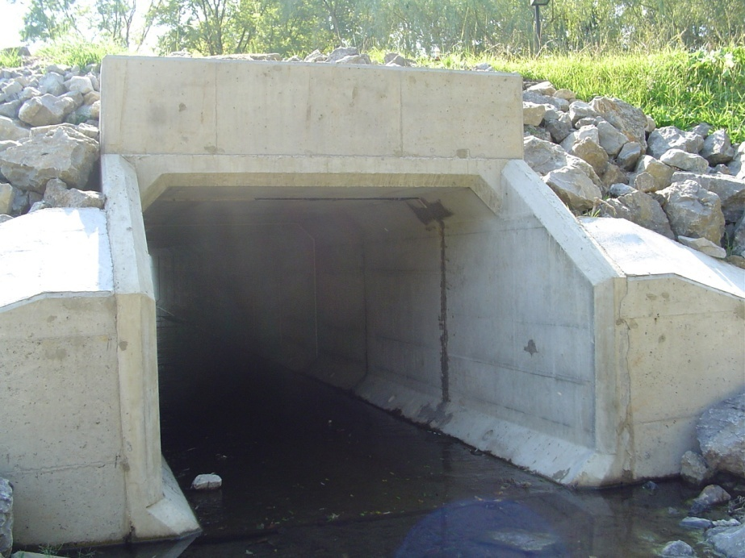
Objectives
Understand basic laws protecting water sources
Know some of the water quality acronyms

Slide 3
Major Laws
1914-Public Health Service first established drinking water standards
1948-Water Pollution Control Act (amendments 1956 and 1965)
1972-Clean Water Act (CWA)---(NPDES)
1974-Safe Drinking Water Act
1987-Water Quality Act (amendment to CWA)
Phase I stormwater regs (1990)
Industrial site runoff
Construction sites > 5 acres
Phase II stormwater regs (1999)
Construction sites > 1 acre
NOI/SWPPP-Stormwater Pollution Prevention Plan

Slide 4
Safe Drinking Water Act Public Water System-Definition
Community Water System
At least 25 people at their primary residence (or at least 15 residences that are primary residences)
Examples (municipalities, mobile home park, subdivision)
Nontransient Noncommunity Water System
At least 25 of the same people for at least 6 months/yr, but not at their primary residences
Examples (schools, commercial facilities, or manufacturing plants that have their own water system)
Transient Noncommunity Water System
At least 25 or more people for at least 60 days/year but not the same people or not on regular basis
Examples (highway rest areas, recreation areas, gas stations that have their own water system)

Slide 5
Safe Drinking Water Act
Regularly Amended
Total Coliform Rule (max conc of zero for total coliform, fecal coliform and e. coli)
Lead Contamination Control Act (special requirements for lead)
Surface Water Treatment Rule (requires filtration followed by chemical disinfection from surface water supplies and groundwater under the influence of surface water).
Identifies contaminants considered for regulatory control

Slide 6
Definitions
MCLG-maximum contaminant level goal
(non-enforceable)
MCL-Max. contaminant level; no adverse effect
(enforceable)
MRDLG-max. residual disinfectant level goal
MRDL-max. residual disinfectant level

Slide 7
Concept of Multiple Barriers
Protect Watershed
Treat Water
Disinfect Water
Operate distribution system at high pressure

Slide 8
Biological Quality
No pathogens
Coliform tests

Slide 9
Chemical Quality
Inorganics
VOC’s (volatile organic chemicals)
Synthetic organic chemicals
Disinfection by-products (THM’s, others)
Radionuclides (natural or artificial)

Slide 10
Secondary Standards
Aesthetics
Aluminum
Chloride
Color
Copper
Corrosivity
Fluoride
Foaming agents
Others

Slide 11
Clean Water Act-Amendment created NPDES permit program
National pollution discharge elimination system
Permit program for point sources
Self monitoring
EPA – responsible for implementation
States often take over primary functions (SPDES)

Slide 12
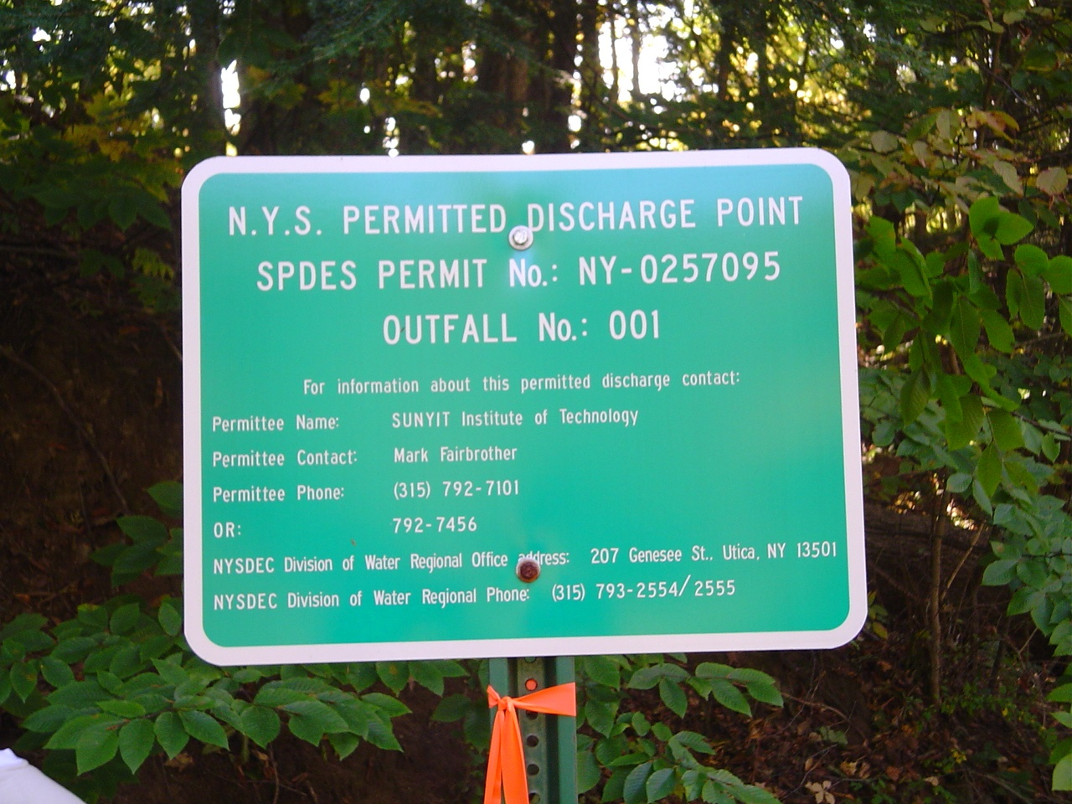

Slide 13
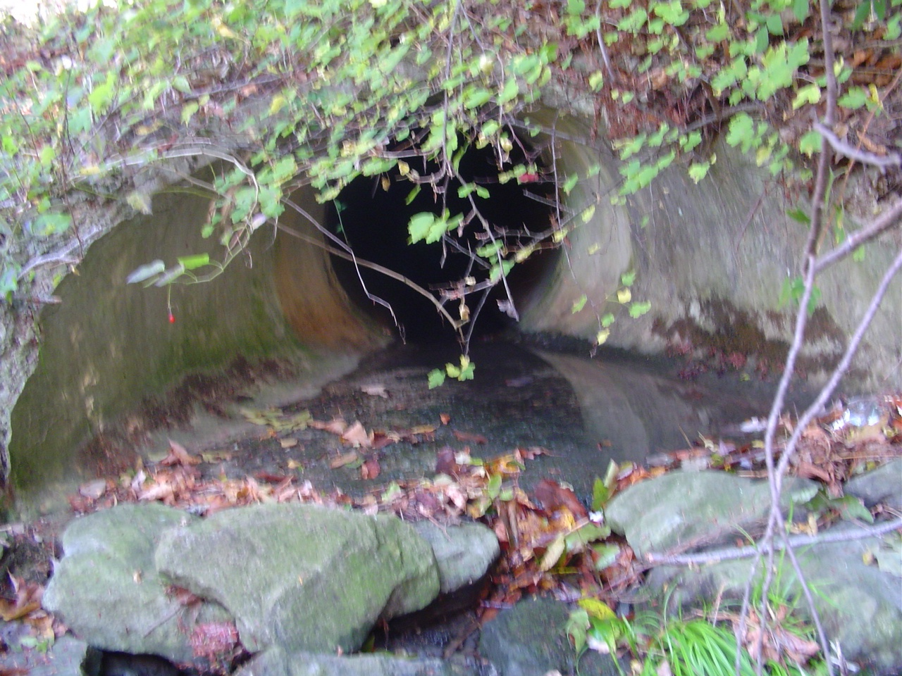
Outfall Number 1

Slide 14
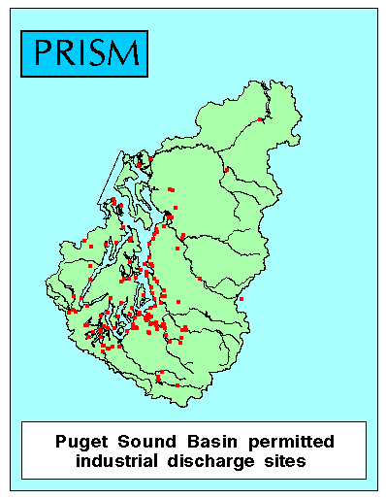
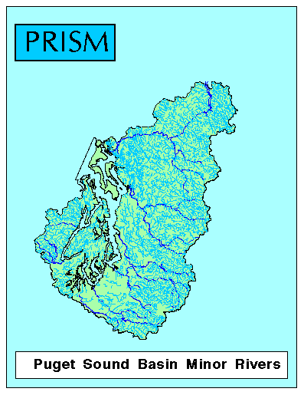

Slide 15
Effluent Standards for Public WW Treatment Plants
BOD & SS < 30 mg/l
pH between 6 and 9
Monitoring of receiving water is important
Specific chemicals can be controlled

Slide 16
Mass Balance Equation
Used to calculate a diluted concentration—such as BOD concentration below a sewage discharge point
Diluted Concentration=(Conc. 1*Flow 1+Conc. 2*Flow 2)/Total Flow
(see page 111 of your book for examples)

Slide 17
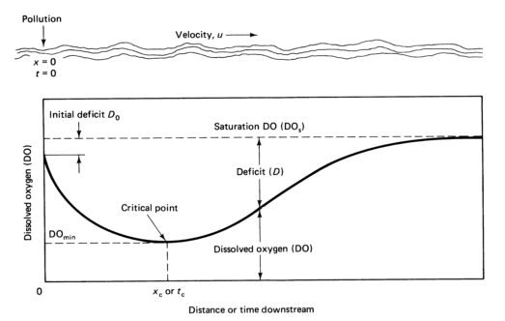
Minimum DO (Streeter-Phelps Equation)
Estimating minimum DO caused by sewage effluent.
Assumes two processes:
1-BOD uses oxygen
2-Oxygen reaeration via oxygen transfer at the surface
https://steemit.com/science/@florencemaej/streeter-phelps-equation

Slide 18
Industrial Pretreatment Program
Industrial discharges can cause problems
Municipal treatment plants may require pretreatment

Slide 19
Groundwater
High-quality economical source
50% of US population uses groundwater
30% community, 20% domestic wells
140,000 public water systems
100 million people
2006-Groundwater Rule (intended to provide increased protection again bacterial and viral pathogens)

Slide 20
Groundwater Quality
Point sources (wastewater ponds, landfills, refuse piles, buried storage tanks, deep injection well)
Management of groundwater quality
Prevention
Monitoring
Abatement
Once pollutants enter the groundwater, it is difficult to fix (not technically or economically feasible)

Slide 21
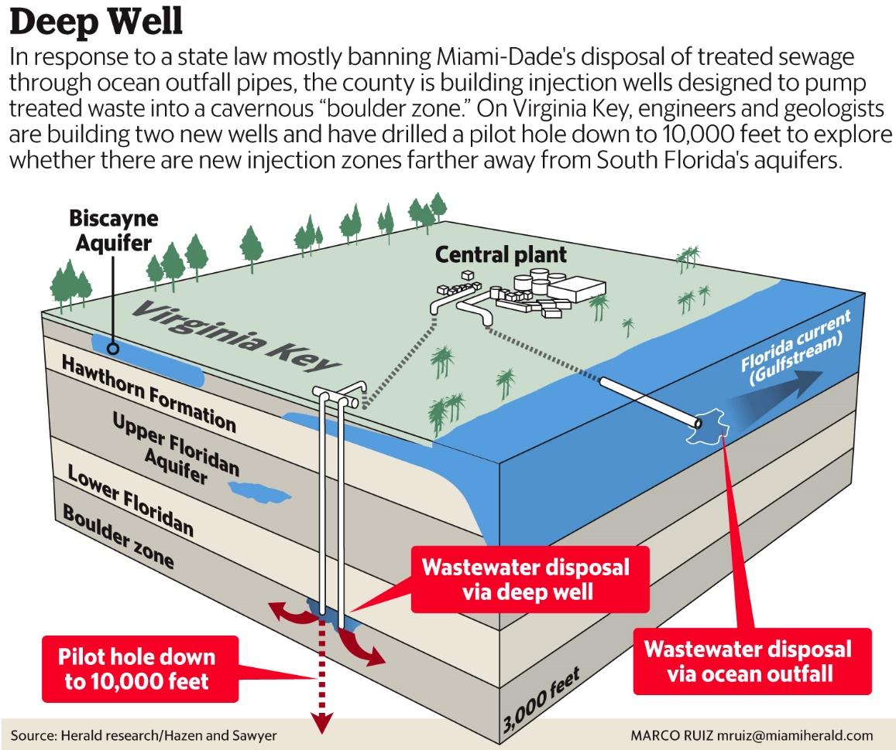
Discharge to Seawater
Must provide outfall (long pipeline w/ diffuser)
Must protect water contact and noncontact uses

Slide 22
History of Water Treatment
Designing Against Disease
Filtration (1893)
Chlorination (1919)

Slide 23
“Forever” Chemicals
Do not easily break down
PFAS: Per- and polyfluoroalkyl substances (carbon-fluorine bond)
Health Problems (high cholesterol, a suppressed immune system, infertility, some cancers and reduced efficacy of vaccines)

Slide 24
Microplastics
Plastic particles < 5 mm
Polyethylene, polypropylene, polystyrene
Growing concerns (persistence, health impacts)
UN and EU initiatives to reduce plastic pollution

Slide 25
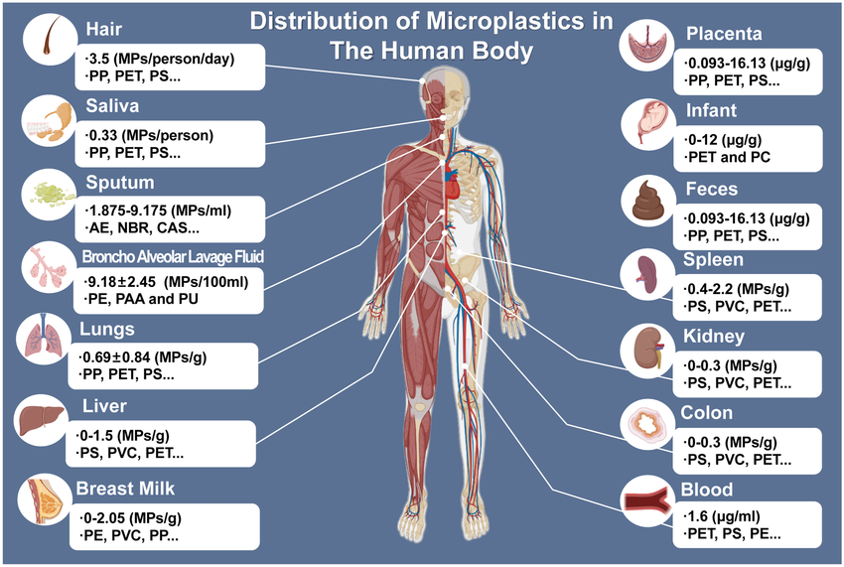
https://www.researchgate.net/figure/Distribution-of-microplastics-in-the-human-body-The-abundance-and-content-of_fig2_373192401

Slide 26
Mohawk Valley Water Authority https://www.mvwa.us/
2024 Water Quality Report https://www.mvwa.us/WaterQuality/AWQR.pdf
Operational in 1992
Source (Hinckley Reservoir; West Canada Creek)
Watershed 374 square miles
126,250 people (38,900 service connections)
18.2 mgd (daily avg); highest was 22.8 mgd
$5.81 per 1000 gallons
Calcium hydroxide (lime) and sodium carbonate (soda ash) are used in small amounts to buffer the water so that it is rendered non-corrosive to your home’s plumbing
Fluoride added at .7 mg/l

Slide 27
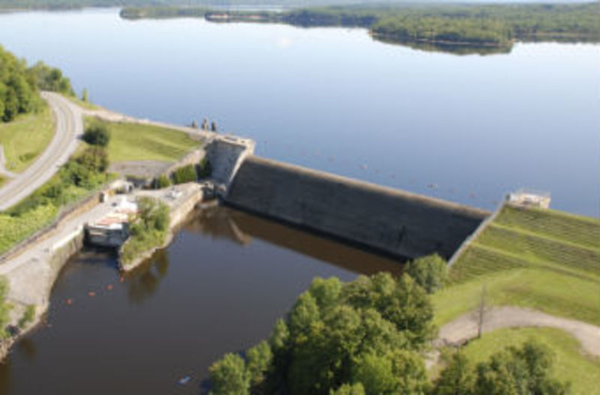
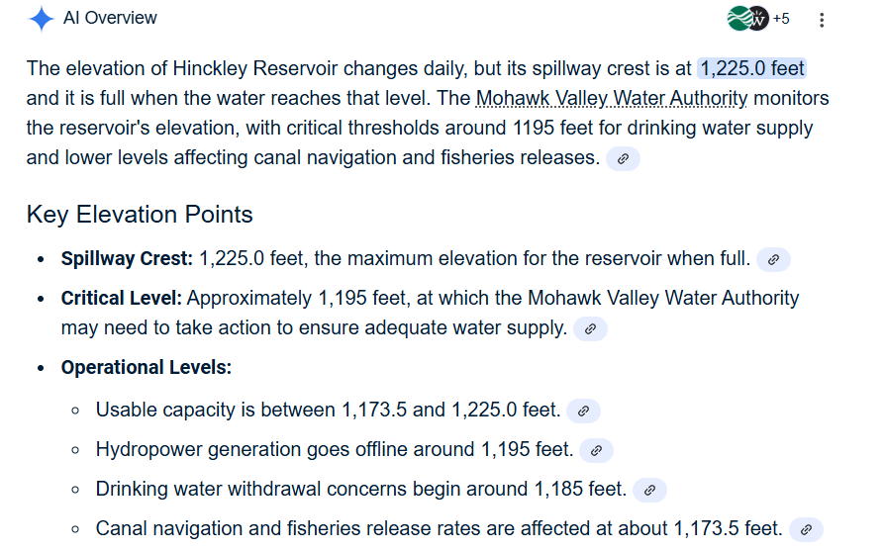
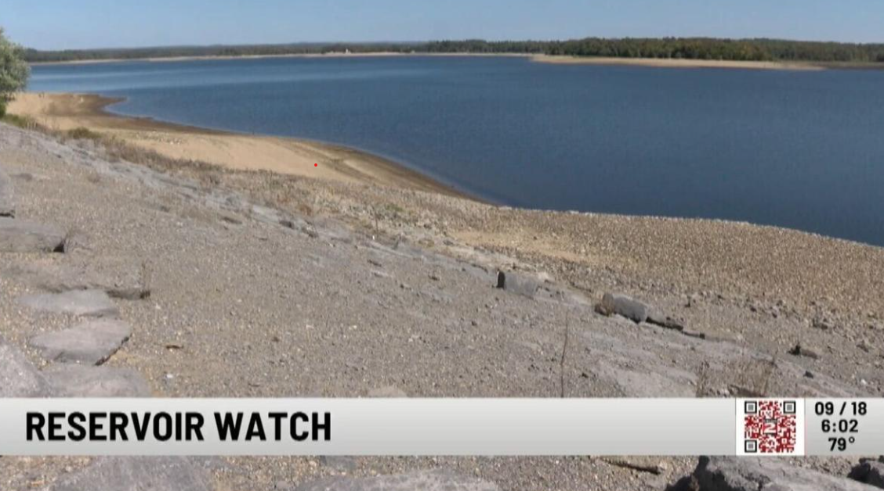
Hinckley Reservoir
Reservoir Elevation https://waterdata.usgs.gov/monitoring-location/USGS-01343900/#dataTypeId=continuous-62615-0&period=P30D&showMedian=true&showFieldMeasurements=true
https://www.wktv.com/news/local/all-eyes-on-hinckley-reservoir-as-dry-sunny-weather-continues/article_79231f3c-e7b9-4a3c-aee4-88f201f1b903.html

Slide 28
Questions
What does NPDES stand for?
What does SPDES stand for?
What is the effluent standard for BOD and SS?
What does NOI stand for?
What does SWPPP stand for?

