Slide 1
CTC 450 Review
Class Requirements
Water treatment exercise
Private
Public
Wastewater treatment exercise
Private
Public

Slide 2
Objectives
Students have the ability to:
Define the chemical properties of water
Use stoichiometry to calculate concentrations
Determine “equivalent” concentrations
Understand the major laboratory water analysis tests

Slide 3
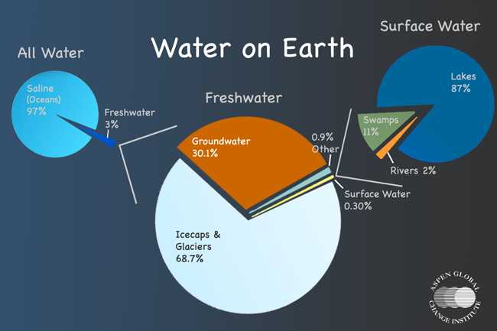
Water Distribution on Earth
Oceans 97.13%
Polar Ice Caps and Glaciers 2.24%
Groundwater 0.61%
Rivers, lakes, streams 0.02%

Slide 4


Water Chemistry
Water contains various inorganic and organic compounds from contact with solids or gases
Water is dipolar (+ & - charged areas) which affects the solubility of solids (dissolved ions)
www.brooklyn.cuny.edu/.../ SD.PS.LG.Water.html
www.shorstmeyer.com/ wxfaqs/float/watermolec.html

Slide 5
Water-Molecular Weight
Usually 18 (16+1+1)
3 isotopes of hydrogen
H-1 Protium (one proton)
H-2 Deuterium (one proton; one neutron)
H-3 Tritium (one proton; two neutrons)
3 stable isotopes of oxygen
O-16 (8 protons; 8 neutrons)
O-13 (8 protons; 5 neutrons)
O-15 (8 protons; 7 neutrons)

Slide 6
Common Elements
Common elements we’ll use can be found in Table 4-1 of your book (pg 78)
The table contain the element name, symbol, and the atomic weight
Oxygen (O); 16
Hydrogen (H); 1
Atomic weight of water is 18 (16+1+1)

Slide 7
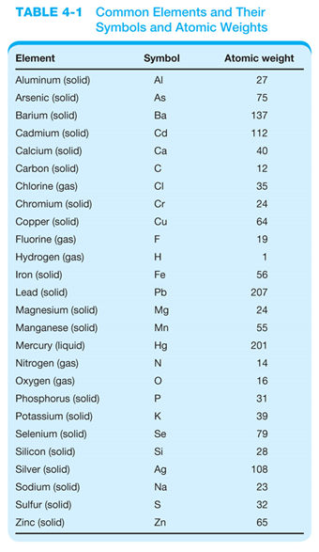
Table 4-1 elements

Slide 8
Common Inorganic Compounds
Common compounds we’ll use can be found in Table 4-2 of your book (pg 79)

Slide 9
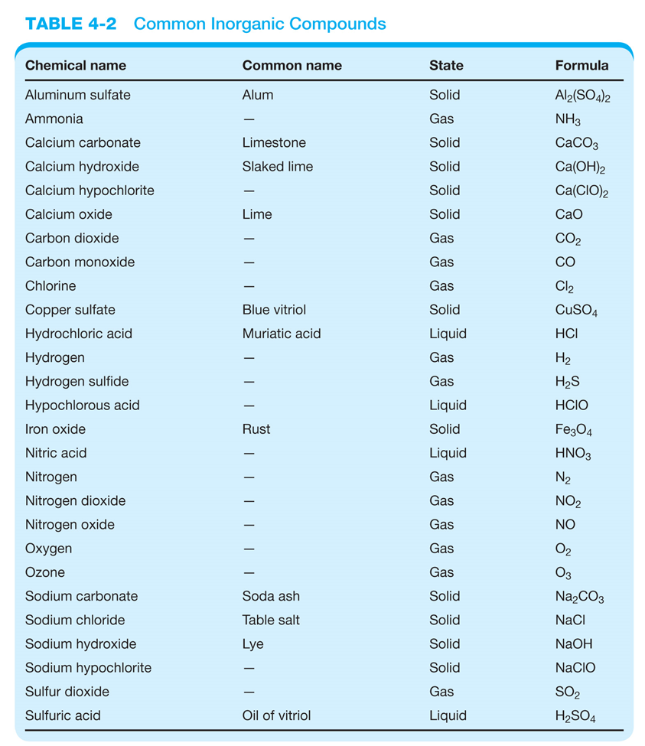
Table 4-2 compounds

Slide 10
Definitions
One mole of a substance contains 6.024 x 10²³ molecules or atoms
The molar mass is found by adding the atomic weights of the elements in the compound
1 mole of NH₃ has 6.024 x 10²³ molecules and weighs 17 grams (14 grams for nitrogen plus 3 grams for 3 hydrogen elements)
The equivalent weight is the molecular weight divided by the valence or electrical charge

Slide 11
Expressing Concentrations
Mass Concentration
Molar Concentration
Equivalents and Normal Concentration

Slide 12
Mass Concentration
Mass of solute per volume of solution
Milligrams per liter (mg/l)
Equivalent to parts per million (ppm) for most natural waters and wastewaters since 1 liter of water has a mass of 1 kg (1E6 mg)
Remember: mg/l = ppm

Slide 13
Molarity/Molality
Molarity-Moles of solute per volume of solution
A 1 molar solution of NaCl would contain 58.5 gm per liter of water
Molality-Moles per mass of water
Equilibrium constants are based on molar concentrations

Slide 14
Equivalents and Normal Concentration
The equivalent weight of an element or radical is equal to its atomic weight divided by the valence it assumes in compounds. The definition is based on reaction type.
Advantage is that the number of equivalents of reacting constituents is equal to the number of equivalents of product.
Disadvantage is that a single substance can have two different equivalent weights because the substance is involved in different reactions
A one normal solution contain one equivalent weight of a substance per liter of solution

Slide 15
Equivalents and Normal Concentration - Example
Oxygen has an atomic weight of 16.0 and always assumes valence 2 in compounds, so its equivalent weight is 8.0
Iron (atomic weight 55.8) has an equivalent weight of 27.9 in ferrous compounds (valence 2) and 18.6 in ferric compounds (valence 3)
In general the normality is the molarity times n where n is either the ion charge or number of protons, hydroxyl ions or electrons transferred in a reaction
The normality of a solution is never less than the molarity.

Slide 16
Expressing Concentrations in Terms of another Compound
Elements can exist in different forms
Nitrogen
Ammonium (NH₄⁺)
Nitrite (NO₂⁻)
Nitrate (NO₃⁻)
Phosphorous
Ortho (PO₄³⁻)
Monohydrogen (HPO₄²⁻)
Dihydrogen (H₂PO₄⁻)

Slide 17
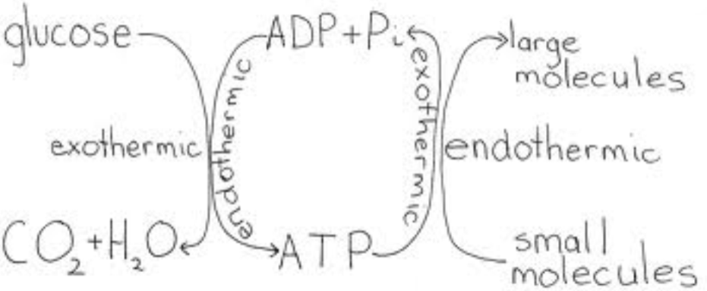
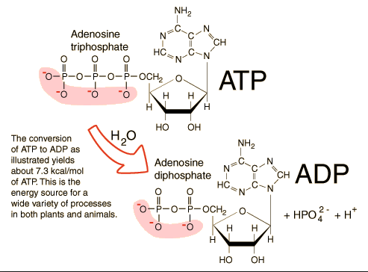
ATP/ADP
http://hyperphysics.phy-astr.gsu.edu/hbase/biology/atp.html

Slide 18
Expressing Concentrations in Terms of another Compound
Hardness and alkalinity are often expressed in terms of CaCO₃ (Calcium Carbonate)
The various forms of nitrogen (ammonium, nitrite, nitrate) are expressed as elemental nitrogen (N)
The various form of phosphorous are expressed as elemental phosphorous (P)

Slide 19
Steps for expressing compounds in terms of another compound/element:
Find the molecular and equivalent weights of all compounds/elements
Use ratios (equivalent wt ratios)

Slide 20
Example: Expressing Nitrogen Compounds in Terms of N
Example 1/3 (Problem statement):
Express the following in terms of Nitrogen:
360 mg/l (NH₄⁺)
1240 mg/l (NO₃⁻)

Slide 21
Example (2/3)
Find the molecular weight of all compounds/elements
N 14 grams (elemental Nitrogen)
NH₄⁺ 18 grams
NO₃⁻ 62 grams
Equivalent weights are same as MW

Slide 22
Example (3/3)
Use ratios to convert compounds to N
360 mg/l of ammonia *
(14 mg N / 18 mg ammonia)
= 280 mg/l ammonia as nitrogen
1240 mg/l of nitrate *
(14 mg of N / 62 mg nitrate)
= 280 mg/l nitrate as nitrogen

Slide 23
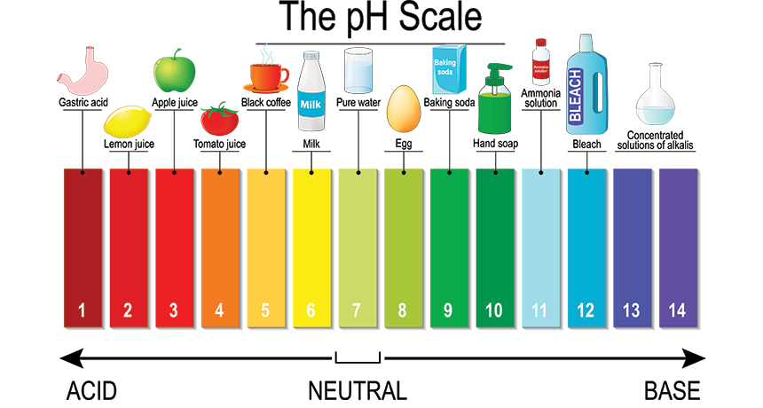
PH Scale
A small amount of water dissociates into H+ and OH- w/ a concentration of hydrogen ion equal to 10-7 moles per liter
pH=inverse of the hydrogen ion conc.
pH at neutrality=7
pH<7 indicates acidity (acid range)
pH>7 indicates alkalinity (basic range)

Slide 24
Chemical Reactions
Chemical reactions can be manipulated to change water quality
Add chemicals to precipitate out solids (remove turbidity)
Raise pH to convert ammonia ions to ammonia gas (remove nitrogen)
Add lime to precipitate out calcium carbonate (remove hardness)

Slide 25
Concentrations and Flows to Mass Rate (Tips)
Units
50 mg/l is equal to 50 mg per 1E6 mg
8.34 pounds per gallon (water)

Slide 26
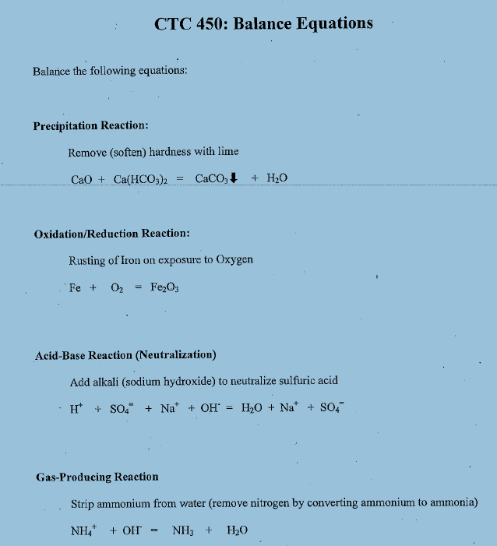
Chemical Reactions
Class Exercise

Slide 27
Chemical Equilibrium
Some reactions are irreversible (example-turns into a solid and precipitates out)
Many chemical reactions are reversible to some degree; they’ll eventually reach “equilibrium”---reactant and product concentrations stay the same

Slide 28
Chemical Reactions
Reactions occur at different rates
Some reaction rates don’t depend on concentrations (zero order)
Some reactions rates depend on concentrations (first/second order)
Temperature can affect rates
http://en.wikipedia.org/wiki/Chemical_kinetics

Slide 29
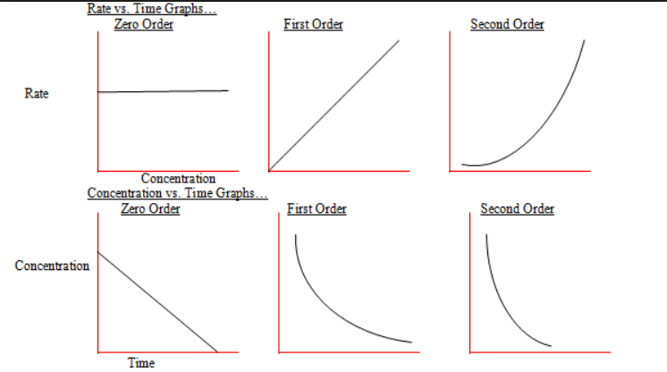
Reaction Rates
http://chemistry-helper.blogspot.co.uk/2011/04/distinguish-between-terms-rate-constant.html

Slide 30
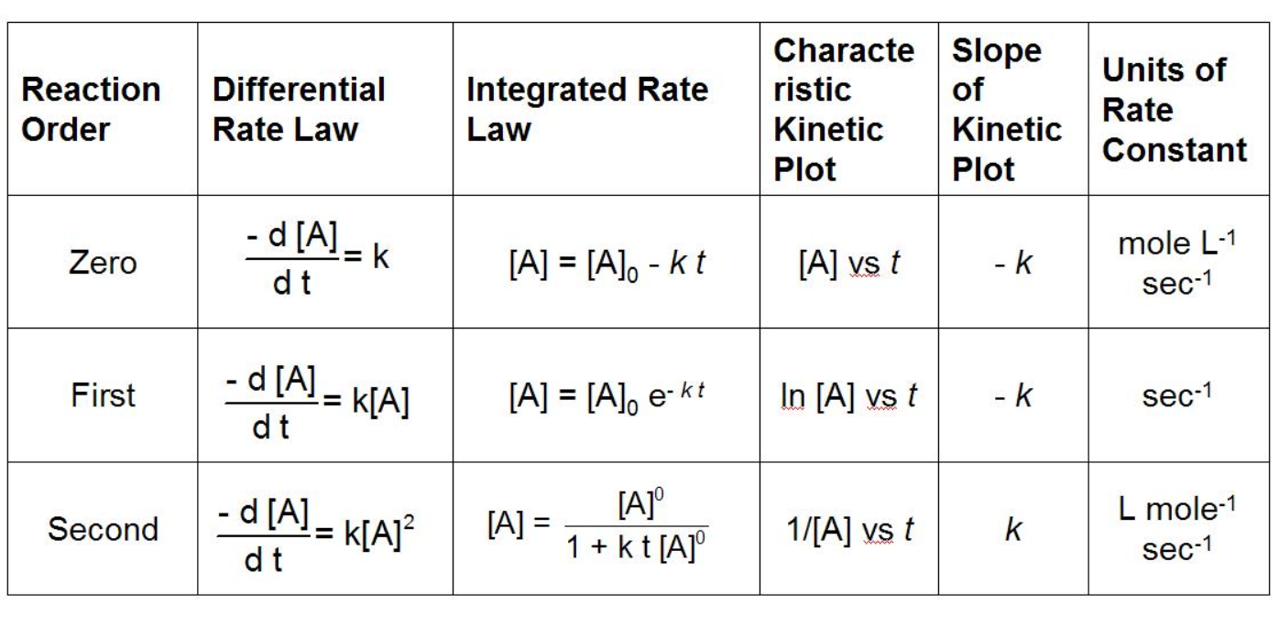
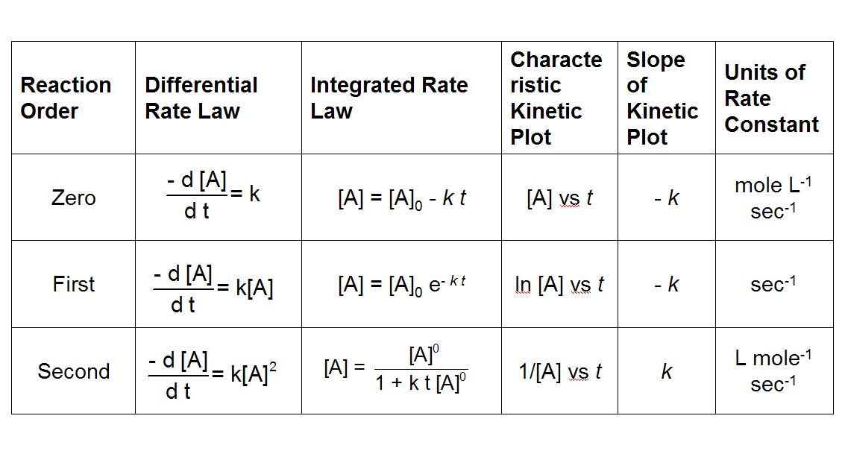
Rate Constant k
https://www.chem.fsu.edu/chemlab/chm1046course/integrated.html

Slide 31
Stoichiometry
The quantitative relationship between chemical substances in a reaction

Slide 32
Example: Stoichiometry (1/4)
Adding Lime to Remove Hardness:
CaO+Ca(HCO₃)₂=2CaCO₃ +H₂O
What dosage of lime (purity of 78%) is required to combine w/ 70 mg/l of calcium?
Note: The hardness is expressed as calcium

Slide 33
Example (2/4)
In this case the reaction is balanced. If not balanced, then balance.

Slide 34
Example-Find Molecular and Equivalent Weights (3/4)
Ca(HCO₃)₂ 162 81
Ca 40.1 20
CaO 56.1 28
56 grams of CaO combines w/ 162 grams of Ca(HCO₃)₂
Also, 70 mg/l Ca is equivalent to 283 mg/l of Ca(HCO₃)₂ ====70*(81/20)

Slide 35
Example (4/4) Use ratios & correct for purity
(28/81)*(283)=98 mg/l CaO
But lime has a purity of only 78%
So 98/.78=126 mg/l CaO ANSWER
56 grams of CaO combines w/ 162 grams of Ca(HCO₃)₂
Also, 70 mg/l Ca is equivalent to 283 mg/l of Ca(HCO₃)₂

Slide 36
Gas Solubility
Oxygen is soluble in water. The oxygen concentration is dependent on temperature, elevation, and chloride concentration
Carbon dioxide is soluble in water
Chlorine is soluble in water

Slide 37
Colloids
Small particles that don’t settle out
Removed by coagulants (salts of aluminum or iron)
Hydrophilic (hard to remove)
Hydrophobic (easier to remove)

Slide 38
Solids
Suspended Solids (retained on a filter)
Dissolved Solids (pass through a filter)-if evaporated and measured—TDS (total dissolved solids)
Volatile Solids (those solids that burn off at 550C in a furnace)

Slide 39
Organic Compounds
Organic compounds contain carbon atoms attached to each other in chains
Common elements that are attached are hydrogen and oxygen
Common organic compounds are hydrocarbons, alcohols, aldehydes, ketones, and carboxylic acids

Slide 40
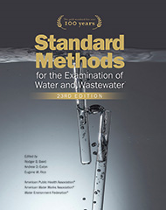
Common Lab Tests
Standard Methods for the Examination of Water and Wastewater, Published jointly by the American Public Health Association, American Water Works Association, and Water Environment Federation
23nd edition 2017
Available at AWWA

Slide 41
Common Lab Tests
pH, turbidity, DO—meters & probes
Alkalinity, Acidity, Ammonia, Hardness, COD – titration
Iron and Manganese - spectrophotometer
Trace metals – atomic absorption spectrophotometer
Color, Fluoride, Chlorine, Nitrite, Nitrate – colorimeter
Solids (suspended, dissolved)-filters, drying, weighing

Slide 42
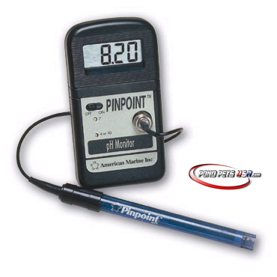
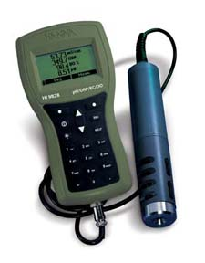
Probes

Slide 43
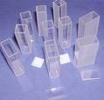
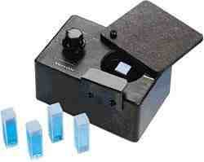
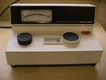
Colorimeter Spectrophotometer
http://www.newton.dep.anl.gov/askasci/chem03/chem03728.htm

Slide 44
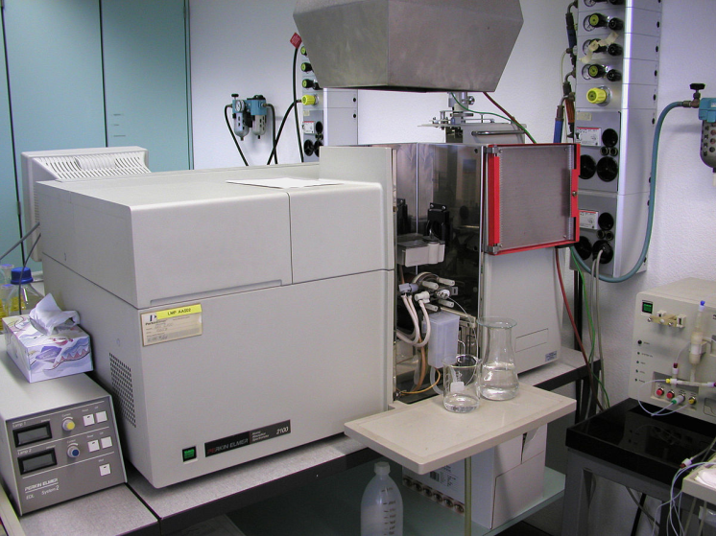
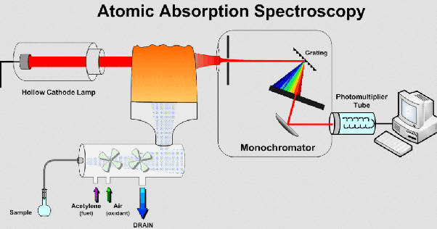
Atomic Absorption Spectrophotometer

Slide 45
Review Questions
In this class what concentration is typically used:
Mass
Normal
Molar
A mg/l is equivalent to ??=
What does DO stand for?
Neutral pH is?

