Slide 1
CTC 450
Energy Equation

Slide 2
Review
Bernoulli’s Equation
Kinetic Energy-velocity head
Pressure energy-pressure head
Potential Energy
EGL/HGL graphs
Energy grade line
Hydraulic grade line

Slide 3
Objectives
Know how to apply the energy equation
Know how to incorporate head losses, turbines, and pumps into EGL/HGL graphs

Slide 4
Energy Equation
Incorporates energy supplied by a pump, energy lost to a turbine, and energy lost due to pipe friction and other head losses (bends, valves, contractions, entrances, exits, etc)

Slide 5
Energy Equation-In words
PE+Pressure+KE+Pump Energy=
PE+Pressure+KE+Turbine Losses+Head Losses (pipe and other)

Slide 6
Energy/Work/Power
Work = force*distance (in same direction)
Power = work/time
Power=pressure head*specific weight*Q
Watt=Joule/second=1 N-m/sec
1 HP=550 ft-lb/sec
1 HP=746 Watts

Slide 7
Energy Examples
For homework review the following 3 example problems located in Brightspace:
Pump Example
Transition Example (contraction)
Reservoir Example (pumped storage)

Slide 8
Energy Equation-Pump Example
A pipe is 50-cm in diameter and carries water at a rate of 0.5 cms. Before a pump, the elevation of the pipe is 30 meters in elevation and the pressure is 70 kPa. After the pump, the pipe is 40 meters and 350 kPa. Assume the head loss is 3 meters.
What power in kilowatts and horsepower must be supplied to the flow by the pump?

Slide 9
Energy Equation-Pump Example (Continued)
Calculate velocities before and after pump:
Before & after pump velocity=2.55 m/sec
If velocities are the same then what????

Slide 10
Energy Equation for Pump Example
PE+Pressure+Pump Energy=
PE+Pressure+Losses (other)

Slide 11
Energy Equation-Pump Example1
Before pump:
Pressure=70 kPa
Potential energy=30m
Power supplied by pump=?
After pump:
Pressure=350 kPA
Potential energy=40 m
Head loss=3m (unclear-assume pump head loss?)

Slide 12
Energy Equation-Pump Example2
Solve for energy supplied by pump:
41.5 meters
28.5 m (increase pressure from 70-350 kPa)
10 m (increase in elev of 10m after pump)
3 m (overcome friction loss)
What power in kilowatts and horsepower must be supplied to the flow by the pump?

Slide 13
Energy Equation-Pump Power
What power in kilowatts and horsepower must be supplied to the flow by the pump?
Power=head*specific weight*Q
Power=206 kilowatts
Power=276 horsepower

Slide 14
Hints for drawing EGL/HGL graphs
EGL=HGL+Velocity Head
Friction in pipe: EGL/HGL lines slope downwards in direction of flow
A pump supplies energy; abrupt rise in EGL/HGL
A turbine decreases energy; abrupt drop in EGL/HGL
When pressure/velocity=0, the HGL=EGL=water surface elevation
Steady, uniform flow: EGL/HGL are parallel to each other
Velocity changes when the pipe diameter changes
If HGL<pipe elev., then pressure head is negative (vacuum-cavitation)

Slide 15
Transition Example
Flow in a pipe goes through a transition (contraction).
Q=0.707 cms
D₁=30 cm
D₂=20 cm
Head loss due to contraction = 2.6 m
P₁=250 kPa
P₂=? (Answer=22 kPA)

Slide 16
Reservoir Example
A pump draws water from a reservoir, where the WSE=520 ft, and forces the water through a pipe 5,000 feet long and 1 foot in diameter.
The pipe then discharges the water into a reservoir with WSE=620 ft.
The flow rate is 7.85 cfs and the head loss is 77.6 feet.
Determine the head supplied by the pump and the power supplied to the flow.

Slide 17
Reservoir Example Answers
Head supplied by the pump is 177.6 ft (100’ to raise water to an increased elevation and 77.6’ to overcome friction loss in the pipe)
Power supplied by the pump=158 hp

Slide 18
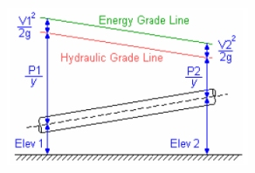
EGL/HGL (pipe elev. Increasing)

Slide 19
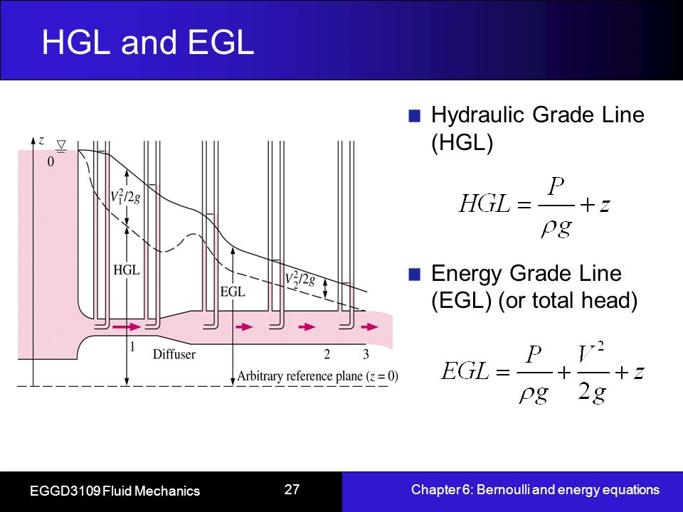
Another EGL/HGL example

Slide 20
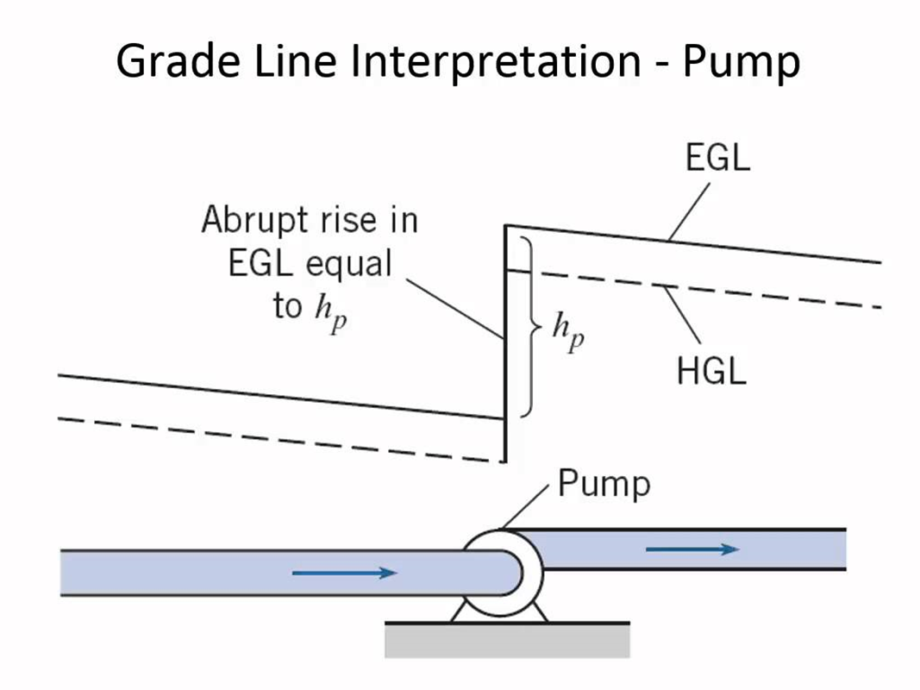
EGL/HGL (Pump)

Slide 21
Next Lecture
Head loss due to friction
Other head losses

